Slide 1
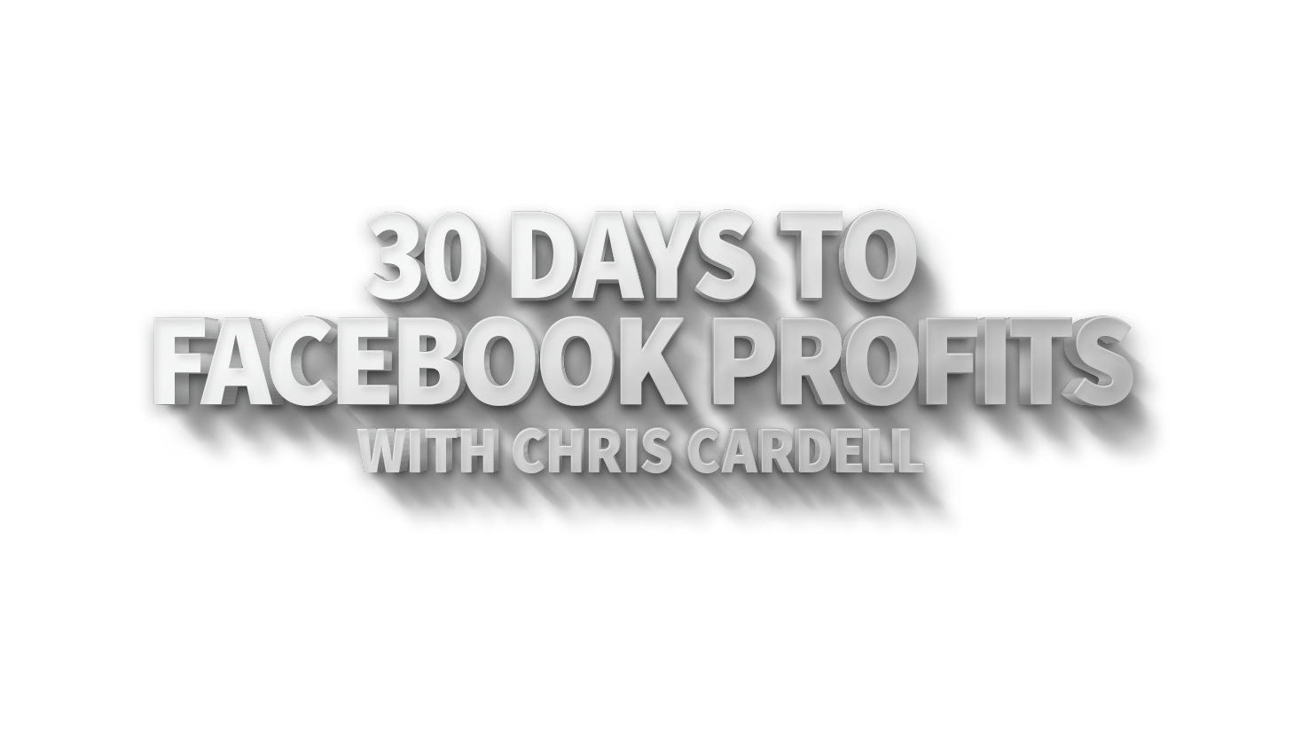

Slide 2
Seminar 1:
Facebook Overview,
Business Pages, The 5 Step Facebook Success Formula,
Ad Creation, Reaching Existing Customers, Bidding Options
and Conversion Pixels

Slide 3
Seminar 1:
www.CardellMedia.com/members-hub

Slide 4
Why Facebook? Why Now?
1.49 Billion monthly active users
More than one third of the UK population visits Facebook every day

Slide 5
Why Facebook? Why Now?
844 Million People Access Facebook Every Day on Their Smartphone or Tablet
Adult Facebook users have, on average, 200 friends
Mobile ad revenue now accounts for 76 percent of Facebook’s advertising revenue
Facebook is on three of every four smartphones

Slide 6
Why Facebook? Why Now?
Every 20 minutes on Facebook,
its users…
Share one million links
Make two million friend requests
Send three million messages

Slide 7
Why Facebook? Why Now?
50% of the Population are on Facebook for an average of 30 minutes every day.

Slide 8
Facebook and Your Customers
You can run the most highly targeted advertising campaigns in the history
of the world – for just a few pennies
or cents per click.

Slide 9
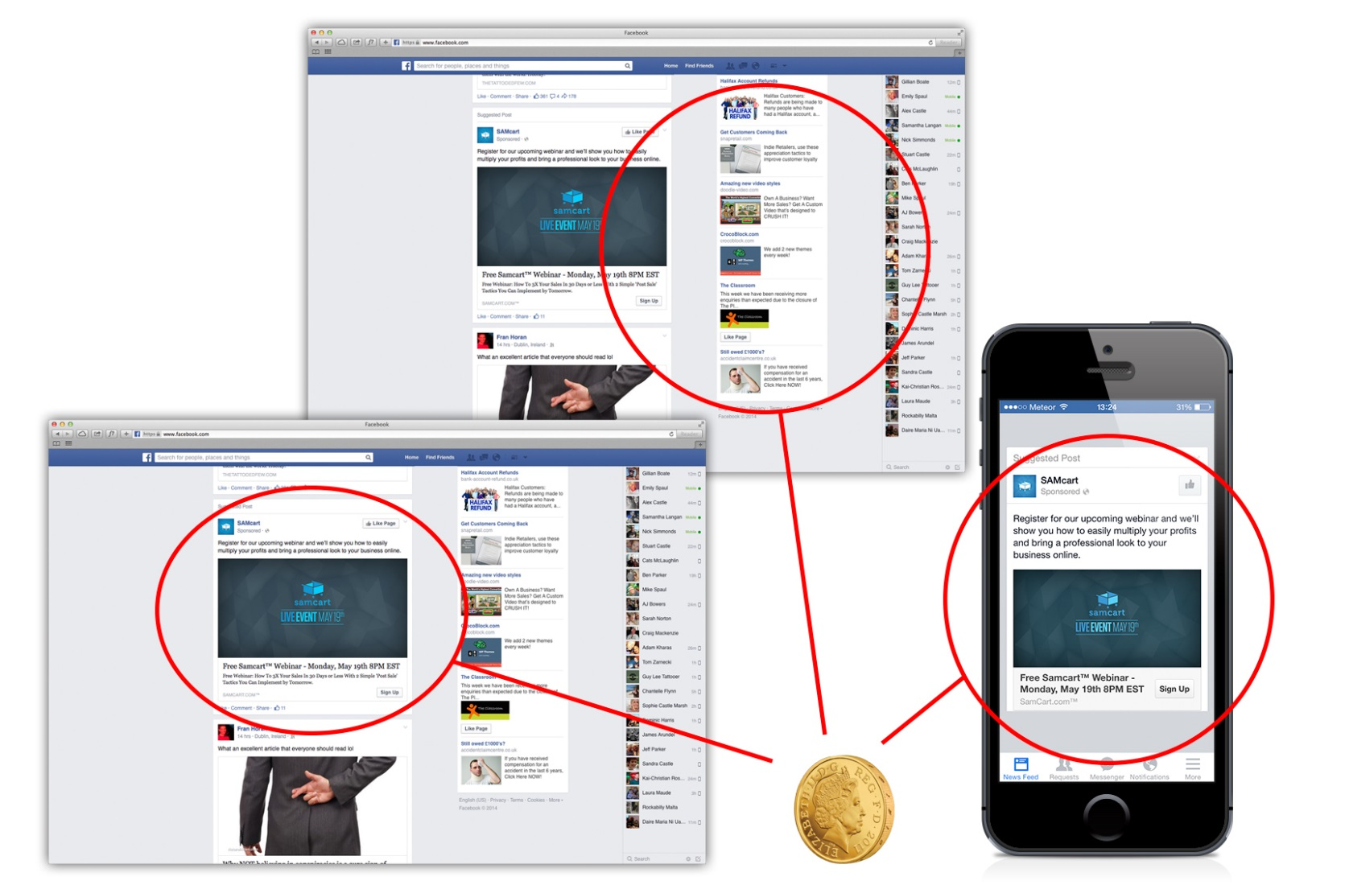

Slide 10
Facebook’s ‘Perfect Storm’
Massive Reach
Unprecedented Precision Targeting
Computer Buying
Very Cheap

Slide 11
Myth #1:
Facebook is just for young people

Slide 12
Myth #2:
Facebook won’t
work in B2B

Slide 13
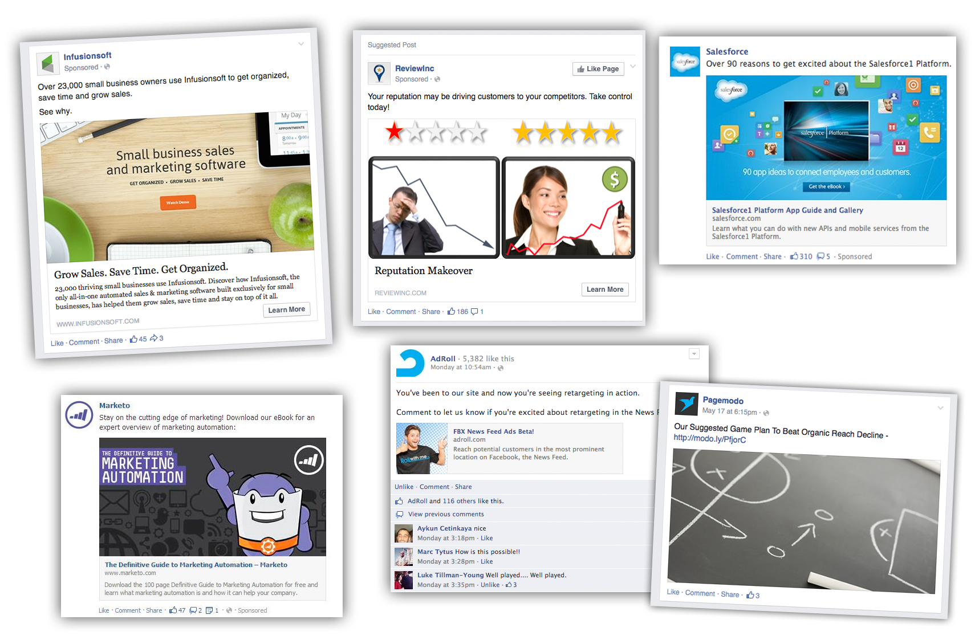

Slide 14
Myth #3:
People on Facebook don’t like to leave it or visit your website

Slide 15
Myth #4:
“I already have a personal profile so I don’t need a Facebook business page.”

Slide 16
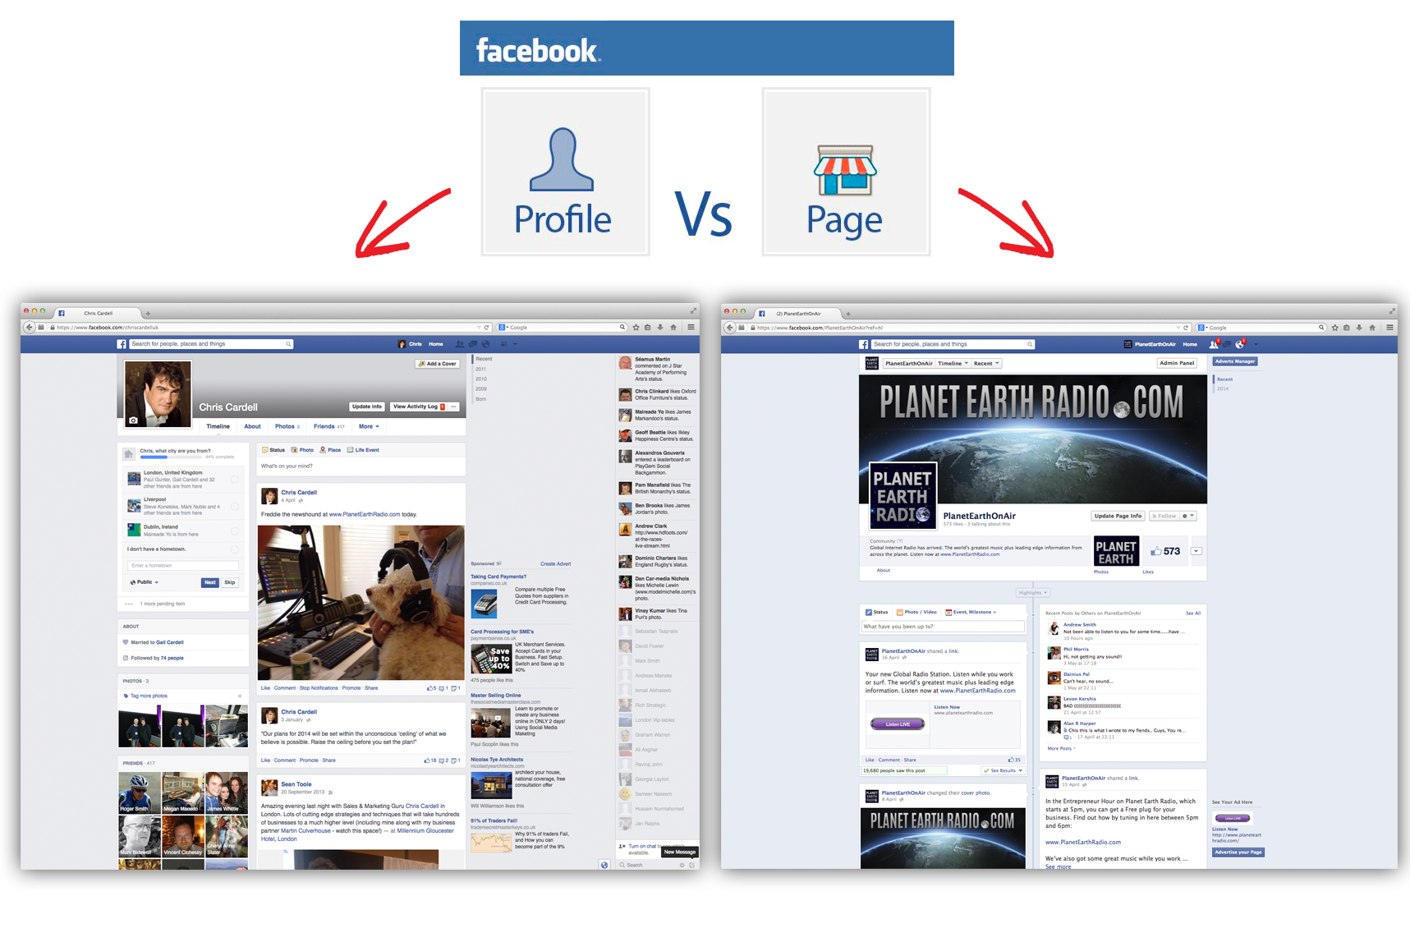

Slide 17
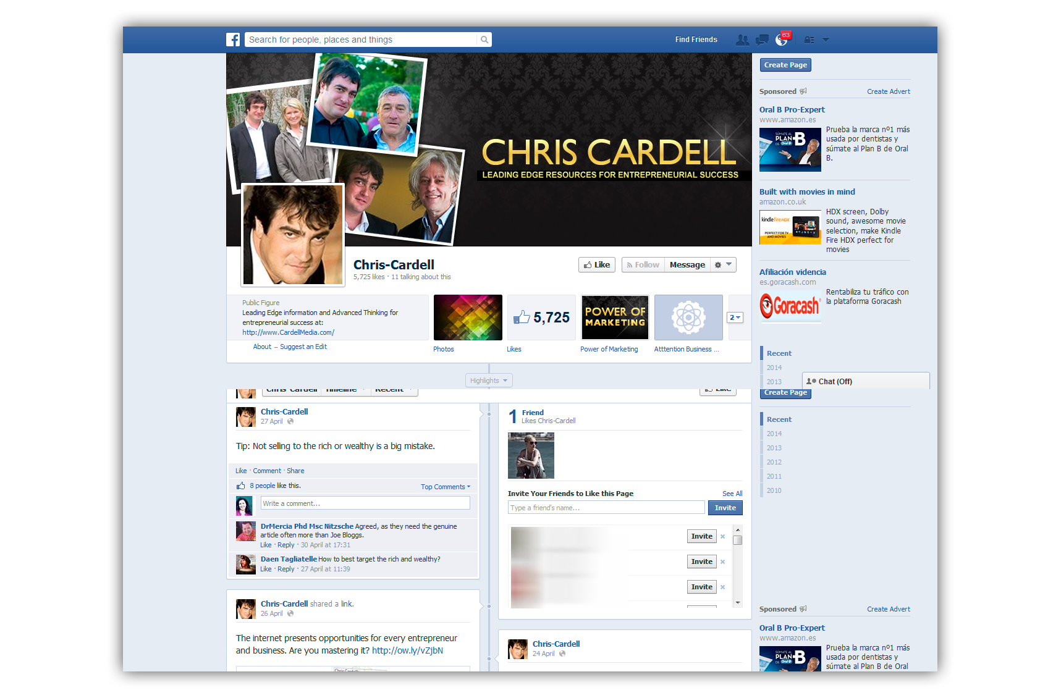

Slide 18
Your Facebook Page
You must have a Facebook Profile to be able to create a Facebook Page for your business or brand
If you don’t already have a personal profile set up... you need to create one
Each time you create a new page... a link to it will be added to your personal Profile homepage - this ensures you have easy access to the page whenever you want

Slide 19
Why People Struggle With Facebook
Too many choices!

Slide 20
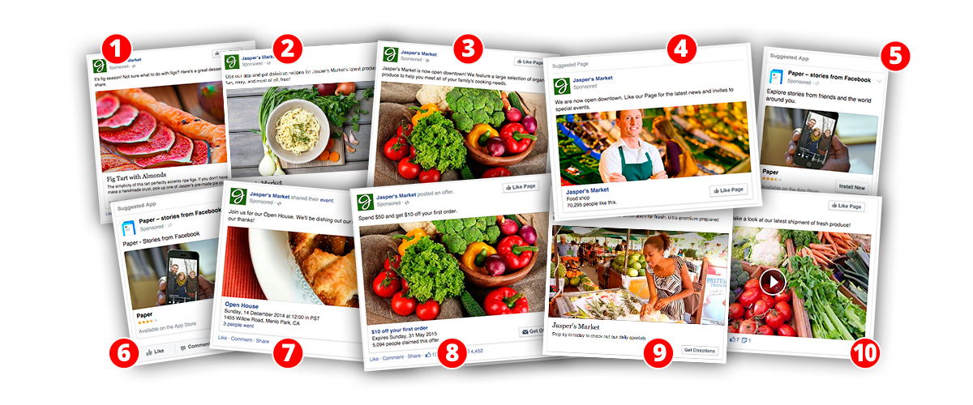
The Power of Facebook Ads
Notes:
Clicks to website
Website conversions
Post page engagement
Page likes
App installs
App engagement
Local Awareness
Event responses
Offer claims
Video views

Slide 21
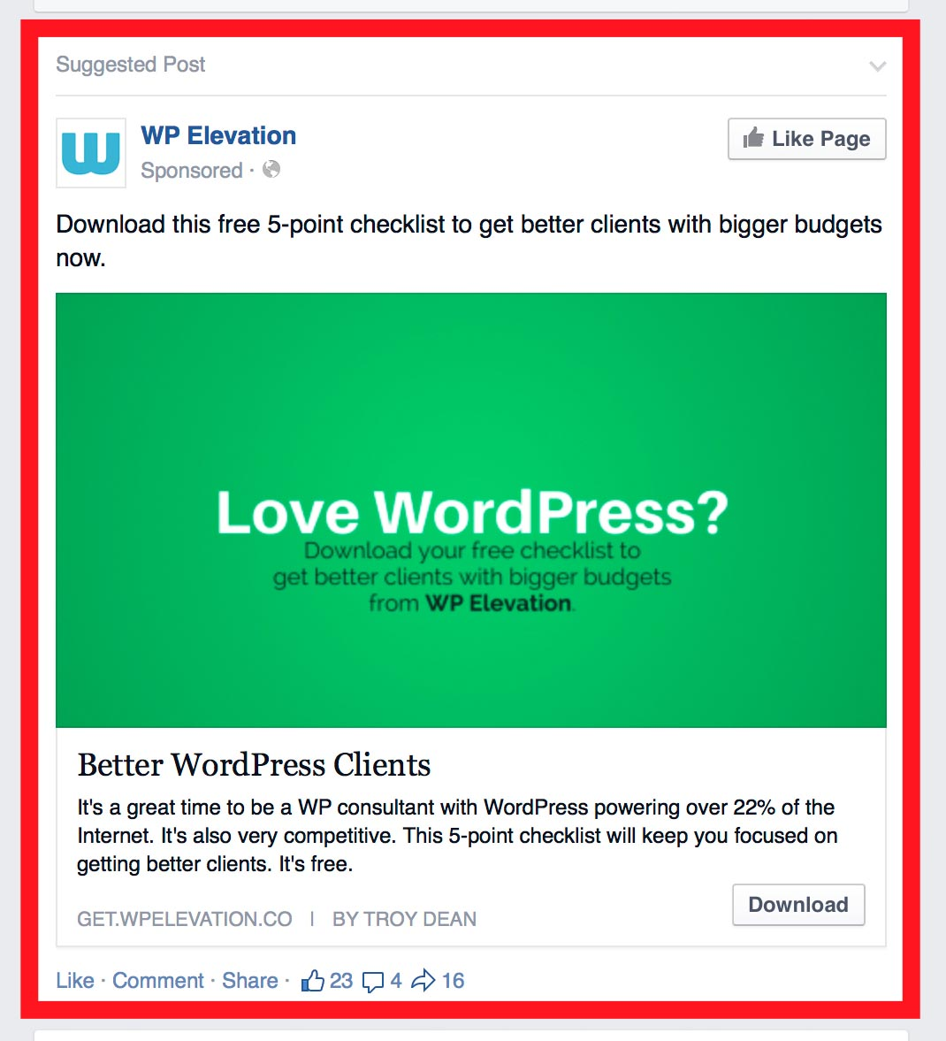
The Power of Facebook Ads
Confused? Here’s
the good news:
80% of your success
on Facebook will come from just one source: Facebook Ads in your Customers’ newsfeeds

Slide 22
The Power of Facebook Ads
They are not really ads. They are Sponsored Posts (also referred to as ‘Native Advertising’)
They go directly into the customers’ newsfeeds
They get delivered
You choose who sees them

Slide 23
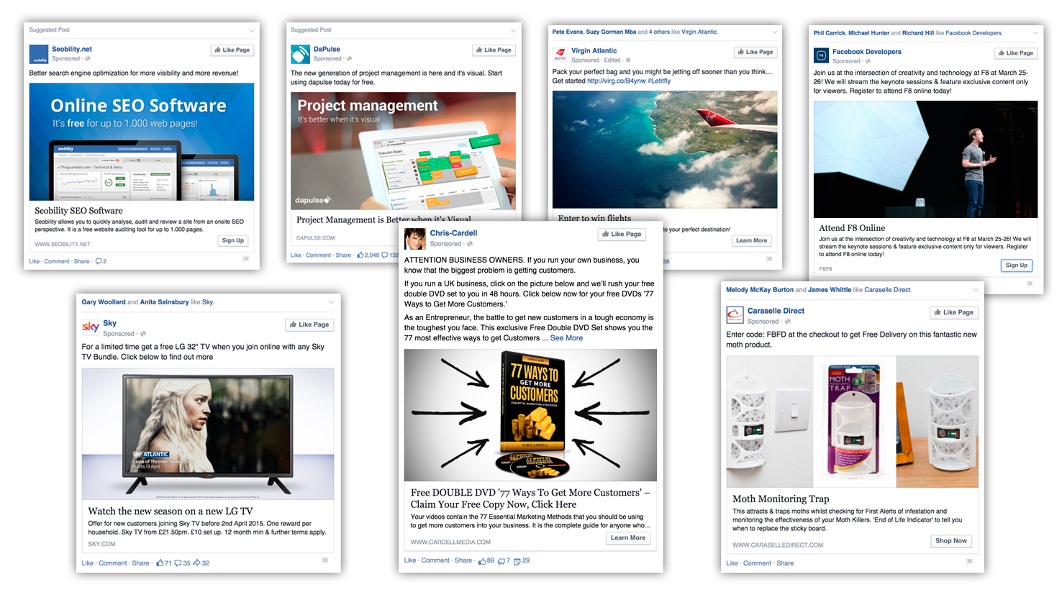

Slide 24
The 5 Steps to Successful Facebook Advertising
Create your Newsfeed ads
Start with Remarketing to your existing Customers
Target new customers through Facebook targeting
Move to lookalike audiences as soon as possible
Use Cost-Per-Conversion bidding

Slide 25
The 5 Steps to Successful Facebook Advertising
Create your
Newsfeed ads

Slide 26
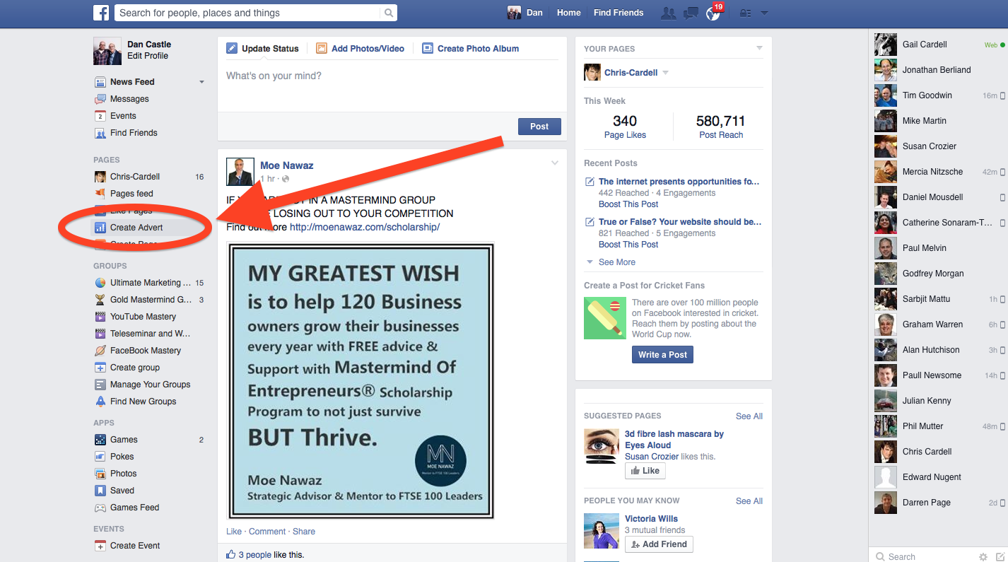
How to Create Your First Ad
Log in to Facebook and click the 'Create Advert' shortcut

Slide 27
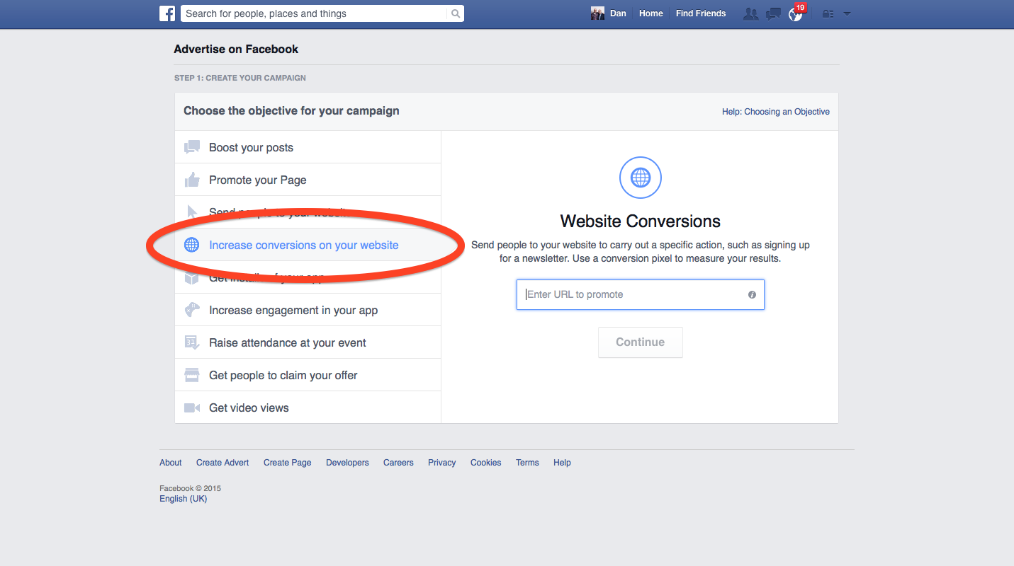
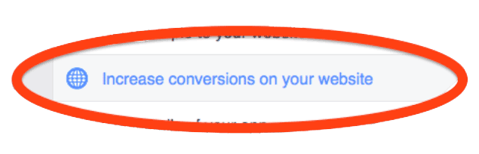
How to Create Your First Ad
Choose Increase Conversions on Your Website as your campaign objective and enter the URL of the webpage you want to send people to when they click your ad.

Slide 28
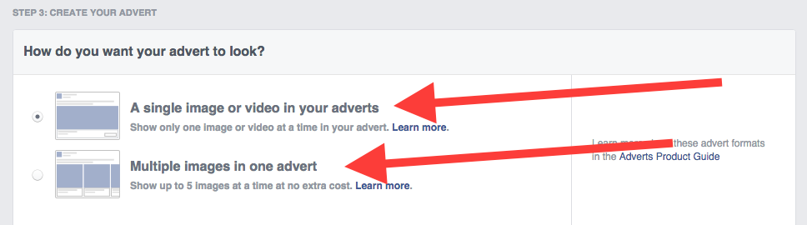
How to Create Your First Ad
Select either Single Image Ad – or Multiple Image Ad
(multiple image ads allow you to show up to 5 images in one advert)

Slide 29
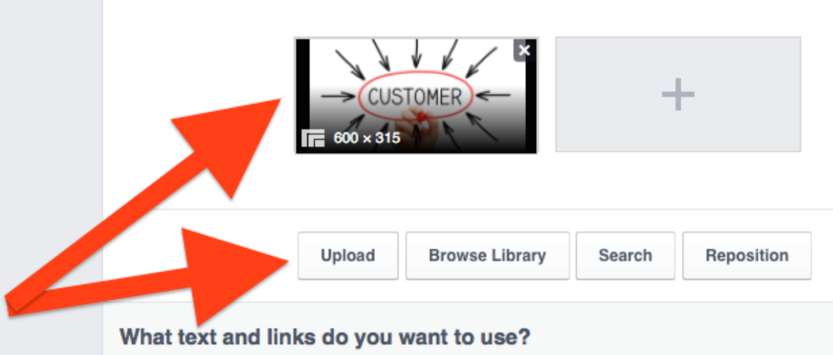
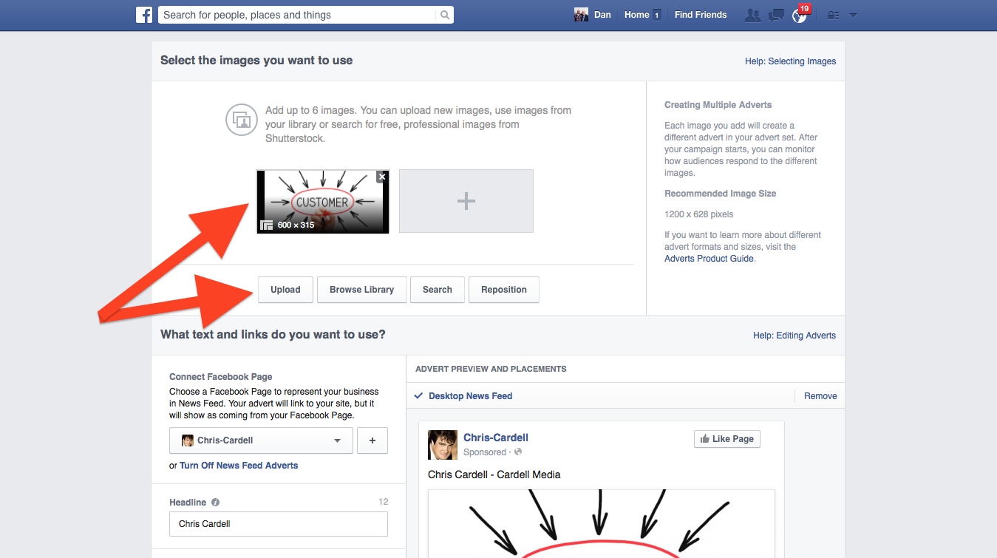
How to Create Your First Ad
Upload your graphic to
use on
your ad

Slide 30
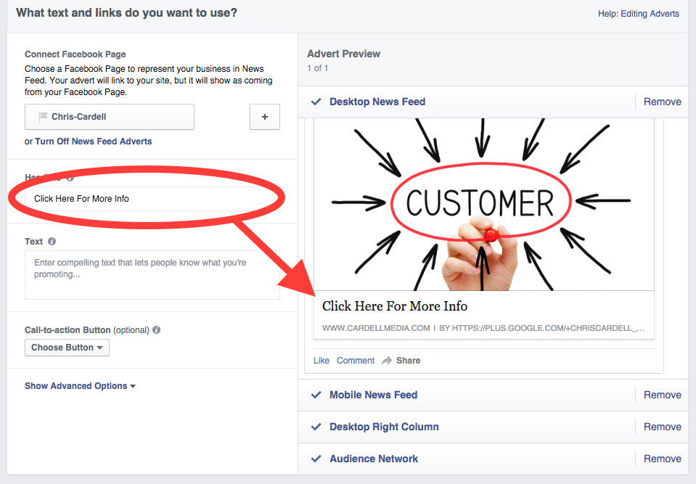
How to Create Your First Ad
Enter your Ad headline. This appears under your ad.

Slide 31
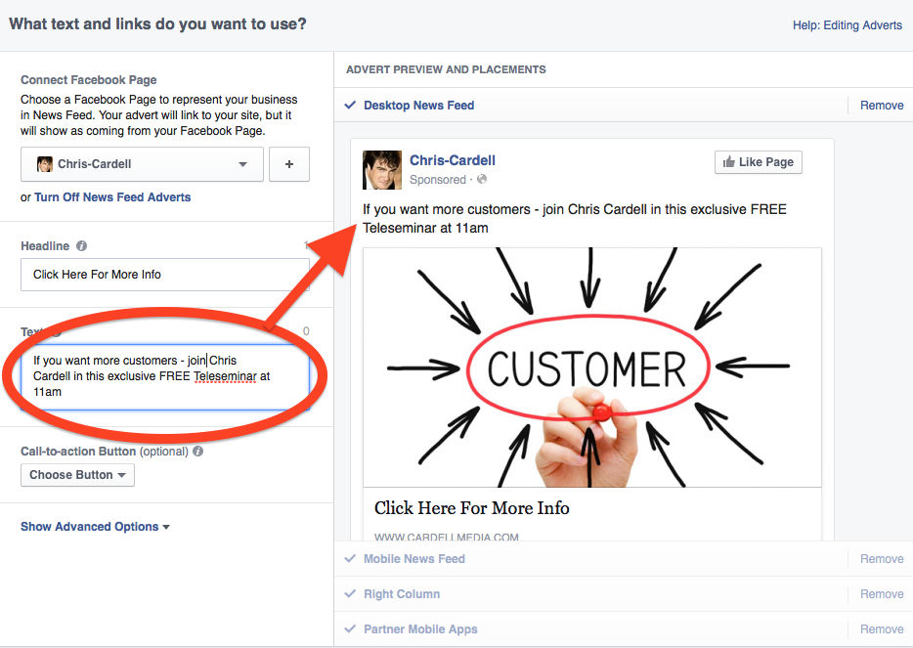
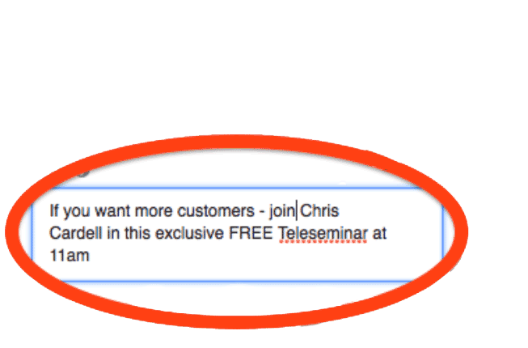
How to Create Your First Ad
Enter your
Ad text. This appears above the headline.

Slide 32
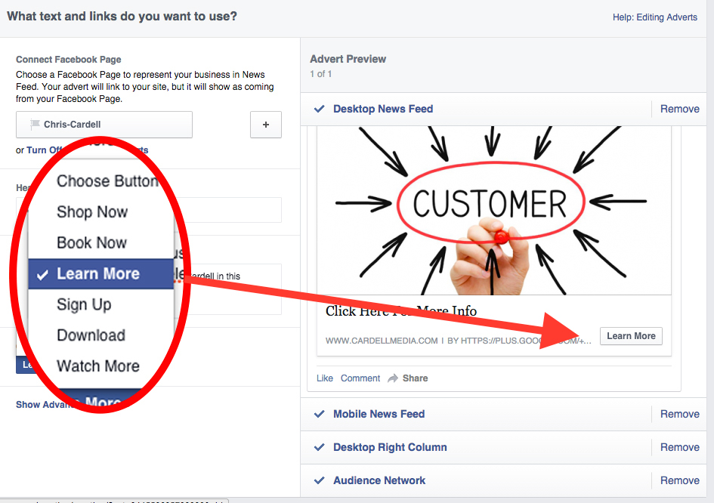
How to Create Your First Ad
Select a Call to Action button - choose from:
Shop Now
Book Now
Learn More
Sign Up
Download
Watch More

Slide 33
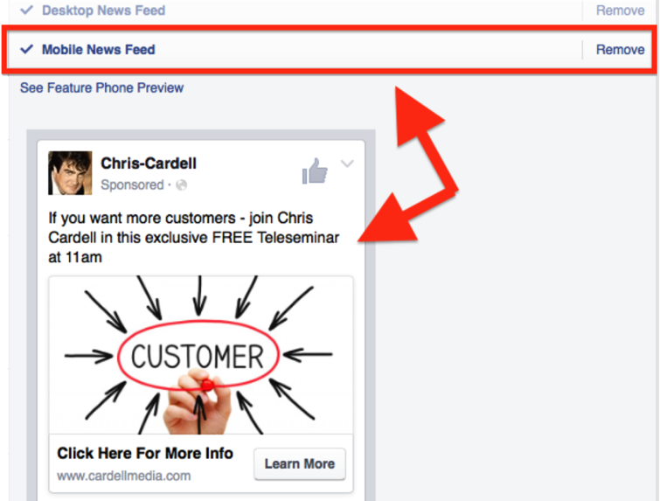
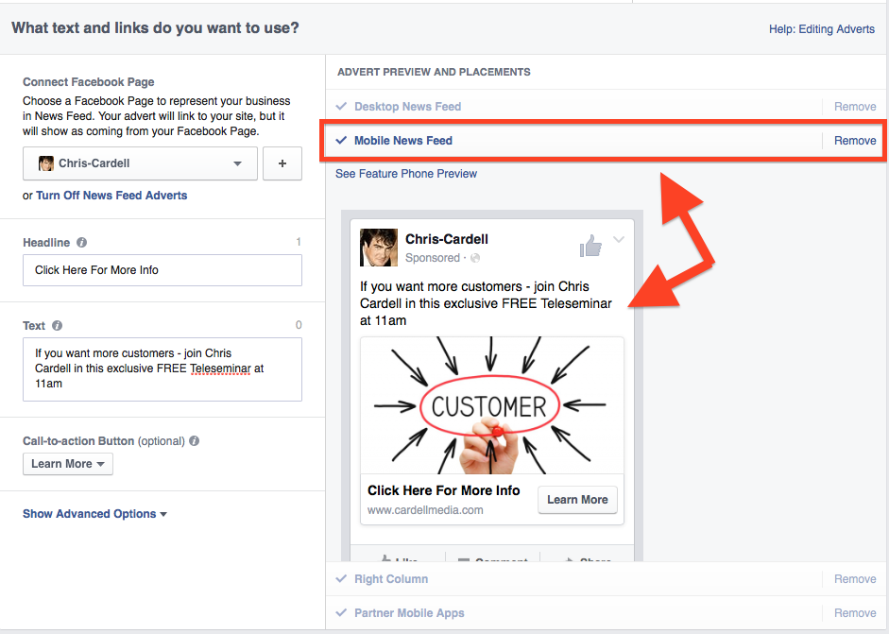
How to Create Your First Ad
Click the Ad Preview heading to preview how your Ad will appear on Mobiles, the Newsfeed, and in the right-hand column

Slide 34
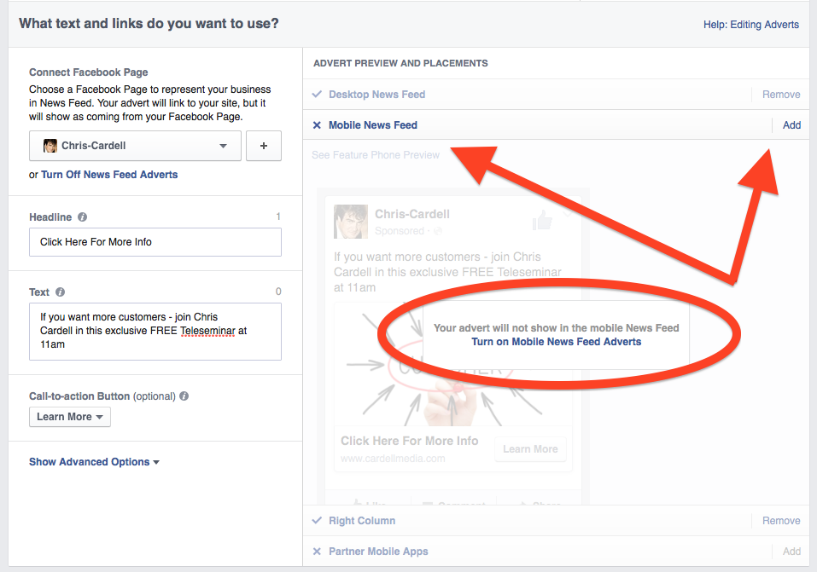
How to Create Your First Ad
Click Remove to turn off mobile and right-hand column ads

Slide 35
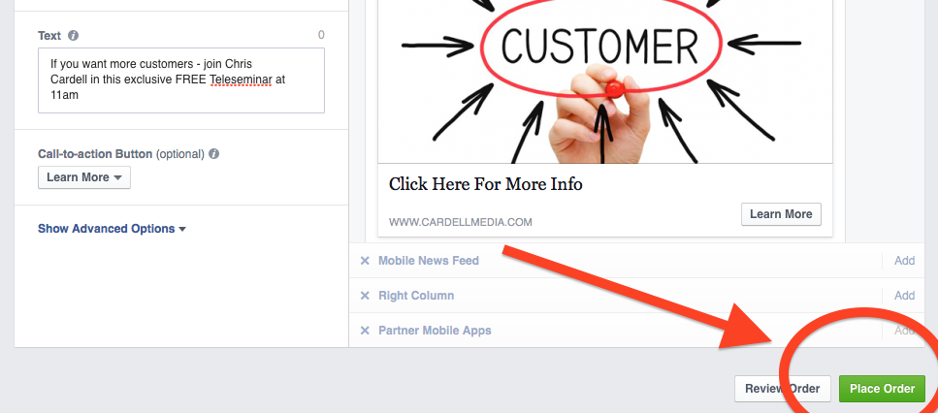
How to Create Your First Ad
Click Place Order and enter your payment details to launch your first Newsfeed Ad

Slide 36
The 5 Steps to Successful Facebook Advertising
Target your existing customers through Custom Audiences

Slide 37
Custom Audiences
Custom Audiences are audiences you build with your own data. You can:
Upload your customer email addresses
Add a Custom Audience tag to your
website and then target people who visit specific pages of your site (Remarketing)

Slide 38
Targeting Customer Groups on Facebook
Serve Ads to all your customers
Serve Ads to customers who have purchased specific products / services
Serve more Ads to your best buyers
Pay more to reach your best buyers
Target your leads

Slide 39
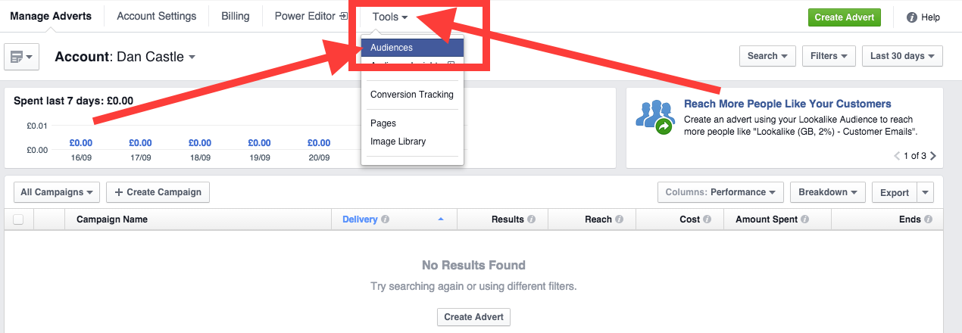
Uploading Customer Email Addresses/Phone Numbers
Log in to your Ad Manager and select Tools > Audiences

Slide 40
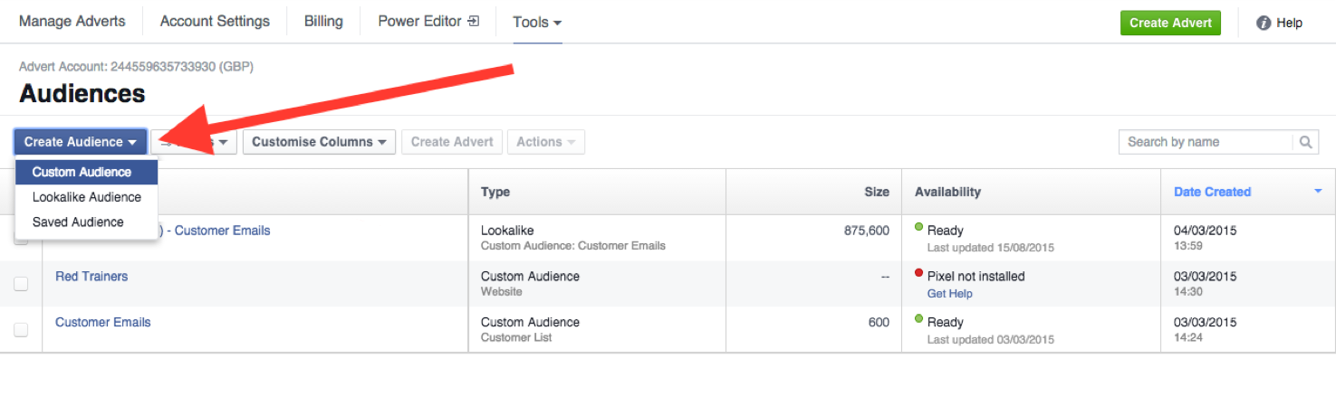
Uploading Customer Email Addresses/Phone Numbers
Click Create Audience and select Custom Audience from the drop-down menu

Slide 41
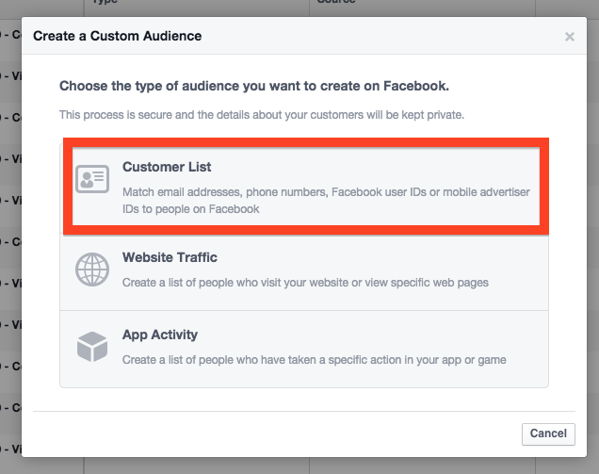
Uploading Customer Email Addresses/Phone Numbers
Select Customer List and click Upload a File

Slide 42
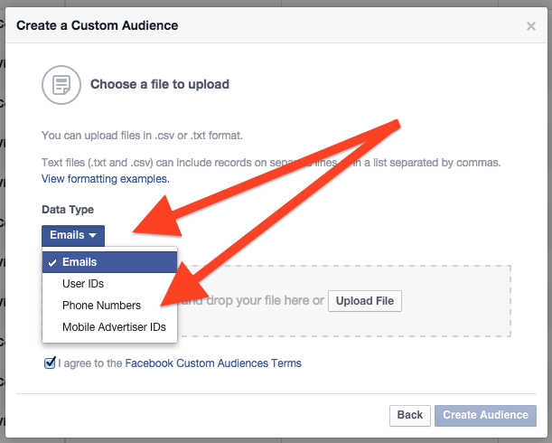
Uploading Customer Email Addresses/Phone Numbers
Choose Email or Phone Numbers and upload your list

Slide 43
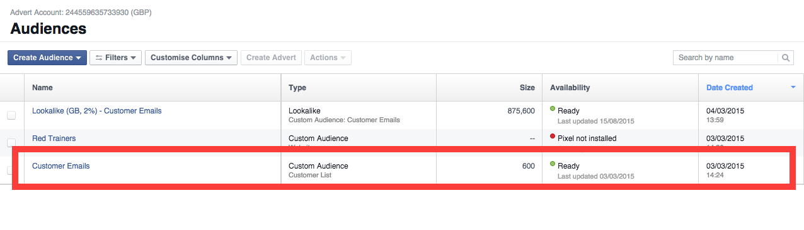
Uploading Customer Email Addresses/Phone Numbers
Facebook will then pair your list with the user data it has on file. When it is ready, your audience will appear in the Custom Audience list

Slide 44
Budgets, Bidding & ‘Conversion Optimised’ Ads
Before you can set your bidding, you need to tell Facebook how much your willing to spend on your Ad campaign.
To set your campaign budget…

Slide 45
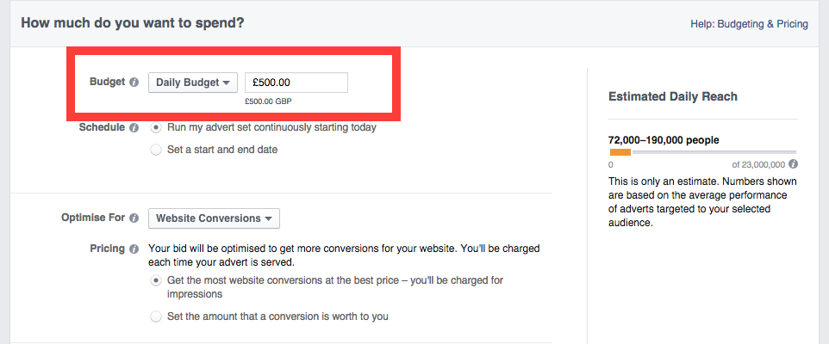
Budgets, Bidding & ‘Conversion Optimised’ Ads
In your Ad Targeting settings, enter either a daily budget or a lifetime budget for your campaign

Slide 46
Budgets, Bidding & ‘Conversion Optimised’ Ads
Next, you need to set your bid settings. You have four options to choose from…

Slide 47
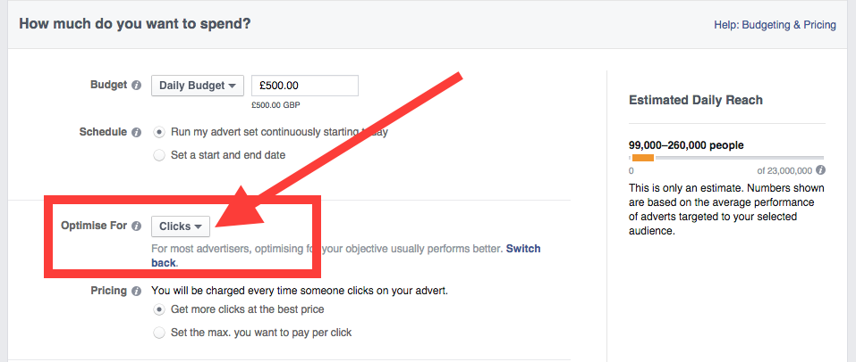
Option 1
Clicks: Facebook will serve your Ad to people who might click on your Ad

Slide 48
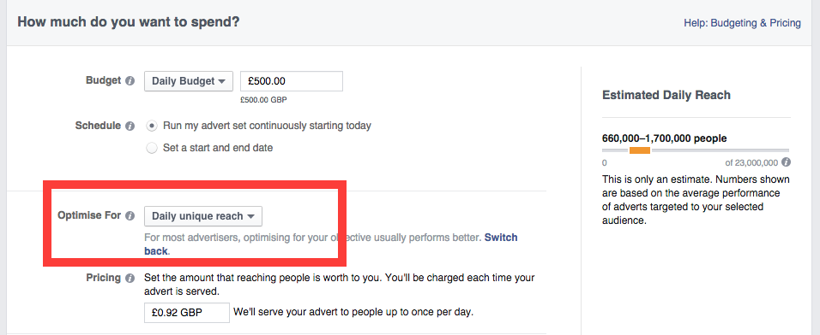
Option 2
Daily Unique Reach: Your Ad will only be served to people once per day

Slide 49
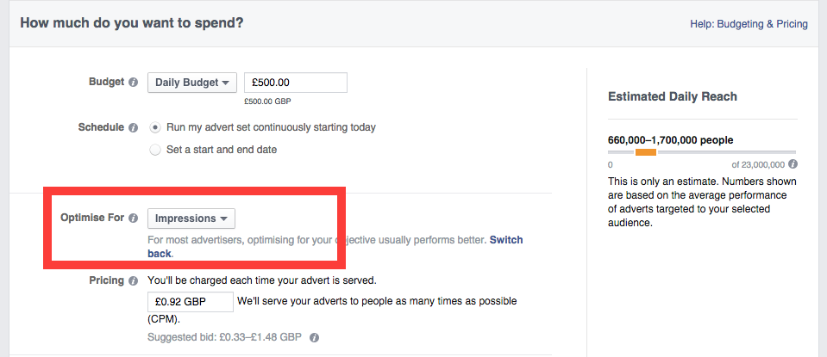
Option 3
Impressions: Your Ad will be served to as many people as many times as possible

Slide 50
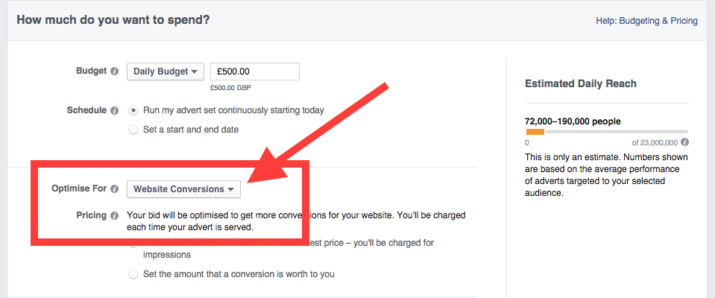
Option 4
Website Conversions: Facebook will serve your Ad to people who are more likely to reach your Conversion Pixel

Slide 51
For targeting existing customers, choose Option 3
(but don’t use this for targeting new customers)
Impressions: Your Ad will be served to as many people as many times as possible

Slide 52
Budgets, Bidding & ‘Conversion Optimised’ Ads
PRO TIP:
If you're doing Re-Marketing with a Custom Audience, you can set your bidding to Impressions (CPM) with a high bid of around £10 to £30. (You won’t necessarily pay this, but you will win the auction and dominate your Custom Audiences newsfeed).

Slide 53
Tracking and Measuring Conversions
Creating a Conversion Pixel

Slide 54
Creating a Conversion Pixel
A Conversion Pixel is a small piece of code that will send information about the success of your adverts back to Facebook

Slide 55
Creating a Conversion Pixel
You'll need to put your Conversion Pixel on your website, or ask the person who manages your website to do it for you
If you want to track registrations, this code will go on your Registrations Confirmation page
If you want to track checkouts, this code will go on your Order Confirmation page

Slide 56
Creating a Conversion Pixel
To create a Conversion Pixel…

Slide 57
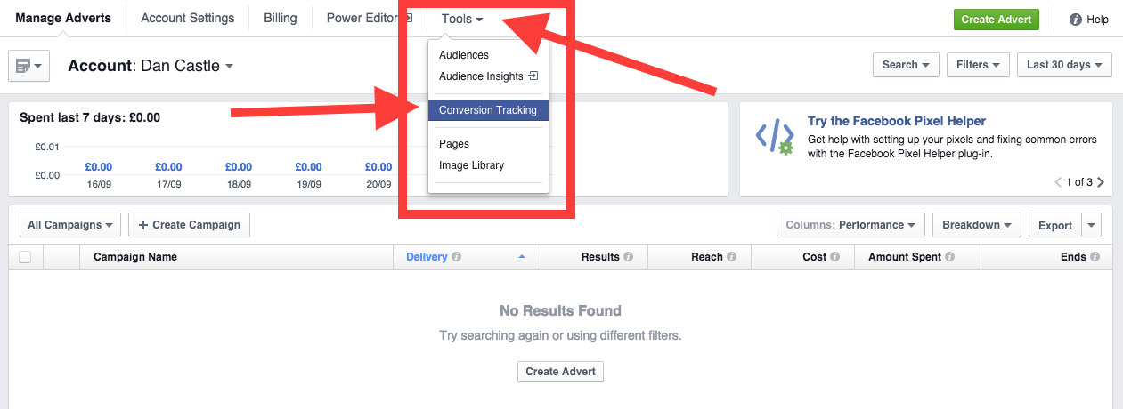
Creating a Conversion Pixel
Click Tools > Conversion Tracking

Slide 58
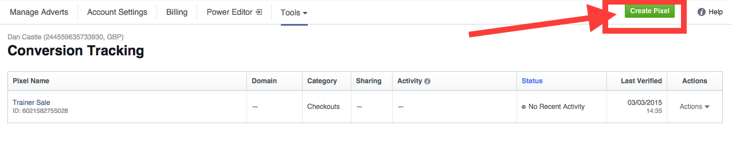
Creating a Conversion Pixel
Click Create Pixel

Slide 59
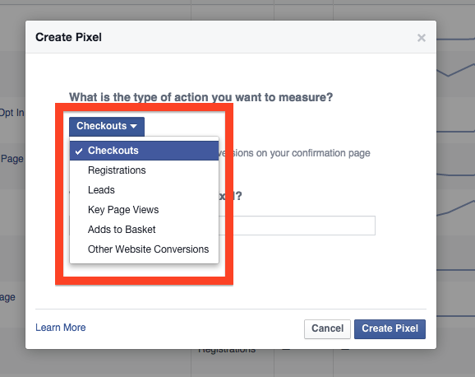
Creating a Conversion Pixel
Define what action you want to measure. The choices are:
Checkouts
Registrations
Leads
Key Page Views
Adds to Basket
Other Website Conversions
Then click Create Pixel

Slide 60
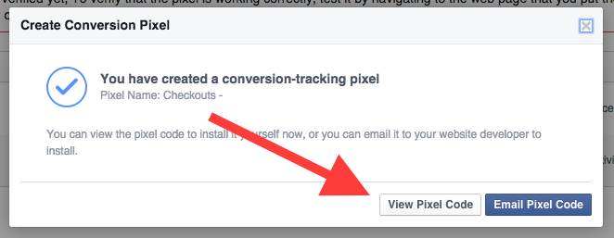
Creating a Conversion Pixel
Click View Pixel Code

Slide 61
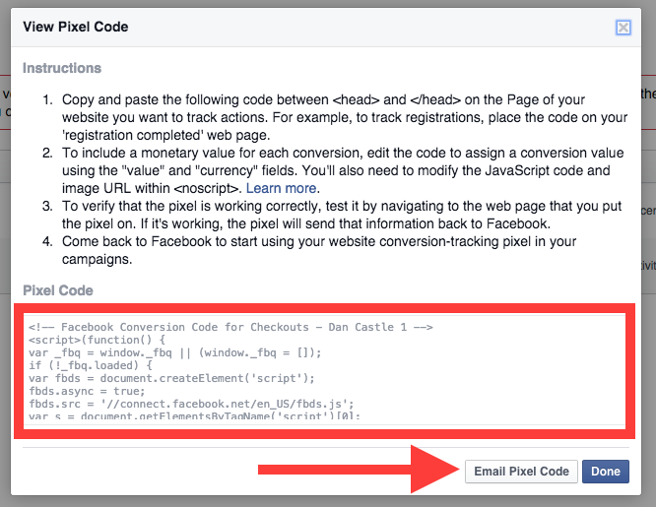
Creating a Conversion Pixel
Follow the instructions to add the code to your website – or click Email Pixel Code
to send the code to your web developer

Slide 62
The 5 Steps to Successful Facebook Advertising
Create your Newsfeed ads
Start with Remarketing to your existing Customers
Target new customers through Facebook targeting
Move to lookalike audiences as soon as possible
Use Cost-Per-Conversion bidding

Slide 63
Seminar 1: Action Steps
If you’re new to Facebook Advertising:
Open your Account
Create your first Ad
Upload your customer list
Set your bidding and launch
your campaign

Slide 64
Seminar 1: Action Steps
If you’re currently advertising on Facebook:
Segment your customer lists
Test at least three different Ads to
different groups
Start exploring ‘Lookalike audiences’
in your account

Slide 65
Coming Next…
Seminar 2:
Targeting: Geography, Demographics and Interests
How to Create Lookalike Audiences
When and How to use Right-Hand Side Ads
Step-by-Step Guide to Profitable Ads
Advanced Bidding Strategies

Slide 66
Coming Next…
Seminar 3:
Budgeting and Scheduling
Ad Manager Panel and Reporting
Video Ads
MOBILE
10 Principles for a Successful Facebook
Landing Page

Slide 67
30 Days To Facebook Profits
‘Mission Control’
www.CardellMedia.com/members-hub

