Slide 1


Slide 2
Seminar 3:
Budgeting and Scheduling,
Ad Manager Panel and Reporting,
Video Ads, Mobile, 10 Principles
for a Successful Facebook
Landing Page

Slide 3
Seminar 3:
www.CardellMedia.com/members-hub

Slide 4
The 5 Steps to Successful Facebook Advertising
5) Use Cost-Per-Conversion Bidding

Slide 5
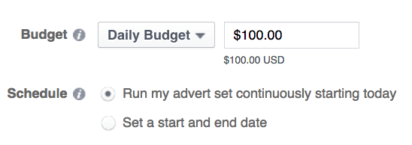
Budgeting and Scheduling
When it comes to setting your ad budget,
you have two options:
Daily Budget: From our
experience, avoid using
a Daily Budget
– Facebook will typically
spend the full amount
each day – even if hardly
anyone is converting
(your cost per conversion
will just go up)

Slide 6
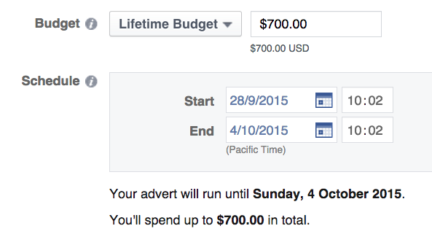
Budgeting and Scheduling
Instead, set your campaign to a ‘Lifetime’ budget
Lifetime Budgets:
For example, set your ad
to run for 7 days with a
lifetime spend of £700
– Facebook will still spend
100% of your budget, but
it will spread the spending
– taking more when
conversions are flowing

Slide 7
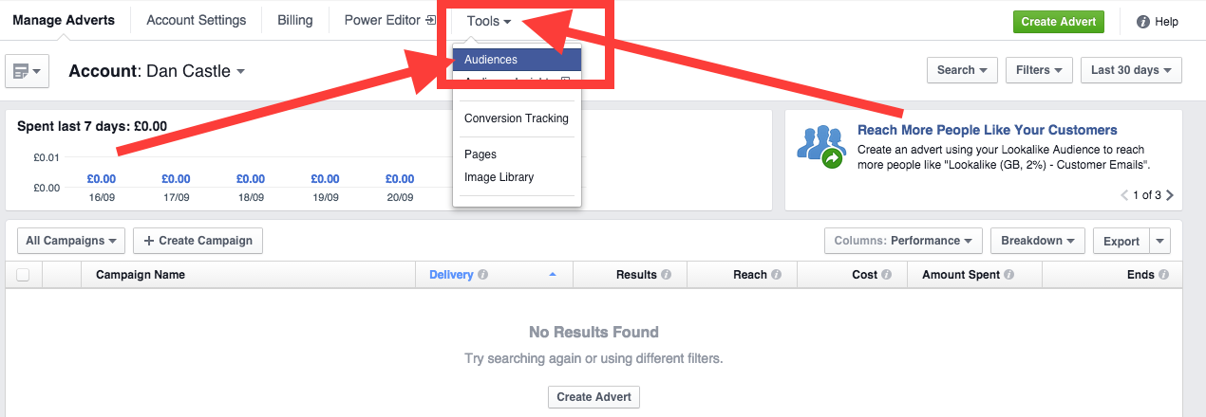
Remarketing
Log in to your Ad Manager and click Tools > Audiences in the menu

Slide 8
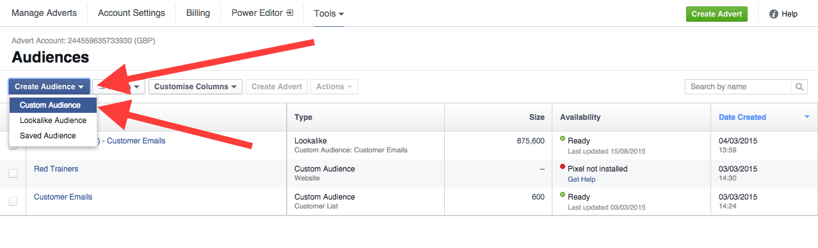
Remarketing
Click Create Audience and select Custom Audience from the drop-down menu

Slide 9
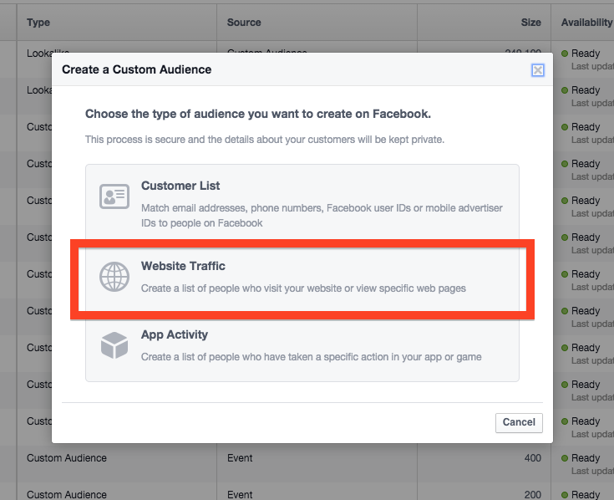

Remarketing
Select Website Traffic from the overlay menu

Slide 10
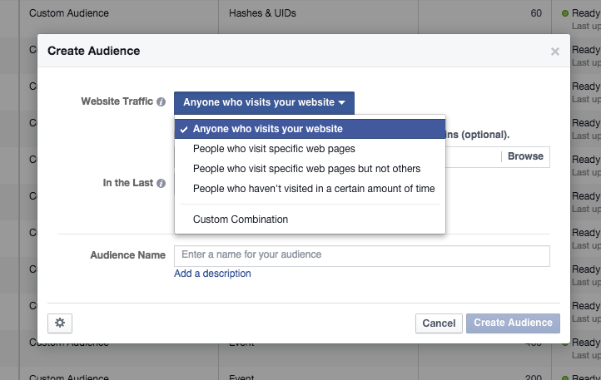
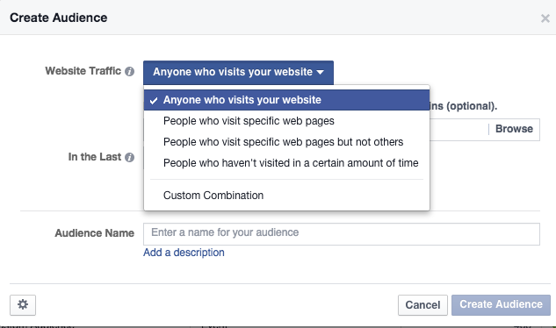
Remarketing
Define the traffic you want to target by selecting one of the following options:
Anyone who visits your website
People who
visit specific
web pages

Slide 11
Remarketing
Define the traffic you want to target by selecting one of the following options:
People who visit specific web pages but not others
People who haven’t visited in a certain amount of time

Slide 12
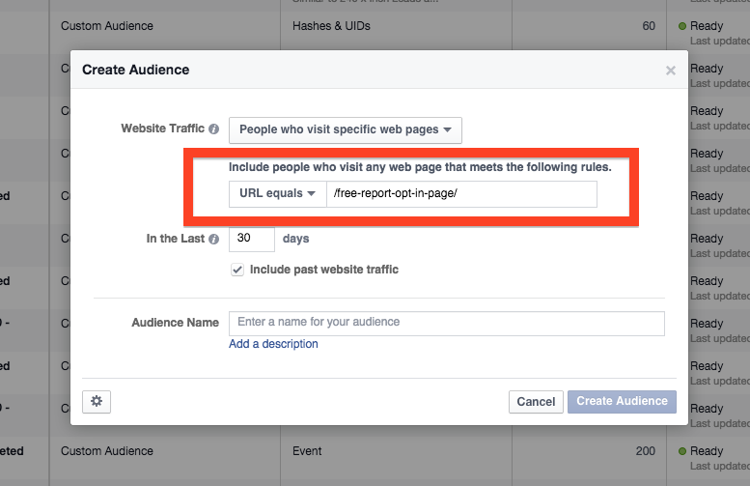

Remarketing
Enter the URL
of the page you want to target with your Remarketing

Slide 13
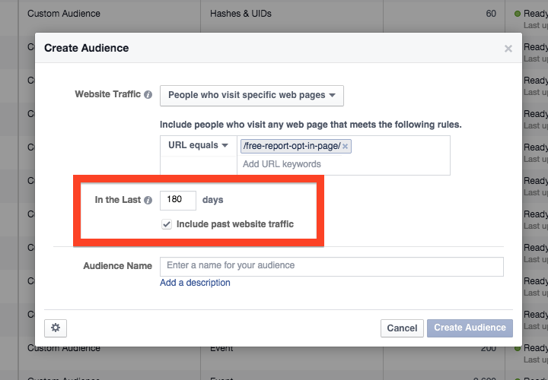

Remarketing
Enter the number of days you want people to stay in your Remarketing audience for – the maximum is 180

Slide 14
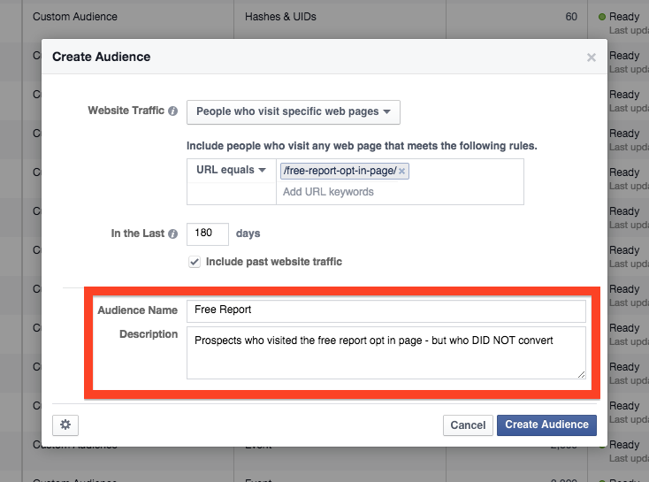
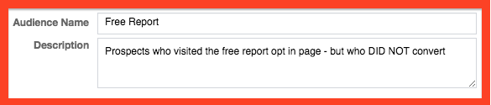
Remarketing
Give your Remarketing audience a Name and include a description for future reference

Slide 15
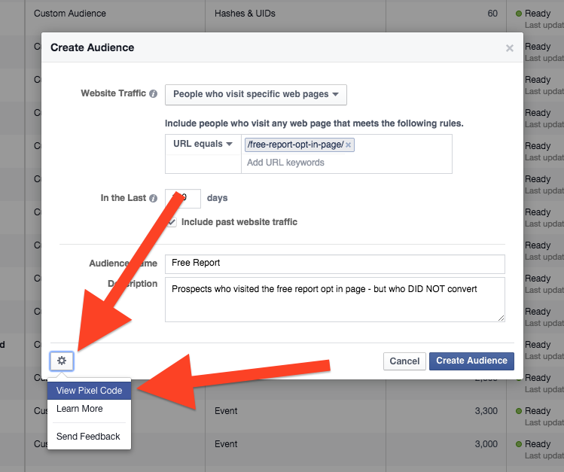

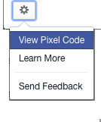

Remarketing
If this is your first Remarketing audience, click the gear icon and select View Pixel Code

Slide 16
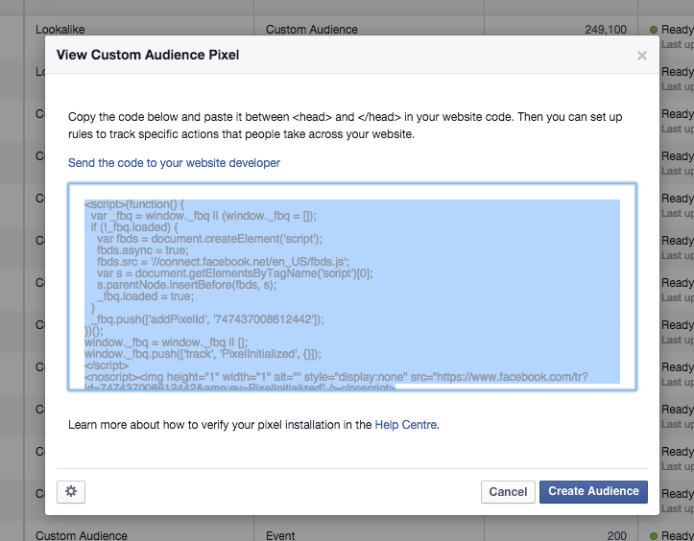
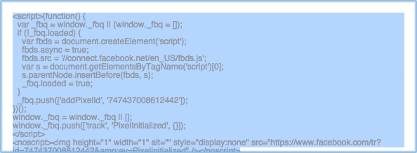
Remarketing
Copy the code and add it to your website – or email it you web developer. As soon as your code is on your site – Facebook will start to track and build your Remarketing audience

Slide 17
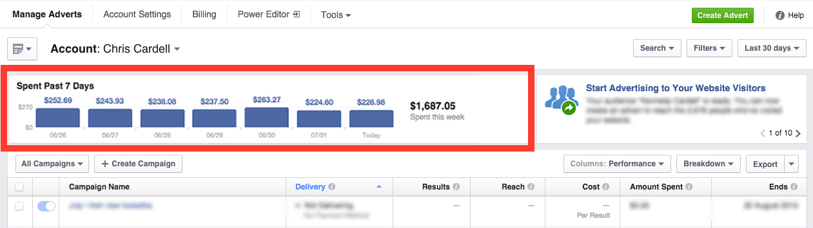
Your Ad Manager Panel (Campaign Level)
At the top of the Ad Manager page is a graph showing your spend over 7 days

Slide 18
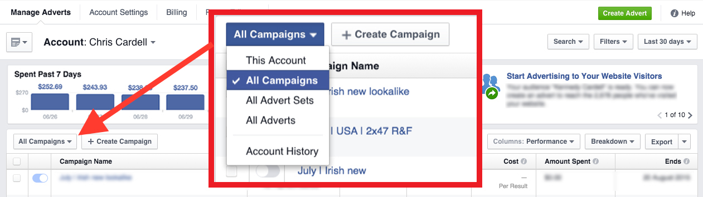
Your Ad Manager Panel (Campaign Level)
By default your report is broken down by campaign. Click the dropdown to change the report to show All Ad Sets or All Ads

Slide 19
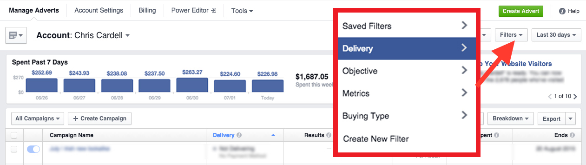
Your Ad Manager Panel (Campaign Level)
You can filter your report using the menu on the right – you can filter by Delivery, Objective, Metrics and Buying Type

Slide 20
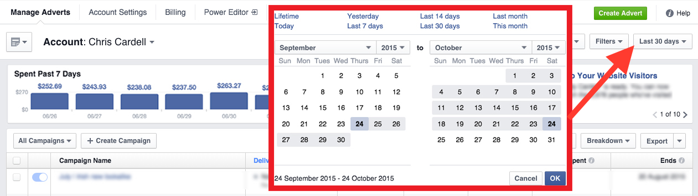
Your Ad Manager Panel (Campaign Level)
By default your report will be set to ‘Last 30 Days’ but you can choose from Lifetime, Today, Yesterday, Last 7 Days, Last 14 Days, Last 30 Days, Last Month or This Month

Slide 21
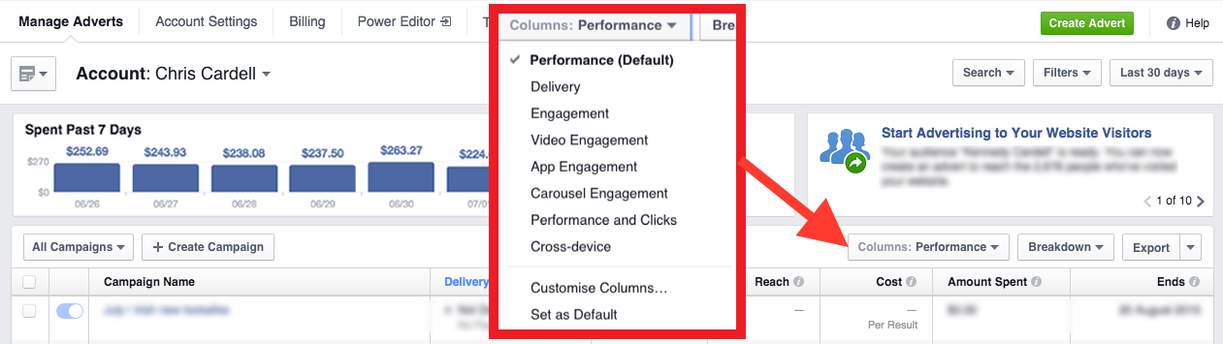
Your Ad Manager Panel (Campaign Level)
At the far right is a dropdown for ‘Columns’ use this to define what metrics you want your report to show. By default it is set to ‘Performance’ but you can change it to show other key metrics such as Delivery and Engagement

Slide 22
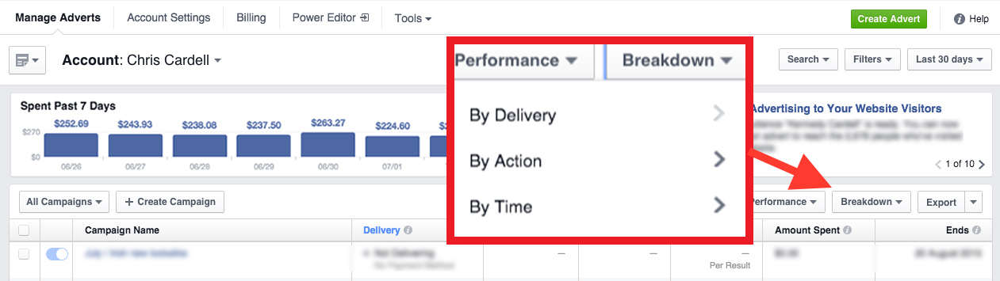
Your Ad Manager Panel (Campaign Level)
Next to Performance is the ‘Breakdown’ menu. Use this to access valuable information broken down into the following categories:
By Delivery, By Action or By Time

Slide 23
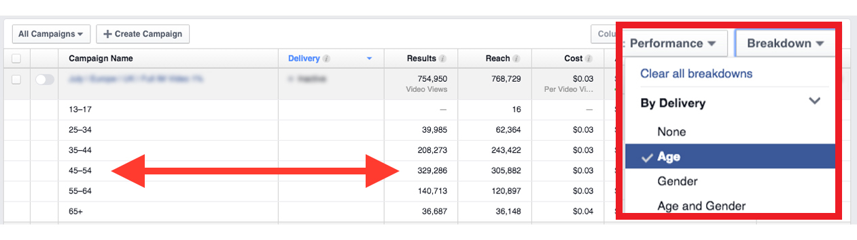
Your Ad Manager Panel (Campaign Level)
For example, select ‘Age’ to reveal what age category are responding to your ads the most – other Breakdown filters include: Gender, Country, Region, Day or Week

Slide 24
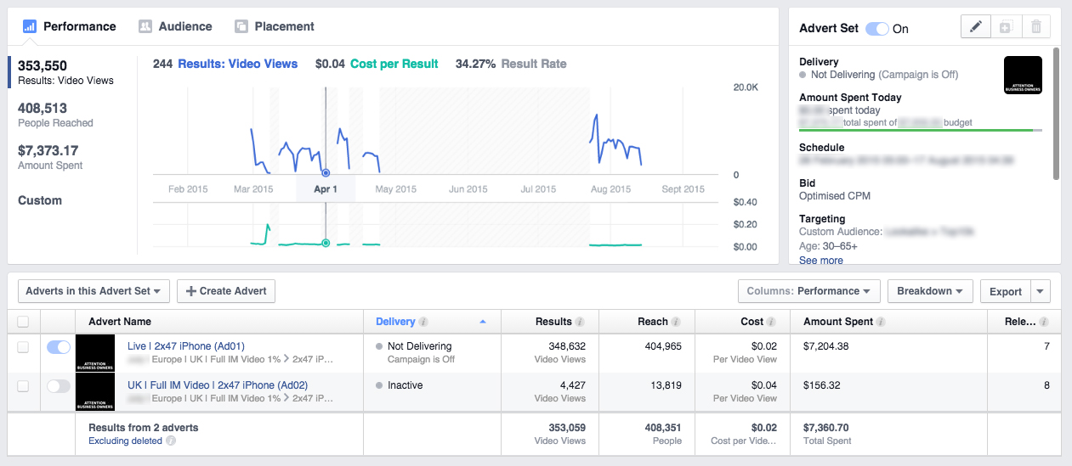
Your Ad Manager Panel (Advert Level)
Click through from the Campaign level to reveal the Advert level menu

Slide 25
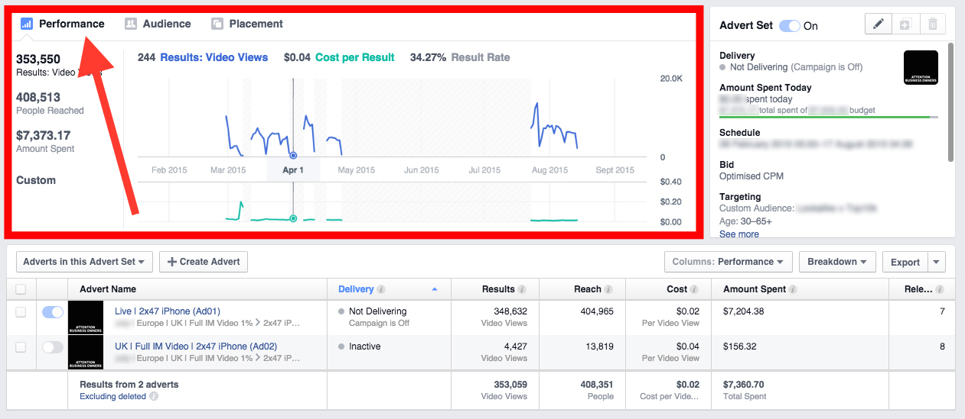
Your Ad Manager Panel (Advert Level)
Select Performance to reveal a quick overview of ad performance

Slide 26
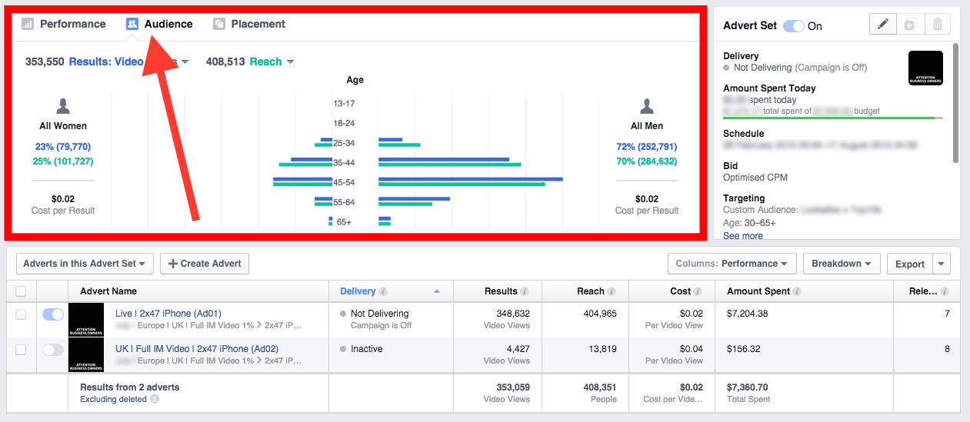
Your Ad Manager Panel (Advert Level)
Select Audience to show who is responding to your ad the most

Slide 27
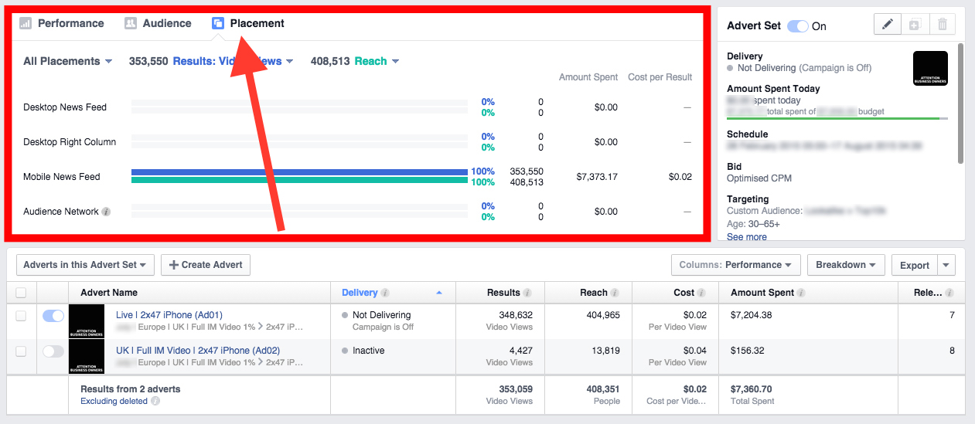
Your Ad Manager Panel (Advert Level)
Select Placement to check your placement statistics

Slide 28
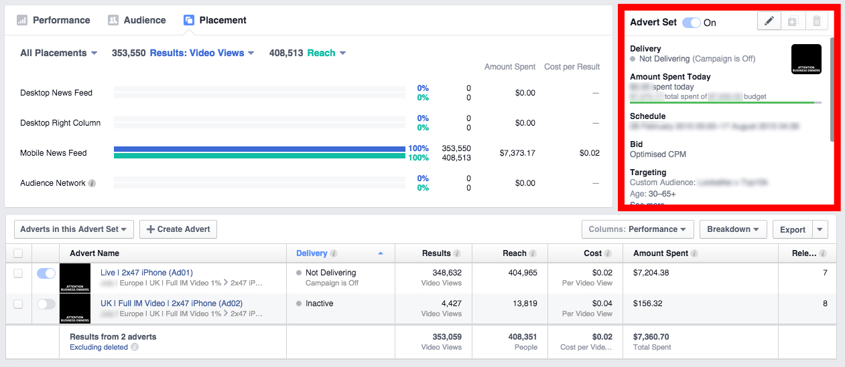
Your Ad Manager Panel (Advert Level)
An overview of your ad settings including Amount Spent, Schedule, Bid, Targeting and Delivery can be found on the far right

Slide 29
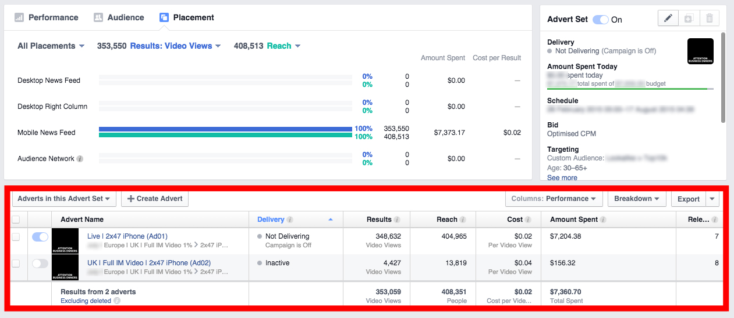
Your Ad Manager Panel (Advert Level)
You can view other key metrics like Relevance Score in the columns. Use the ‘Performance’ and ‘Breakdown’ menus to tailor the data shown

Slide 30
Video Ads
Facebook is changing from a picture-based experience to a video-based experience
Very high engagement
Your video can be clicked on

Slide 31
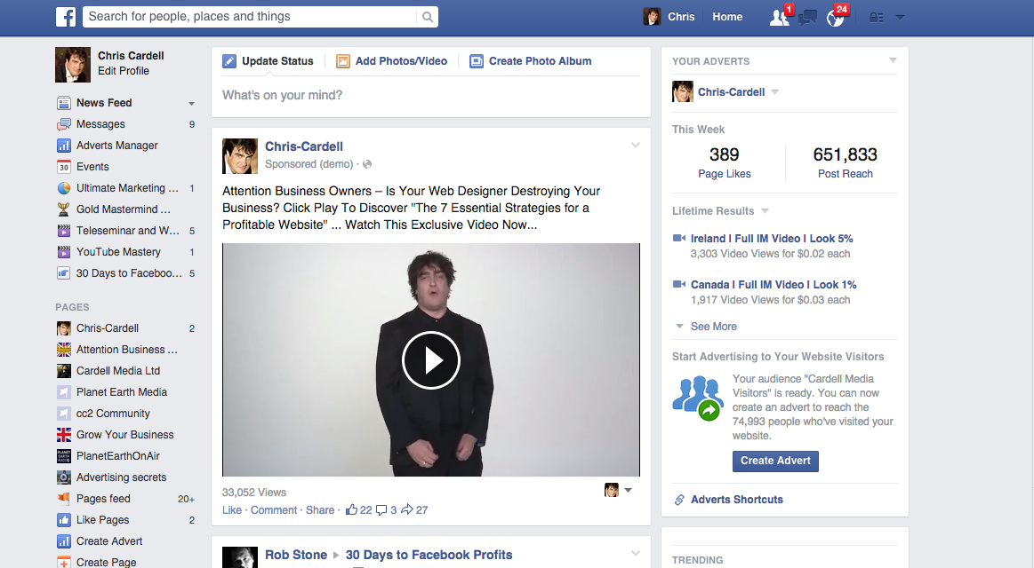
Video Ads
Desktop
The Video appears in the news feed
Depending on user settings, the video may or may not auto play

Slide 32
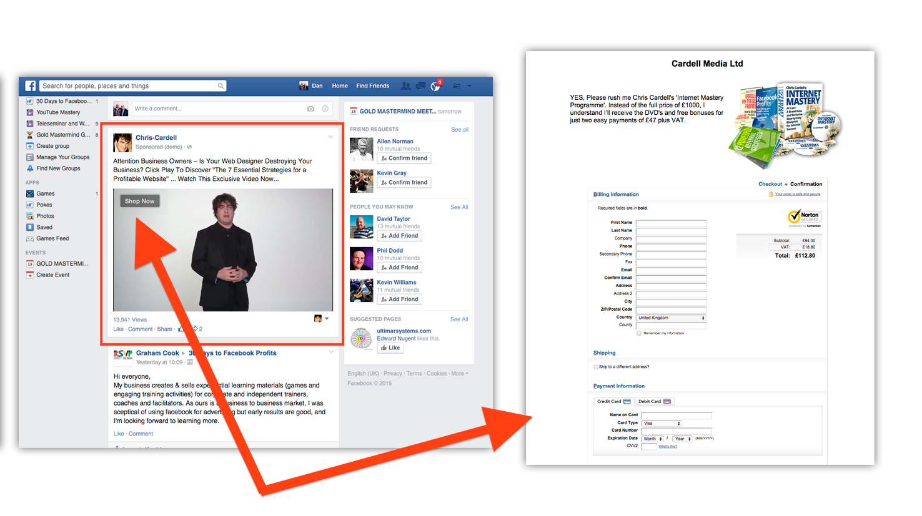
Video Ads
Clicking on the video activates the Call to Action button
Clicking the button will take you to your destination URL

Slide 33
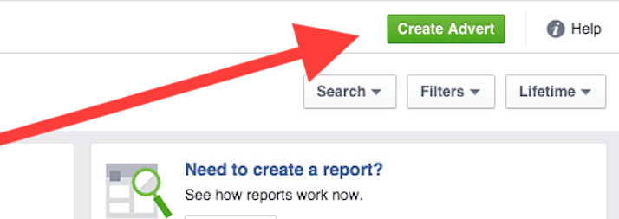
How to Create a Video Ad
Go to your Ad Manager and click Create Ad

Slide 34
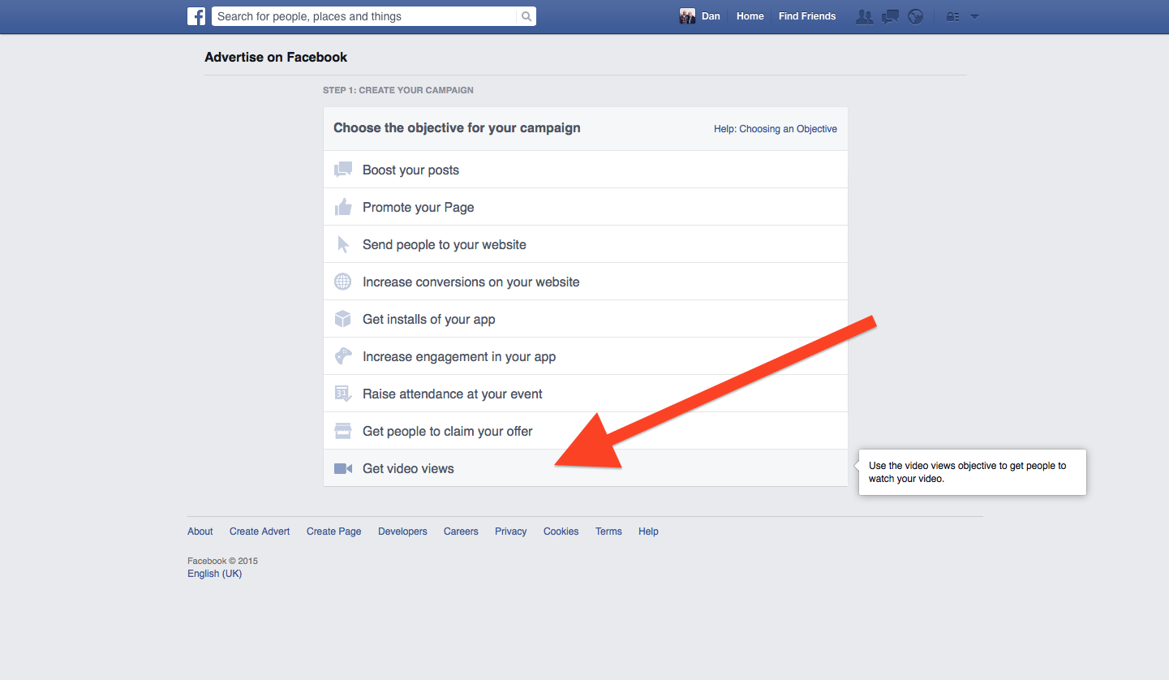
How to Create a Video Ad
Select Get
Video Views

Slide 35
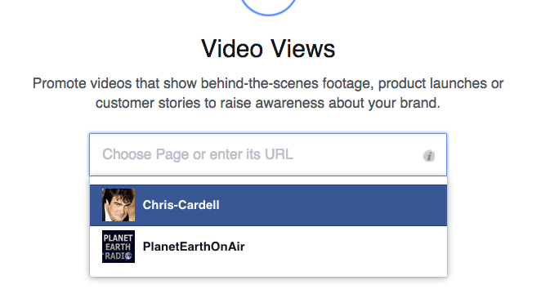
How to Create a Video Ad
Locate your Facebook Business Page from the drop-down menu

Slide 36
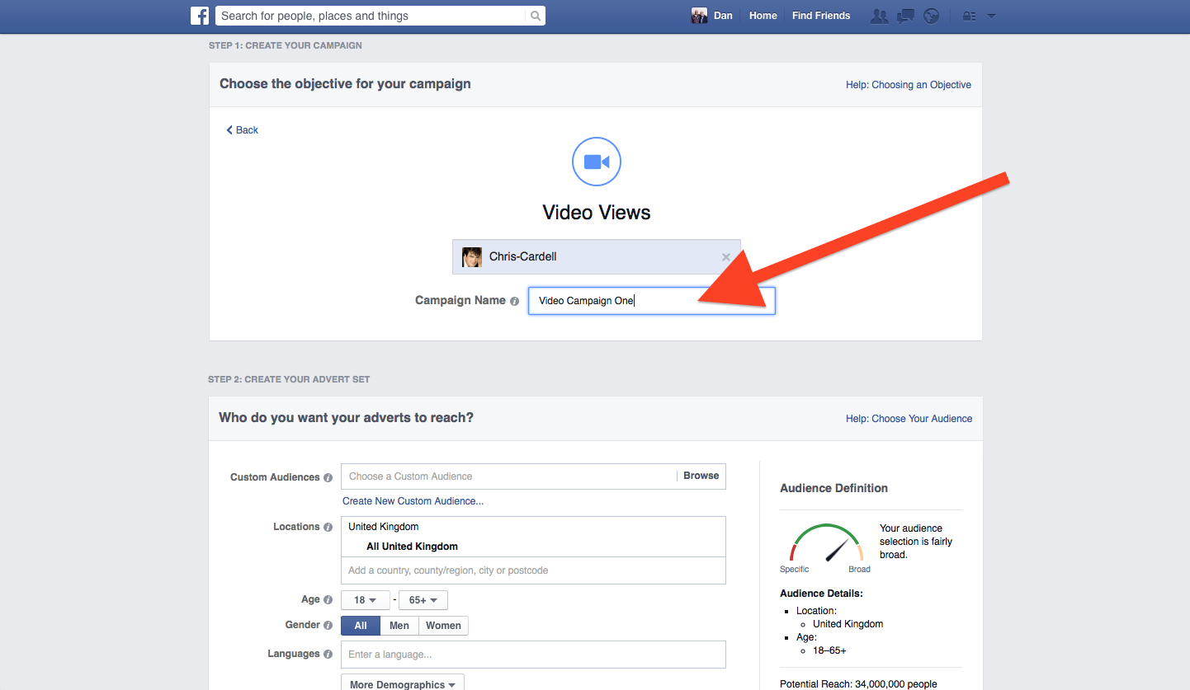

How to Create a Video Ad
Name your campaign

Slide 37
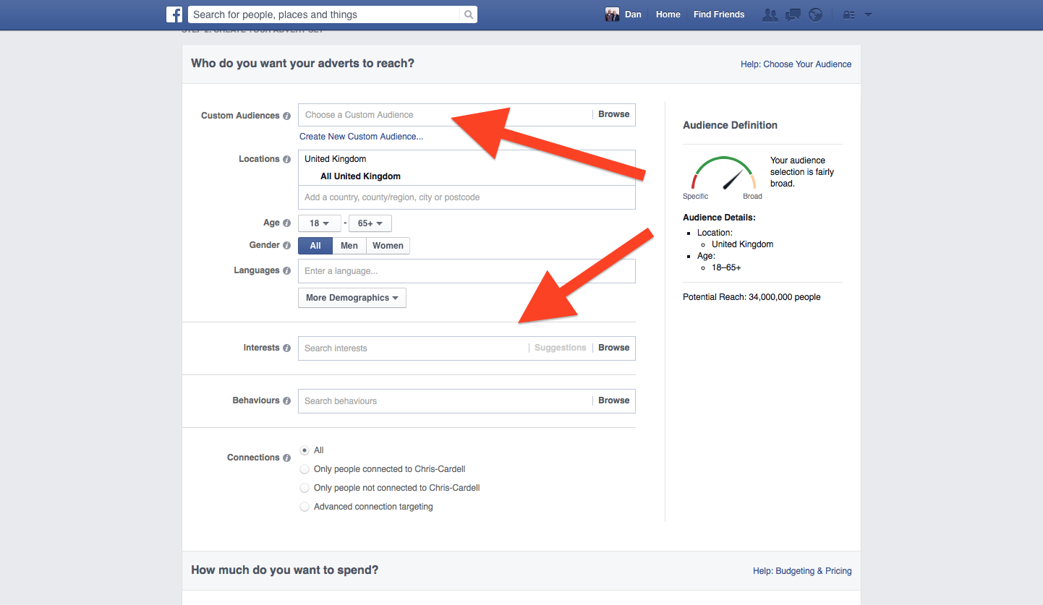
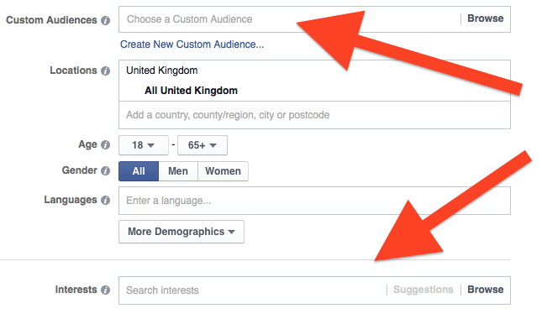
How to Create a Video Ad
Targeting
Select either a Custom Audience
Or a Lookalike Audience
Or use the Interests and Demographics options

Slide 38
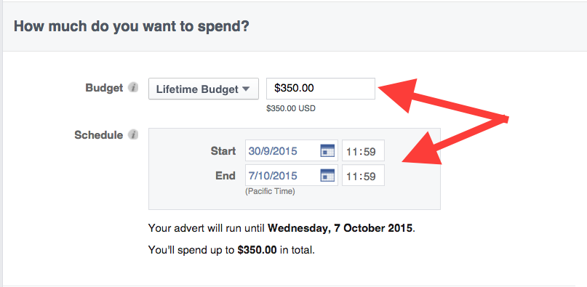
How to Create a Video Ad
Budgeting
Set a lifetime budget (e.g., £50 a day x 7 days = £350)
Then schedule your campaign to run for 1 week

Slide 39
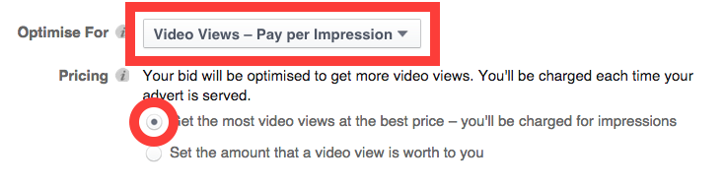
How to Create a Video Ad
Bidding
Optimise for Video Views – Pay per Impression
Select Get the most video views at the best price

Slide 40
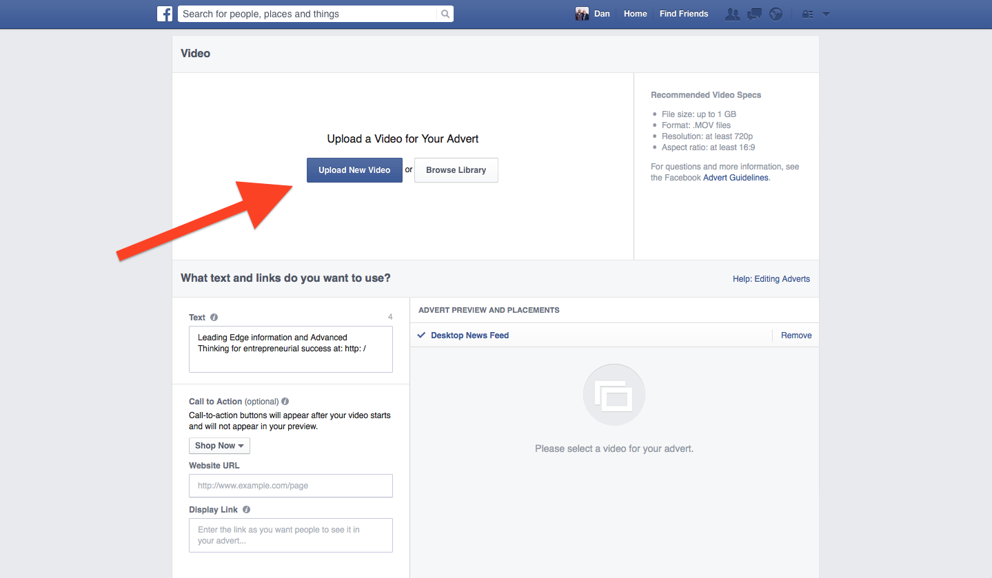

How to Create a Video Ad
Video
Click Upload New Video
Videos must be in .MOV format
Maximum file size is 1GB (most videos will be fine)

Slide 41
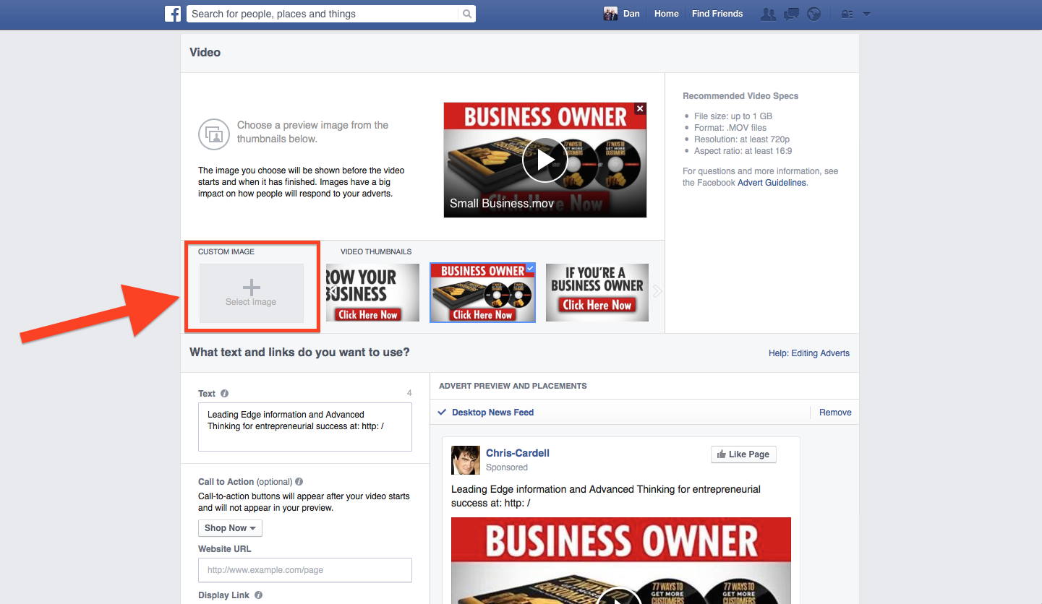
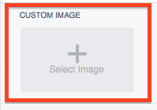
How to Create a Video Ad
Thumbnail
Select a video thumbnail (this will be shown before your video starts and when it ends)
Or upload your own
The ‘no more than 20% text’ rule applies to video thumbnails

Slide 42
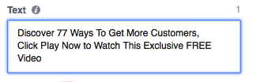
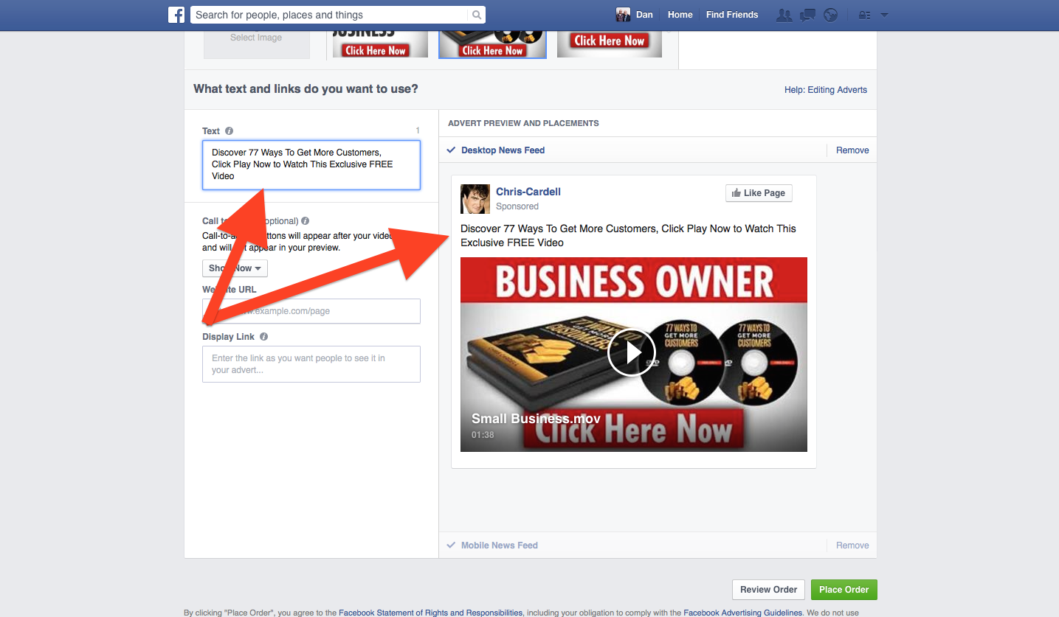
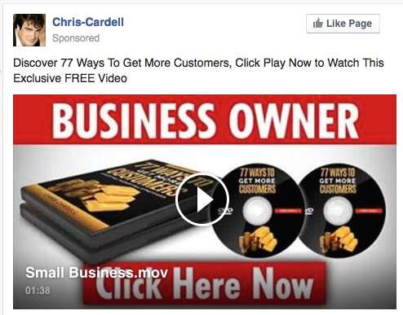
How to Create a Video Ad
Text
Add your text to appear above the thumbnail

Slide 43
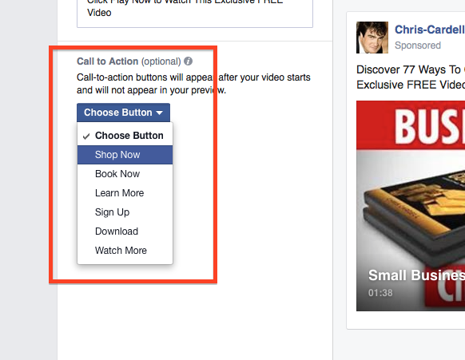
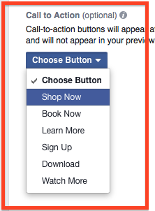
How to Create a Video Ad
Call to Action
Add a Call to Action button. Choose from:
Shop Now
Book Now
Learn More
Sign up
Download
Watch More

Slide 44
How to Create a Video Ad
Call to Action
Buttons appear top right of the video
A Call to Action link appears on the screen at the end of your video

Slide 45
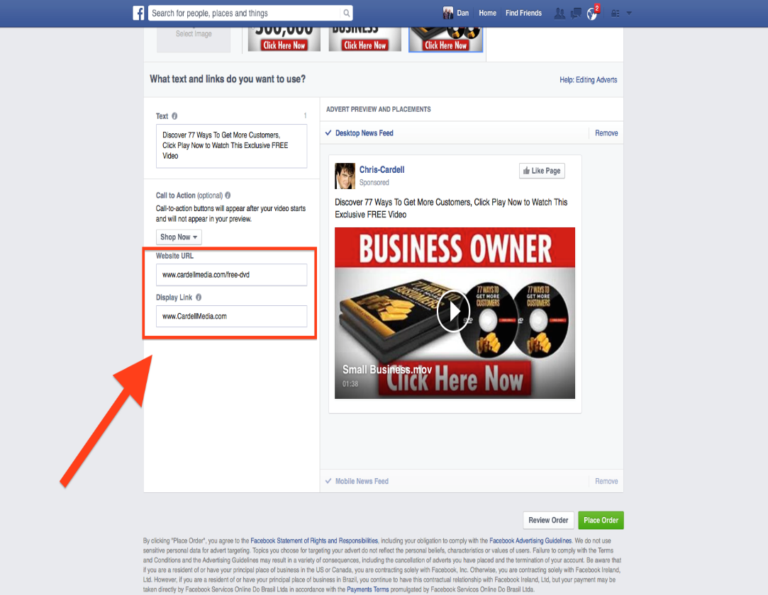
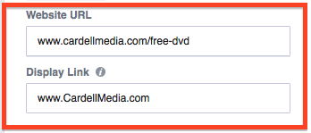
How to Create a Video Ad
Call to Action
Enter a website URL
Enter a display URL

Slide 46
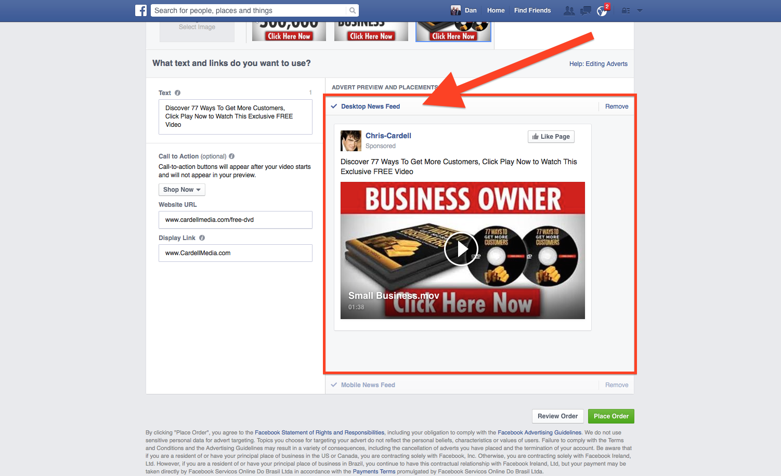
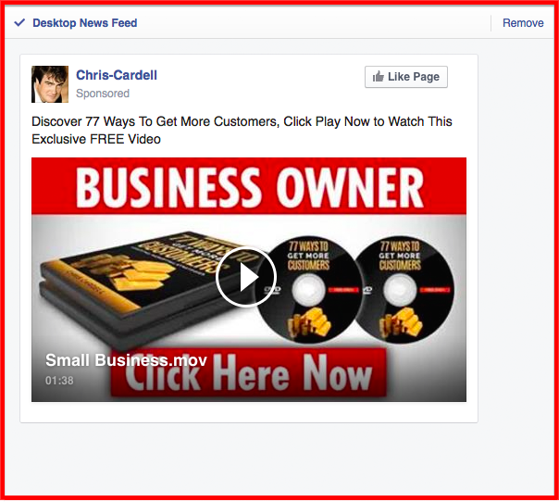
How to Create a Video Ad
Preview and Placement
Select / Remove Desktop News Feed

Slide 47


How to Create a Video Ad
Preview and Placement
Select / Remove Mobile News Feed

Slide 48
Mobile: The 3 Key Points
Massive Inventory
CHEAP
Mobile Video

Slide 49

Mobile Video Ads
Video ad takes up the full mobile screen
Depending on user settings, the video may or may not auto play
Tapping the video opens it in a ‘play screen’

Slide 50
Mobile Video Ads
The Call to Action button appears top left
Tapping the button will take you to your destination URL

Slide 51

Mobile
Video Ads

Slide 52
Pro Tips
Use the Power Editor to…
Upload MP4 files and Facebook with encode them to MOV for you
Target Mobiles and Tablets independently
Target iOS and Android operating systems independently
Automatically create audiences from people who view your video

Slide 53


Slide 54

1) Page headlines and ad copy

Slide 55
1) Page headlines and ad copy
Your landing page headline and ad wording need to complement one another. Remember, when a person clicks your ad, they are immediately taken away from the comfort and familiarity of Facebook. Having consistent content between your ad message and landing page is critical if you want to avoid a high bounce rate. This also applies to your Google Adwords, but we’ve found it even more essential with Facebook traffic.

Slide 56

2) No navigation

Slide 57

3) Use familiar colours

Slide 58
3) Use familiar colours
Remember, the more congruent you can make the transition from Facebook to your landing page, the better. For this reason, use a pale blue background and white page. Your web designer can easily match the blue used by Facebook. We’ve tested this, and mirroring the colour scheme of the newsfeed is a great way to reduce your bounce rate.

Slide 59

4) Include an Anti-Spam guarantee and a trust icon

Slide 60

5) Have a strong call to action

Slide 61

6) Use buttons

Slide 62
6) Use buttons
Again, mirror the wording you’ve used in your ads. Identify the keywords used on your ads such as Download, Learn More, Get Now, etc., and use them on your button. Don’t use ‘Submit’ on your button. Use a benefit, and your conversions will increase.

Slide 63
6) Use buttons
Your button should stand out and be placed directly below your call to action. Or have your call to action as the button. Whichever you choose, your button should be big, bright, and above the fold.
Try Blue, Orange and Yellow buttons, as these catch the eye.

Slide 64

7) Keep it all above the fold

Slide 65

8) Use images and/or video that relates to your ad and landing page copy

Slide 66
8) Use images and/or video that relates to your ad and landing page copy
Our best-performing Facebook landing page to date uses a 3D image of the report and DVD on offer. 3D product shots are a great way of making your offer appear more tangible - even if what you’re offering is a pdf or consultation, a 3D image can increase response. You can get a graphic put together on www.fiverr.com for just $5. Better still, ask them to provide you with a Facebook graphic to go on your ad along with the 3D shot for your page.

Slide 67

9) Keep your form simple

Slide 68
10) Always test
As with all landing pages - testing is critical. The most impactful landing page elements to test are:
Headline
Your call to action
Your image/video
Your button
Your page copy
Your form layout

Slide 69
10) Always test
Optimise your landing page for conversions over time. Run your ads and monitor response, pause your ads once you have some results, and change an element of your page before activating your ads again. Constant testing like this is the key to building high-converting landing pages for your Facebook traffic.

Slide 70
The 5 Steps to Successful Facebook Advertising
Create your Newsfeed ads
Start with Remarketing to your existing Customers
Target new customers through Facebook targeting
Move to lookalike audiences as soon as possible
Use Cost-Per-Conversion bidding

Slide 71
30 Days To Facebook Profits
‘Mission Control’
www.CardellMedia.com/members-hub

