Slide 1


Slide 2
Seminar 2:
Targeting, How to Create Lookalike Audiences, When and How to Use Right-Hand Side Ads, Step-by-Step Guide to Profitable Ads, and
Advanced Bidding Strategies

Slide 3
The 5 Steps to Successful
Facebook Advertising
Create your Newsfeed ads
Start with Remarketing to your existing Customers
Target new customers through Facebook targeting
Move to lookalike audiences as soon as possible
Use Cost-Per-Conversion bidding

Slide 4
The 5 Steps to Successful Facebook Advertising
3) Target New
Customers Through Facebook Targeting

Slide 5
Targeting
While most advertising online provides about 38% targeting accuracy, Facebook on average delivers 89% targeting accuracy.
That’s because it holds an enormous amount of information about its users – information that those users have willingly shared with Facebook.

Slide 6
Targeting
That information is both demographic
and psychographic
Demographic information may include age, gender, location, ethnic background, marital status, income, and more.
Psychographic information goes beyond the “external” and identifies more about a customer’s psychology, interests, hobbies, values, attitudes behaviours, lifestyle, and more.

Slide 7
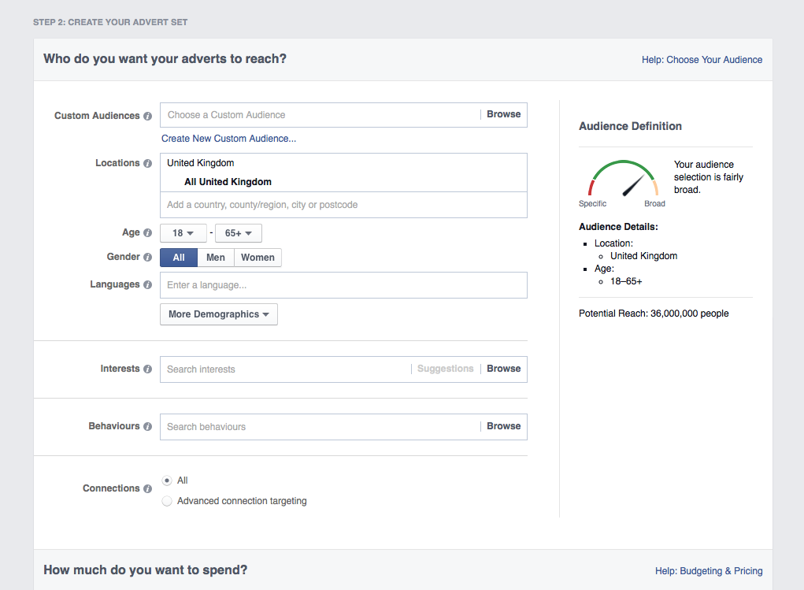
Targeting
You set your target objectives in the Ad Create tool (you should be familiar with this now)

Slide 8
Facebook Allows You to Target By:
Location
Age
Gender
Interests
Behaviours
Relationship Status
Job
Education
Connections

Slide 9
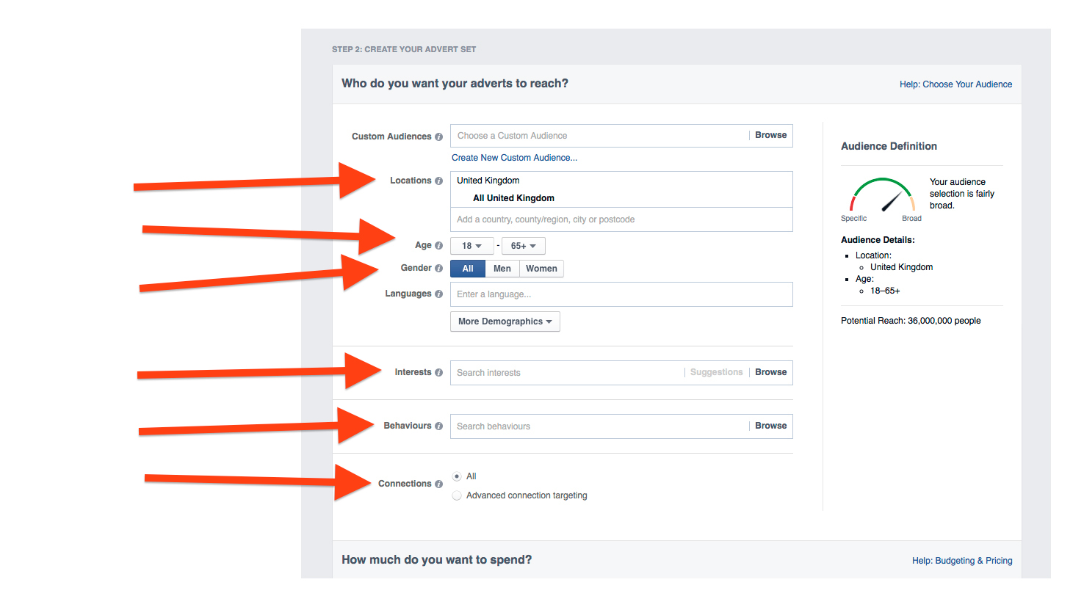

Slide 10
What’s More, Facebook Allows
You to Combine Targets
For example, if your target market is single women in the UK aged 28 and over who like cats, you’ll find them on Facebook!

Slide 11
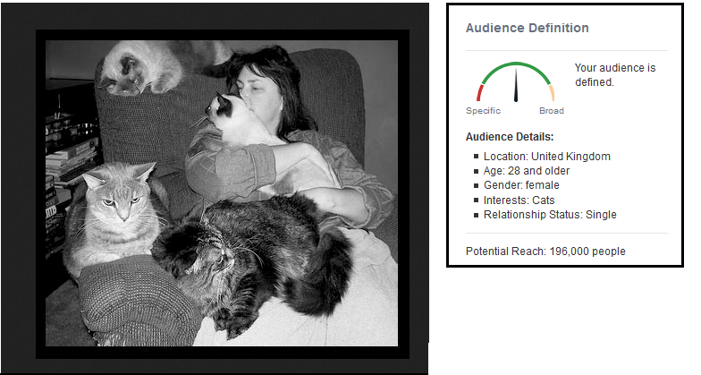

Slide 12
Facebook Allows You to Target By:
Location
You can target customers in specific countries, counties or cities.
Age and Gender
Select the age range and gender of the audience you want to target.

Slide 13
Facebook Allows You to Target By:
Connections
Decide which connections to share your ads with.
For example:
Show your ad only to people who have a connection with you, such as people who've liked your Facebook Page, event or app.
You can use connections targeting for any Page, group, event, or app that you're the administer of, even if it's not what you're advertising.

Slide 14
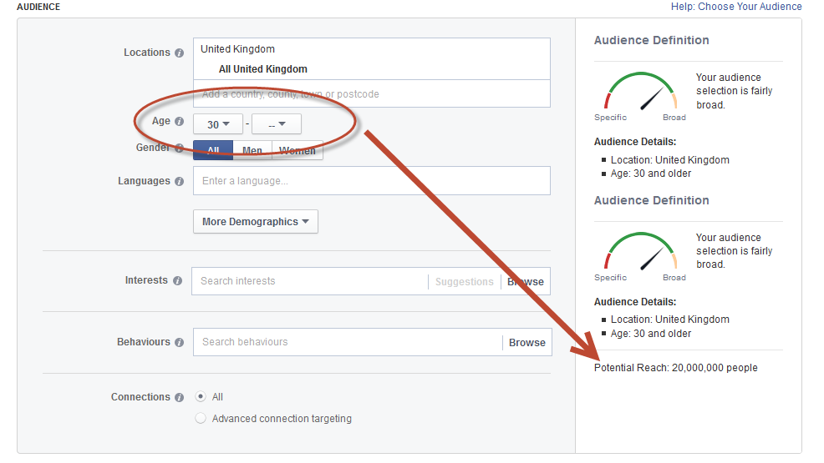
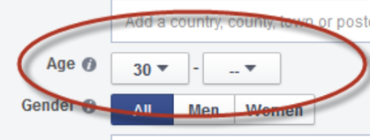

Facebook Shows You the Potential Reach of Each Category You Choose

Slide 15
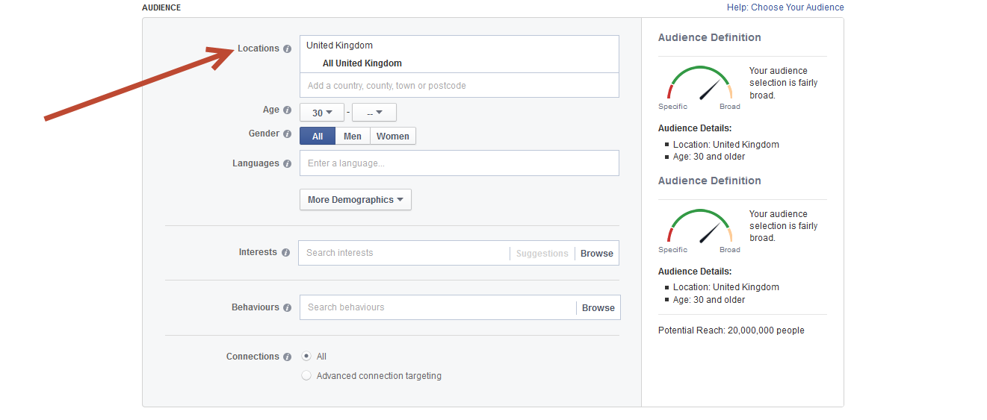
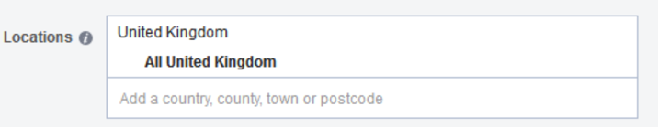
How to Target Based on Geographic Location

Slide 16
Location Targeting
Location targeting allows you target customers in specific countries, counties and towns. For local businesses, this is great, as it means your ads will only be served to people who are in your area.
Just enter the name of one or more countries, counties, or cities that you want to target.

Slide 17
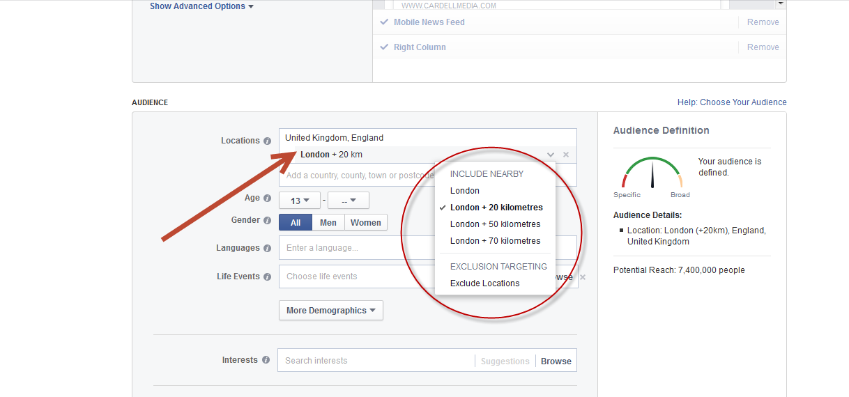
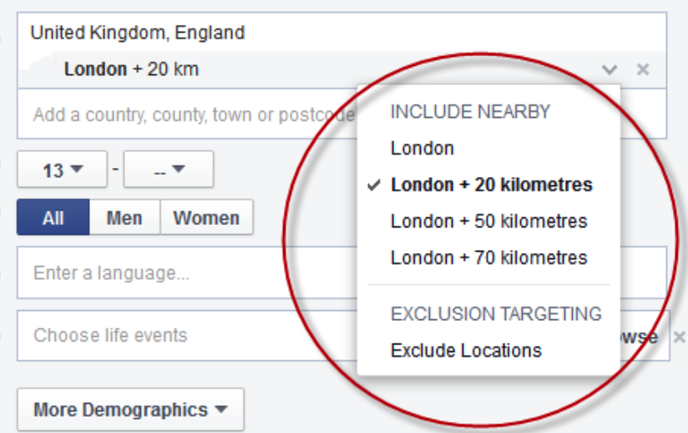
You Can Include People Within a Radius of Your Location

Slide 18
Location Targeting
You can choose to expand the radius of your chosen location.
If you target your ad to a country that offers targeting by city, you'll see the option to include other cities within a selected mile radius. You can use this to target your ad to people in cities and surrounding areas without choosing them individually.

Slide 19
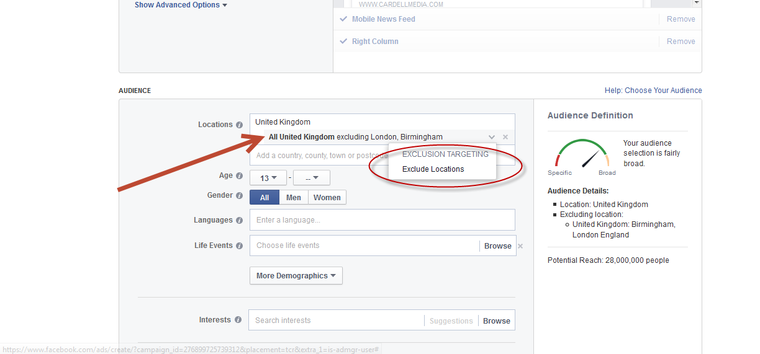
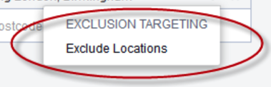
You Can Exclude Cities or Countries

Slide 20
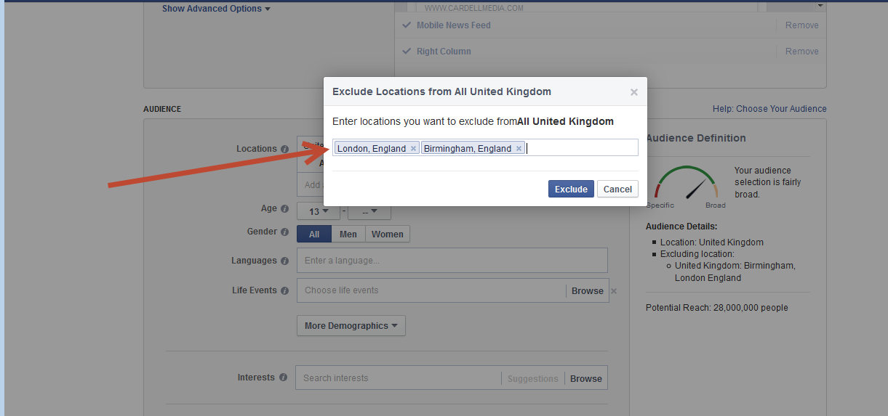
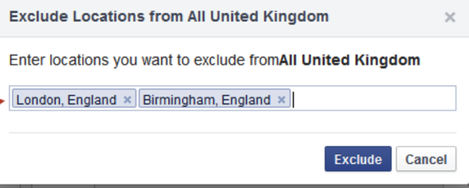
You Can Exclude Cities or Countries
Simply click the Exclude Locations button, and then add the name of the city you want to exclude.

Slide 21
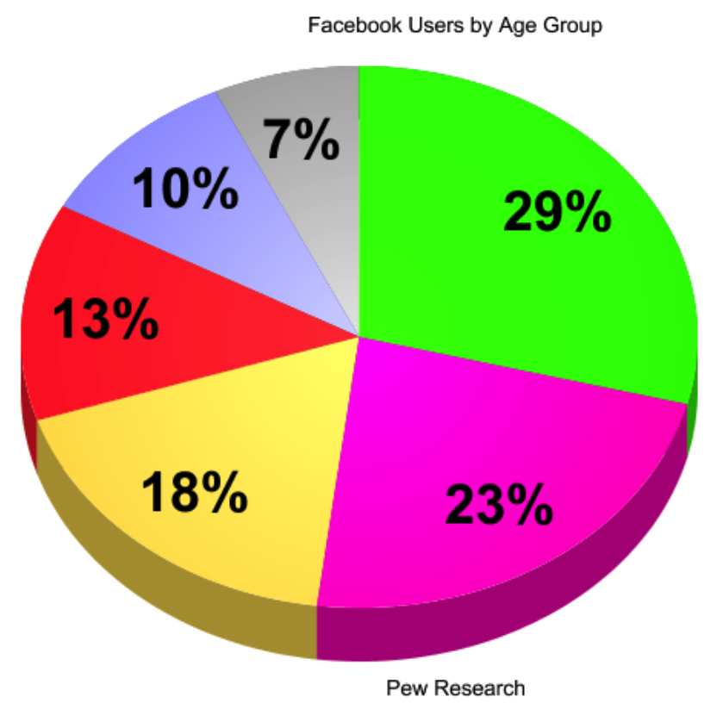
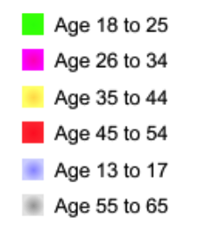
How to Target Based on Age

Slide 22
Age-Based Targeting
Facebook allows you to specify the age of the people you want to target.
Age is a quick way to create more relevance between your ad and your target audience.
The range is from 13 to 65+ years old.

Slide 23
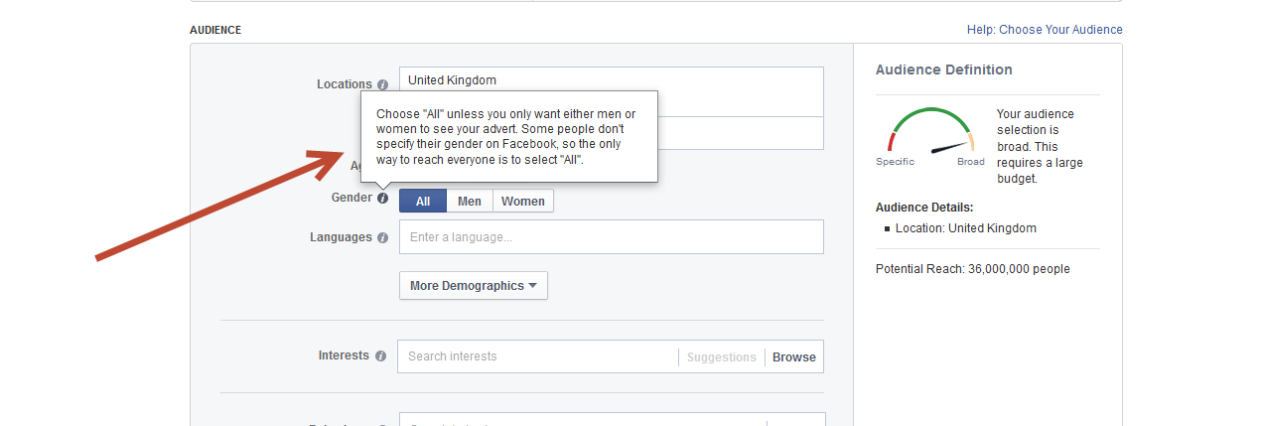
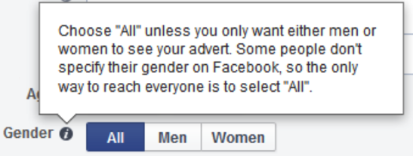
Use Gender Targeting if Your Product or Service is Aimed at Men or Women

Slide 24
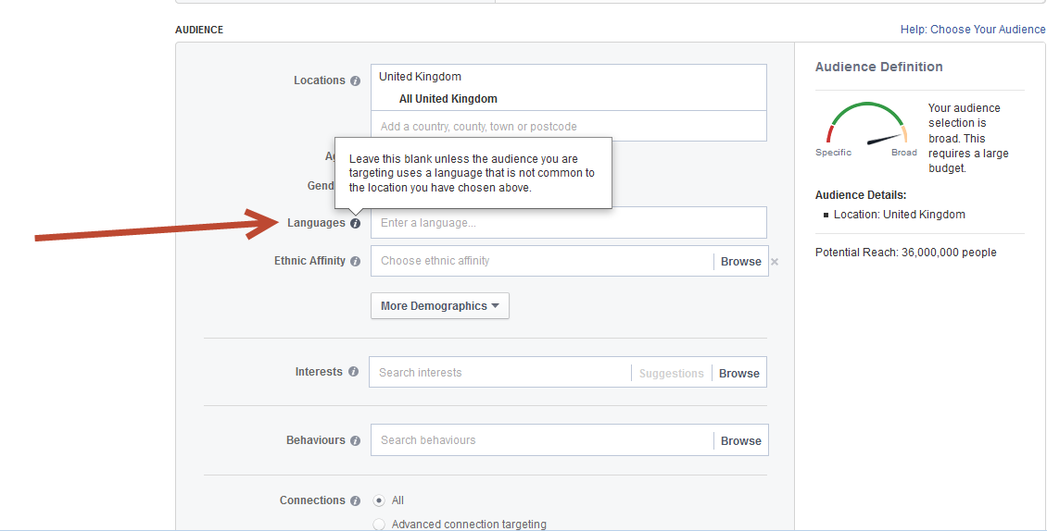
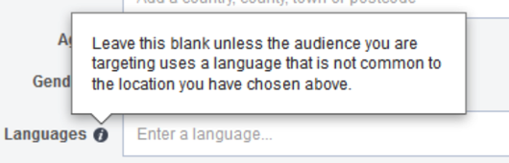
You Can Target People Based on the Language They Speak

Slide 25
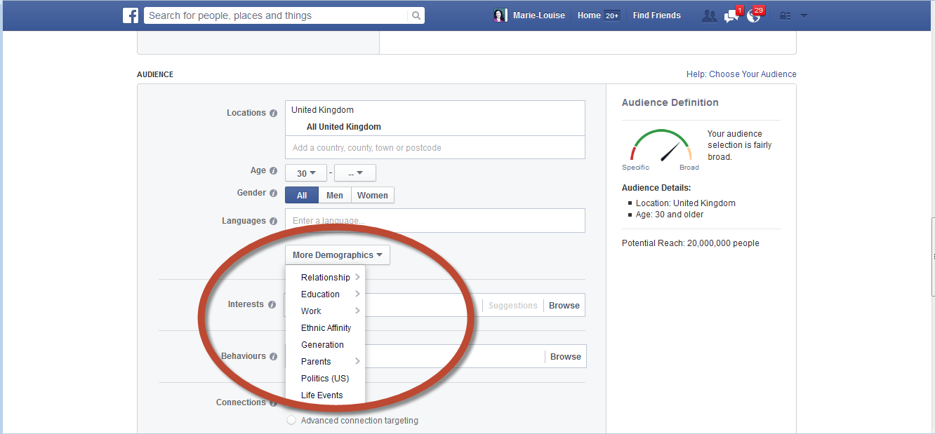
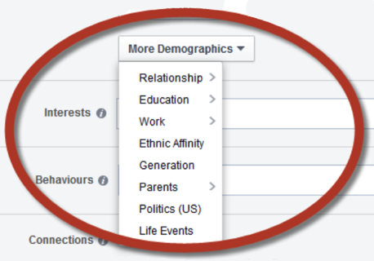
Narrow Your Choices Further With More Demographics

Slide 26
More Demographics
You can drill down and further target your audience with the More Demographics drop-down menu. Here, you can choose:
Relationship
Education
Work
Ethnic Affinity
Generation
Parents
Politics (only applies
to US users)
Life Events

Slide 27
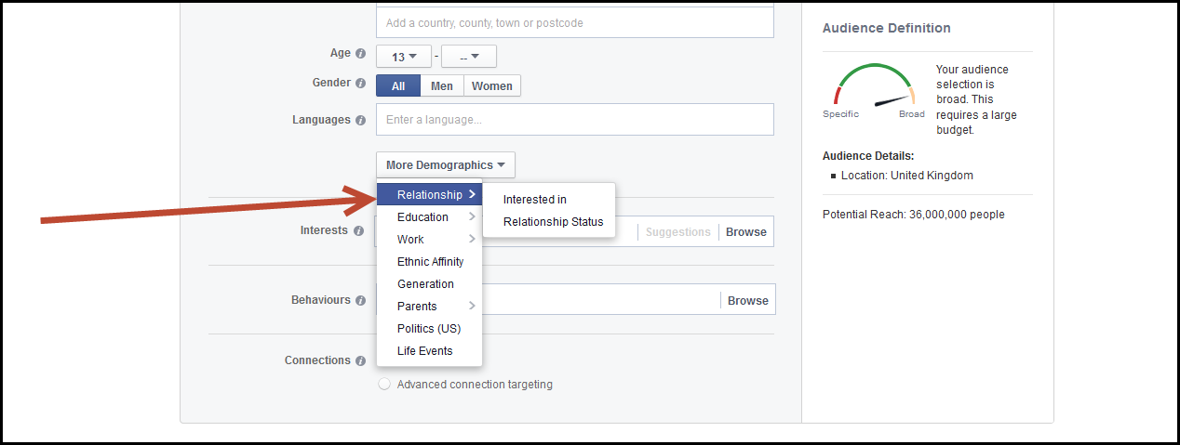
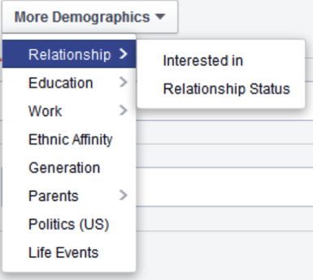
You Can Target People Based on Their Relationship Interests

Slide 28
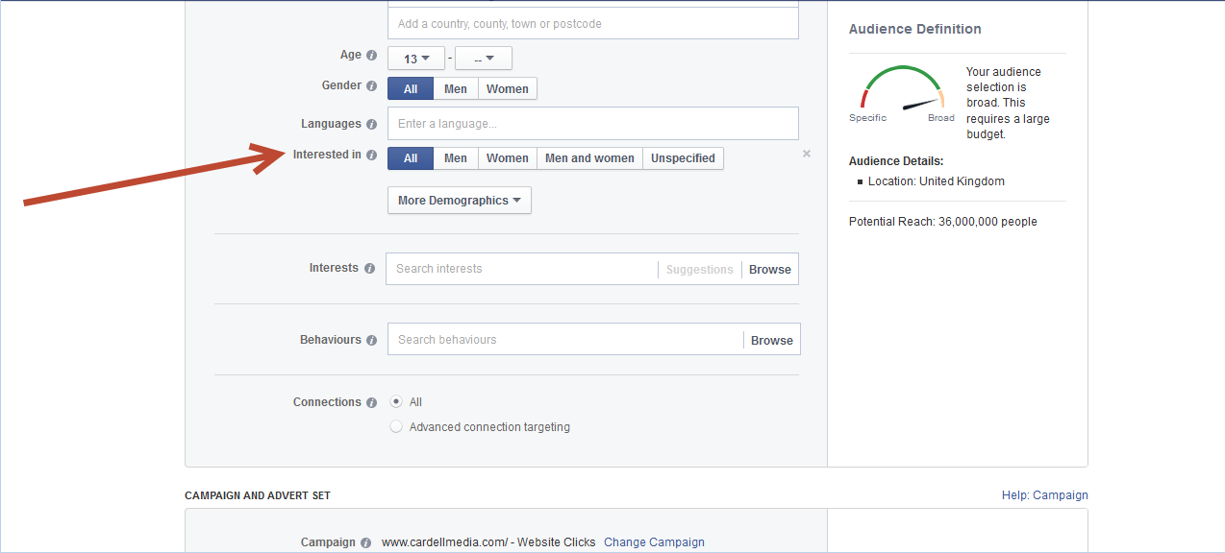
Choose From: All, Men, Women, Men & Women or Unspecified

Slide 29
Or Target People Based On Their Relationship Status:
You can choose between:
Single
In a relationship
Married
Engaged
Unspecified
Civil partnership
Domestic partnership
Open relationship
Complicated
Separated
Divorced
Widowed

Slide 30
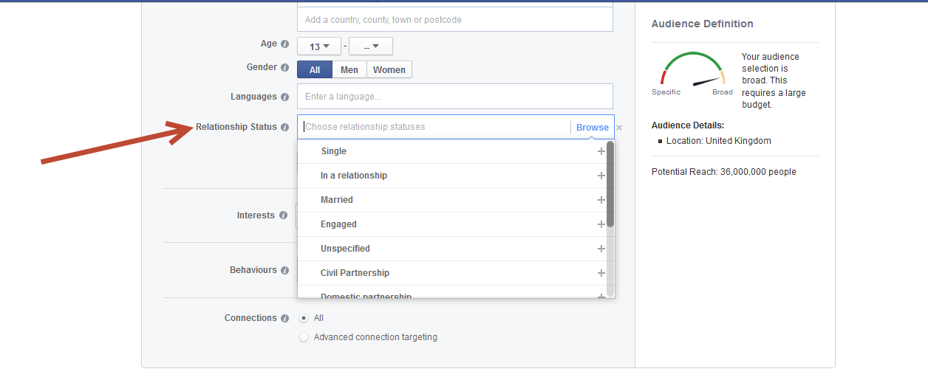
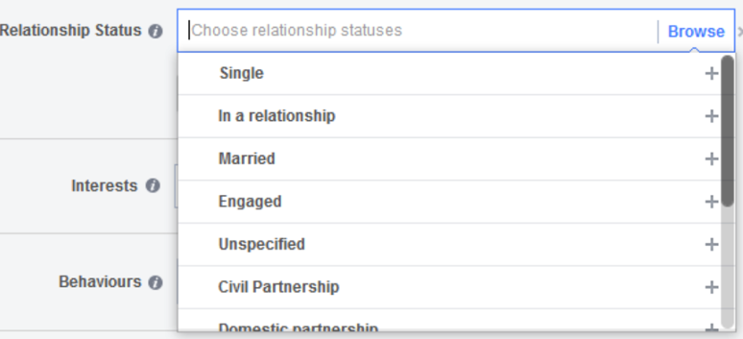
Relationship Status Options

Slide 31
Relationship Status Options
This allows you to target your ads to people based on the Relationship Status listed in their Facebook profile.
Leave this field blank unless you specifically want your ads to be served to people in a specific relationship status.

Slide 32
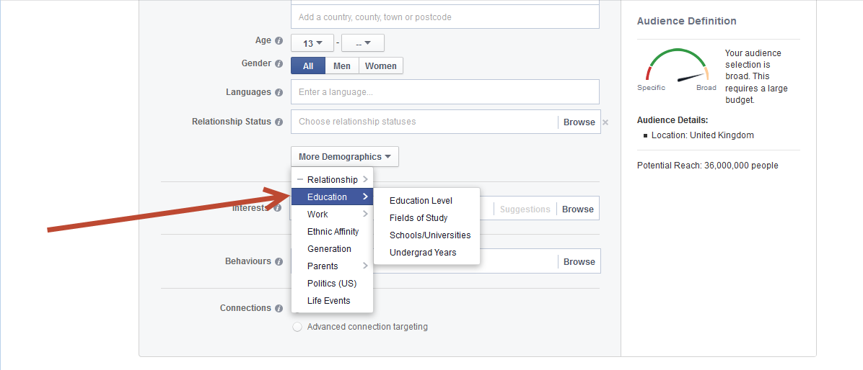
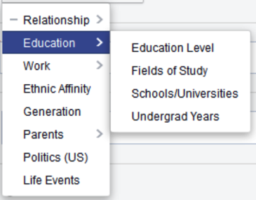
You Can Target People Based on Their Level of Education, School or University, or Field of Study

Slide 33
Education Options
You can choose from the following
Education options:
Education Level
Fields of study
Schools/Universities
Undergrad Years

Slide 34
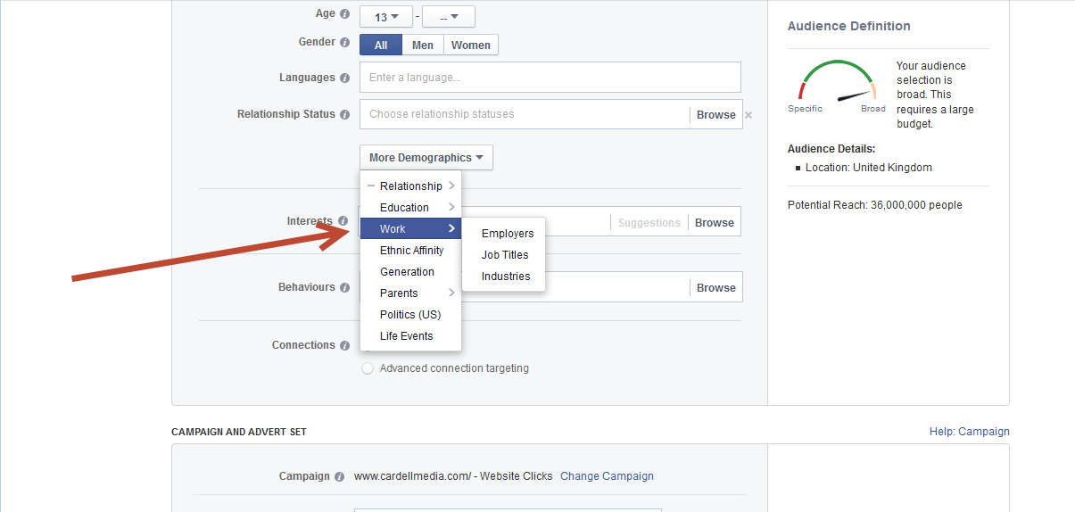
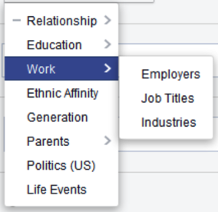
You Can Target People Based on Their Work and Employment

Slide 35
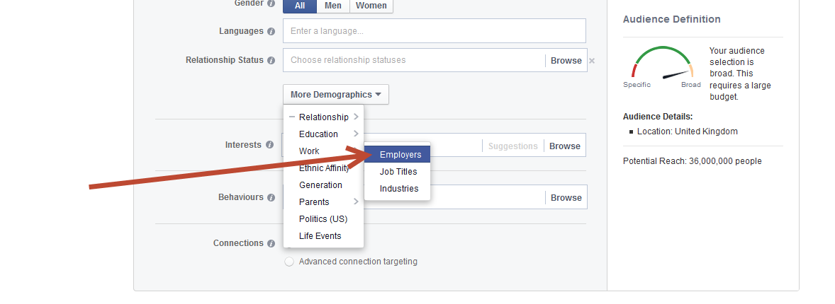
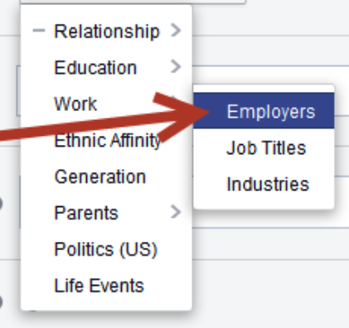
Employees
Use this to target people based on where they work.

Slide 36
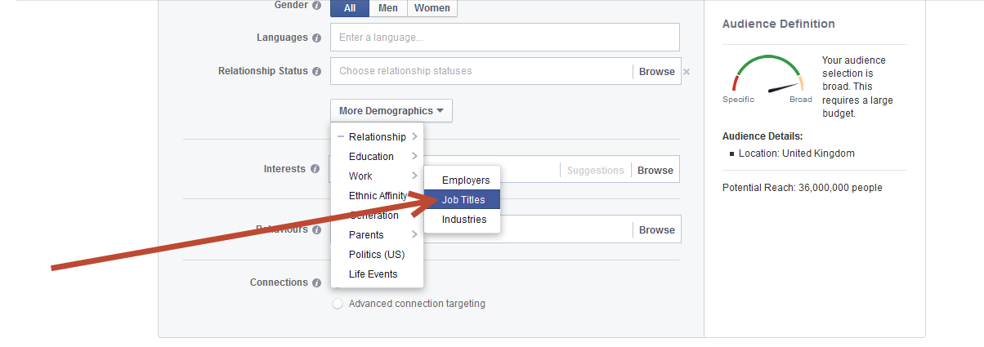
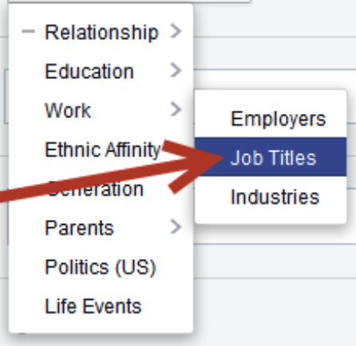
Job Titles
Use this to target people based on the job titles they list on their Facebook profile.

Slide 37
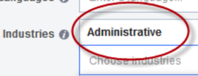
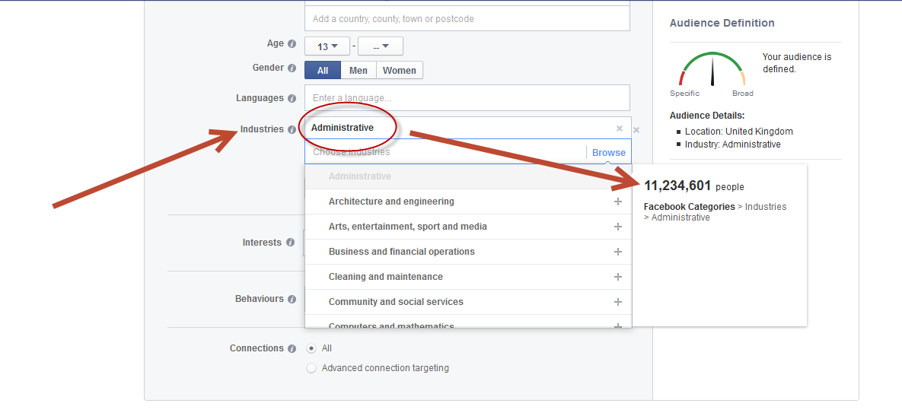

Industries
You can target people based on the industry they have listed in their profile. Again, keep an eye on the Audience Definition score to see how many people fit that category on Facebook.
For example, 11.23 million people on Facebook work in Admin.

Slide 38
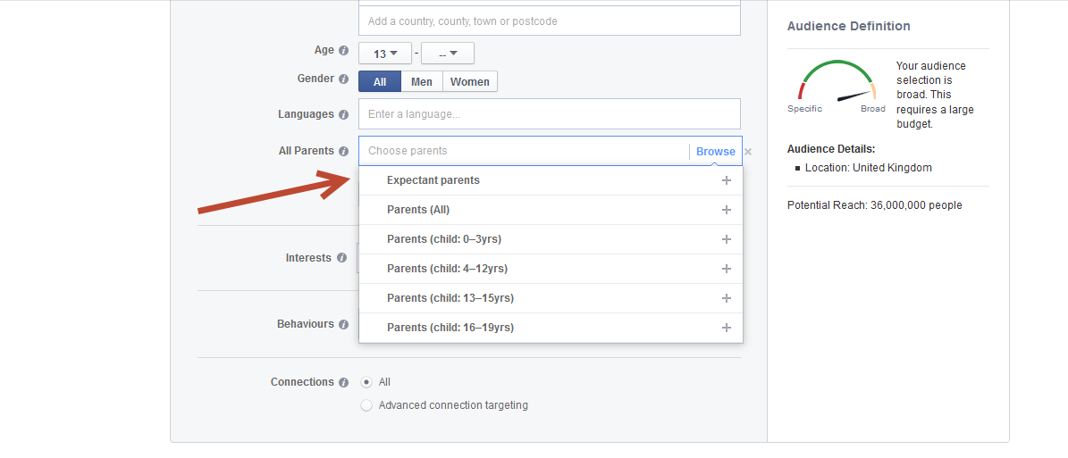
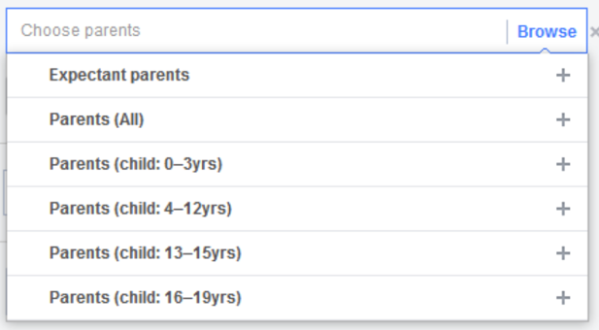
You Can Target Parents
Once again, remember that not everyone specifies this information on their profile page – so the only way to guarantee you reach all parents is by selecting
Parents (All)

Slide 39
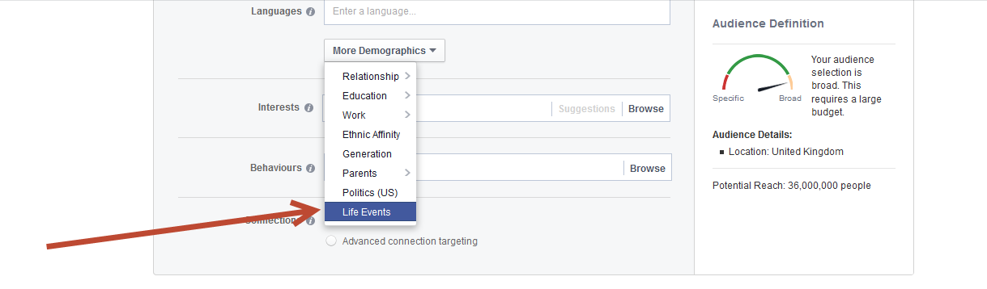
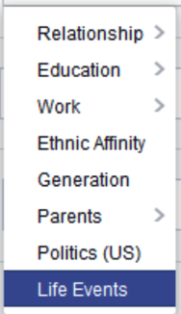
You Can Target People Based on Life Events They’ve Experienced
Leave this field blank unless you want your ad to be seen by someone who’s had a significant life event.

Slide 40
Life Events Options
The categories are:
Anniversary Within
30 Days
Away From Family
Away From Hometown
Long Distance Relationship
New Job
New Relationship
Newly Engaged
(1 Year)
Newly Engaged
(3 Months)
Newly Engaged
(6 Months)

Slide 41
Life Events Options
The categories are:
Newlywed (1 Year)
Newlywed (3 Months)
Newlywed (6 Months)
Recently Moved
Upcoming Birthday
Friends Of :
  Anniversary within
  30 days
  Newly Engaged
  Newly Wed
  Recently Moved

Slide 42
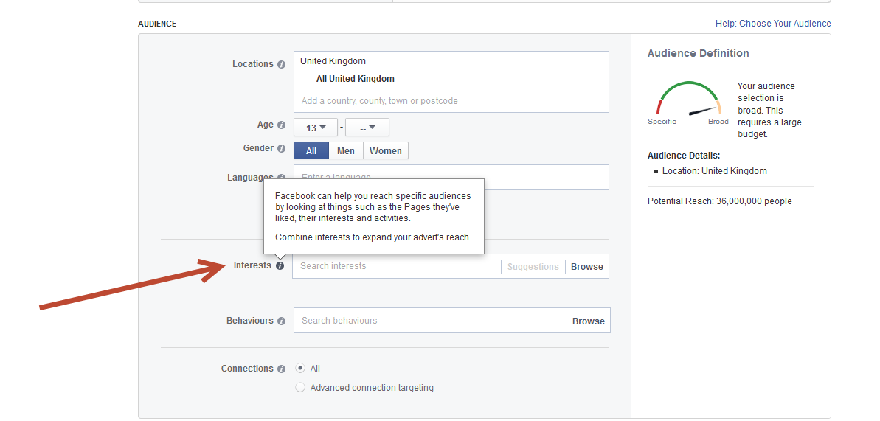
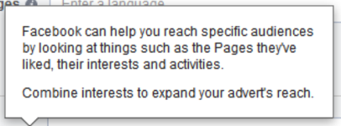
You Can Target People Based on Their Interests

Slide 43
Interests Options
Interests are pulled from the content users included on their Timeline, liked pages, apps downloaded, and other information included in the Interests, Activities, Favourite Music, Movies and TV Shows sections of their profile.

Slide 44
Interests Options
You can reach specific Interests such as:
Business and Industry
Entertainment
Family and Relationships
Fitness and Wellness
Food and Drink
Hobbies and Activities
Shopping and Fashion
Sports and Outdoors
Technology

Slide 45
Interests Options
To expand your ad’s reach, combine interests.
Choosing topics that are narrow in scope will reach a smaller, more targeted audience.

Slide 46
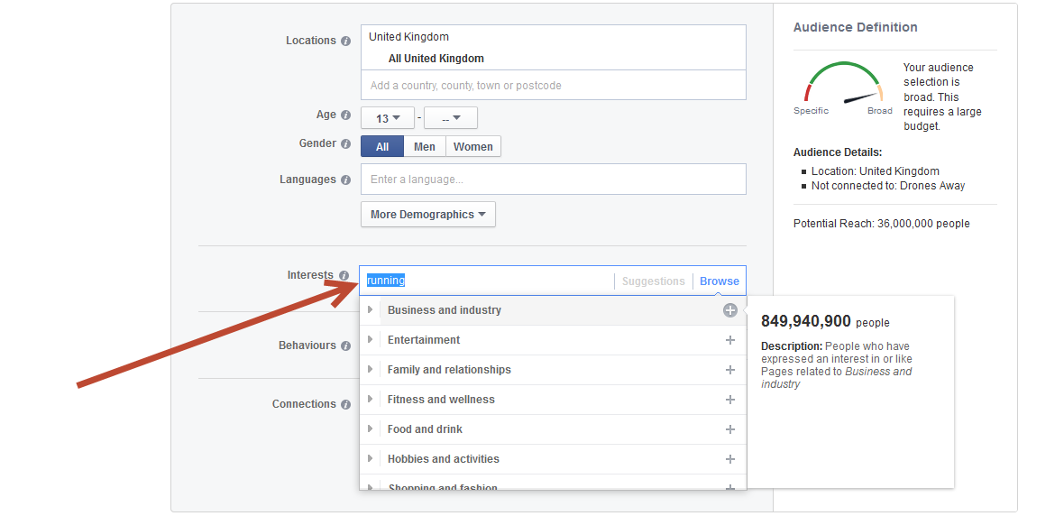
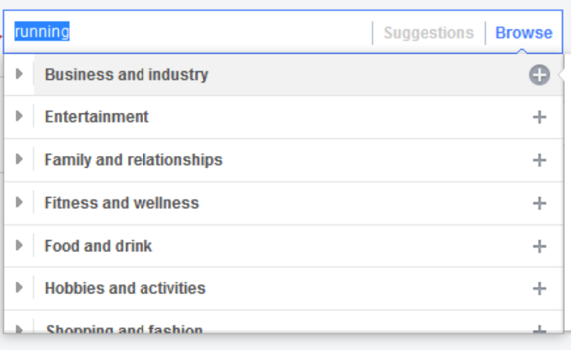
Facebook Suggestions
Facebook will also suggest interests or topics similar to those you’ve searched for or selected to help you further narrow your audience.

Slide 47
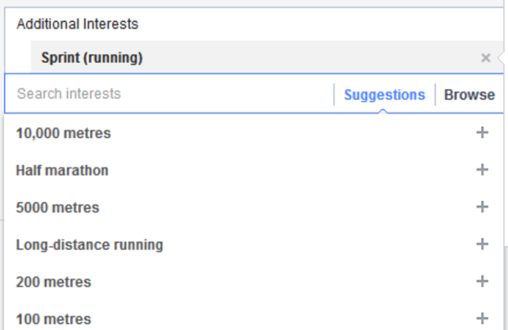
Facebook Suggestions
For example, under the interest ‘Sprint Running’ Facebook offers a list of suggestions to further narrow your audience.
E.g., 10,000 metres, 5000 metres, etc.

Slide 48
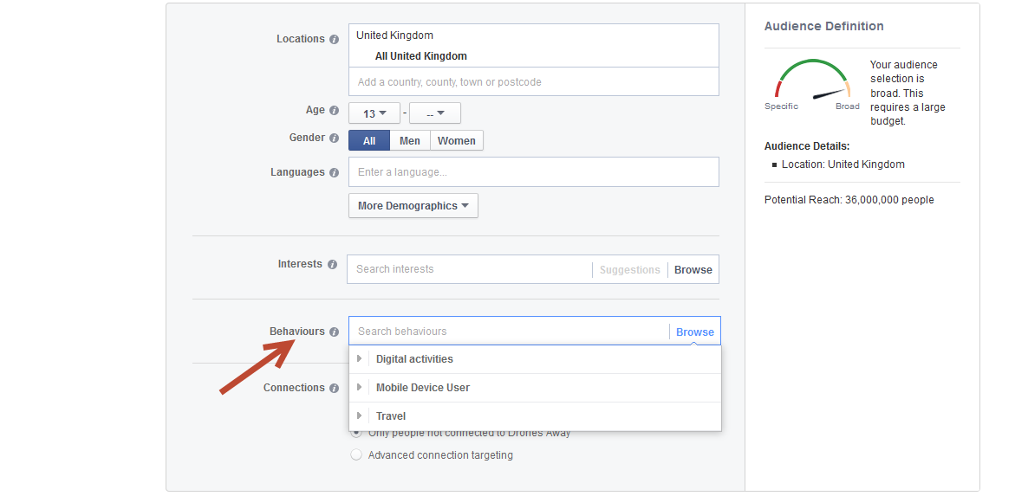
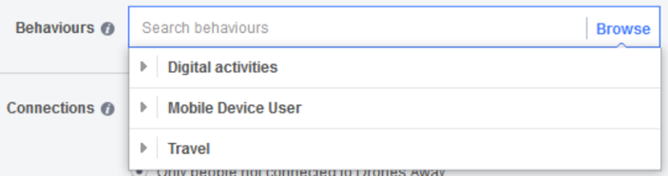

You Can Target People Based on Their Behaviours

Slide 49
Behaviours Options
Behaviours is something we’re going to see a lot more of over the next 12 months.
Currently in the UK, there the following options:
Digital Activities
Mobile device use (Android/iOS)
Seasonal Events
Travel

Slide 50
Behaviours Options
Travel Behaviour includes:
All travel
Business travel
Commuters
Currently travelling
Planning to travel
Returned from a trip – one week ago or two weeks ago
Used a travel app two weeks ago

Slide 51
Behaviours Options
Mobile Device Usage includes:
All mobile devices by brand
Mobile devices by operating system
Feature phones
New smartphone and tablet users
Smartphone and tablet users

Slide 52
Behaviours Options
Digital Activities include:
Console gamers
Early technology adopters
Event creators
Late technology adopters
Facebook Page Admins
Photo uploaders

Slide 53
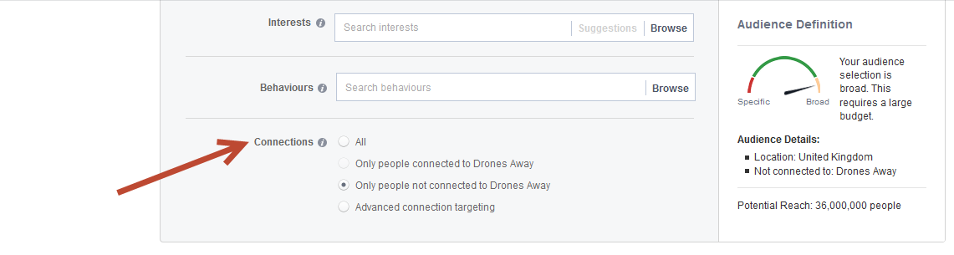
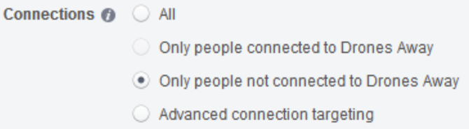
You Can Target People Based on Their Connection to Your Page, App, or Event

Slide 54
Connection Options
This allows you to reach people who have a specific kind of connection with your Page, app or event.
Essentially, connections allow you narrow your audience to only include those with a specific connection to the targeting categories you’ve selected.

Slide 55
Connection Options
The connections option allows Facebook ads to be targeted according to the relationship a user has with a Facebook page, app or event.
This is useful if you want to target or exclude fans from your audience.

Slide 56
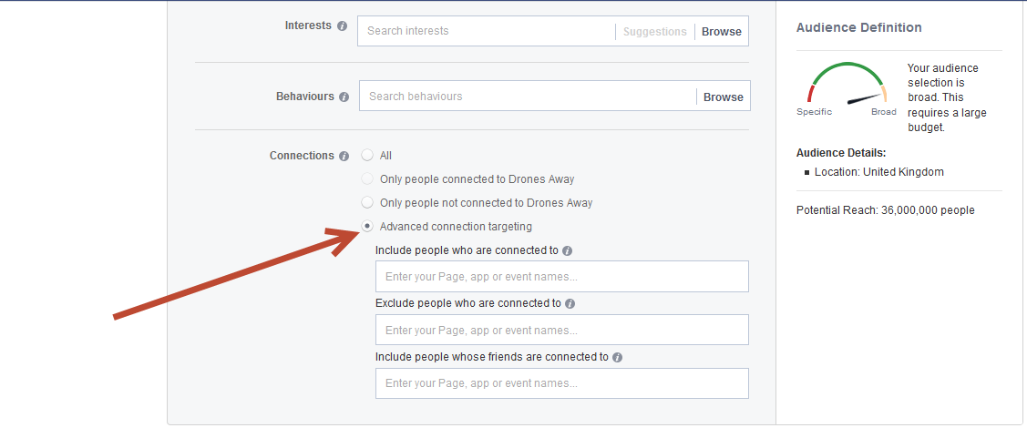

You Can Also Use Advanced Connection Targeting

Slide 57
Advanced Connection Targeting
Advanced Connection Targeting gives you a further option to include or exclude people who’ve connected with your Page, event or app.
It also gives you the opportunity to include people whose friends are connected to your Page, event or app.

Slide 58
Use Friends of Connections
Ads with this option enabled show Facebook users which of their friends already like a page, app, or event on Facebook.
For example, let’s say Robert likes your Page. When you want to promote your Facebook Page, you can choose to target friends of
Robert by selecting the “Friends of people connected to” filter.
Robert’s friends will be served your Ad with the following sentence included: “Robert likes this Page.”
Robert’s friends will naturally be more interested because Robert’s interaction with your company is showcased directly in the ad.

Slide 59
Use Friends of Connections
To take advantage of, look for the “Include Friends of People Connected to" check box under the "Advanced Connection" section of the ad create tool.

Slide 60
The 5 Steps to Successful Facebook Advertising
4) Move to Lookalike Audiences as Soon
as Possible

Slide 61
Lookalike Audiences
Works in a similar way to Custom Audiences – Upload your Emails or put a pixel on your website
Facebook then looks for people who are similar to your customers or website visitors – and serves ads to them
Lookalike Audiences are currently the best way to advertise on Facebook
See Bonus Video for step-by-step guide on setting up Custom Audiences

Slide 62
Lookalike Audiences are
audiences Facebook builds
for you using their vast user data.

Slide 63

Custom Audiences
Log in to your Ad Manager and click Audiences in the left-hand menu

Slide 64

Custom Audiences
This opens the Audiences main screen

Slide 65


Lookalike Audiences
Select the Lookalike Audience option from the Audience drop-down menu

Slide 66


Lookalike Audiences
Lookalike Audiences give you the ability to reach new people who are similar to an audience you care about.

Slide 67

Lookalike Audiences
Unlike Custom Audiences which you build using your data, Lookalike Audiences are built by Facebook using their data (the personal profiles of 1.23 billion monthly users).

Slide 68


Lookalike Audiences
Click Source, then select the Custom Audience you would like Facebook to use to create your new Lookalike audience

Slide 69


Lookalike Audiences
Once you’ve selected your Source audience, enter the country you want to target.

Slide 70


Lookalike Audiences
Finally, use the slider to determine whether you want to optimize for Similarity or Reach.

Slide 71


Lookalike Audiences
Keep the slider all the way to the left to create a highly Similar Lookalike Audience of 410,000 people.

Slide 72


Lookalike Audiences
Move the slider all the way to the right to optimize for the greatest Reach, creating an audience of 4,100,000 people.

Slide 73
How to Create
Profitable Ads

Slide 74
How to Create Profitable Ads
It’s All About Click-Through Rate—Picture + Copy
Engage with an image, convert with a value proposition
Facebook research shows that images massively increase people’s engagement with your content:
Photo albums increase engagement by 180 percent
Pictures increase engagement by 120 percent
Videos increase engagement by 100 percent

Slide 75
How to Create Profitable Ads
Keep your ads fresh to avoid ad fatigue
Ads display on Facebook multiple times to the same user
The average number of times each individual user has seen your ad is reported as ‘frequency’
If you run your ad long enough, your actual reach will approach your estimated reach

Slide 76

Pictures Grab People’s Attention
Our brains are hardwired to respond to pictures, which is why ads with images do so much better than those that are just text-based
Facebook is all about people, so look for images that include people
Choose images where people are looking directly at the viewer. That’s because people looking at you catch your attention

Slide 77

Interrupt Your Audience
Your image needs to be attention grabbing
Your image doesn’t need to be associated with your product or service. The goal of your image is to attract the eye—leave the message to your title and ad copy.

Slide 78

Interrupt Your Audience
Dogs are one of the most effective images you can use to grab attention for your ad
Images of babies, women, and chocolate have all been proven to grab attention

Slide 79

Quirky, Funny Images Work Well
Comedy helps a brand connect to their audience
Brands that make people smile after a long day at the office, or laugh, often have high levels of engagement

Slide 80
Use Colour Effectively
Colours are associated with different emotions or states and trigger different responses in people
Test the colour of your logo, border, background, image, and graphics
If your product image, logo or mascot is blue, make a bright background or border
Ensure a background or border you choose contrasts with the image itself
Attract the eye with a bright colour and encourage a conversion with a great Call To Action in the title or copy

Slide 81
You Can Access Copyright-Free Images for Free
You have 3 ways to add pictures to your Ad:
Upload a picture from your computer
Browse your Facebook Library to reuse a picture
you’ve previously uploaded
Find Images in the Shutterstock database
Facebook and Shutterstock.com have partnered,
which means you can access millions of stock
pictures for free!

Slide 82

Ad Copy
Convey a clear message - fast

Slide 83

Ad Copy
Convey a clear message - fast

Slide 84

Ad Copy
Convey a clear message - fast

Slide 85
Use You and Your, Not
We and Our
Make users feel as if you’re speaking to them directly

Slide 86

Be Controversial or Edgy in Your Ad

Slide 87

Use Questions
Pose a question in your headline or in the body of your ad. Use a question mark where appropriate.
Love horses?
Run your own business?
Like Star Trek?
Do you know why Richard Branson is successful?

Slide 88
Ad Fatigue
Your audience will get bored with your ads
How do you avoid ad fatigue?
Create and test new ads – new copy, new images

Slide 89



Test Different Images

Slide 90
Rotate Ads
Rotate your ads
Bring back top performing ads
Before you stop running an ad, look in reports to check there’s not a category it’s still performing well in

Slide 91

Relevance Scores
Ads are scored on their positive and negative feedback
Positive indicators are views, conversions, etc.
The more people 'hide' or 'report' an ad - the lower the score

Slide 92
Relevance Scores
Ads receive a score between 1 and 10, with 10 being the highest
A good score will lower the cost of reaching people

Slide 93


How to Check Your Relevance Score
Click through to your ad in the ad manager
Select Relevance Score in the performance menu

Slide 94


Right-Hand Side Ads
In April 2014, Facebook changed the right-hand side ads to the new, larger format
Cheaper than News Feed ads, they are worth testing - but generally they don’t perform as well as News Feed campaigns
Create independent Right-Hand Ad campaigns and track results separately

Slide 95
Right-Hand Side Ads
They can be Conversion Optimised just like News Feed Ads
Due to their smaller size, you need larger text on your graphics

Slide 96
BUDGETS, BIDDING, & ‘CONVERSION OPTIMISED’ ADS
From our testing, the best results come from setting your ad to ‘Website Conversions’ and letting Facebook automatically optimise your bid to get the most amount of conversions for the best possible price…

Slide 97


Step One
Step 1) Let Facebook optimise your bid to get maximum conversions…

Slide 98
BUDGETS, BIDDING, & ‘CONVERSION OPTIMISED’ ADS
Once you have at least 50 conversions, switch over to manually telling Facebook how much you want to pay per conversion…

Slide 99


Step Two
Step 2) Once you have at least 50 conversions – switch to manually setting your bid per conversion

Slide 100
The 5 Steps to Successful Facebook Advertising
Create your Newsfeed ads
Start with Remarketing to your existing Customers
Target new customers through Facebook targeting
Move to lookalike audiences as soon as possible
Use Cost-Per-Conversion bidding

Slide 101
Coming Next…
Seminar 3:
Budgeting and Scheduling
Ad Manager Panel and Reporting
Video Ads
MOBILE
10 Principles for a Successful Facebook
Landing Page

