Slide 1
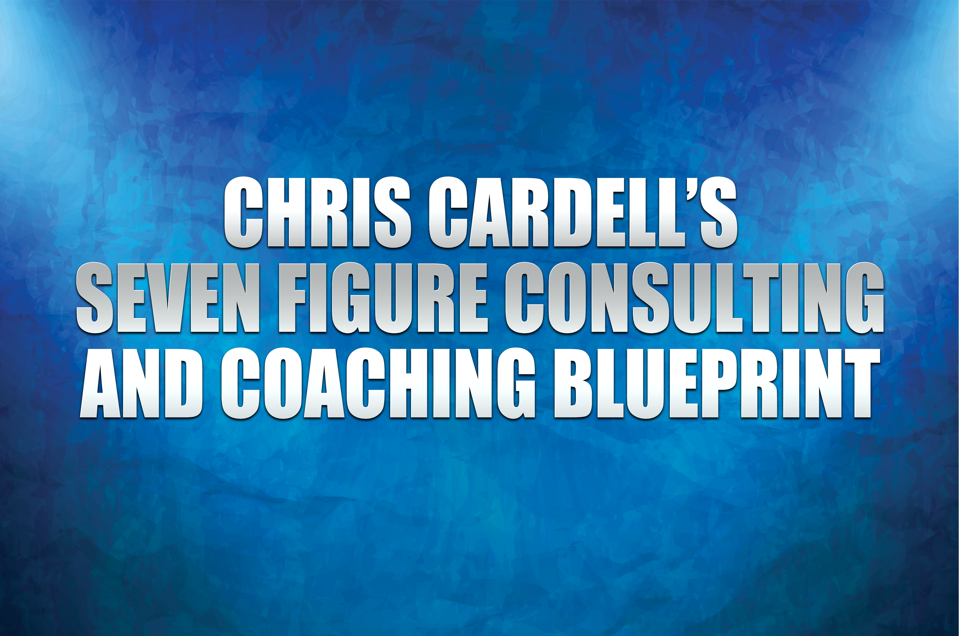

Slide 2
The 4 BIG Secrets of
Seven Figure Consulting
and Coaching

Slide 3
The 4 BIG Secrets of Seven Figure Consulting and Coaching
It has to be done through ATTRACTION marketing
Price Elasticity: Pricing can be made irrelevant
It can ONLY be achieved through STATUS and AUTHORITY
Seven Figures can only be achieved through Information Marketing

Slide 4
Pricing Structures

Slide 5
Hourly Rates
PROS:
Simple to sell
Lower entry price
Easy to scale
CONS:
Billing for hours
Pre-conditions
the client

Slide 6
Daily Rates
PROS:
Can establish
high fees
Immersion
– can sell more
CONS:
Billing for hours
If you’re good, what do you do
all day?

Slide 7
Breakthrough Session
PROS:
Not billing for hours
Price Elasticity
No price precedent set
Client gets a breakthrough
Great for selling

Slide 8
Project Rates
PROS:
Separates time from Activities
and Results
High fees
CONS:
Can be harder
to sell

Slide 9
Monthly Continuity
Direct access
Remote access
Implementation
Can include online material/training, including group

Slide 10
Monthly Continuity
PROS:
Guaranteed monthly income
Higher fees
Separates Time from Money
Client feels more involved
CONS:
Dependency
on good client(s)

Slide 11
Pricing Structures
Hour / Daily >>>> Project
Hour / Daily >>>> Continuity

Slide 12
Pricing Structures
NEVER charge for results, with the exception of:
Royalties
‘Icing on the cake’ agreements

Slide 13
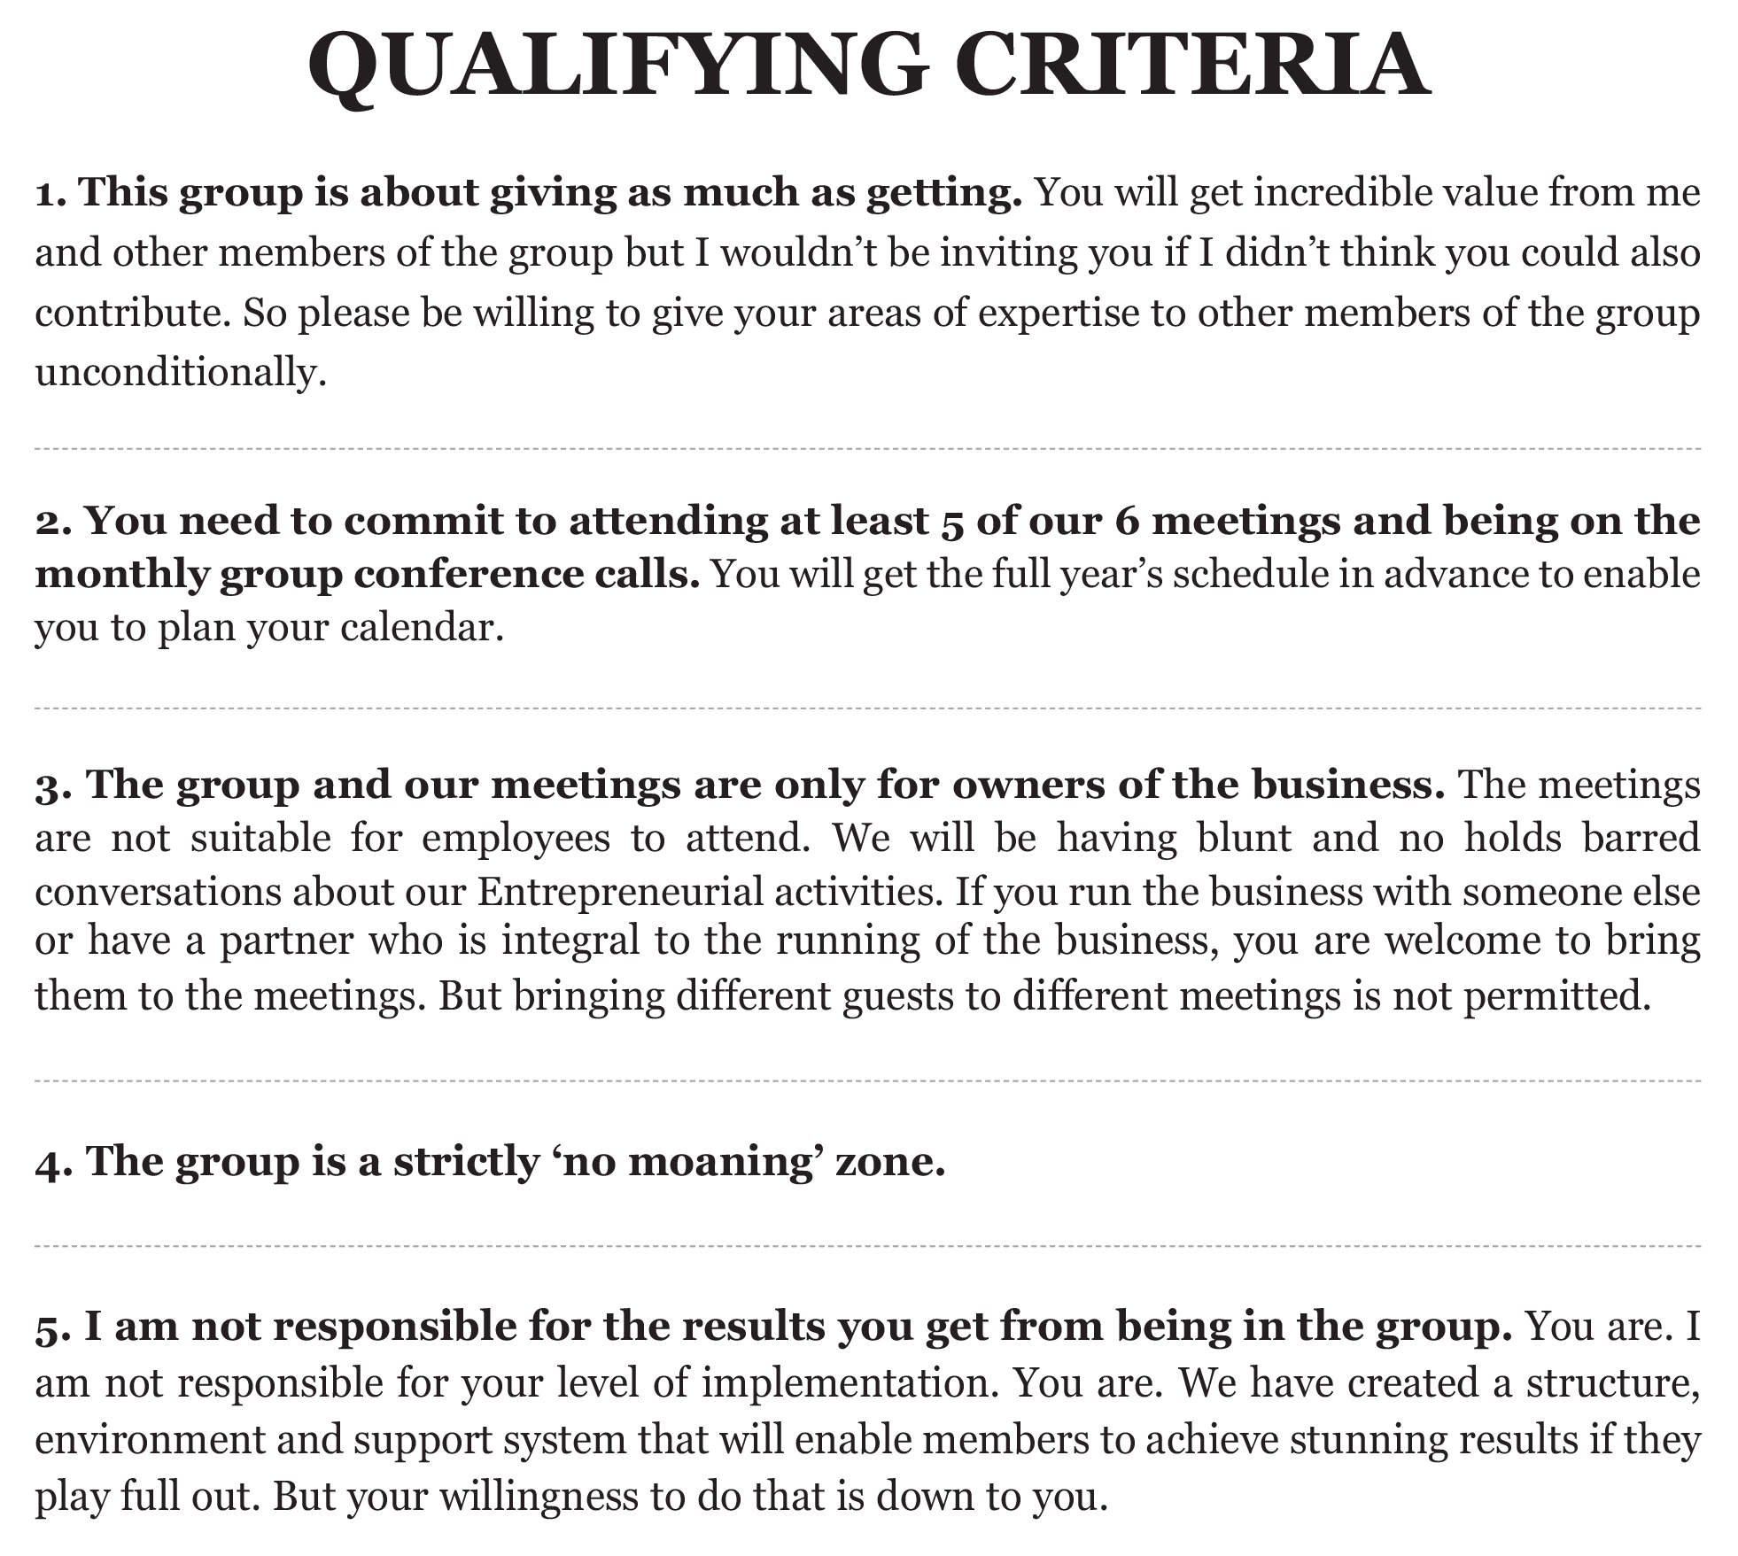

Slide 14
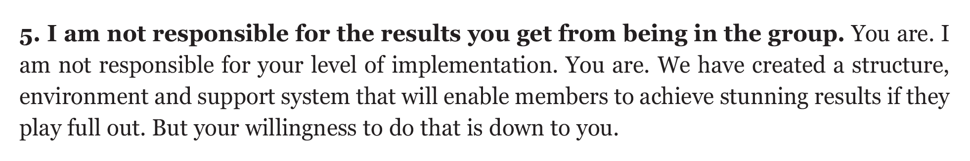

Slide 15
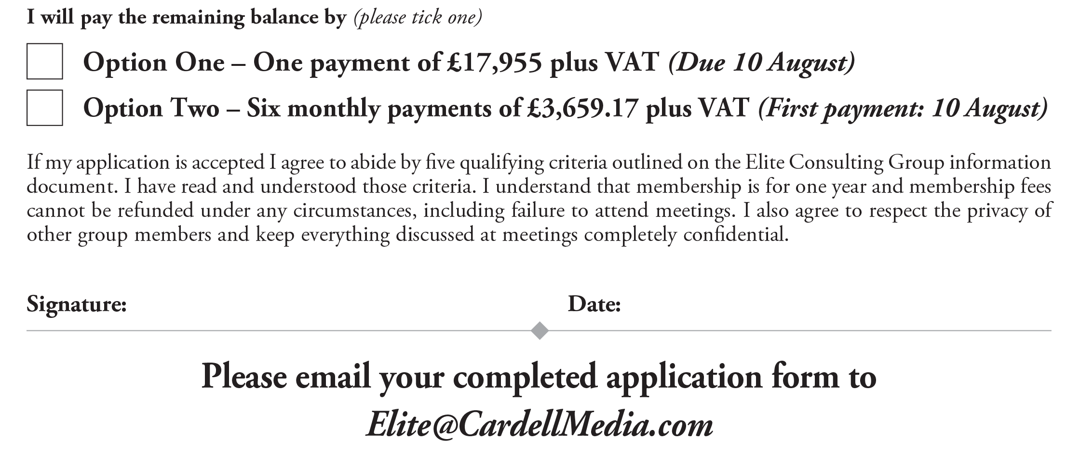

Slide 16
Pricing Structures:
COACHING

Slide 17
Hourly Rates
PROS:
Simple to sell
Lower entry price
Easy to scale
CONS:
Billing for hours
Pre-conditions
the client

Slide 18
Breakthrough Session
PROS:
Not billing for hours
Price Elasticity
No price precedent set
Client gets a breakthrough
Great for selling

Slide 19
Charge by the Change

Slide 20
Three Consulting and Coaching Game Changers

Slide 21
Three Consulting and
Coaching Game Changers
GAME CHANGER 1
Periodic > Continuity
GAME CHANGER 2
Expand your Geography
GAME CHANGER 3
Niche

Slide 22
Premium Pricing

Slide 23
Premium Pricing
The individual or business who is willing to hire a Consultant/Coach is by definition experiencing enough pain to start to make price irrelevant.
The individual or business who is willing to hire a Consultant/Coach is not likely to be a price buyer.
What happens if they get it wrong? This can be a fear-based sale.

Slide 24
Premium Pricing
If you ensure that the client associates to the value of the result they want to achieve, your ‘high’ fees will not appear high.
If they approached you, they have probably already made the decision.
Avoid charging for time where possible.
Expensive implies great.

Slide 25
Premium Pricing
There is a presupposition that people are paying the fees you describe (Very important for those starting out.)
The best Authority and Status strategy.
A higher price can impact the results the client achieves.
Pre Qualification – implies they might not be able to have it.
Waiting Lists

Slide 26
How to Increase
Your Prices

Slide 27
How to Increase Your Prices
Double your fees for New Clients.
Sell different offerings to existing clients, packaged in different ways – at your new price point.
Announce your fees for the year for existing clients – e.g., lawyers and accountants.
Push a higher increase for existing clients out into the future.

Slide 28
How to Increase Your Prices
Put people into continuity
Create and offer a VIP package to existing clients.
Start giving existing clients to others at the current price point – or they keep you at the new price point.
Test the upper limits.

Slide 29
17 Step Customer
Attraction Model

Slide 30
1. A Referral System
A form of Attraction Marketing
Enables Premium Pricing
Engrained in client’s mind
A system for giving others an experience
Can be a reason for Free
Great for events
The book
Internal Marketing

Slide 31
2. Speaking
A form of Attraction Marketing – You only have to ‘chase’ the organiser
Measurable
Should be organised
like a normal
Marketing campaign
Give – don’t hold back
Demonstration
Ideally include lead generation and offer
Stay to speak to people
Follow up

Slide 32
3. PR
B2B: Trade Press Articles
B2C: Mainstream Pres
Consumers: Radio, TV, Newspapers, Magazines, Online

Slide 33
4. Phone >>> Sales Meeting >>> Sale
The traditional B2B Consulting model

Slide 34
5. Phone >>> Mini Seminar >>> Sale

Slide 35
6. General Lead Generation – Direct Mail and Online and Phone >>> Sales Meeting or Mini Seminar >>> Sale

Slide 36
6. General Lead Generation
Google AdWords
LinkedIn
Facebook
Direct Mail
Telephone
Print Advertising
Speaking

Slide 37
7. Understand Customer Value
Average Lifetime Customer Value
Cost per Customer
The Decision: How much are you willing to spend to buy a new Customer?

Slide 38
8. Online, Direct Mail and Phone
>>> Discovery/Content Call

Slide 39
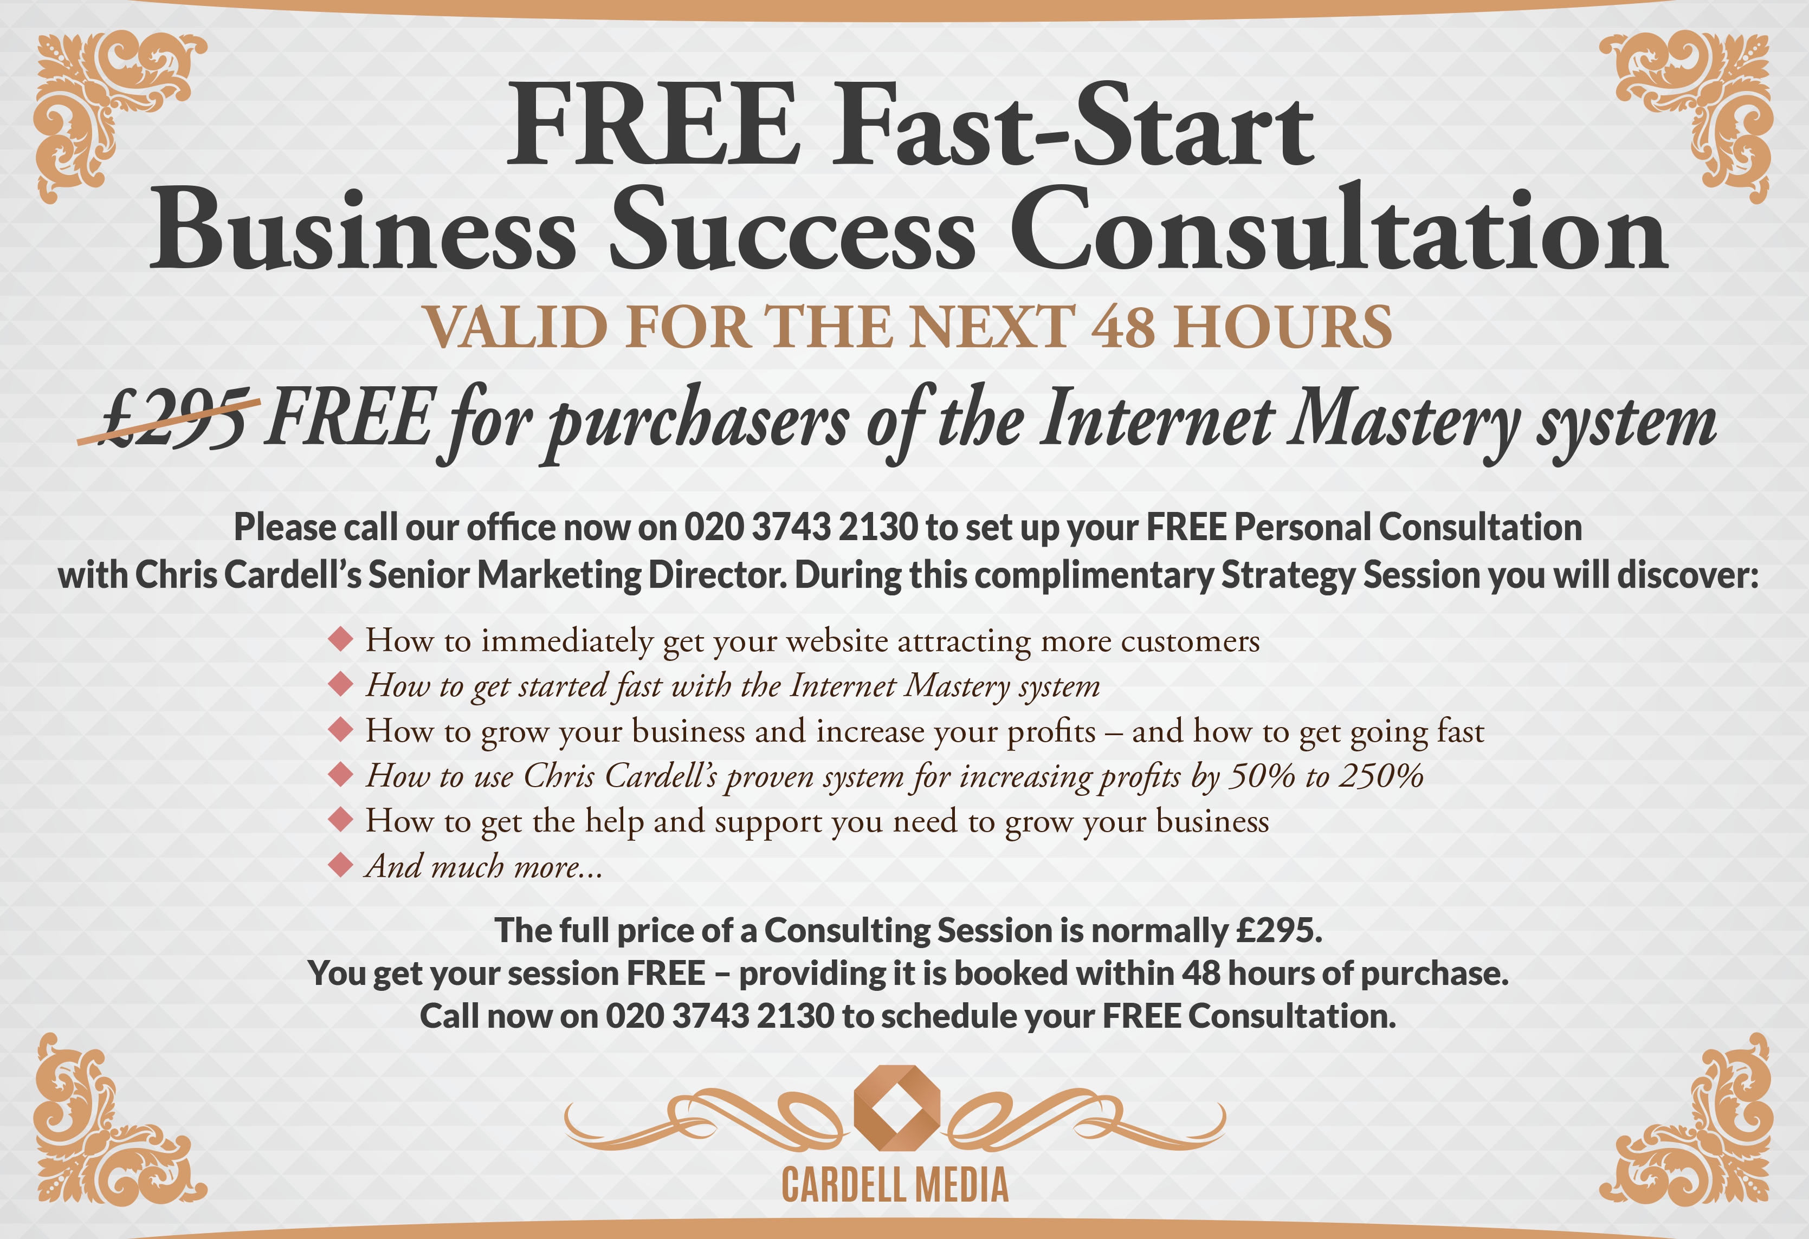

Slide 40
9. Online, Direct Mail and Phone >>> Paid or Free Seminar

Slide 41
10. Online, Direct Mail and Phone >> Discovery Event
10 to 25 people
Pre-Qualify – online or on phone
An upfront pitch
Scarcity helps

Slide 42
11. Online Lead Generation plus Info >>> Customer Attraction
Chris’s original model
Give value for 6 to 12 weeks. Don’t sell.
Primarily email driven

Slide 43
12. Online Lead Generation >>> Webinars/Teleseminars >>> Any of Above
Best alternative to in-person selling
Enables greater email frequency
Gets the best people to raise their hands
Follow up

Slide 44
13. Pure Attraction through Status and Positioning

Slide 45
14. A Book

Slide 46
15. Life Coaching – Print Advertising

Slide 47
16. Joint Ventures
Can compress years into weeks
Free client acquisition

Slide 48
17. Ascension
The second reason for Engagement
Speed is important

Slide 49
Business Success Consulting / Coaching

Slide 50
The Opportunity
3 Million Businesses
None of them have got a clue about Marketing, the Internet and Customer Acquisition
The basics are simple
to teach
Money at a discount
/effectively Free
The good clients will ascend
Very responsive to Direct Marketing

Slide 51
Models
Grow your Business - General

Slide 52
The 3 Ways to Grow Your Business
If you…
Increase the number of Customers by 10%
Increase the ‘average spend’ by 10%
Increase the number of times people
purchase by 10%
Your Turnover will increase by: 33%

Slide 53
The 3 Ways to Grow Your Business
If you…
Increase the number of Customers by 30%
Increase the ‘average spend’ by 20%
Increase the number of times people purchase
by 30%
Your Turnover will increase by: over 100%

Slide 54
Models
Grow your Business - General
Get more Customers
Website / Online Marketing
Facebook Advertising
Google AdWords

Slide 55
Models
Online Conversion
Premium Pricing
Done for You – BIG Opportunity
Any of the above in a business niche
Any of the above ‘Area Exclusive’

Slide 56
Pricing Models
Daily Rate £1000 to £10,000
Monthly Retainer £5,000 to £20,0000
Project Based £10,000 to £250,000
Group Consulting / Coaching £10,000 to £100,000
Online Courses – Pays for Lead Generation
and produces clients £1000 to £3000

Slide 57
How to Sell It
Speaking
Traditional Lead Generation
Free / Paid Seminars
Free / Paid Webinars / Teleseminars

Slide 58
How to Sell It
Paid Phone Consult – applied to final fee
Half or One Day Consulting – applied to final fee
Referrals

Slide 59
The big issue is
IMPLEMENTATION

Slide 60
The Consulting and Coaching Process:
Lessons Learned

Slide 61
Decision Maker vs. ‘The Rest’
Be Prepared! It can get personal
Communication / Influence skills required
You can require buy in
What’s your outcome: e.g., Consulting, Implementation, Money, Results

Slide 62
What Does the Client Really Want?
Outcome
Activity
Approval
Money
Time
Emotional

Slide 63
The Implementation Issue
What’s your personal philosophy and expectation?
How can you help the client with implementation?
What is the money opportunity?

Slide 64
Familiarity breeds _________
There is a lifespan to all client relationships.

Slide 65
All Good Consultants and Coaches are in the Personal Development Business
Leadership
Communication
Stress Management
Work/Life issues
Money
Fear
Self-Confidence
Other personal issues

Slide 66
Information Marketing

Slide 67
Two BIG Reasons
The Obvious: More income and profits.
The Less Obvious – but bigger – opportunity:
It pays for the leads.
It’s the ultimate marketing tool and brings you all the clients you need at Premium Pricing.

Slide 68
1. The Book

Slide 69
2. Webinars and Teleseminars:
Free and Paid
FREE:
Enhances Relationship
Adds significant value
Opportunity to Sell

Slide 70
2. Webinars and Teleseminars:
Free and Paid
Format:
Intro
40 to 50 minutes value. 5 to 7 Steps / Strategies
10 to 15 minutes Sale
Scarcity:
Time or Numbers

Slide 71
2. Webinars and Teleseminars:
Free and Paid
PAID:
One off or part of a programme
If you add personal support and other resources to a 5 to 10 step programme, it adds considerable value.

Slide 72
2. Webinars and Teleseminars:
Free and Paid
RESOURCES:
Intercall for Teleseminars
StealthSeminar.com and GoToWebinar.com for Webinars

Slide 73
3. Seminars
Historically a VERY important part of most successful Information Marketing businesses because of three main factors:
Profitable
Relationship
The best place to sell (VERY important)

Slide 74
3. Seminars
The Two Big Seminar Secrets:
Getting non customers to seminars at a profit is virtually impossible.
Once you get them there, they are 10 times easier to sell to than anyone else.

Slide 75
3. Seminars
The Annual Event:
2 -3 Days
You and other industry experts
Celebrities
Networking
An experience
Awards and Prizes
The best place to sell high-end Coaching

Slide 76
3. Seminars
The 1 to 2 Day Event:
Good place to start
Easy for Customers to attend

Slide 77
3. Seminars
Open Evenings:
Paid or Free
Larger numbers, lower risk for attendees
Can sell longer event

Slide 78
3. Seminars
Running Events:
Watch your Costs
AV is very important at large events
Take control / assume incompetence
Establish Control of the group

Slide 79
3. Seminars
Running Events:
Learn Speaking / Training skills
Get ‘Permission’ to sell
Congruent Selling is essential
Scarcity when selling

Slide 80
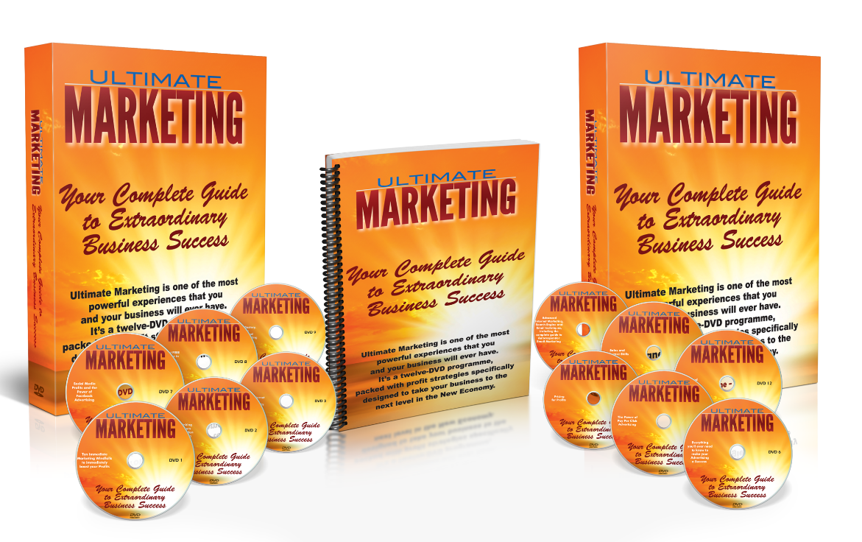
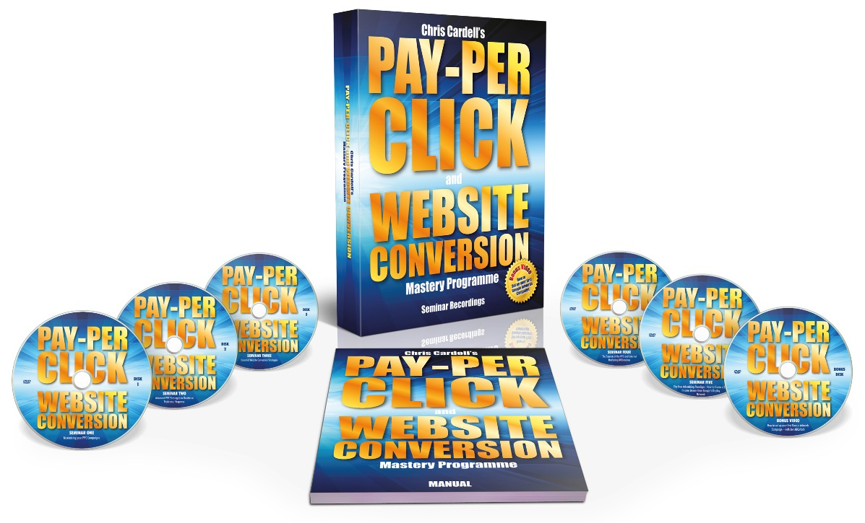

4. Products / Online Courses

Slide 81
5. Membership
Normally an important part of Customer Value
Purpose: Income AND Engagement
Formats:
Physical Newsletter
CD/DVD
Online Resources / Video
Monthly Teleseminars
Monthly Coaching Calls
Live Events

Slide 82
5. Membership
Price points:
Low end: £19.95 – £97
High end: £195 - £395
Often sold through Free Trials
Forced Continuity
Retention is achieved through Engagement

Slide 83
6. Group Coaching
50 to150 People
£10,000 to £15,000
Group Mastermind
Mastermind Element is Important
Support between meetings
Information, Support, Networking and Access
Immersed
Re-enforcement
Excellent for High Performers
Easy ‘money for nothing’ pitch for implementers

Slide 84
7. Group Consulting (Mastermind)
Round Table Discussion
3 to 25 People
£10,000 to £30,000
Hotseat format
Group or Individual Coaching between meetings

Slide 85
How Many Clients / Customers do you need for a £1 Million Business?
10 £25k Private Clients
10 in £15k Private Consulting Group
30 in £10k Group Coaching
200 attend £495 Seminars
20 attend boutique £3000 Seminars
200 in £50 per month membership
100 buy £1000 Product / Online Course

