Slide 1



Slide 2
Members Hub
http://www.cardellmedia.com/info-hub

Slide 3
Seminar Five:
CONSULTING
AND COACHING

Slide 4
Consulting and Coaching
Business Coaching
Business Consulting
Life Coaching

Slide 5
The 3 BIG Secrets of
Seven Figure Consulting
and Coaching

Slide 6
The 3 BIG Secrets of Seven Figure Consulting and Coaching
It’s best done through ATTRACTION marketing
Price Elasticity: Pricing can be made irrelevant
It can ONLY be achieved through STATUS and AUTHORITY

Slide 7
Pricing Structures

Slide 8
Hourly Rates
PROS:
Simple to sell
Lower entry price
Easy to scale
CONS:
Billing for hours
Pre-conditions
the client

Slide 9
Daily Rates
PROS:
Can establish
high fees
Immersion
– can sell more
CONS:
Billing for hours
If you’re good, what do you do
all day?

Slide 10
Breakthrough Session
PROS:
Not billing for hours
Price Elasticity
No price precedent set
Client gets a breakthrough
Great for selling

Slide 11
Project Rates
PROS:
Separates time from Activities
and Results
High fees
CONS:
Can be harder
to sell

Slide 12
Monthly Continuity
Direct access
Remote access
Implementation
Can include online material/training, including group

Slide 13
Monthly Continuity
PROS:
Guaranteed monthly income
Higher fees
Separates Time from Money
Client feels more involved
CONS:
Dependency
on good client(s)

Slide 14
Three Consulting and Coaching Game Changers

Slide 15
Three Consulting and
Coaching Game Changers
GAME CHANGER 1
Periodic > Continuity
GAME CHANGER 2
Expand your Geography
GAME CHANGER 3
Niche

Slide 16
Premium Pricing

Slide 17
Premium Pricing
The individual or business who is willing to hire a Consultant/Coach is by definition experiencing enough pain to start to make price irrelevant.
The individual or business who is willing to hire a Consultant/Coach is not likely to be a price buyer.
What happens if they get it wrong? This can be a fear-based sale.

Slide 18
Premium Pricing
If you ensure that the client associates to the value of the result they want to achieve, your ‘high’ fees will not appear high.
If they approached you, they have probably already made the decision.
Avoid charging for time where possible.
Expensive implies great.

Slide 19
10 Step Customer
Attraction Model

Slide 20
1. A Referral System
A form of Attraction Marketing
Enables Premium Pricing
Engrained in client’s mind
A system for giving others an experience
Can be a reason for Free
Great for events
The book
Internal Marketing

Slide 21
2. Speaking
A form of Attraction Marketing – You only have to ‘chase’ the organiser
Measurable
Should be organised
like a normal
Marketing campaign
Give – don’t hold back
Demonstration
Ideally include lead generation and offer
Stay to speak to people
Follow up

Slide 22
3. PR
B2B: Trade Press Articles
B2C: Mainstream Press
Consumers: Radio, TV, Newspapers, Magazines, Online

Slide 23
4. Phone >>> Sales Meeting >>> Sale
The traditional B2B Consulting model

Slide 24
5. General Lead Generation
Google AdWords
LinkedIn
Facebook
Direct Mail
Telephone
Print Advertising
Speaking

Slide 25
6. Online, Direct Mail and Phone
>>> Discovery/Content Call

Slide 26
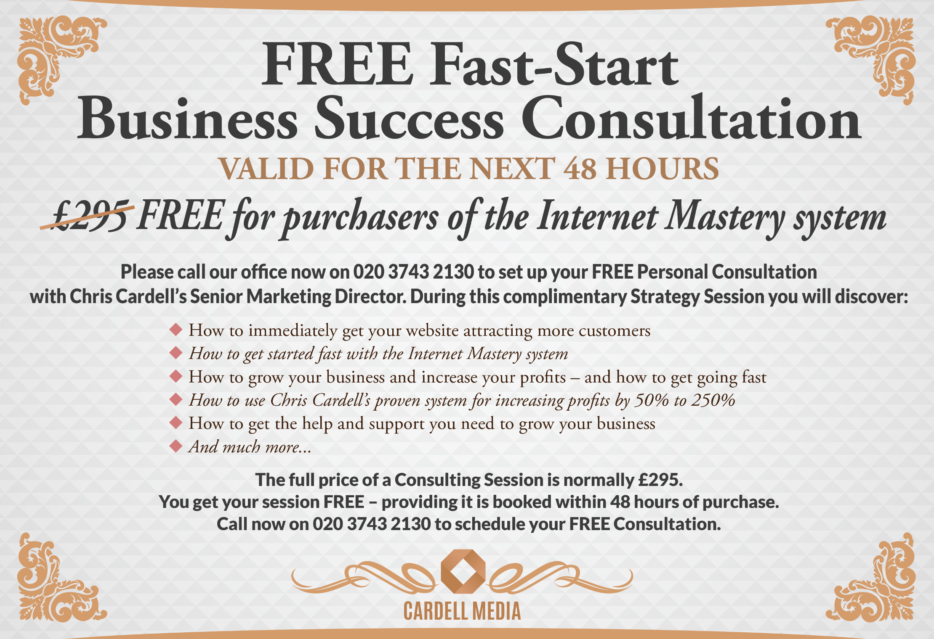

Slide 27
7. Online Lead Generation Plus Info >>> Customer Attraction
Chris’s original model
Give value for 6 to 12 weeks. Don’t sell.
Primarily email driven

Slide 28
8. Online Lead Generation >>> Webinars/Teleseminars >>> Any of Above
Best alternative to in-person selling
Enables greater email frequency
Gets the best people to raise their hands
Follow up

Slide 29
9. Pure Attraction Through Status and Positioning

Slide 30
10. A Book

Slide 31
The Consulting and Coaching Process:
Lessons Learned

Slide 32
Decision Maker vs. ‘The Rest’
Be Prepared! It can get personal
Communication / Influence skills required
You can require buy in
What’s your outcome: e.g., Consulting, Implementation, Money, Results

Slide 33
What Does the Client Really Want?
Outcome
Activity
Approval
Money
Time
Emotional

Slide 34
The Implementation Issue
What’s your personal philosophy and expectation?
How can you help the client with implementation?
What is the money opportunity?

Slide 35
How Many Clients / Customers do you need for a £1 Million Business?
10 £25k Private Clients
10 in £15k Private Consulting Group
30 in £10k Group Coaching
200 attend £495 Seminars

Slide 36
How Many Clients / Customers do you need for a £1 Million Business?
20 attend boutique £3000 Seminars
200 in £50 per month membership
100 buy £1000 Product / Online Course

Slide 37
Members Hub
http://www.cardellmedia.com/info-hub

