Slide 1



Slide 2
Members Hub
http://www.cardellmedia.com/info-hub

Slide 3
Seminar Four:
CUSTOMER ACQUISITION MARKETING

Slide 4
Information Marketing is an inherently NICHE activity which gives you an immediate Marketing advantage.
They can be found by category
They can be found by behaviour
They can be found in ‘places’

Slide 5
The 5 Most Popular Marketing Strategies for Attracting New Customers in Information Marketing
1) Direct Mail
A buyer is a buyer
Compiled lists vs. Buyer lists
Compelling Front End Offer
Resources:
www.MarketingFile.com
HiLite

Slide 7
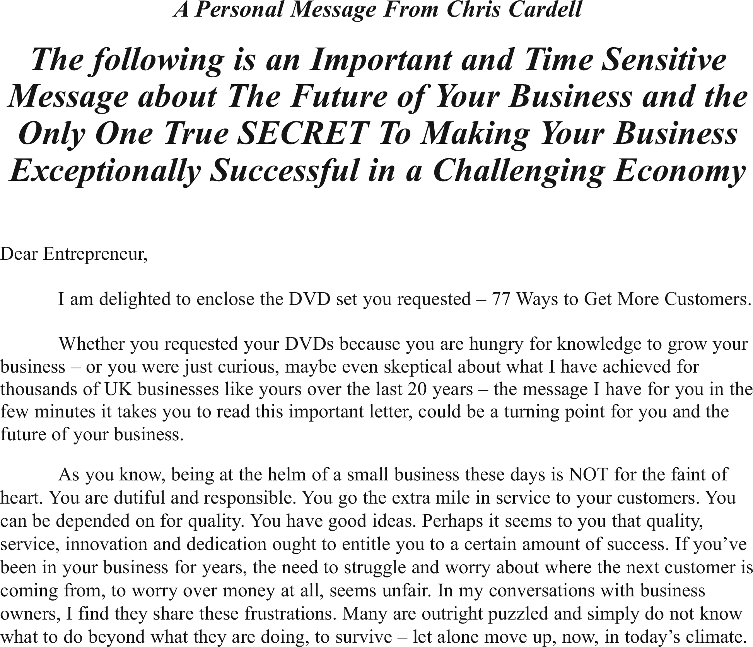
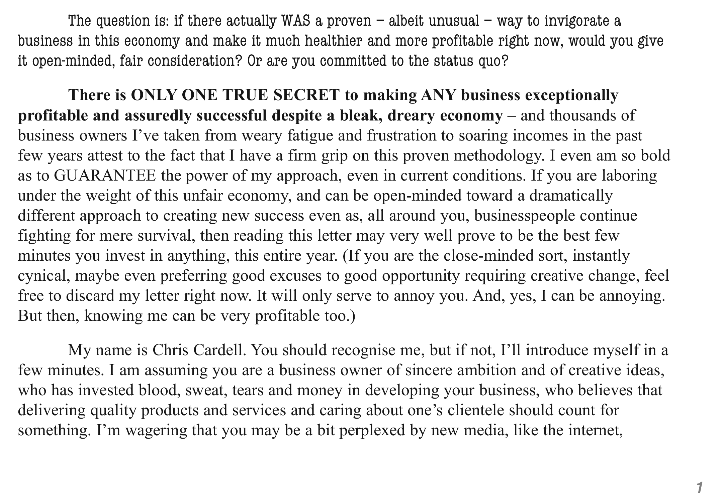

Slide 8
The 5 Most Popular Marketing Strategies for Attracting New Customers in Information Marketing
2) Print Advertising
Info Marketing niches can
have very high readership

Slide 9
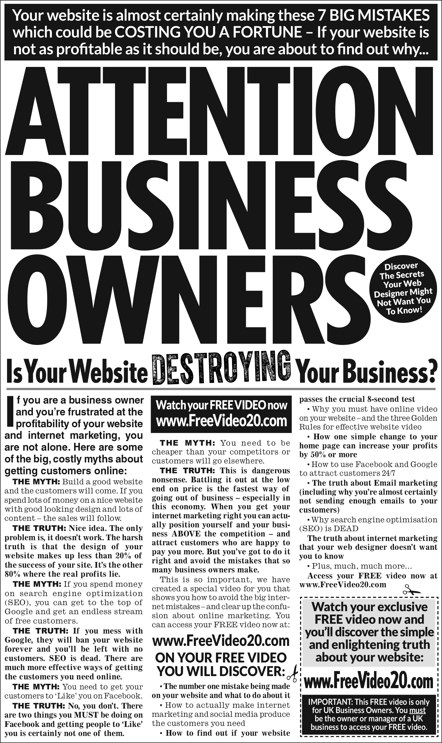

Slide 10
The 5 Most Popular Marketing Strategies for Attracting New Customers in Information Marketing
3) Google
Google’s Keyword Planner

Slide 11
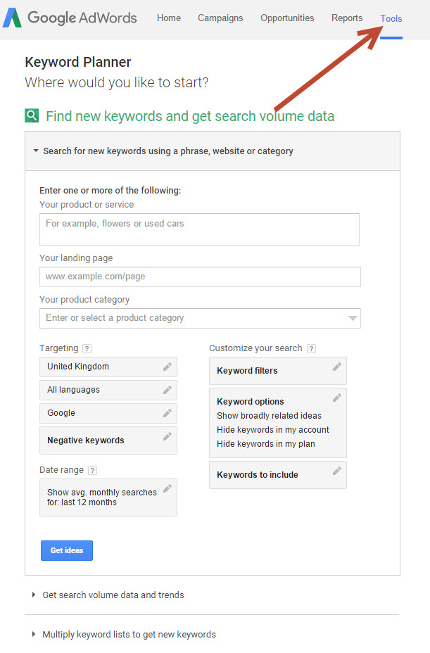

Slide 12
The 5 Most Popular Marketing Strategies for Attracting New Customers in Information Marketing
3) Google
Google’s Keyword Planner
Top positions are King
Split test ads
Ad extensions

Slide 13
The 5 Most Popular Marketing Strategies for Attracting New Customers in Information Marketing
4) The 4 Steps to Info Marketing
Facebook Success

Slide 14
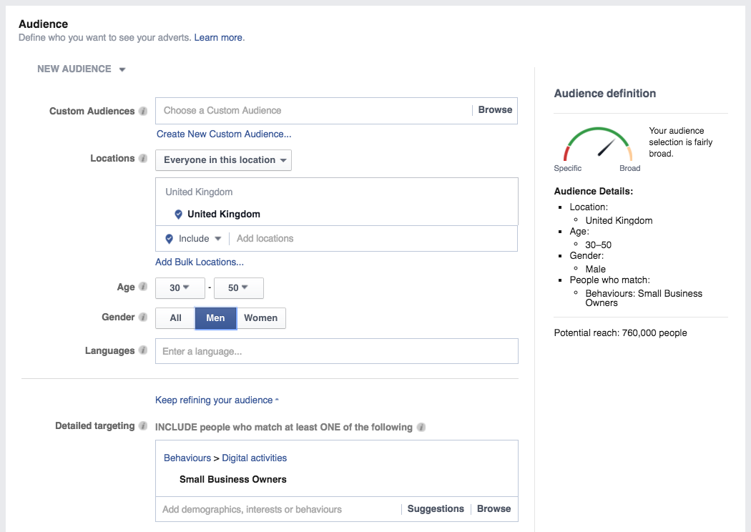
THE 4 STEPS TO INFO MARKETING FACEBOOK SUCCESS
1) Targeting

Slide 15
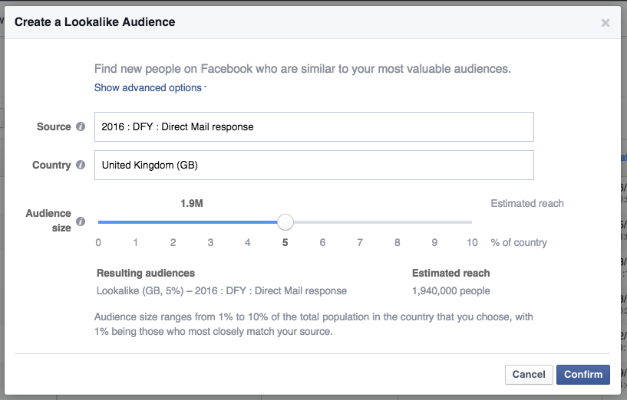
THE 4 STEPS TO INFO MARKETING FACEBOOK SUCCESS
2) Lookalike
Audiences

Slide 16
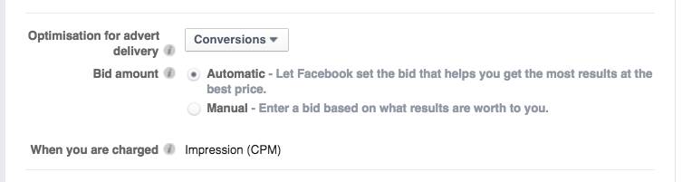
THE 4 STEPS TO INFO MARKETING FACEBOOK SUCCESS
3) Pay for Conversions

Slide 17
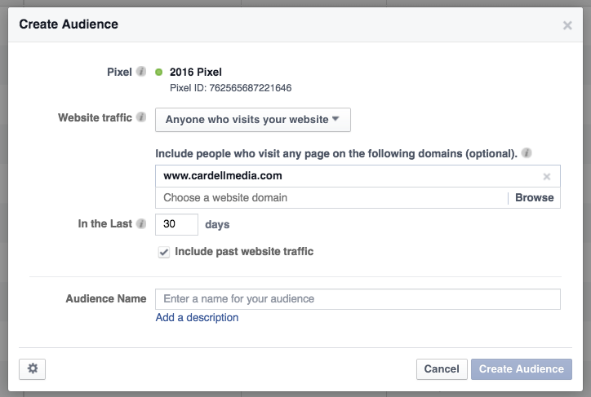
THE 4 STEPS TO INFO MARKETING FACEBOOK SUCCESS
4) Remarketing

Slide 18
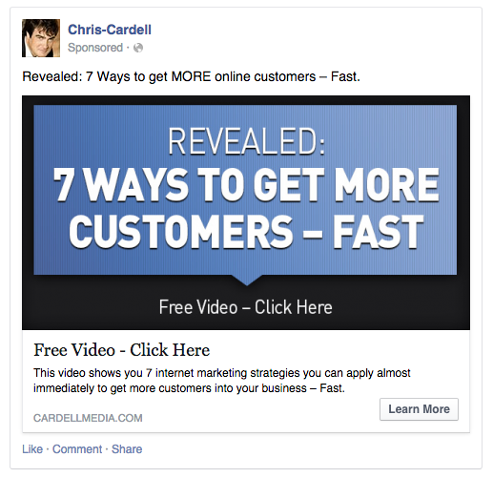

Slide 19
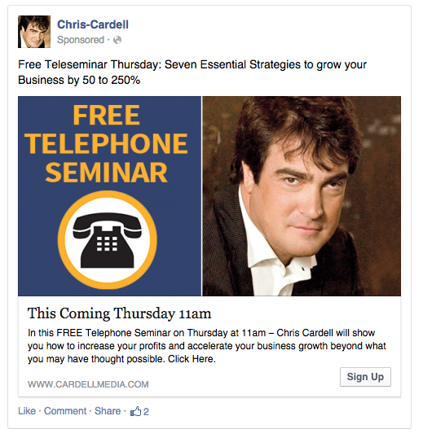

Slide 20
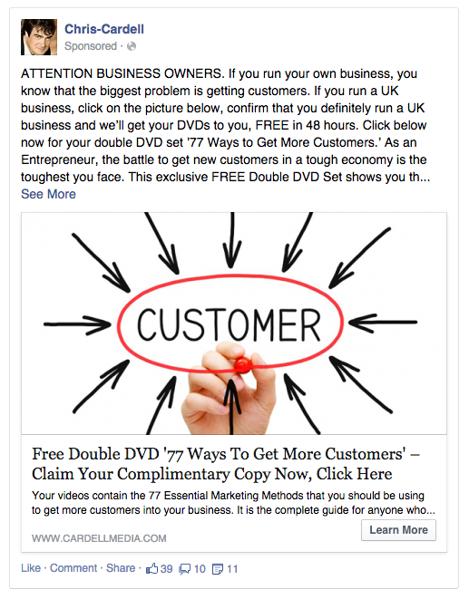

Slide 21
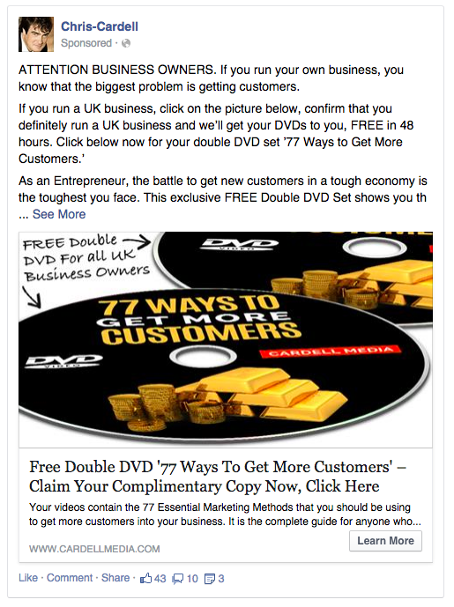

Slide 22
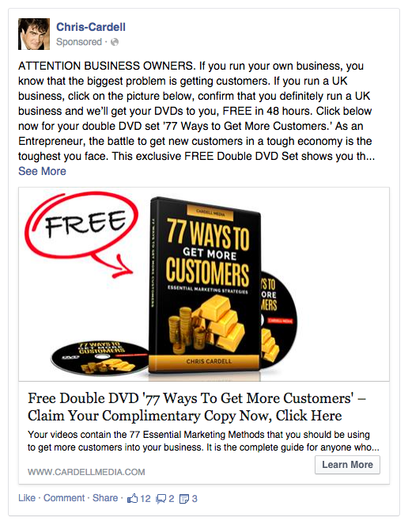

Slide 23
The 5 Most Popular Marketing Strategies for Attracting New Customers in Information Marketing
5) Joint Ventures
Who has access to your niche?
Endorsed Emails/Mailings
Joint Ventures need to be marketed
and sold

Slide 24
Riches in Niches
The more you niche, the easier it is
Higher prices
More specific messages
Easier to find

Slide 25
The Breakeven Concept
BIG Secret: Most Information Marketing businesses lose money or break even on
new customers
Know your numbers
Cost of buying a customer
Importance of ascension

Slide 26
Lead Generation
Historical foundation of Info Marketing businesses but test it
Compelling Offer
Still need to sell the benefits
Immediate upsell to Sale

Slide 27
Offline Marketing
Another BIG Secret: The Most successful ‘Online’ Information Marketers rely heavily on Offline Marketing

Slide 28
Risk Reversal / Guarantees
Even more important in Information Marketing because you’re selling an intangible
The bigger and more powerful, the better
Test

Slide 29
Time and Testing
Masterpieces take time
The new customer acquisition is likely to take time
Whatever your starting point – you can double the effectiveness

Slide 30
Your Core Focus
Buying customers

Slide 31
Bill Glazer’s Information
Marketing Formula
Q.P. + Q.L. = M.F. + R.R. + C.I. + W.N. =Big £££
Q.P. Quality Product
Q. L. Quality Lead
M.F. Marketing Funnel
R.R. Risk Reversal
C.I. Continuity Income
W.N. What’s Next

Slide 32
Personal Requirements
Immunity to criticism
Leadership skills
Influence / sales skills
Charisma

Slide 33
Next Week – Seminar 5
Consulting and Coaching

Slide 34
Members Hub
http://www.cardellmedia.com/info-hub

