Slide 1



Slide 2
Members Hub
http://www.cardellmedia.com/info-hub

Slide 3
The Opportunity

Slide 4
The Opportunity
Zeroes and Ones: The Software Model
and Information Marketing
UK: An Untapped Market
The Model Proven and Tested by Others
The Leverage of Marketing
The ‘Secret’ Too Good to be True

Slide 5
Bill Glazer’s Information
Marketing Formula
Q.P. + Q.L. = M.F. + R.R. + C.I. + W.N. =Big £££
Q.P. Quality Product
Q. L. Quality Lead
M.F. Marketing Funnel
R.R. Risk Reversal
C.I. Continuity Income
W.N. What’s Next

Slide 6
Categories of Information
Marketing Business
There are four main categories of Information Marketing businesses.
The two main ones that Entrepreneurs make their money with are:
B2B: How to succeed in a specific business market or with a specific set of business skills
Hobbies / Passions / Niches

Slide 7
Categories of Information
Marketing Business
The other two categories of Info Marketing Businesses are are:
Health / Lifestyle / Weight Loss / etc.
Personal Development

Slide 8
Information Marketing Examples

Slide 9
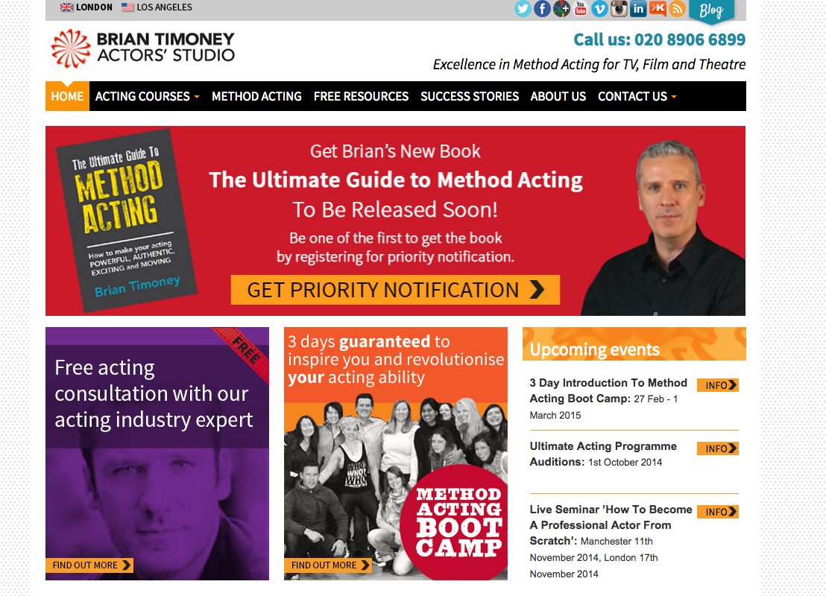

Slide 10
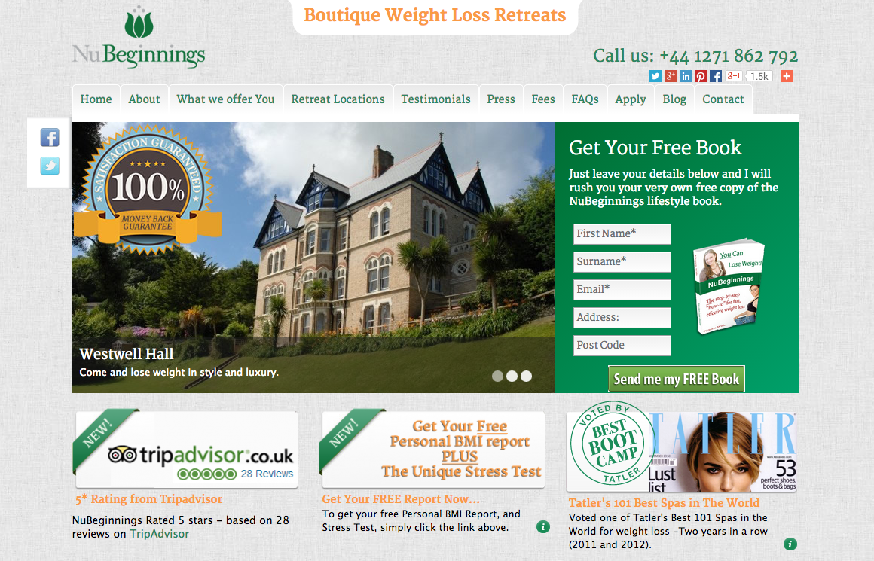

Slide 11
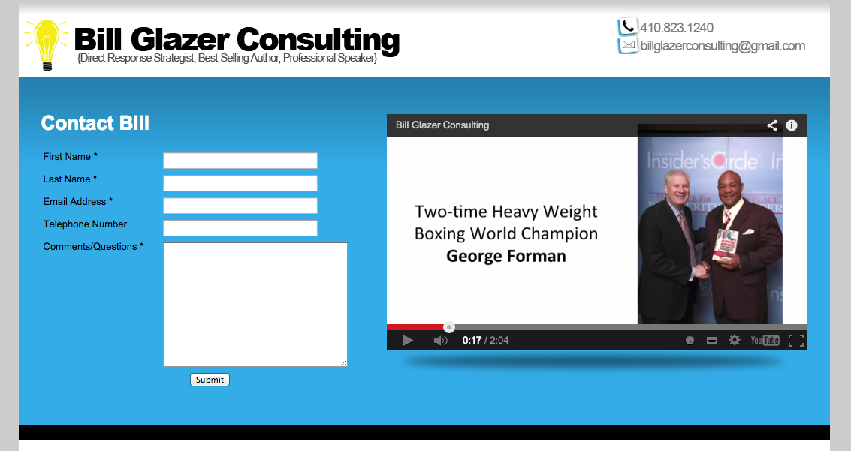

Slide 12
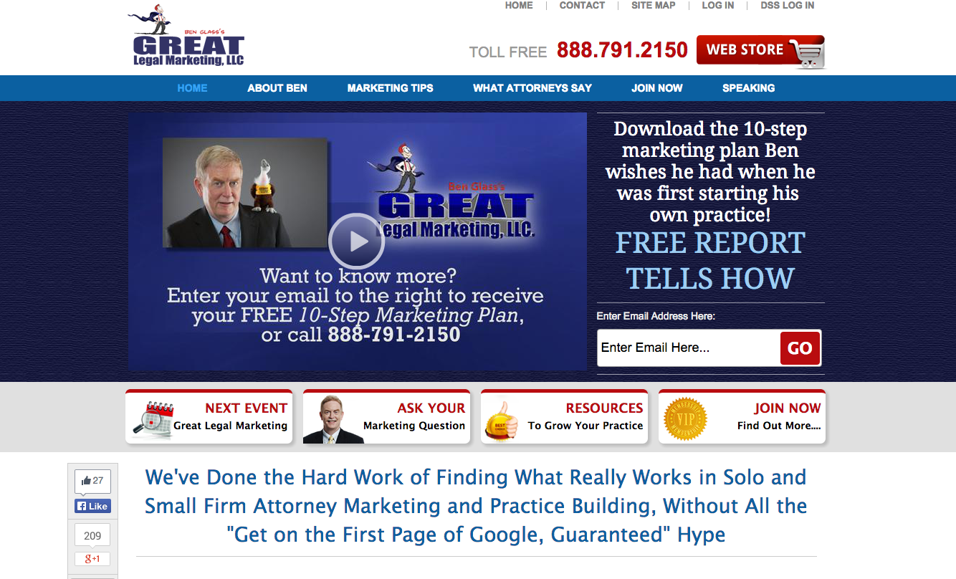

Slide 13
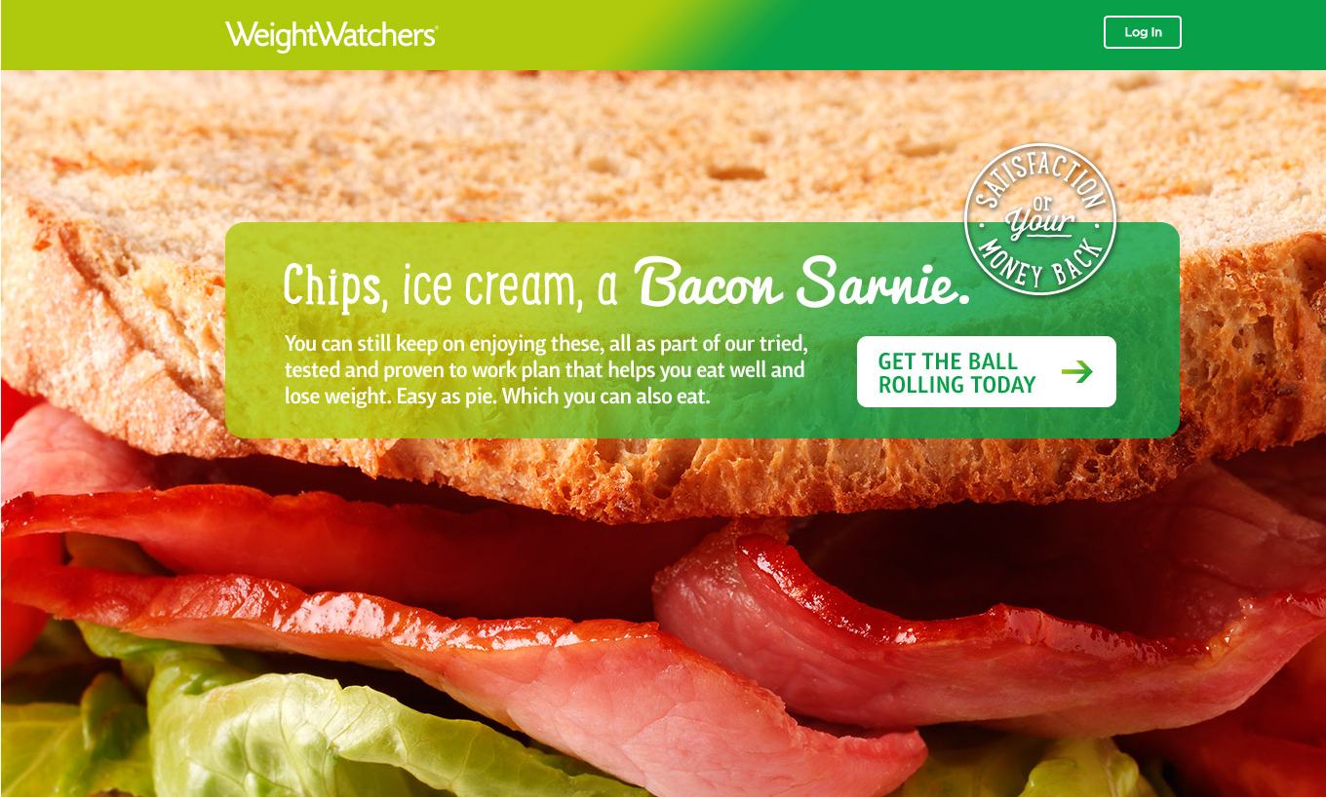

Slide 14
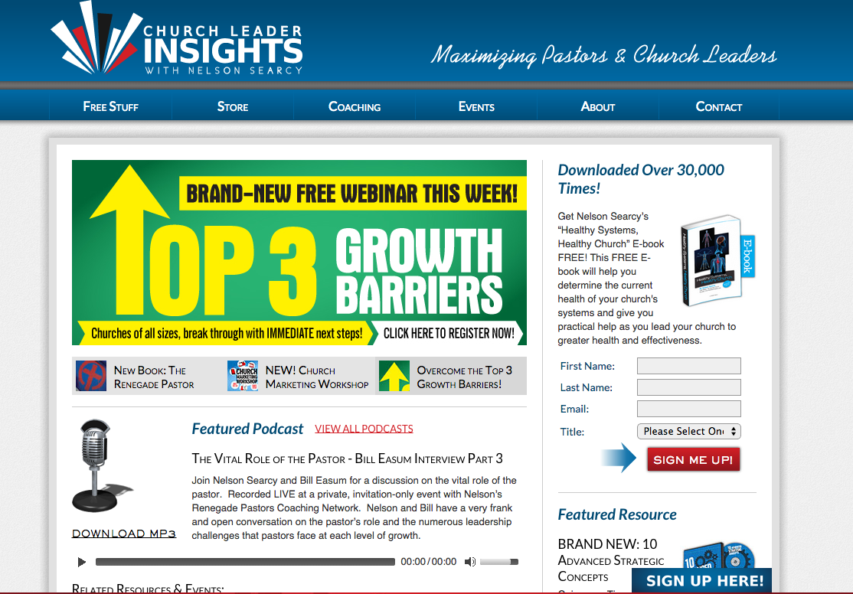

Slide 15


Slide 16
What Will You Sell?
CDs and DVDs
Books
Reports / Manuals
Monthly Membership
Teleseminars / Webinars
Seminars / Live Events
Consulting / Coaching
Done for You
High-End Coaching Groups
Boutique Events

Slide 17
The Golden Secret
of the Information Marketing Business

Slide 18
The Golden Secret of the Information Marketing Business
The world’s most successful information marketing businesses are not primarily about Information.
They are primarily about Relationship.

Slide 19
Essential Strategies for
Relationship Building
Status
Leadership
A story
Failure to success
Personal
Trusted Advisor
Fame / Celebrity

Slide 20
Books

Slide 21
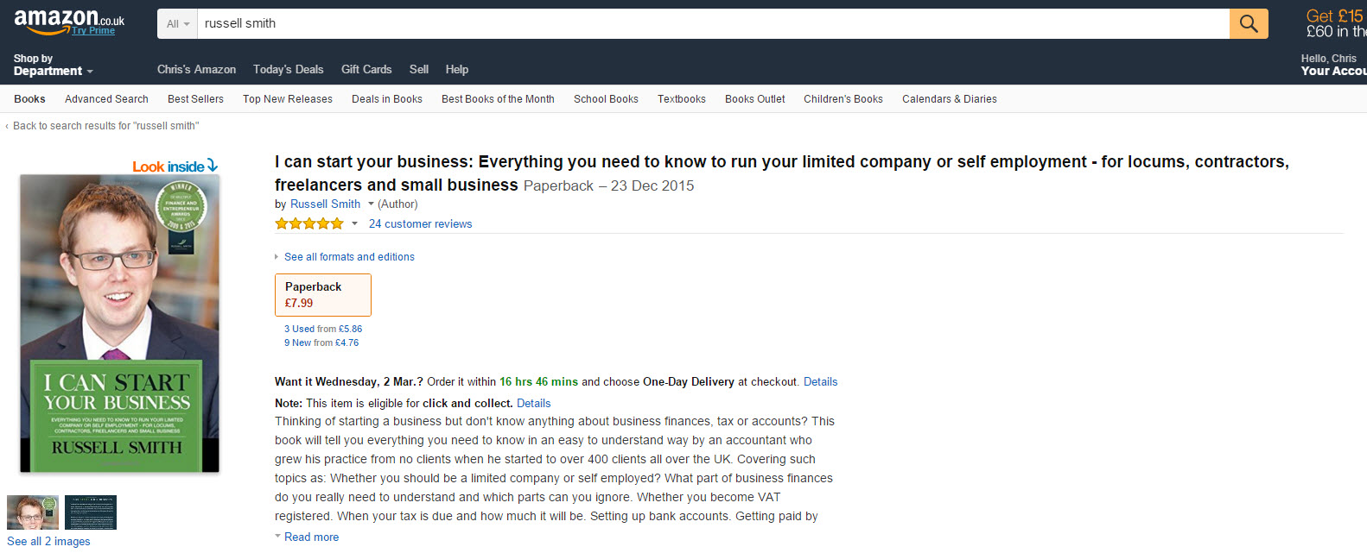

Slide 22


Slide 23
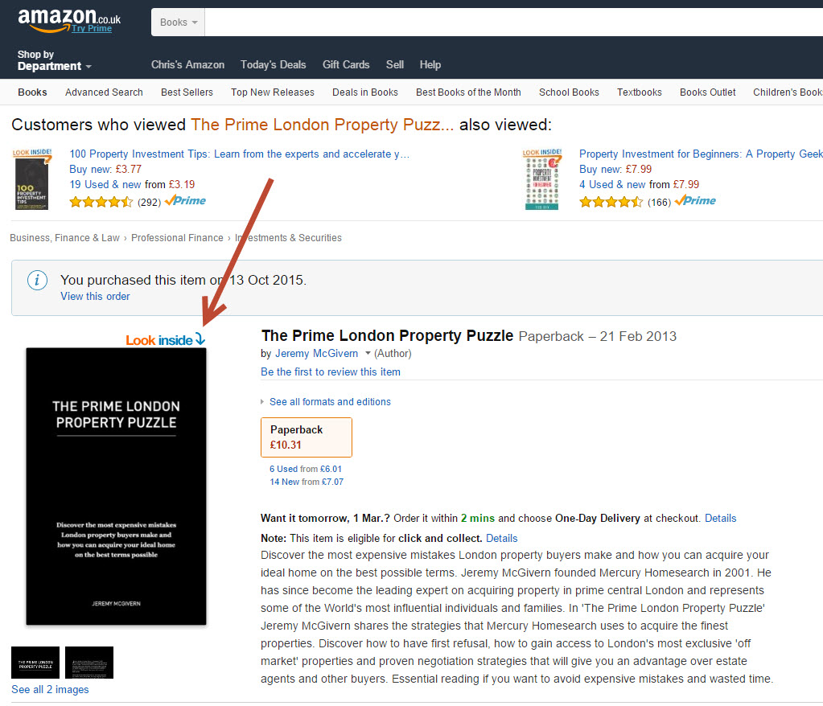

Slide 24
Books
Easy self-publishing
Purpose is not to sell
Lead generation tool
Conversion Tool
(shock and awe)
PR Tool
Celebrity & authority
Premium pricing
Short book is ok
Readership – The big secret
Interview or Ghost writer
Price
Speed – Make a decision

Slide 25
Next Week – Seminar 2
Products
DVD Programmes
Online Courses
Product creation
Suppliers
Pricing
Membership and Membership Sites
The 5% Rule

Slide 26
Members Hub
http://www.cardellmedia.com/info-hub

