Slide 1



Slide 2
Members Hub
http://www.cardellmedia.com/info-hub

Slide 3
Seminar Three:
The Profitable World of Teleseminars, Webinars
and Seminars

Slide 4
Teleseminars and Webinars: Free & Paid
FREE
Enhances Relationship
Adds significant value
Opportunity to Sell
Resources: Intercall for Teleseminars, StealthSeminar.com and GoToWebinar.com for Webinars

Slide 5
Teleseminars and Webinars: Free & Paid
FREE: Format
Intro
40 to 50 minutes of value
5 to 7 Steps / Strategies
10 to 15 minutes Sale
Scarcity: Time or Numbers

Slide 6
Teleseminars and Webinars: Free & Paid
Paid
One-off or part of a programme
If you add personal support and other resources to a 5 to 10 step programme,
it adds considerable value

Slide 7
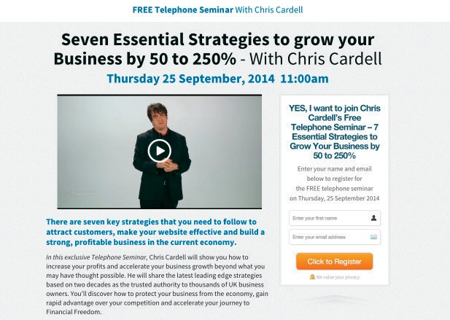

Slide 8
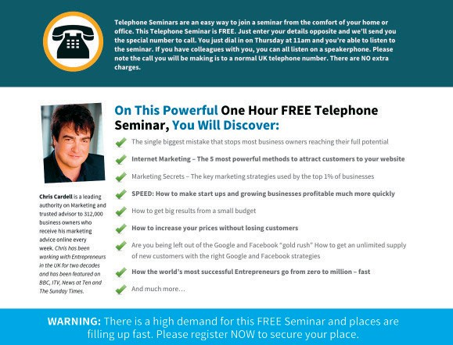
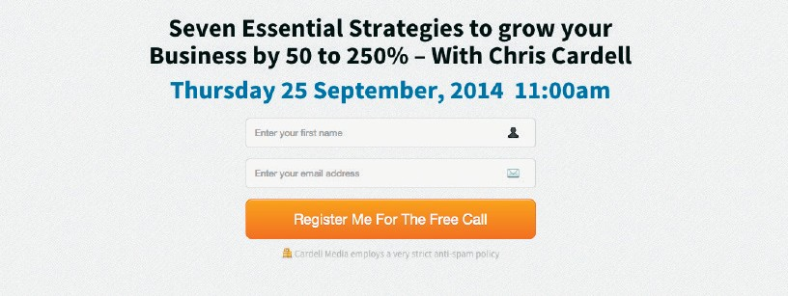

Slide 9
Teleseminars and Webinars: Free & Paid
Getting Them to show up
Thank you page
Confirmation Emails
Texts
Additional support information
Direct Mail

Slide 10
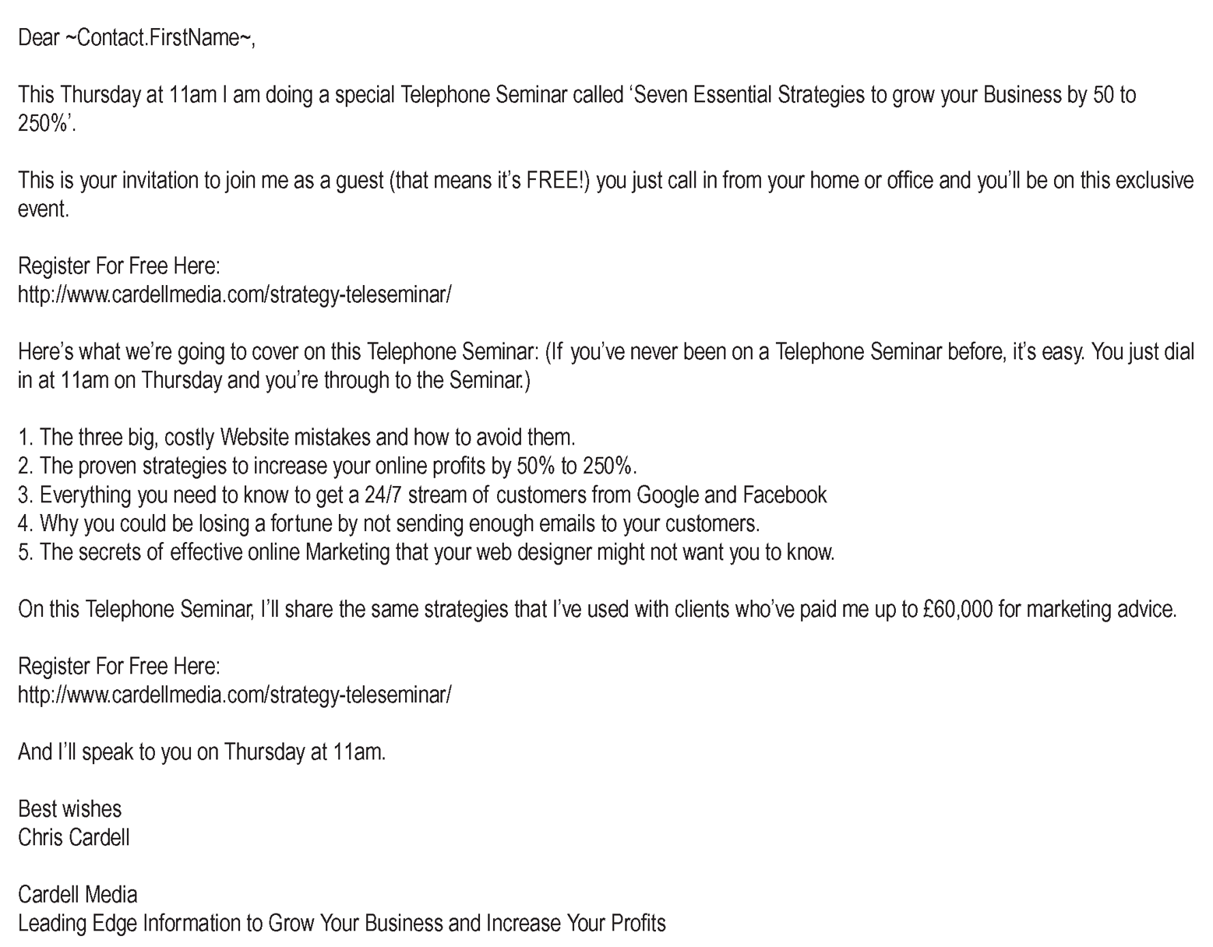
Promotional Email 1

Slide 11
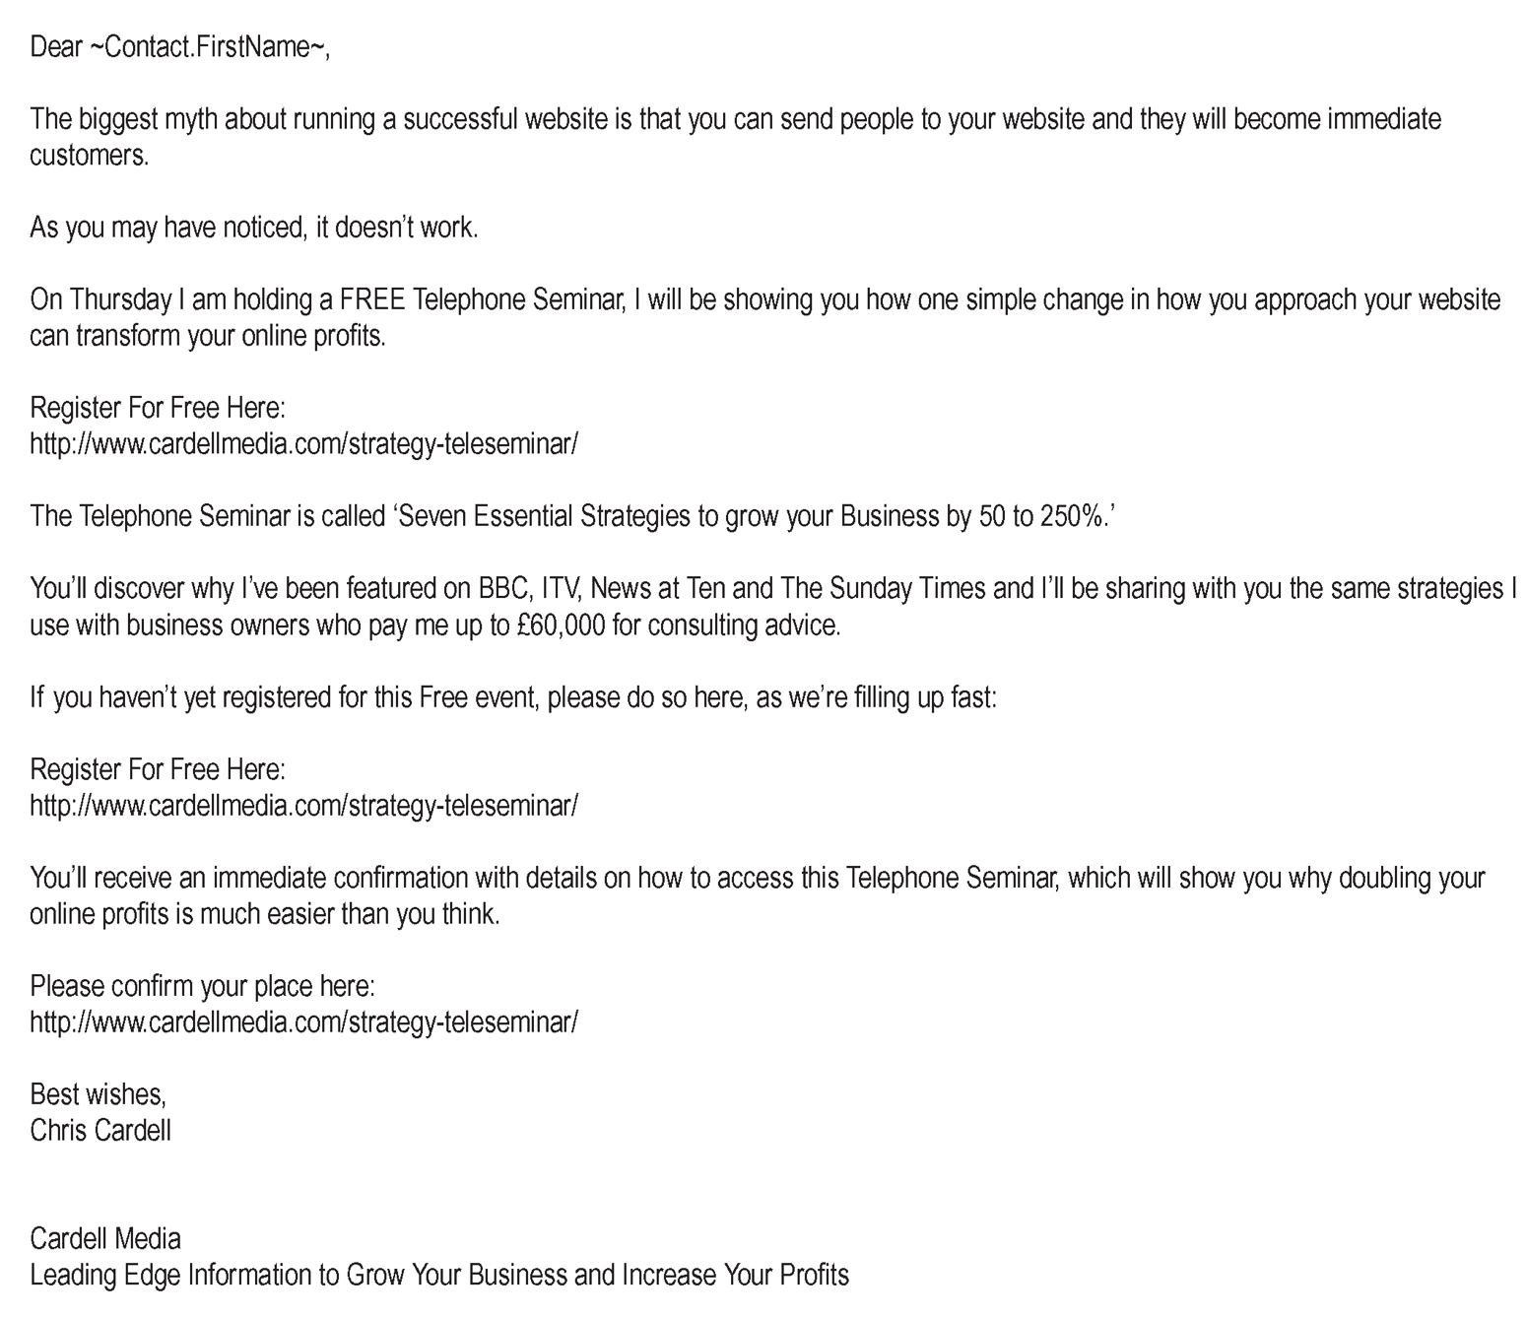
Promotional Email 2

Slide 12
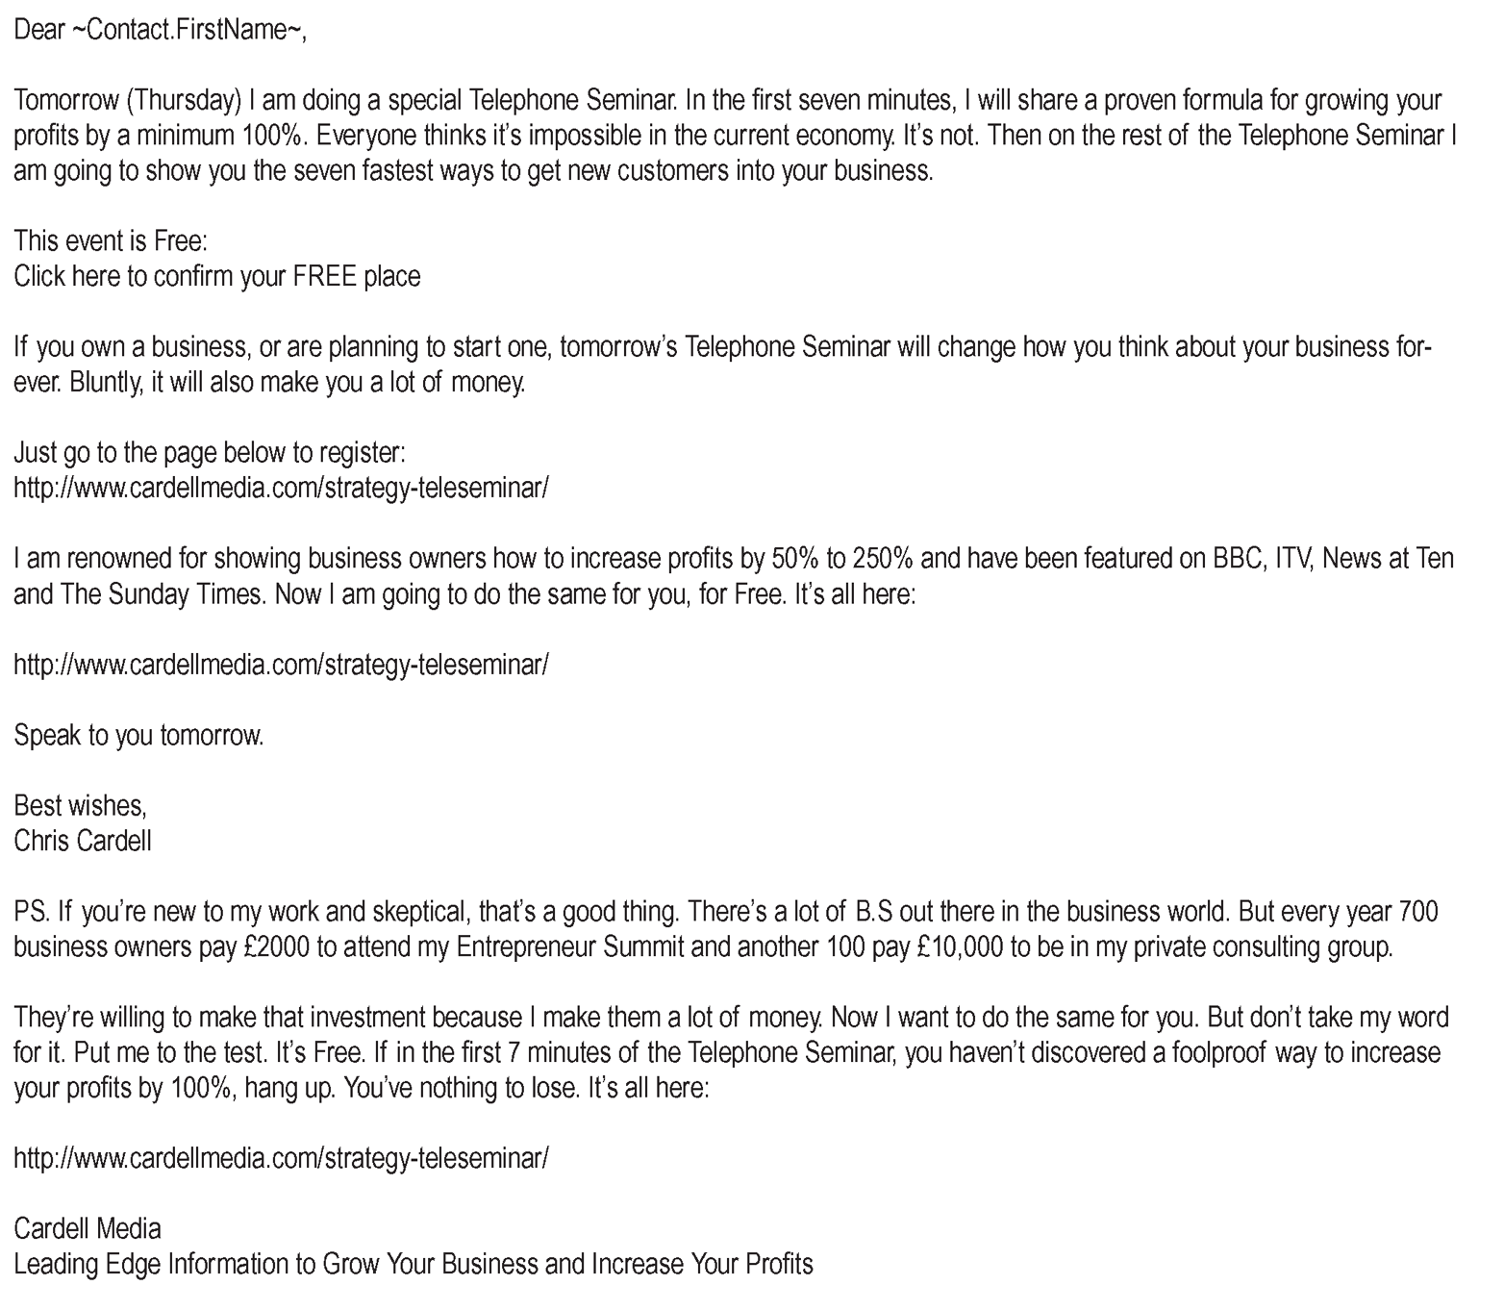
Promotional Email 3

Slide 13
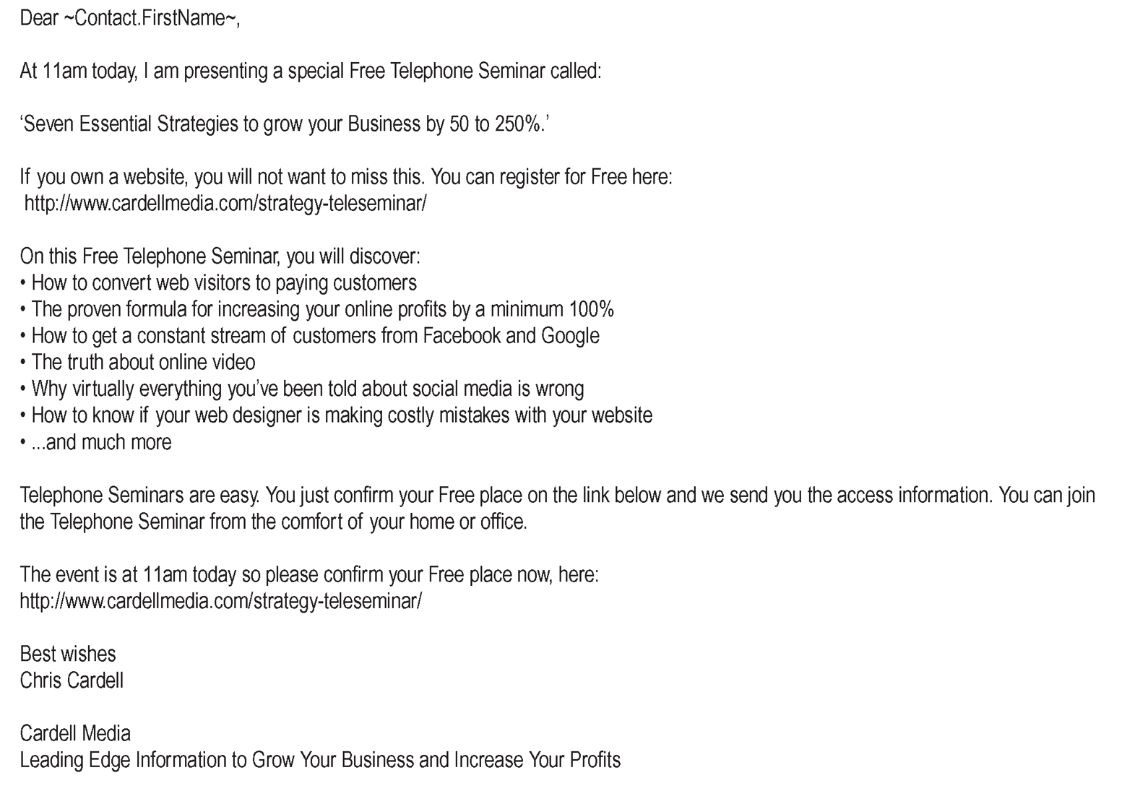
Promotional Email 4

Slide 14
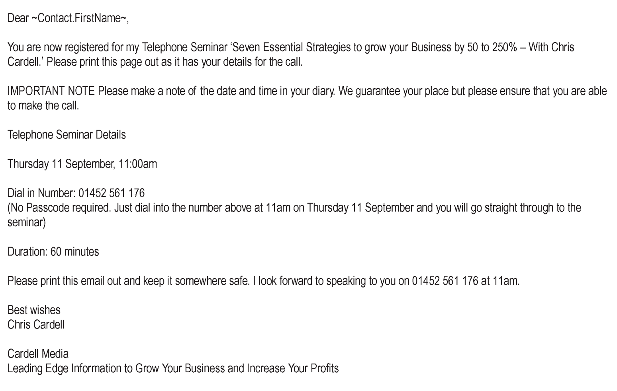
Confirmation Email 1

Slide 15
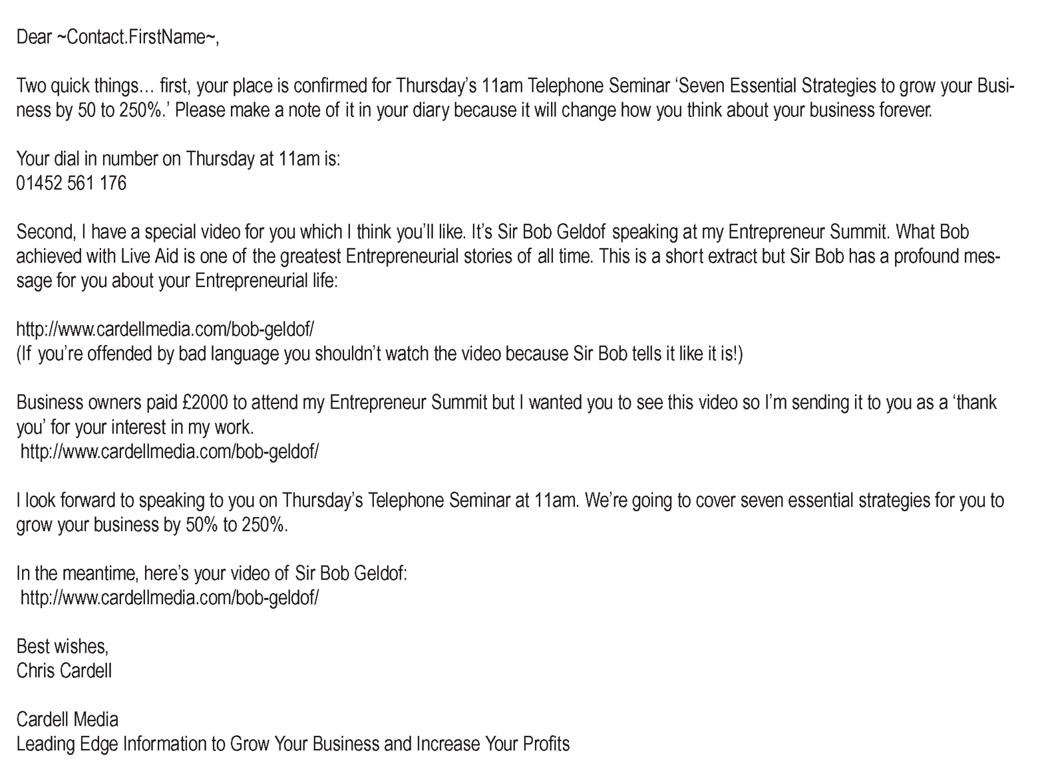
Confirmation Email 2

Slide 16
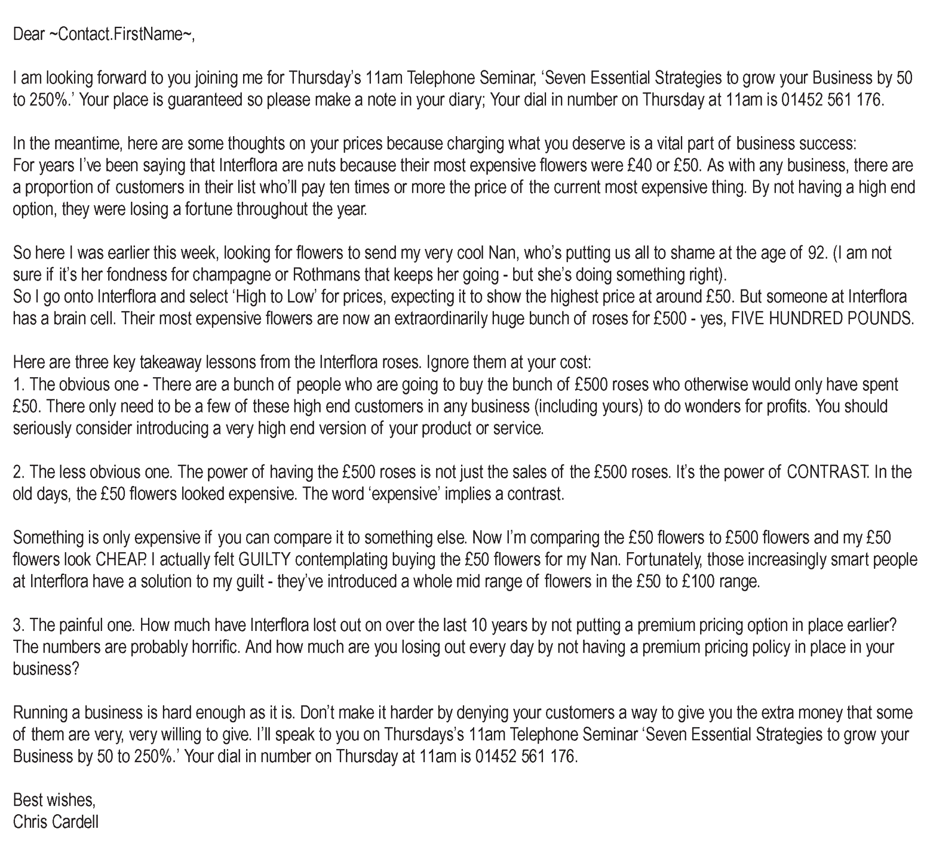
Confirmation Email 3

Slide 17
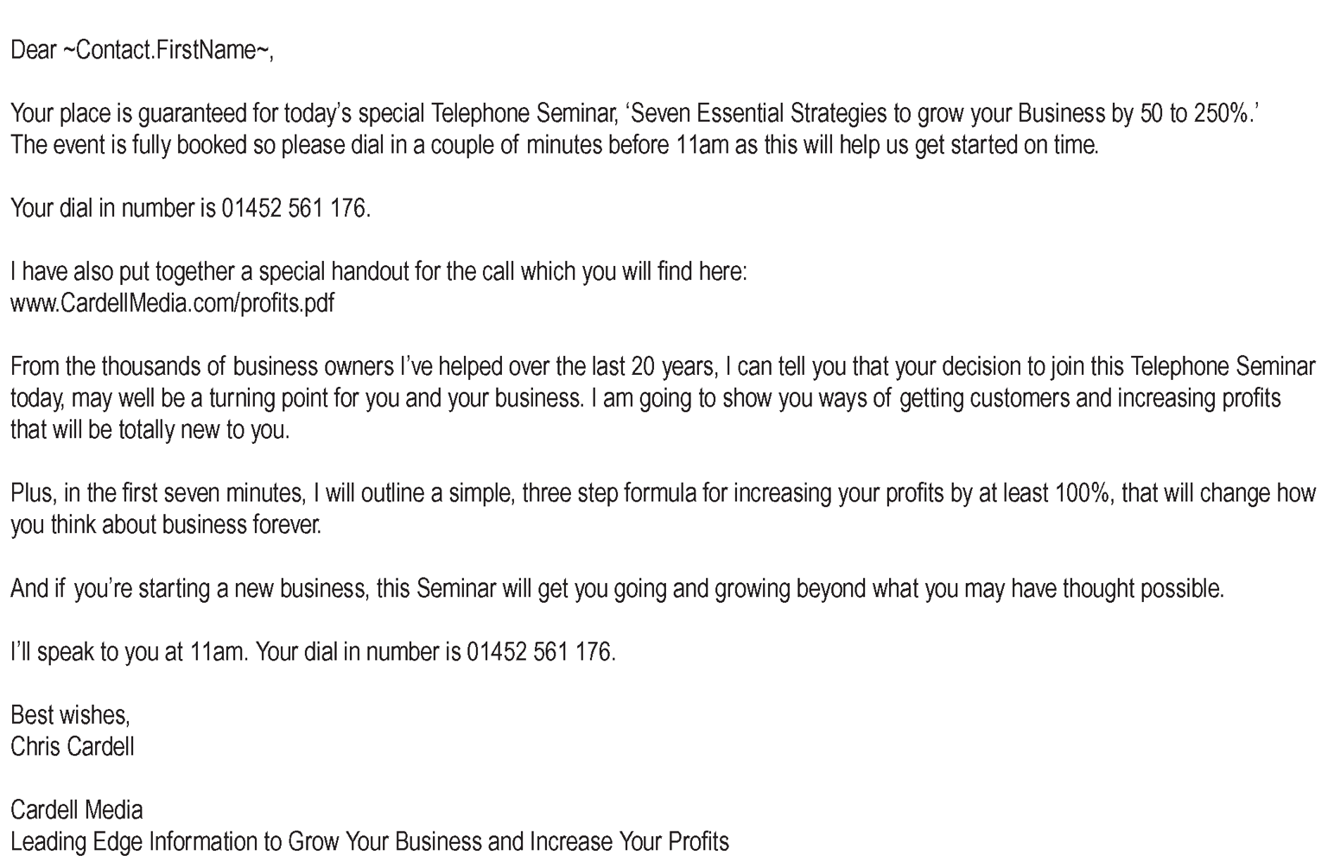
Confirmation Email 4

Slide 18
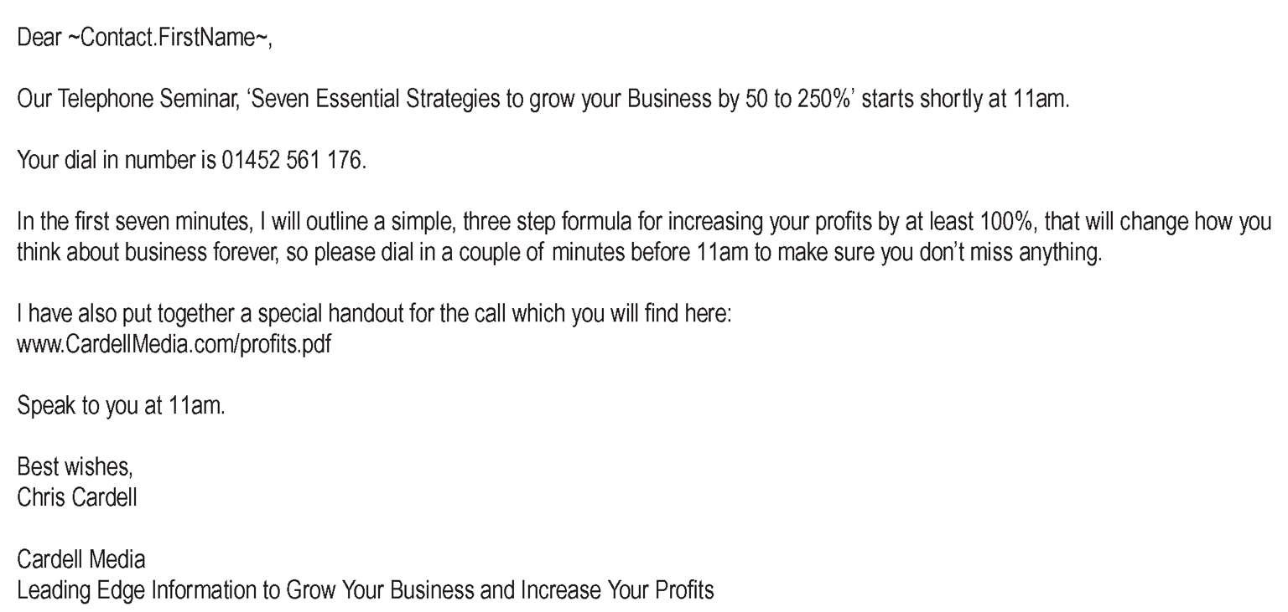
Confirmation Email 5

Slide 19
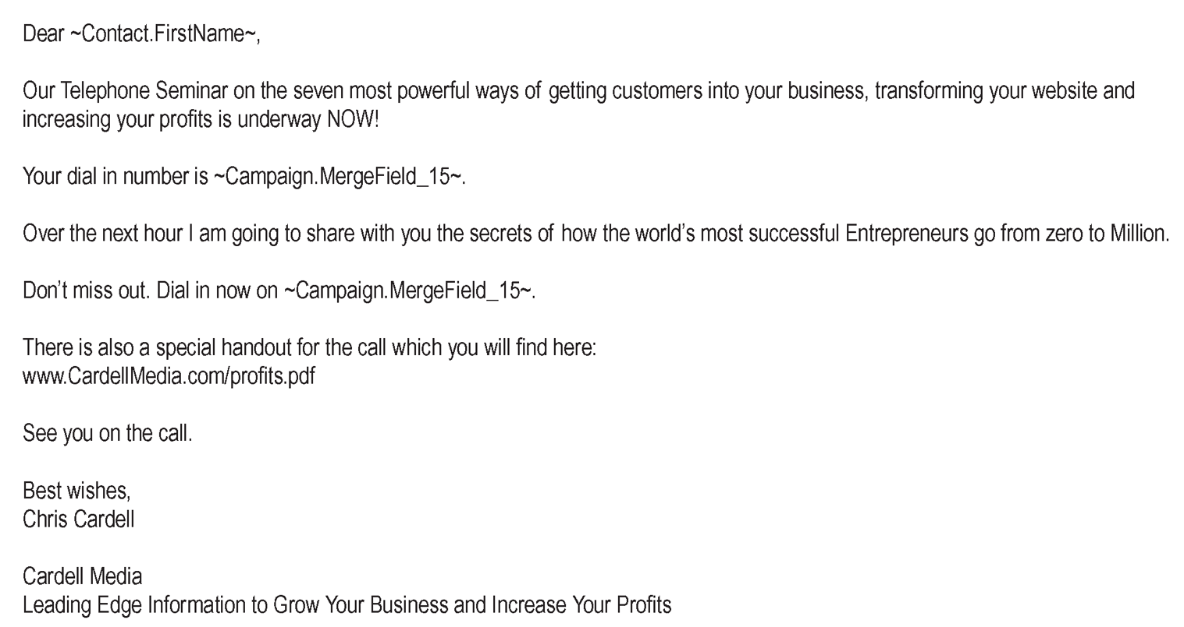
Confirmation Email 6

Slide 20
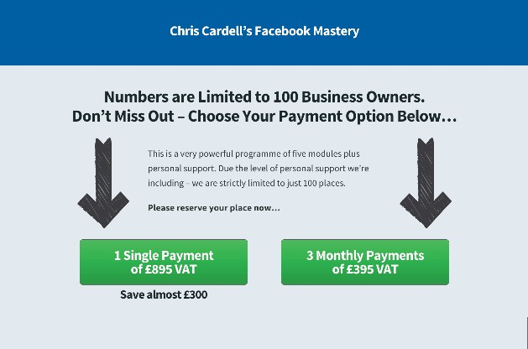
Facebook Mastery Web Page

Slide 21
Seminars and Live Events
Historically, they a VERY important part of most successful Information Marketing Businesses because of three main factors:
Profitable
Relationship
The best place to sell (very important!)

Slide 22
Seminars and Live Events
What I Wish I’d Known About Seminars from Day One:
Getting non-Customers to seminars at a profit is virtually impossible
Once you get them there, they are ten times easier to sell to than anyone else

Slide 23
The Annual Event
2 to 3 Days
You and other industry experts
Celebrities
Networking
An experience
Awards and Prizes
The best place to sell high-end Coaching

Slide 24
The 1 to 2 Day Event
Good place to start
Easy for Customers to attend

Slide 25
Open Evenings
Paid or Free
Large numbers, lower risk for attendees
Can sell longer event

Slide 26
The Free Event Model
Normally designed to sell
Attracts people you won’t reach in
other ways
Refundable deposit if show-up rate
is important

Slide 27
The Free Event Model
Good if you know your numbers:
Cost per Customer
Cost per attendee
Conversion rate

Slide 28
The Million Dollar Weekend
BIG SECRET: The purpose of the event is not to make money from ticket sales

Slide 29
Running Events
Watch your Costs
AV is very important at large events
Take control / assume incompetence
Establish Control of the group

Slide 30
Running Events
Learn Speaking / Training skills
Get ‘Permission’ to sell
Congruent Selling is essential
Scarcity when selling

Slide 31
Marketing and Promoting
Seminars and Live Events
High Frequency
Multiple Media
Telemarketing
Deadlines
Multiple Messages
Segmentation

Slide 32
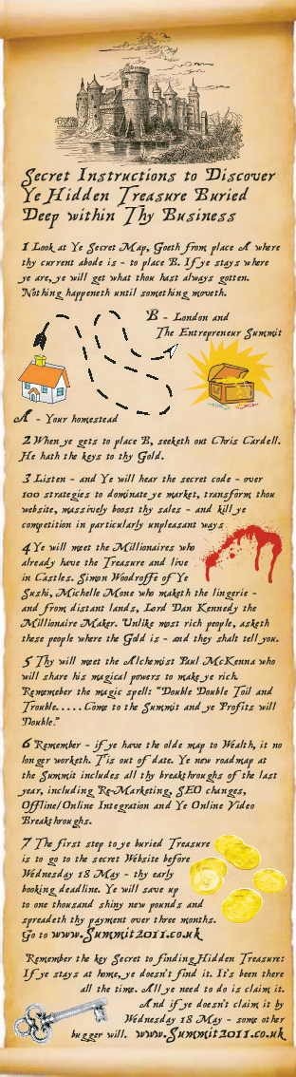
Marketing and Promoting
Seminars and Live Events

Slide 33

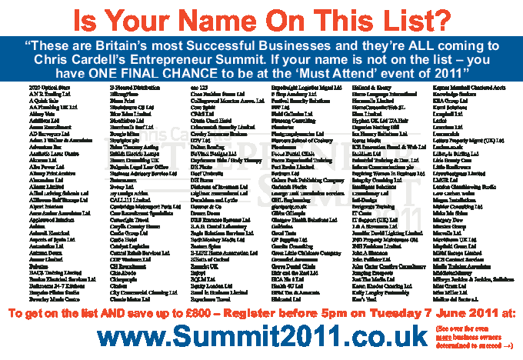
Marketing and Promoting
Seminars and Live Events

Slide 34
Boutique Events
Small group
Niche subject
£2,000 to £10,000

Slide 35
Next Week – Seminar 4
Marketing your Information Marketing Business

Slide 36
Members Hub
http://www.cardellmedia.com/info-hub

