Slide 1



Slide 2
Members Hub
http://www.cardellmedia.com/info-hub

Slide 3
Seminar Two: Products, Online Courses and Membership Programmes

Slide 4
Products
High Profit Margins
Solutions in a Box
High Perceived Value
No Geographic Limits
No Customer effort required

Slide 5
Formats
DVDs
CDs
Reports / Manuals
Books
Online Resources

Slide 6




Products

Slide 7
Key Principles
Bulk
The Flagship Product
Repurposing

Slide 8
Product Creation Strategies - DVDs
Narrated Power Points
You to camera
Filming of event
Event Recording
Interview Format

Slide 9
Product Creation Strategies – Reports / Guides / Manuals / Ebooks
Written by you
Written by Copywriter (possible interview format)
Transcribed from Teleseminar / Webinar
Re-purposed

Slide 10
Writing Strategies
Bullet Points vs. Scripts
Visual and Auditory processing
Examples, stories and metaphors
Remember – RELATIONSHIP

Slide 11
Writing Strategies
The Radio News Format:
Tell them you’re going to tell them
Tell them
Tell them you told them

Slide 12
The Big Info Marketing Transition:
Products >>> Online Courses

Slide 13
Online Programmes
Live Webinar Format
1 – 10 Webinars
Live Events plus access to the Recordings
Backed up with Personal Support

Slide 14
Online Programmes
Highly Popular Format
Location not an issue
Taps into ‘Netflix’ Behaviour
Consumption is easier so
implementation is more likely

Slide 15
Online Programmes – Suppliers
GoToWebinar
Stealth Seminars
Ustream

Slide 16
Membership

Slide 17
Membership
Normally an important part of
Customer Value
Purpose: Income AND Engagement

Slide 18
Membership
Formats:
  Physical Newsletter
  CD/DVD
  Online Resources / Video
  Monthly Teleseminars
  Monthly Coaching Calls
  Live Events

Slide 19
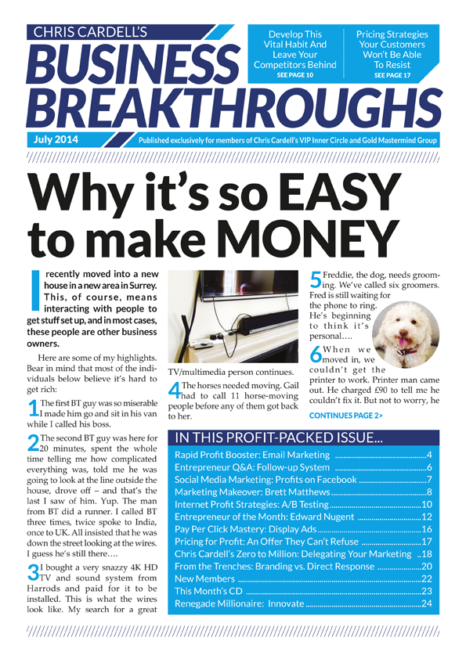

Slide 20
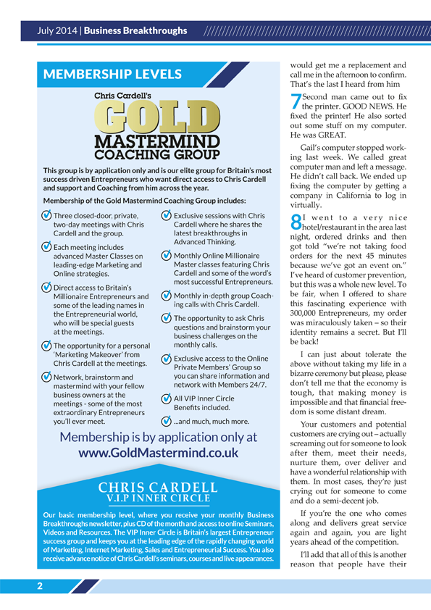

Slide 21
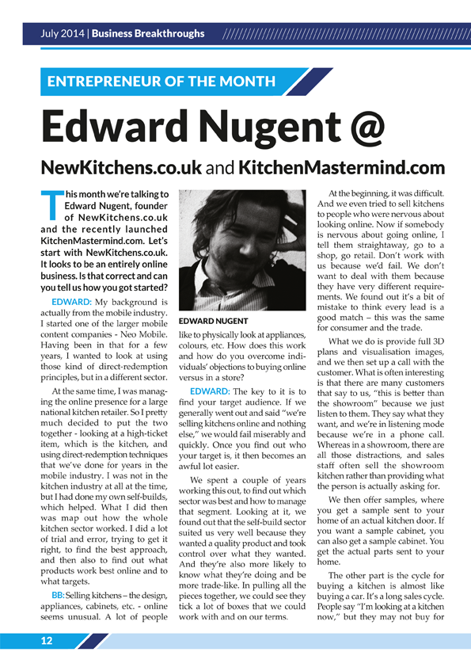

Slide 22
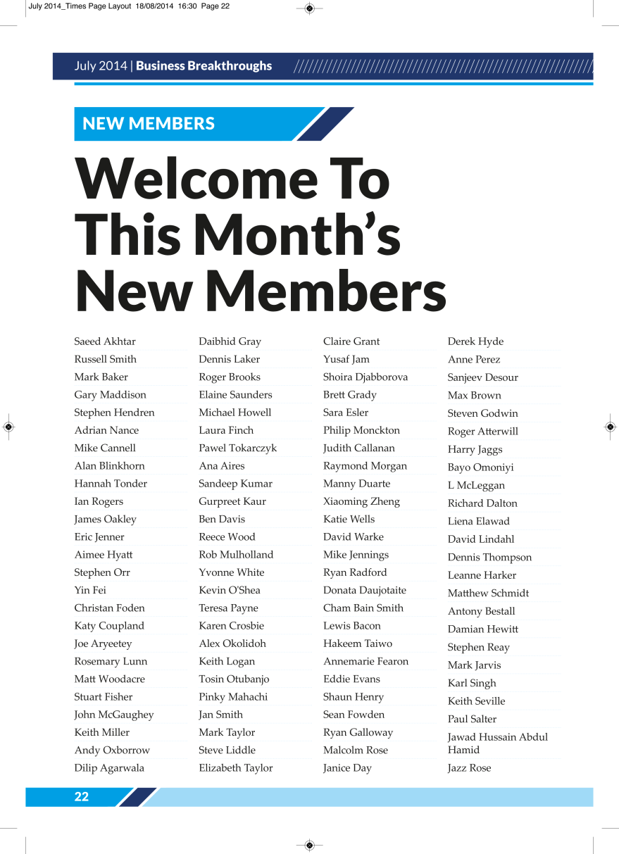

Slide 23
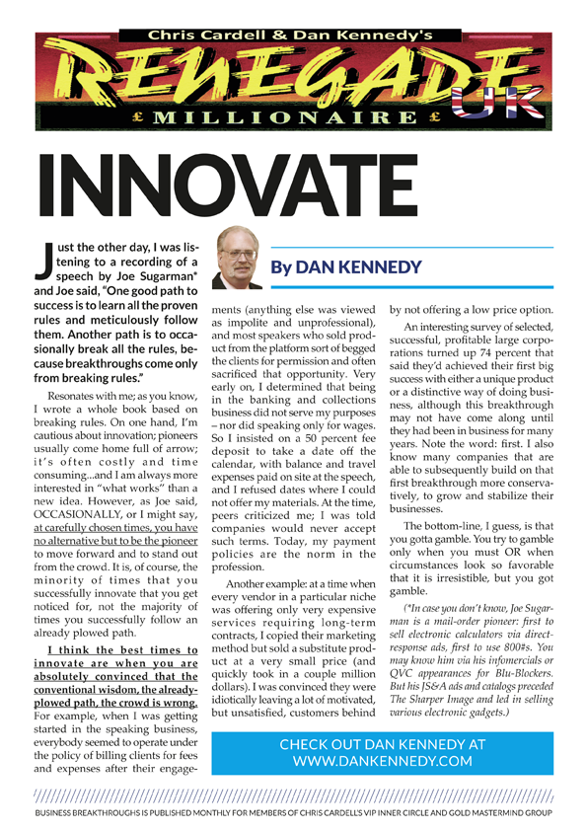

Slide 24


Slide 25
Membership
Price points
Low end: £19.95 – £97
High end: £195 - £995
Often sold through Free Trials
Forced Continuity
Retention is achieved through Engagement

Slide 26
The Golden Secrets
of the Information Marketing Business

Slide 27
The Golden Secrets of the Information Marketing Business
2) The 5% Rule

Slide 28
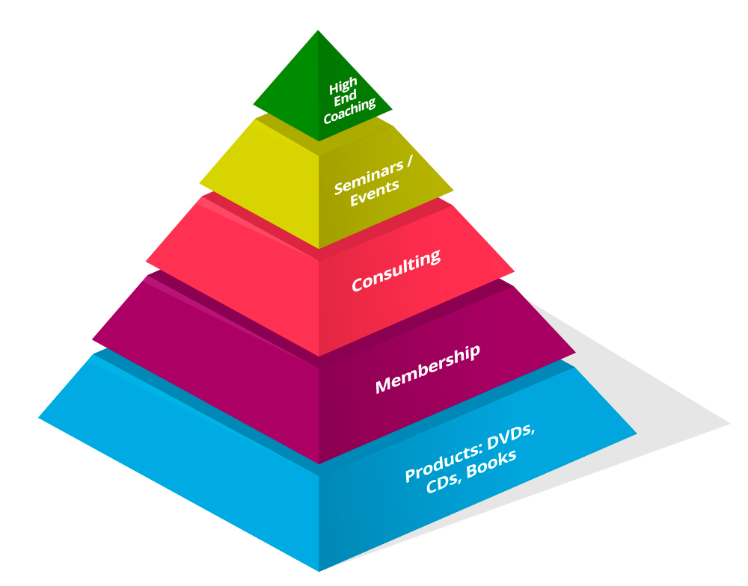

Slide 29
Next Week – Seminar 3
The Profitable World of Teleseminars, Webinars and Seminars

Slide 30
Members Hub
http://www.cardellmedia.com/info-hub

