Slide 1

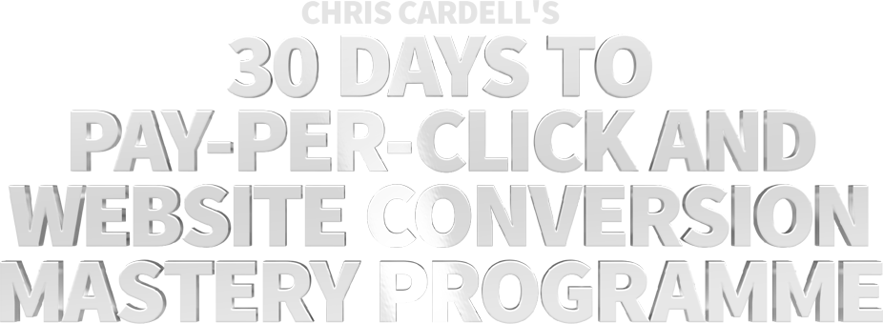

Slide 2
SEMINAR ONE:
Getting Started, and Maximising Your
PPC Campaigns

Slide 3
MAIN COURSE PAGE AND MEMBERS’ PRIVATE GROUP
All the course information, slides and
Seminar recordings are here:
http://www.cardell2015.com
The Private Facebook Group for Members is here:
https://www.facebook.com/groups/ppcmastery/

Slide 4
BONUS VIDEO
How to Create Your First
Google AdWords Campaign
http://www.cardell2015.com

Slide 5
30 Days to Pay-Per-Click and Website Conversion Mastery Programme
Video Seminar One:
Getting Started and Maximising Your
Pay-per-Click Campaigns
Video Seminar Two:
Advanced PPC Strategies to Double
or Triple Your Response

Slide 6
30 Days to Pay-Per-Click and Website Conversion Mastery Programme
Video Seminar Three:
Essential Website Conversion Strategies
Video Seminar Four:
The Secrets of the PPC and Internet Marketing Millionaires
Video Seminar Five:
The New Advertising Paradigm –
Google and the Mobile Revolution

Slide 7
Why Mastery?
In any successful business, we are constantly looking at the most productive use of our time. For every hour of input, what will produce the maximum output – specifically, customers, income and profit?
There is a dramatic disparity between those who take the time to excel at PPC – and the rest. Google reward the smart marketers with hundreds or thousands more customers, often at up to half the price.

Slide 8
Why Mastery?
Combine the power of PPC with the potential that exists from optimising your website conversions and you have a true Game Changer. So there’s a reason that the word ‘Mastery’ is included in the title of this course.

Slide 9
Your Sales Process
Google serves up your ad - Can be significantly increased with a good Keyword strategy.
A percentage of people who see the ad click on it - improvements through copy and pricing strategy.
They arrive at your website, where a percentage take action - conversion strategy.

Slide 10
Your Sales Process
Having begun a relationship with you, you are able to communicate regularly to these leads
and customers.
Over time, leads become customers and customers can be re-sold to.

Slide 11
The Cumulative Effect of improving your
Pay-per-Click and Website Conversion
EXAMPLE 1
Number of People who click on your Ad 1000
(1.5% click-through rate)
Number of People who take action on your website 5% = 50
Number of people who become Customers 10% = 5
Lifetime Value of each customer £1000
Total Income £5,000

Slide 12
The Cumulative Effect of improving your
Pay-per-Click and Website Conversion
EXAMPLE 2 – Our Goal for This Course
Number of People who click on your Ad 2000
(3.0% click-through rate)
Number of People who take action on your website 10% = 200
Number of people who become Customers 20% = 40
Lifetime Value of each customer £1000
Total Income £40,000

Slide 13
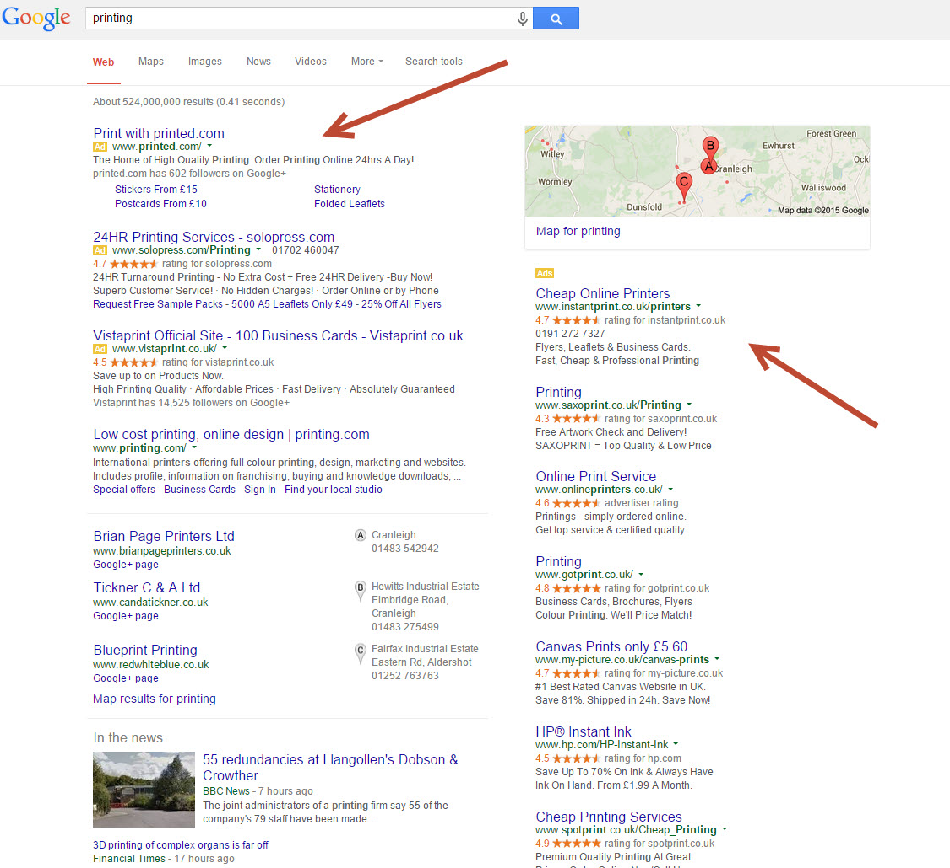

Slide 14
Why Use Pay-per-Click Advertising?
Targeting
Pay for Results
Attraction Marketing
Local or National
Predictable and Scalable
No Staff

Slide 15
How it Works
In your Google AdWords account, you will have:
Campaigns
You can have one or more campaigns. Your campaigns contain a set of Ad Groups.
Ad Groups
Each ad group contains a set of (one or more) Keywords and the ad or ads associated to those Keywords.

Slide 16
How it Works
Choose your Keywords
Write your Ads
Decide how much you’re willing to spend per click
Measure your results

Slide 17
How Much Should You Pay per Click?
Keep the emotion out of it and just look at the figures. Whether 10p or 50p or £5 per click feels too expensive
is totally irrelevant.
All that matters is your return on investment. All that matters is whether your PPC campaign is profitable.

Slide 18
How Much Should You Pay per Click?
You should start off your campaign spending as much as you can to get your ad in the top three or four because it will help you quickly get a good click-through rate (CTR).
Once you're up and running, the most important thing is to be able to measure the response so you can work out what you are willing to pay to 'acquire' each new customer.

Slide 19
How much should you Pay per Click?
Unless cash flow is an issue, start higher.
There is no ‘right’ amount, and ‘expensive’ is not the issue. It’s all about ROI.
If you’re hitting your daily budget, lower your CPC (cost per click).
Expect to be able to halve your cost per click over time if you want to.

Slide 20
Daily Budgets
You can specify a maximum daily budget so that you always know how much you are going to spend.
This is just one of the factors that sets PPC apart from traditional advertising. The ability to be able to test on a very small scale is particularly useful for small businesses.

Slide 21
Daily Budgets
Pay-per-Click Golden Tip
If you want to limit the amount you spend, reduce your cost per click before you reduce the daily budget. This will either reduce the amount you are paying per customer and/or bring you more customers for the same price.

Slide 22
BID HIGHER THAN YOU’RE Planning to pay
One of the anomalies of the Google system is that you often have to enter a maximum bid that’s higher than you’re willing to pay.
For example, if you’re willing to pay 20p per click, you may need to have a maximum Cost per Click (CPC) of 30p or more. But it varies, so make sure that you monitor your campaign carefully.

Slide 23
The breakeven concept
When measuring the results of your Pay-per-Click advertising, be aware of the break even concept. If you have a good ongoing product or service range to offer customers, it can often be worth breaking even on the initial sale.
This should not be necessary with a good PPC campaign, but think carefully before stopping a break-even Marketing campaign (of any type).

Slide 24
Click Fraud

Slide 25
Click Fraud
Google has significant protections in place
Easy to notice if you’re measuring conversions
If it's profitable, does it matter?

Slide 26
LOCAL ADVERTISING

Slide 27
Local advertising
Any Geographic Location – so can be used by any size business
Even Regional and National Advertisers can test local advertising

Slide 28
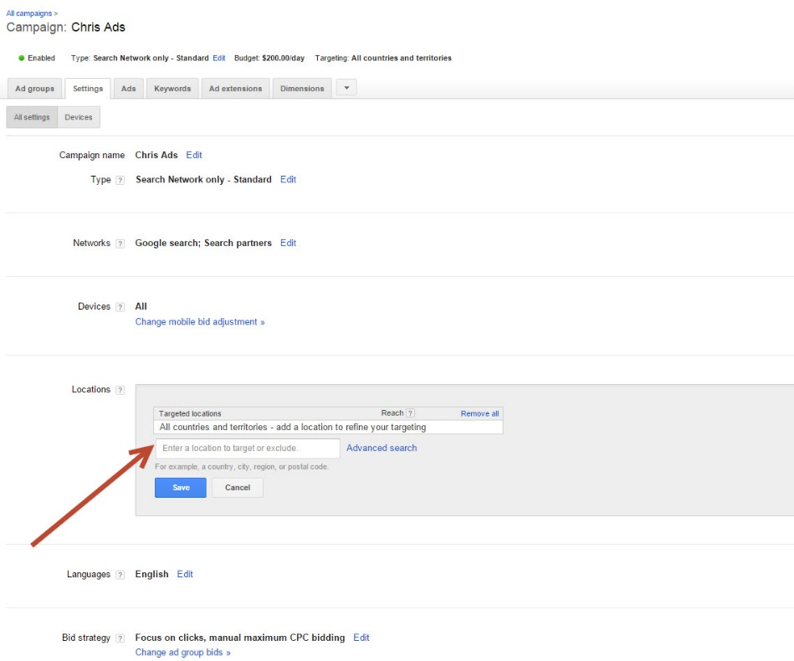
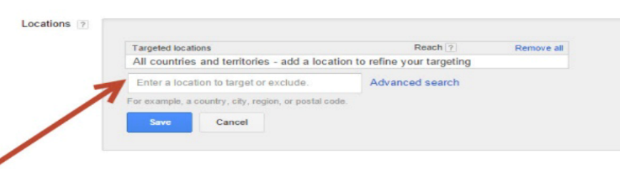
Local advertising

Slide 29
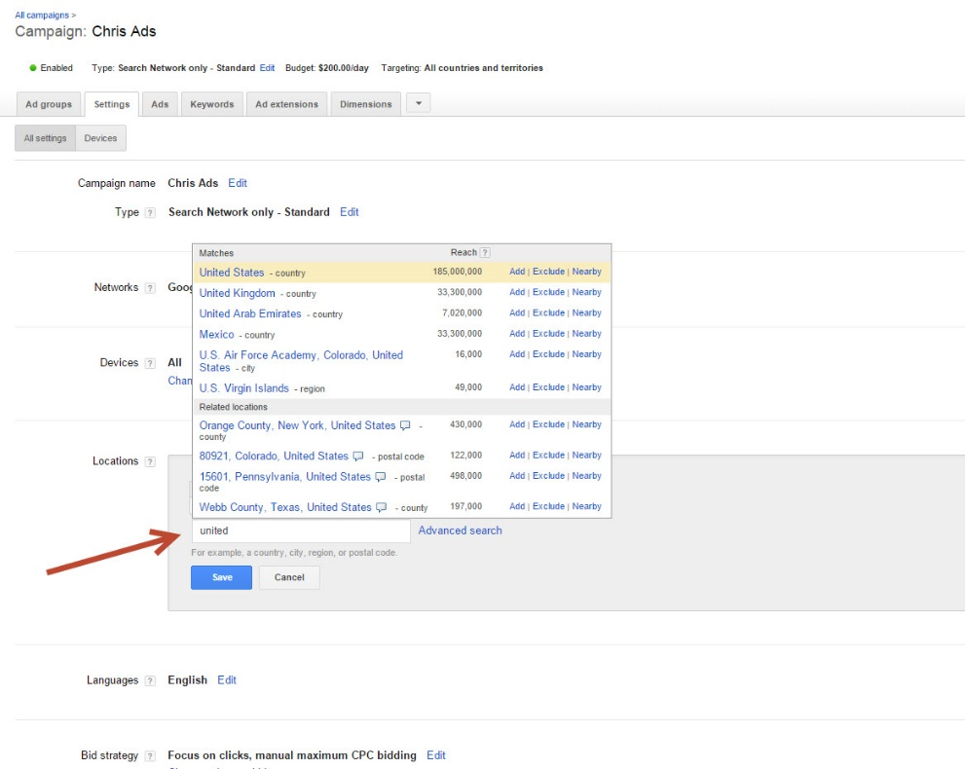
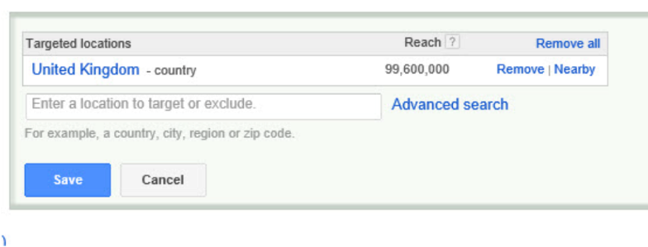
Local advertising

Slide 30
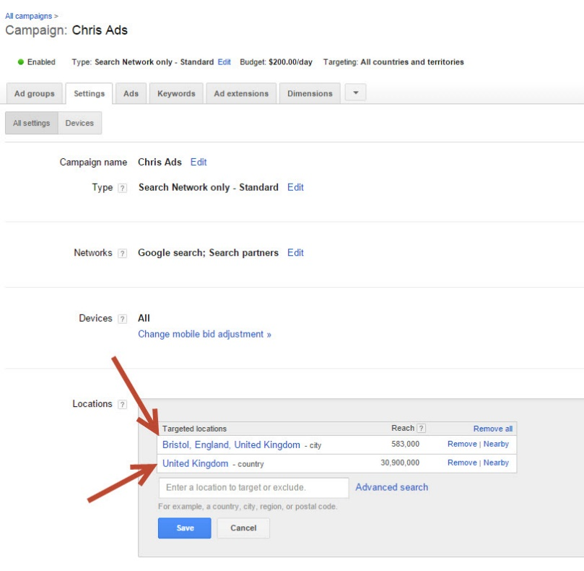
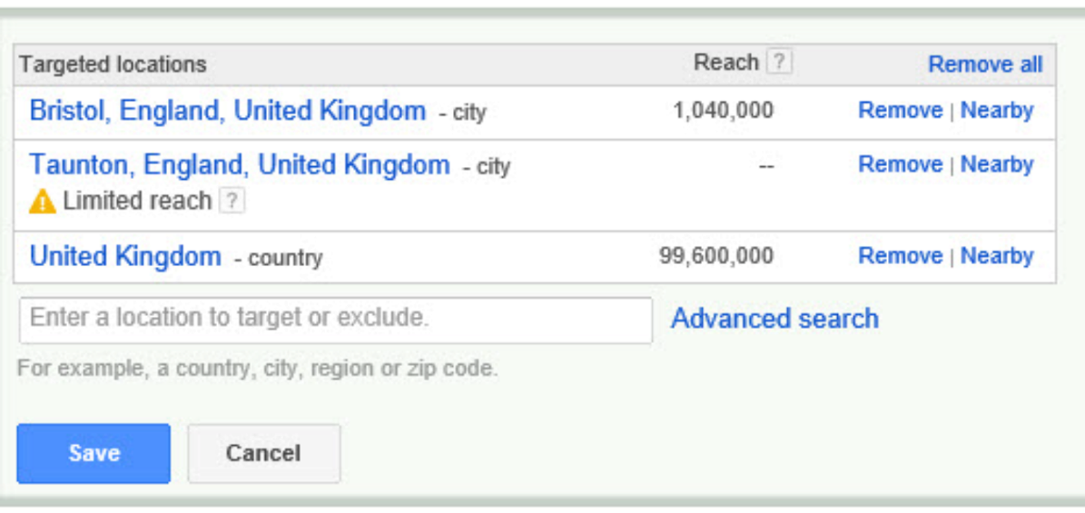
Local advertising

Slide 31
KEYWORDS

Slide 32
Keywords
The
FOUNDATION
of Your Google AdWords Success is
Keywords

Slide 33
Keywords
Whether you’re new to PPC Advertising or improving your current campaigns, most people think that the place to start is the ad.
It isn’t.
Start with your Keywords.

Slide 34
Keywords
One of the keys to Pay-per-Click success is:
LARGE NUMBERS OF
KEYWORDS

Slide 35
Keywords
Typical businesses will list two to six Keywords related to their business.
There are two issues with this approach:
You end up with only the most competitive and expensive Keywords
You miss out on a variety of related Keywords that you could be bidding on

Slide 36
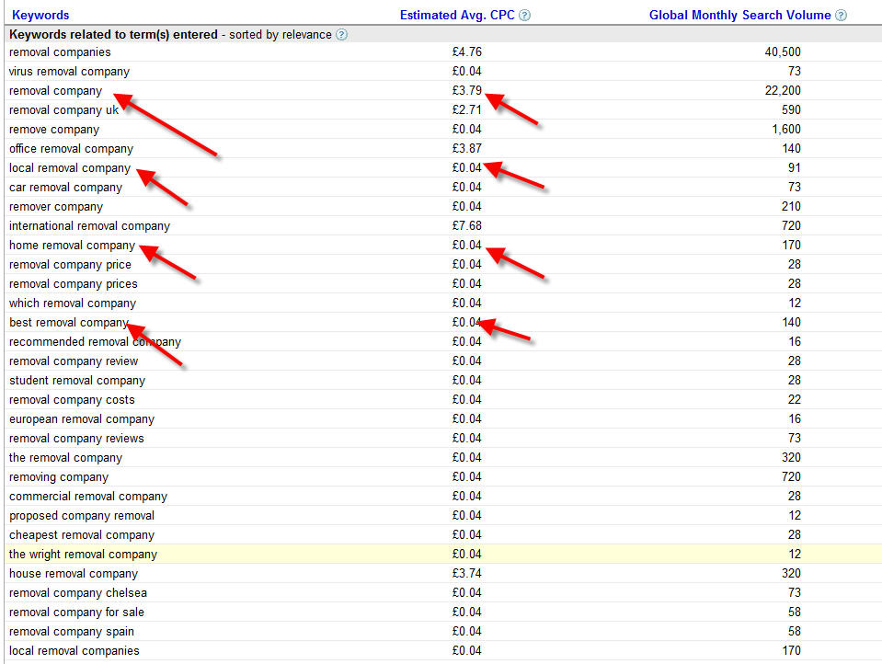

Slide 37
Keywords
If you had the option to pay £3.70 or 4p for someone to come to your website, which
would you choose?

Slide 38
Keywords
Finding Keywords
Common sense
Your own Marketing materials
Website copy
Brochure and Marketing copy
Customer emails

Slide 39
Keywords
Finding Keywords
The Google ‘Keyword Planner’ Tool
Go into your account, then click on “Tools,”
then “Keyword Planner”

Slide 40

Keywords

Slide 41
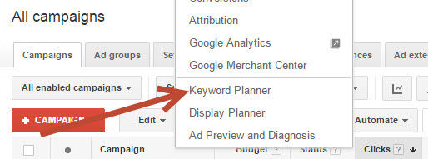
Keywords

Slide 42
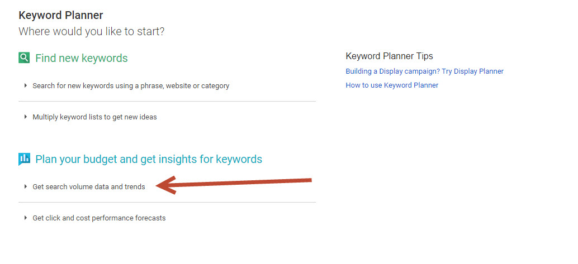
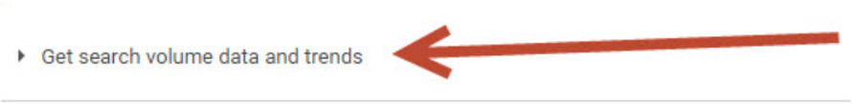
Keywords

Slide 43
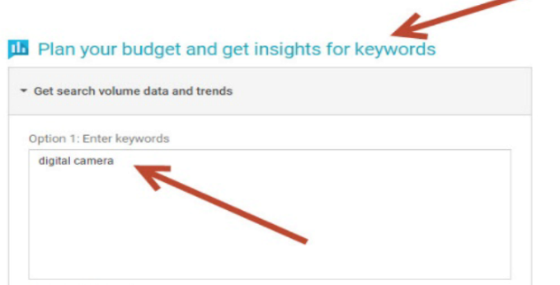
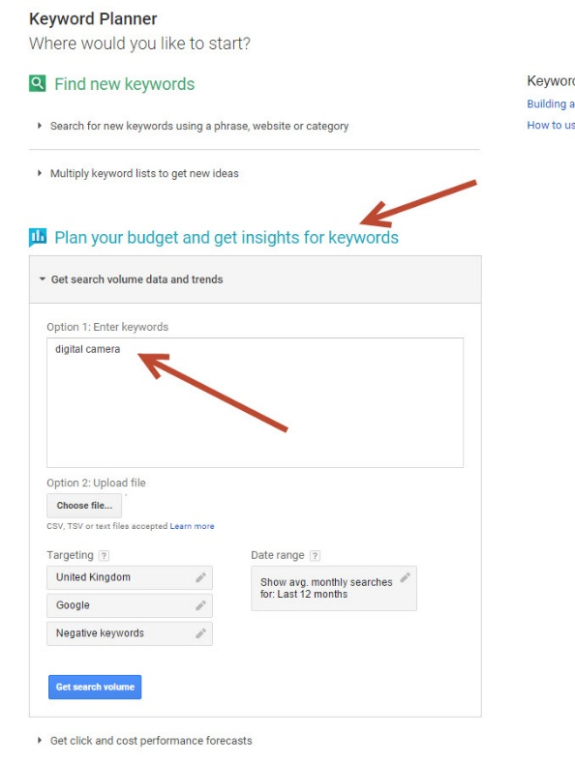
Keywords

Slide 44
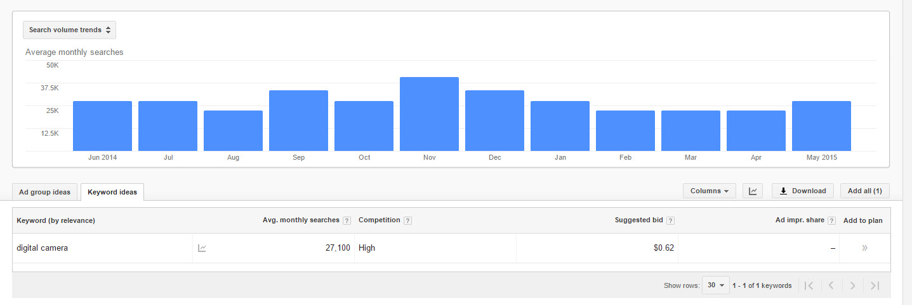
Keywords

Slide 45
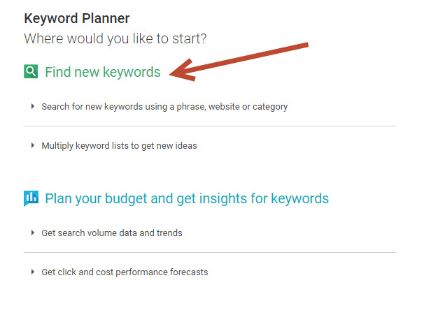
Keywords

Slide 46
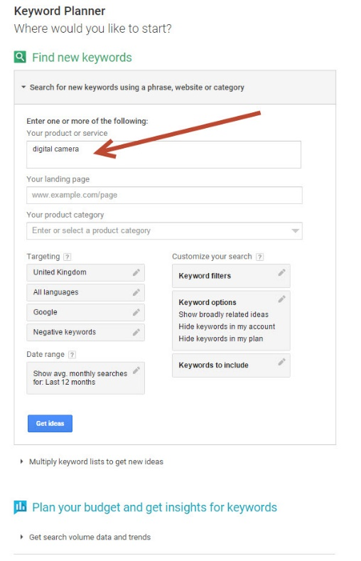
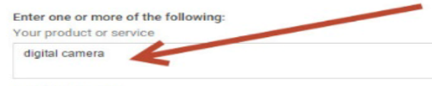
Keywords

Slide 47
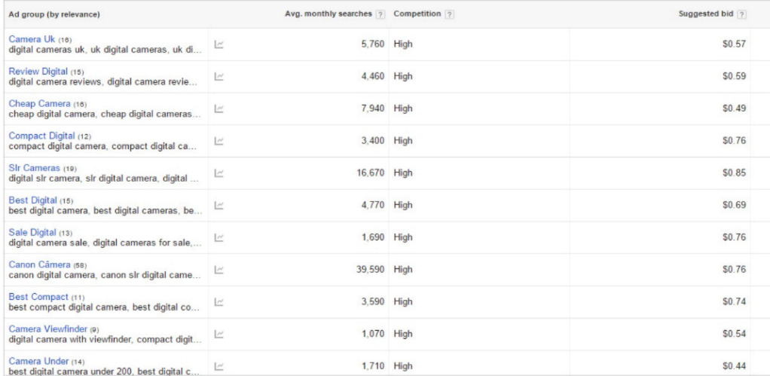
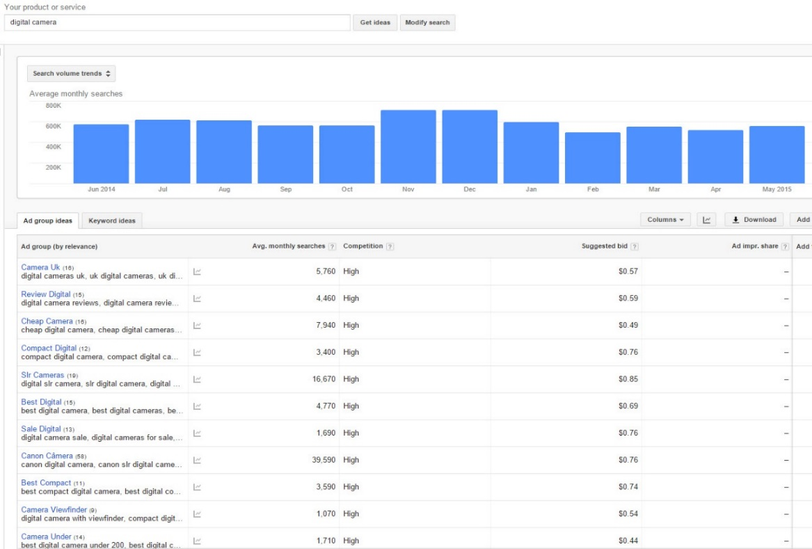
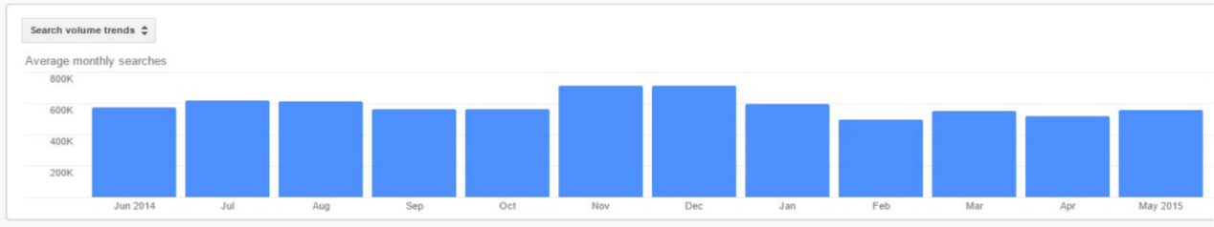
Keywords

Slide 48
Keywords
Finding Keywords
The Google ‘Keyword Planner’ Tool
Go into your account, then click on “Tools,”
then “Keyword Planner”
Wordtracker, www.wordtracker.com
Keyword Details Report

Slide 49
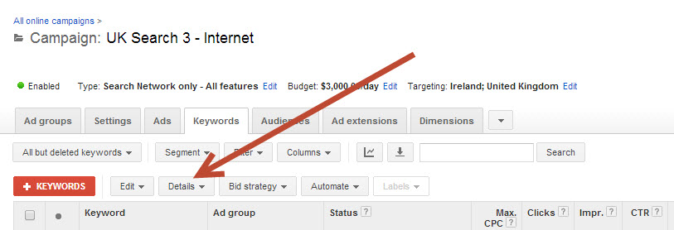
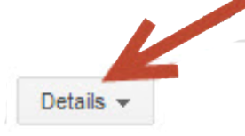
Keywords

Slide 50
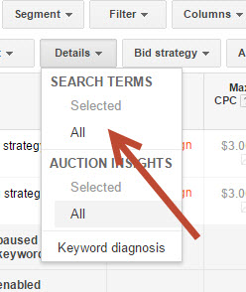
Keywords

Slide 51
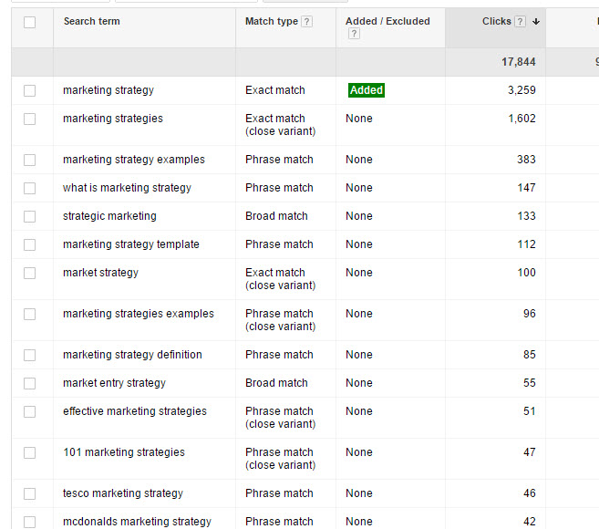
Keywords

Slide 52
KEYWORD
MATCHING
OPTIONS

Slide 53
Keyword Matching options
How Matching Options Work
There are different ways of inputting Keywords, and how you do it will determine when your ads are displayed.
Broad Match: tennis shoes
Broad Match Modifier: +tennis +shoes
Phrase Match: “tennis shoes”
Exact Match: [tennis shoes]

Slide 54
Keyword Matching options
Broad Match: tennis shoes
Google will display your ad on any version of the phrase “tennis shoes”.
On Broad Match, your ad will also appear for related phrases, e.g., “sporting footwear.”

Slide 55
Keyword Matching options
Broad Match: tennis shoes
Example: Marketing
Our ads were appearing when people searched for phrases like “Billingsgate Market”.
Someone searching for Billingsgate Market probably isn’t looking for what I have to offer.
Be very careful about using Broad Match!

Slide 56
Keyword Matching options
Broad Match Modifier: +tennis +shoes
Your ad will display when the words “tennis” and “shoes” are present in the query.
Start with Broad Match Modifier, not Broad Match.

Slide 57
Keyword Matching options
Phrase Match: “tennis shoes”
Your ad will display when the query includes your exact phrase.
Your ad will appear if someone searches for, “Where can I get new tennis shoes?”
If they search for, “Where can I get shoes to play tennis in?” your ad will not appear.
Phrase Match is more specific and more accurate.

Slide 58
Keyword Matching options
Exact Match: [tennis shoes]
Your ad will only be displayed if people search for the phrase “tennis shoes” and nothing else.
If people search for “cheap tennis shoes”, your ad won’t appear.
You will get less clicks, but they will be highly qualified clicks.

Slide 59
Keyword Matching options
Best Practice
Is to get to the point where you have a large number of Ad Groups, each with just a phrase and exact match – or just an exact match. Then broad match is used for research or if you are certain that it is profitable for you.

Slide 60
Competitors’ Trademarks and Keywords
You cannot use a trademark in your ad unless you own it. Legally, you can use a trademark as a Keyword. So if you own your own brand of training shoes, you could use ‘Nike’ as a Keyword.
If your competitors are corporations, this is a strategy you may want to consider. If they are small businesses or individuals, it’s generally regarded as bad practice to try to steal their traffic.

Slide 61
MEASURE CONVERSIONS

Slide 62
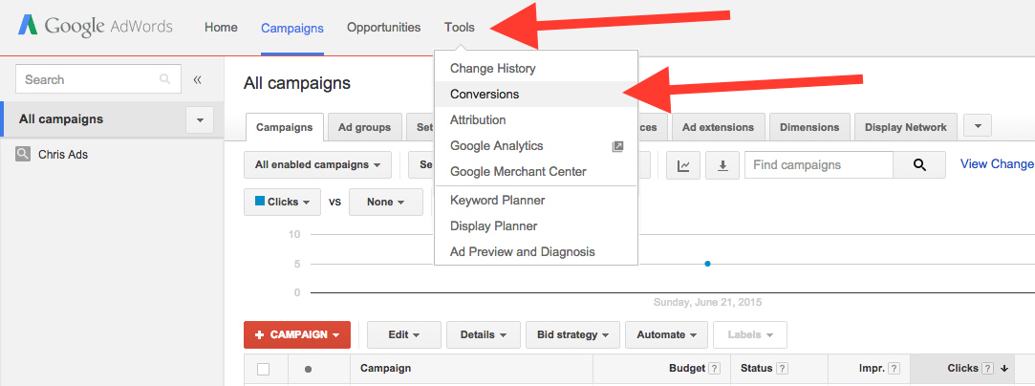
Measure Conversions

Slide 63
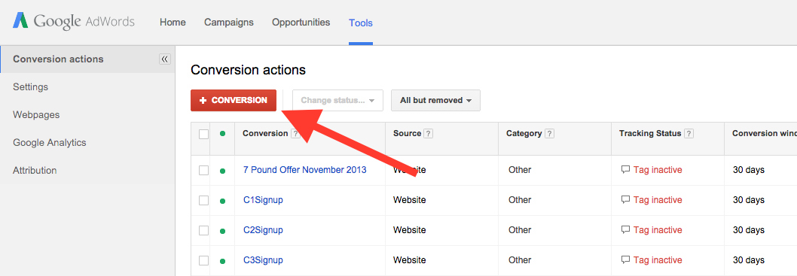
Measure Conversions

Slide 64
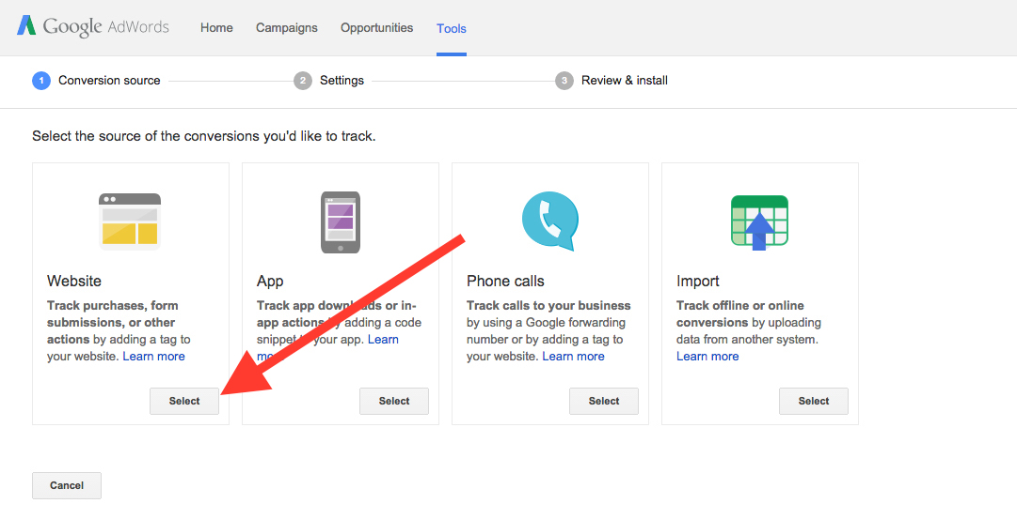
Measure Conversions

Slide 65
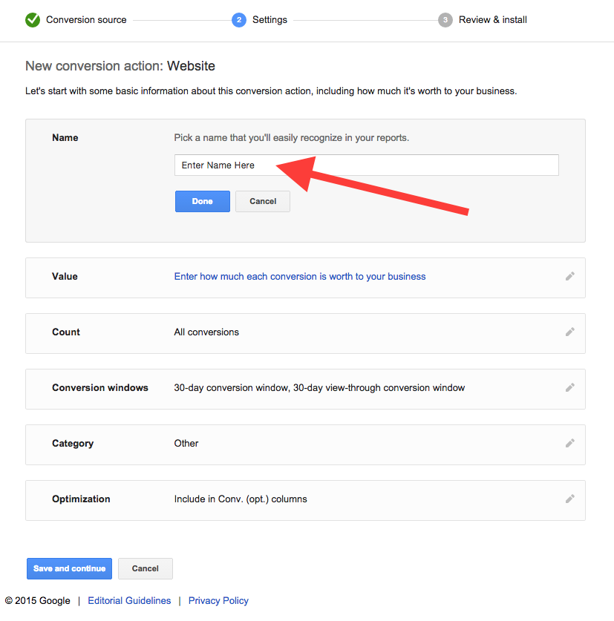
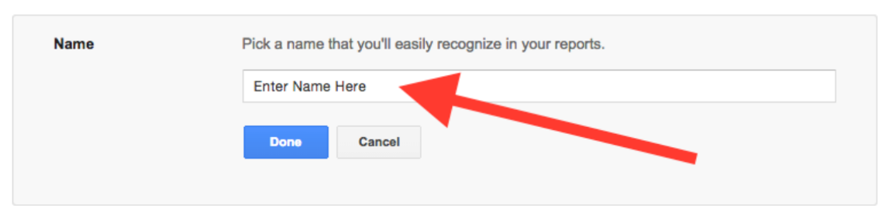
Measure Conversions

Slide 66
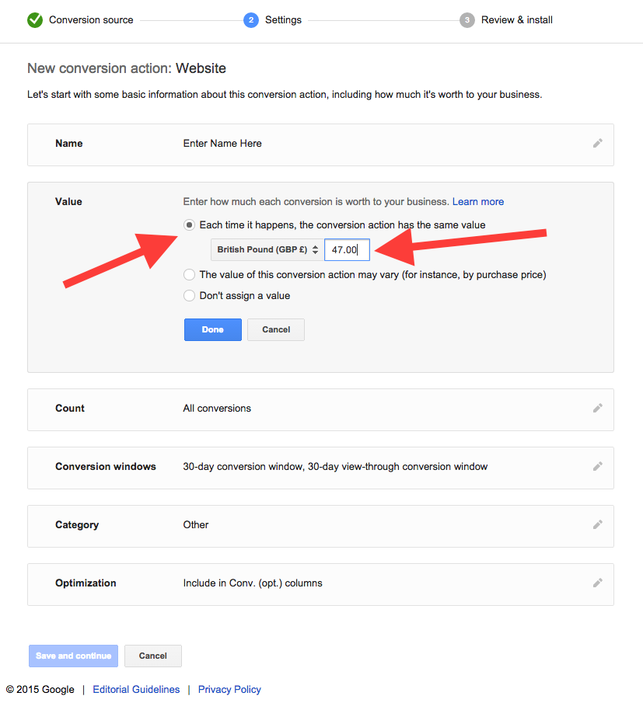
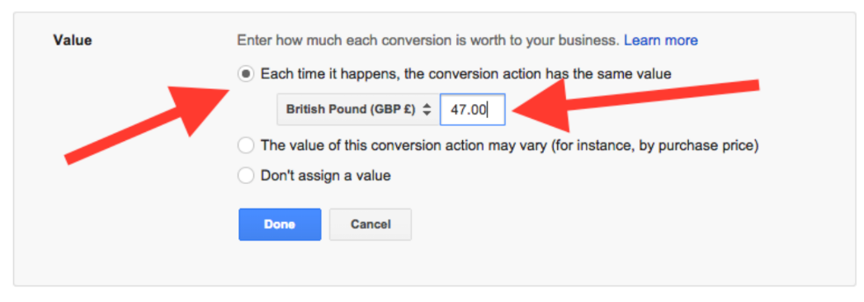
Measure Conversions

Slide 67
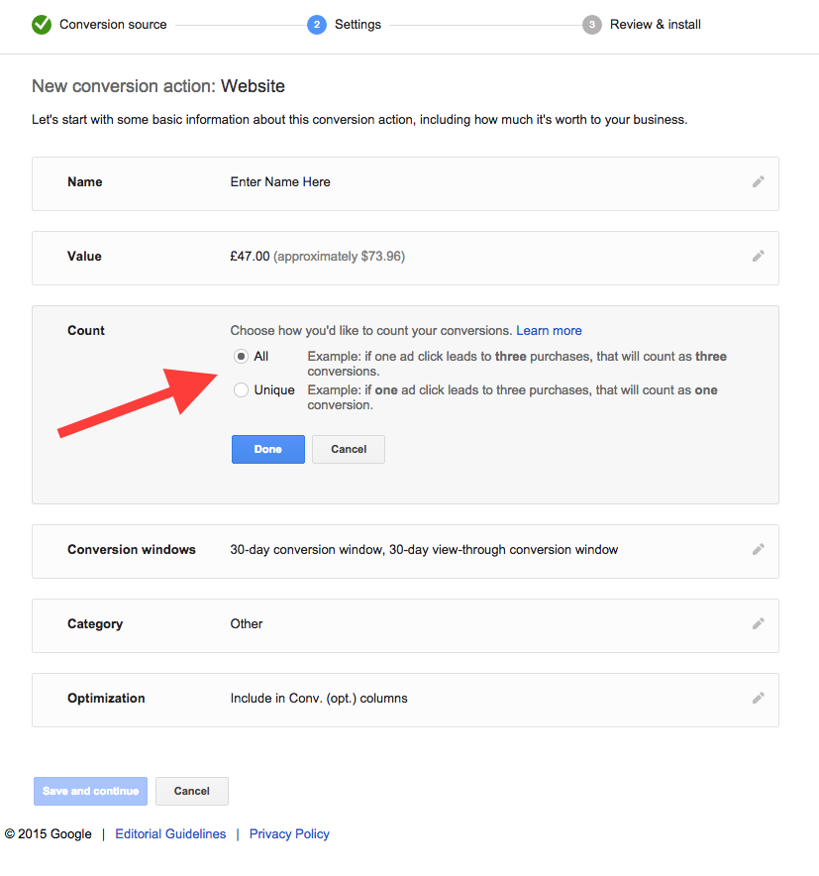
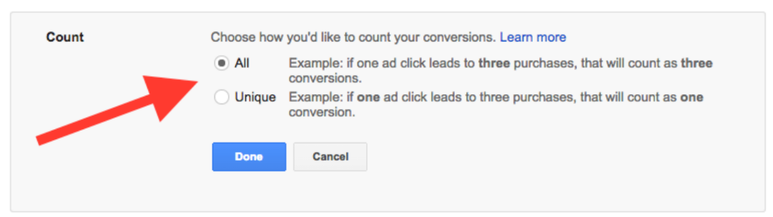
Measure Conversions

Slide 68
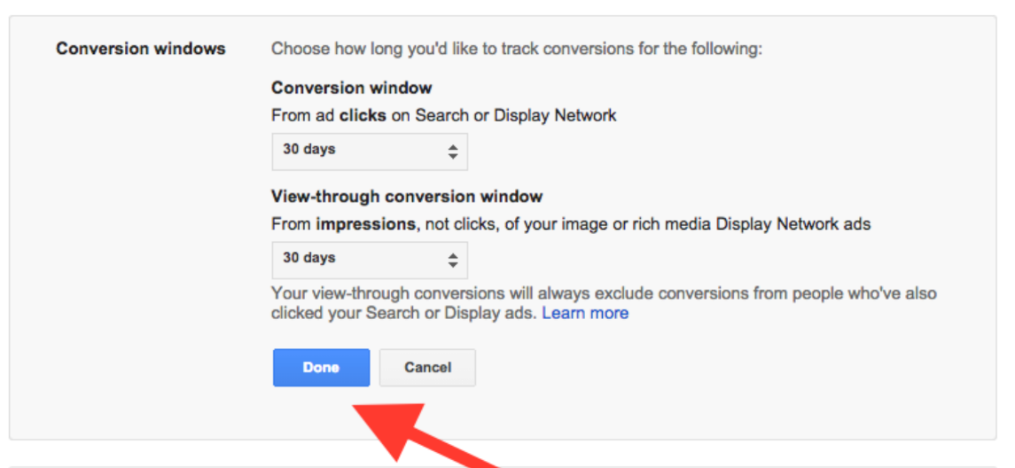
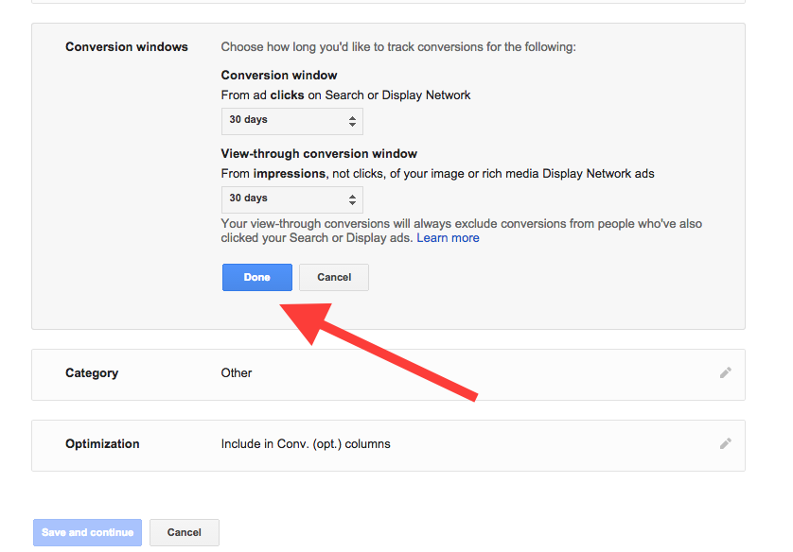
Measure Conversions

Slide 69
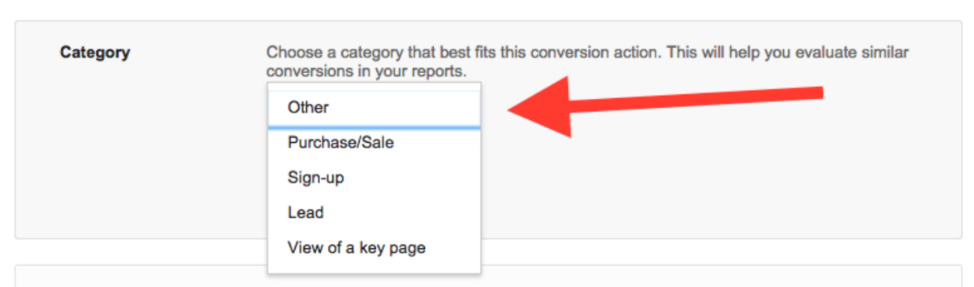
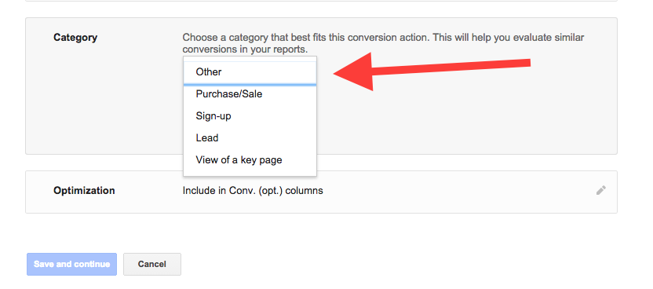
Measure Conversions

Slide 70
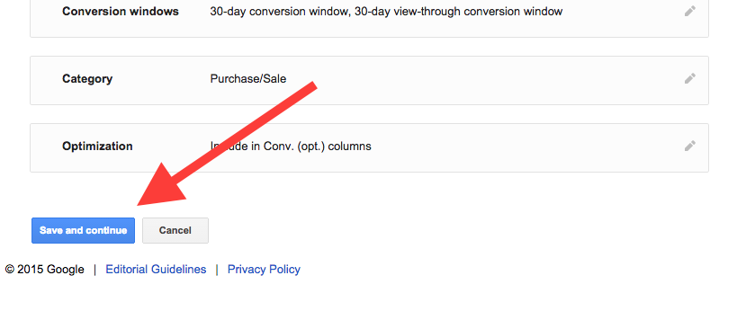
Measure Conversions

Slide 71
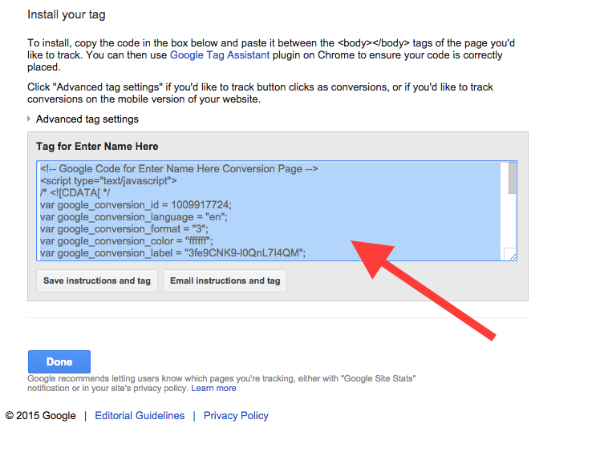
Measure Conversions

Slide 72
Measure Conversions

Slide 73
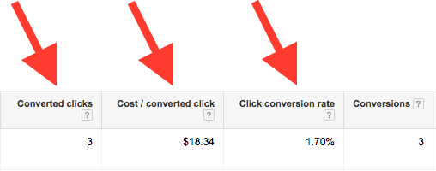
Measure Conversions

Slide 74
Seminar 1 Checklist
If you’re reaching your daily budget, either increase it or reduce the cost per click.
Consider spending more, being willing to break even, and bringing in large numbers of new customers as a result.
Optimize your Keywords. Make sure that you are bidding on the maximum number of relevant Keywords. Brainstorm new Keywords. Use tools such as the Google Search Tool and the Keyword Details Report to assist you.

Slide 75
Seminar 1 Checklist
When you set up your Keywords, enter them with different matching options and start measuring the results.
Make sure that you can measure how many people are coming to your site and how many are converting.
Make sure that the Google conversion counter is on your website ‘thank you’ page(s).

Slide 76
MAIN COURSE PAGE AND MEMBERS’ PRIVATE GROUP
All the course information, slides and
Seminar recordings are here:
http://www.cardell2015.com
The Private Facebook Group for Members is here:
https://www.facebook.com/groups/ppcmastery/

