Slide 1



Slide 2
SEMINAR TWO:
Advanced PPC Strategies
to Double or Triple Your Response

Slide 3
MAIN COURSE PAGE AND MEMBERS’ PRIVATE GROUP
All the course information, slides and
Seminar recordings are here:
http://www.cardell2015.com
The Private Facebook Group for Members is here:
https://www.facebook.com/groups/ppcmastery/

Slide 4
Campaign Settings
Mobile Bidding

Slide 5
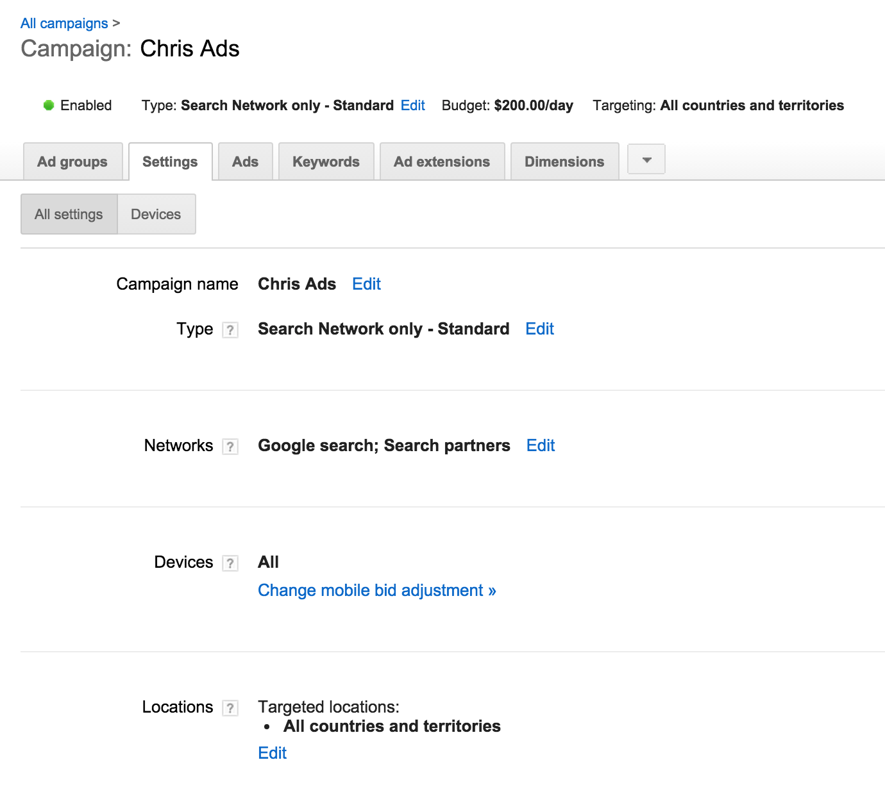
Mobile bid adjustments

Slide 6
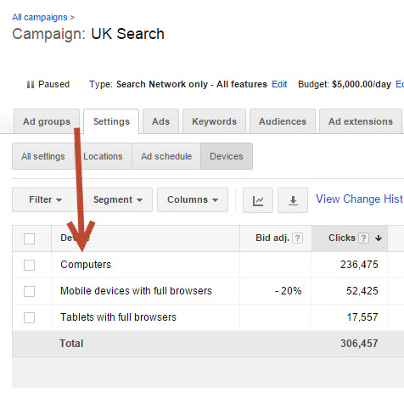
Mobile bid adjustments

Slide 7
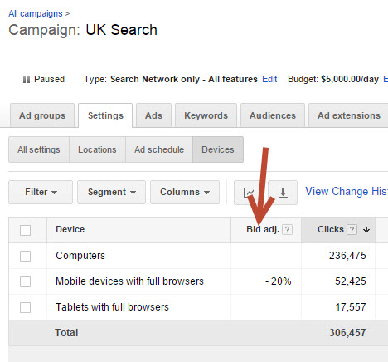
Mobile bid adjustments

Slide 8
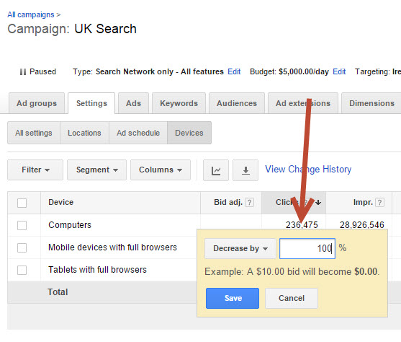
Mobile bid adjustments

Slide 9
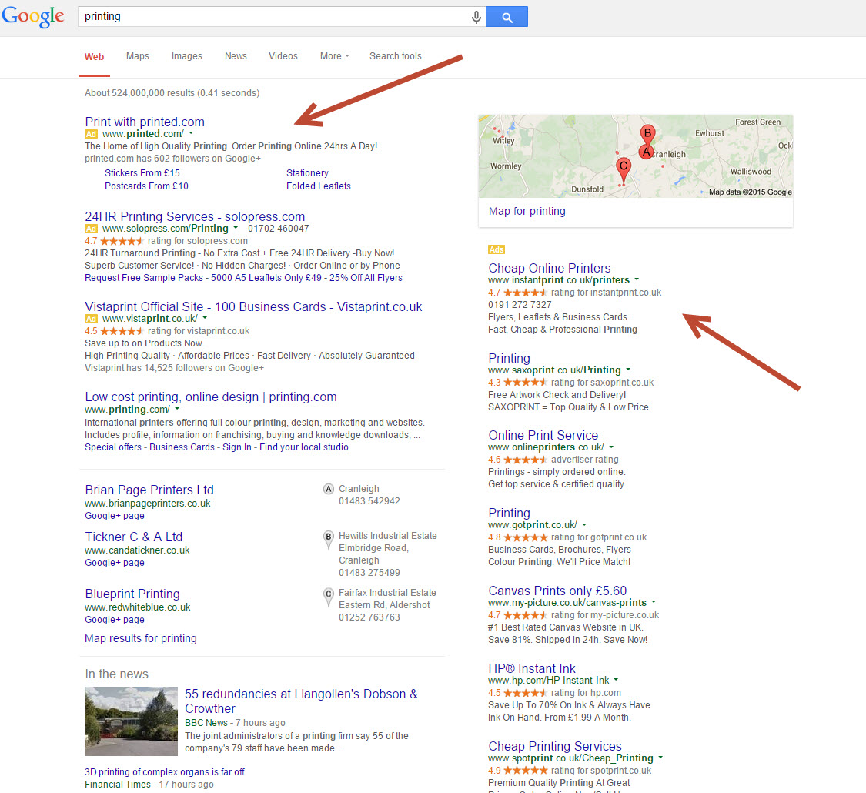
Ad position is vital

Slide 10
Ad position is vital
ADWORDS SUCCESS is all about getting your Ads on the left-hand side
They can get 15 TIMES as many clicks as
the ads on the right

Slide 11
The importance of quality score and click-through rates
It’s not a straightforward auction
Google rewards you for more people clicking on your ad (your ‘click-through rate’ or ‘CTR’)
The higher your click-through rate, the higher your Quality Score
Your position on the page = Cost per Click x Quality Score
There are many ways to increase your Quality Score and most of your competitors won’t have a clue

Slide 12
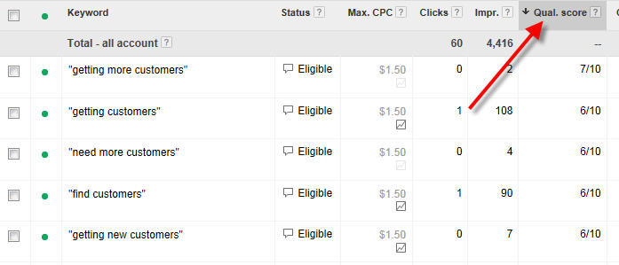
Quality score

Slide 13
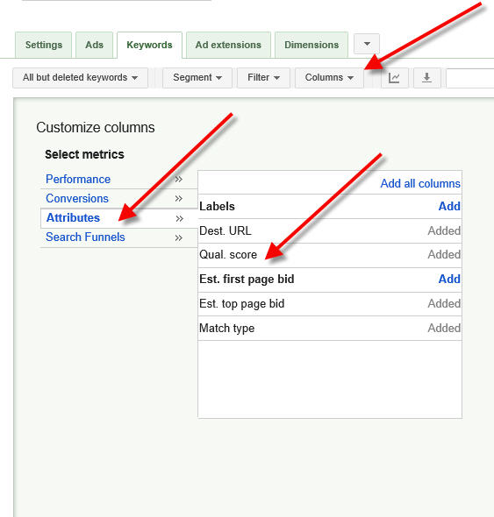
Quality score

Slide 14
The importance of quality score and click-through rates
It’s not a straightforward auction
Google rewards you for more people clicking on your ad (your ‘click-through rate’ or ‘CTR’)
The higher your click-through rate, the higher your Quality Score
Your position on the page = Cost per Click x Quality Score
There are many ways to increase your Quality Score and most of your competitors won’t have a clue

Slide 15
Quality score
Click-Through Rate (CTR)
Relevance of your Ad to the Keyword
Landing Page Relevance
Website Quality

Slide 16
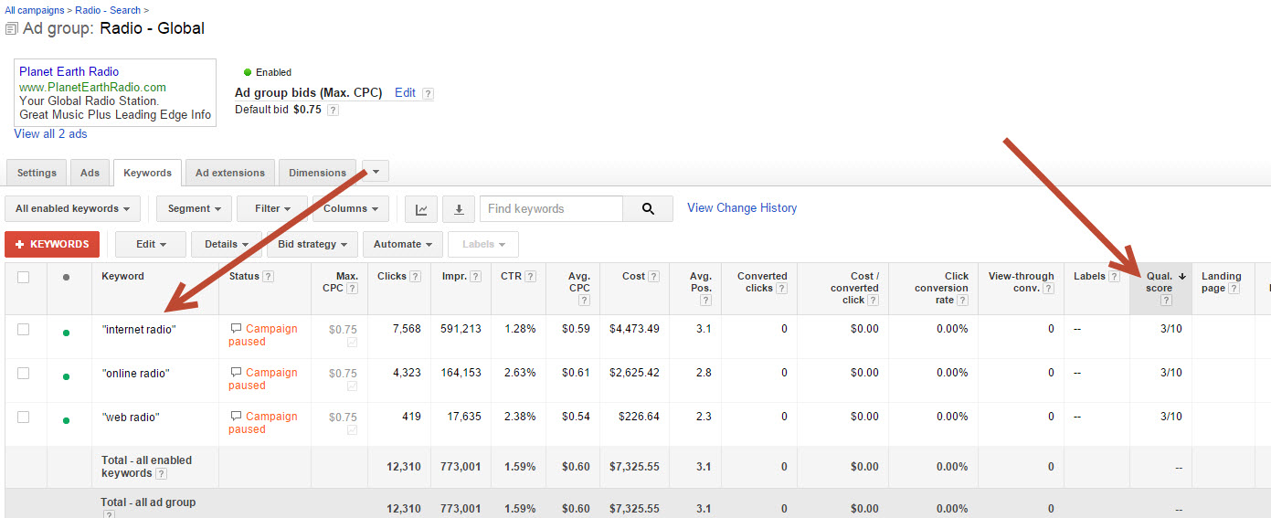
Quality score

Slide 17
The magic of click-through rate (CTR)
When you get more people to click on your ad, your Click-Through Rate and Quality Score go up, and you get a snowball effect.
Click Through Rate is the most important component of your Quality Score.

Slide 18
The CTR Snowball Effect
Using the strategies outlined in this training, your Click-Through Rate increases
This brings more visitors to your website
Because your CTR has increased, Google puts you higher up the page - this brings even more clicks
Because you’re higher up and getting more clicks, your CTR increases and Google moves you higher

Slide 19
The CTR Snowball Effect
Using Using the strategies outlined in this training, your Click-Through Rate increases
Meanwhile, you’re continuing with the strategies I recommend (such as split-testing), so your CTR keeps on increasing
This brings you more visitors
Google puts you higher up (and/or you’re now able to spend more to go even higher)
…and so the process continues.

Slide 20
The CTR Snowball Effect
Using this process, it’s not uncommon to go from a CTR of 1% to 4%, 5% or more.

Slide 21
Increase Your CTR: 1. SPLIT TEST ADS
How do you increase your CTR?
By continually testing two ads against each other and trying to beat your best-performing ad
Google lets you run two or more ads together in
the same ad group

Slide 22
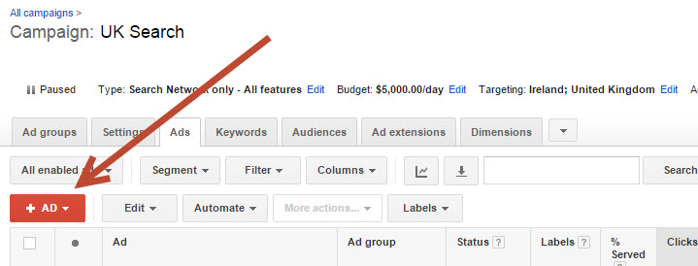
Increase Your CTR: 1. SPLIT TEST ADS

Slide 23
Increase Your CTR: 1. SPLIT TEST ADS
On the second ad, you might…
Write a different headline
Change the copy
Change the message subtly
Change the message dramatically

Slide 24
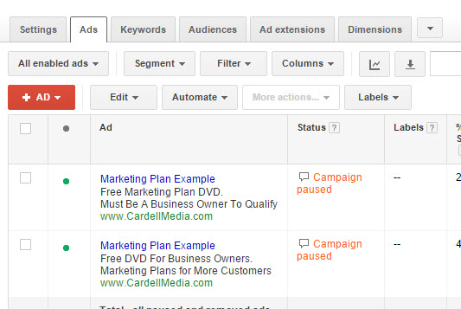
Increase Your CTR: 1. SPLIT TEST ADS

Slide 25
Increase Your CTR: 1. SPLIT TEST ADS
The goal is to beat your existing ad
Once you beat it, get rid of that ad
and try to beat the new one

Slide 26
Increase Your CTR: 1. SPLIT TEST ADS
Capitalisation
You can’t use all capitals, but you can
capitalise the first letter of each word
Capitalisation can make a significant
difference in your CTR

Slide 27
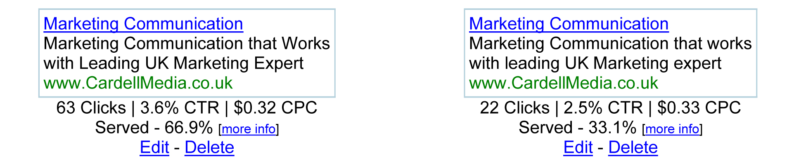
Increase Your CTR: 1. SPLIT TEST ADS

Slide 28
Increase Your CTR: 1. SPLIT TEST ADS
Expect to double or triple your CTR through split-testing.

Slide 29
Increase Your CTR: 1. SPLIT TEST ADS
IMPORTANT NOTE
When split-testing, you need to receive at least 20 clicks on an ad before the results
are reliable.

Slide 30
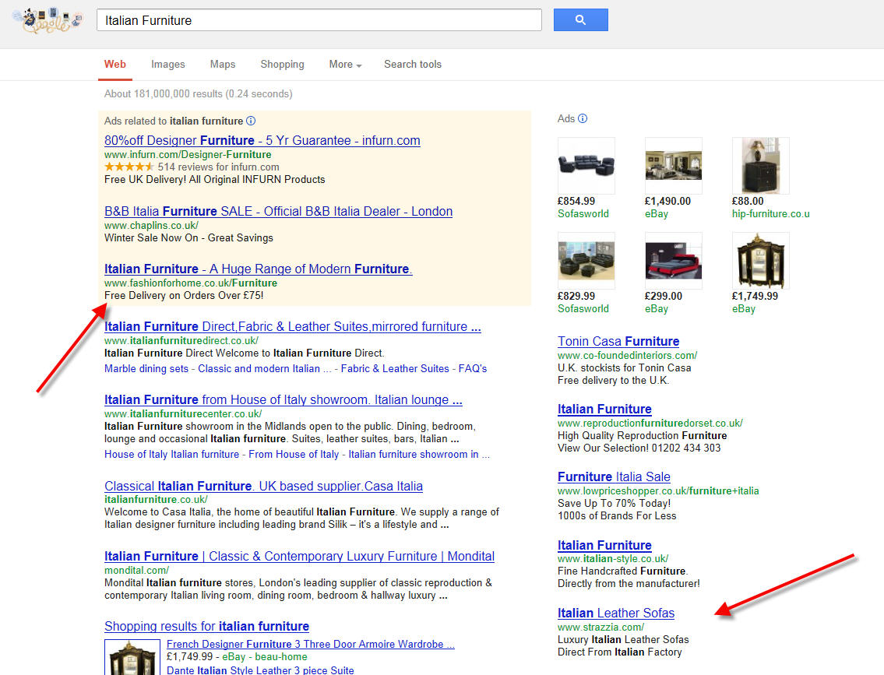
Increase Your CTR: 2. WRITE BETTER ADS

Slide 31

Increase Your CTR: 2. WRITE BETTER ADS

Slide 32
Increase Your CTR: 2. WRITE BETTER ADS

Slide 33

Increase Your CTR: 2. WRITE BETTER ADS

Slide 34
Increase Your CTR: 2. Writer Better ADS
Use the Keyword in the Headline
If possible, use the Keyword in the ad
Use the first line to capture Attention and Interest
Use the second line to get desire and action
Avoid hype or ‘pushy’ copy
Look at the other search results when writing copy
Test, Test, Test

Slide 35
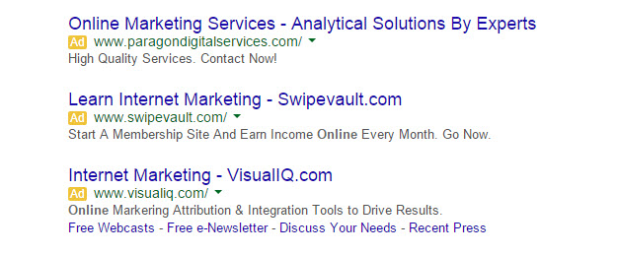
Full stop after the first sentence!

Slide 36
Increase Your CTR: 3. Separate ads for separate Keywords
CTR is about Relevance
The more relevant your ad to the Keyword, the higher your Click-Through Rate
Example: Leather Recliners
If the ad specifically talks about leather recliners, it’s more relevant for the person performing the search
Your competitors are not doing this!
The more specific you can be, the better you will do
Most businesses should have 50 to 100
ads for different Keywords

Slide 37
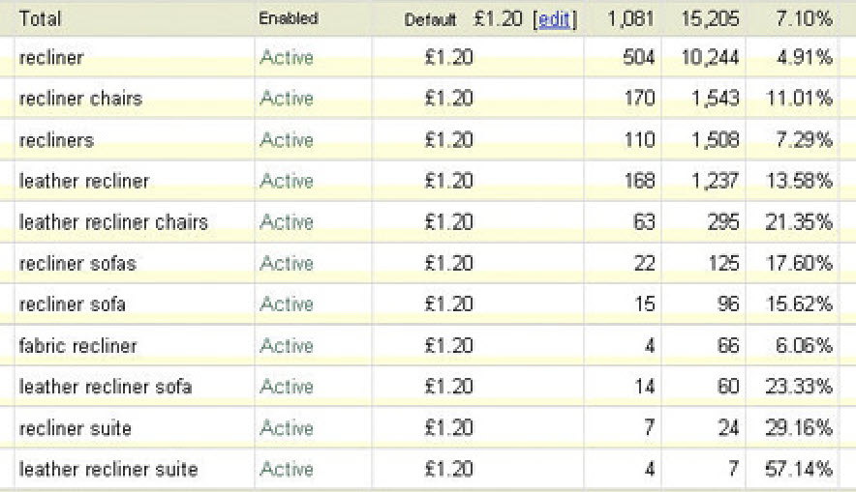

Slide 38
Increase Your CTR: 3. Separate ads for separate Keywords
CTR is about Relevance
The more relevant your ad to the Keyword, the higher your Click-Through Rate
Example: Leather Recliners
If the ad specifically talks about leather recliners, it’s more relevant for the person performing the search
Your competitors are not doing this!
The more specific you can be, the better you will do
Most businesses should have 50 to 100
ads for different Keywords

Slide 39
Increase Your CTR: 4. Display URLS
Display URL
This is the URL that people see in the ad
Example: www.CardellMedia.com
Google lets you change the URL
The basic URL has to be the actual website you send people to
You can add an extension to the display URL
Example: www.CardellMedia.com/MarketingPlan
You can drop the “www” and replace it with something else
Example: MarketingPlan.CardellMedia.com
Test, Test, Test!

Slide 40
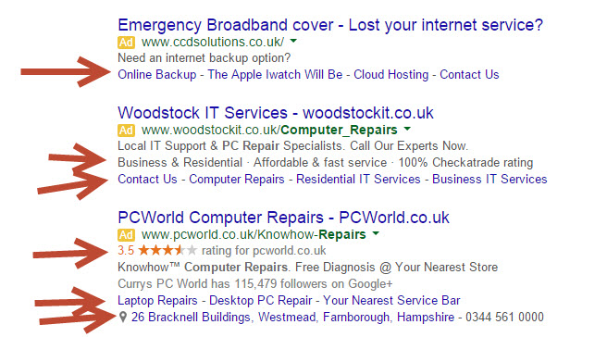
Increase Your CTR: 5. Ad Extensions

Slide 41
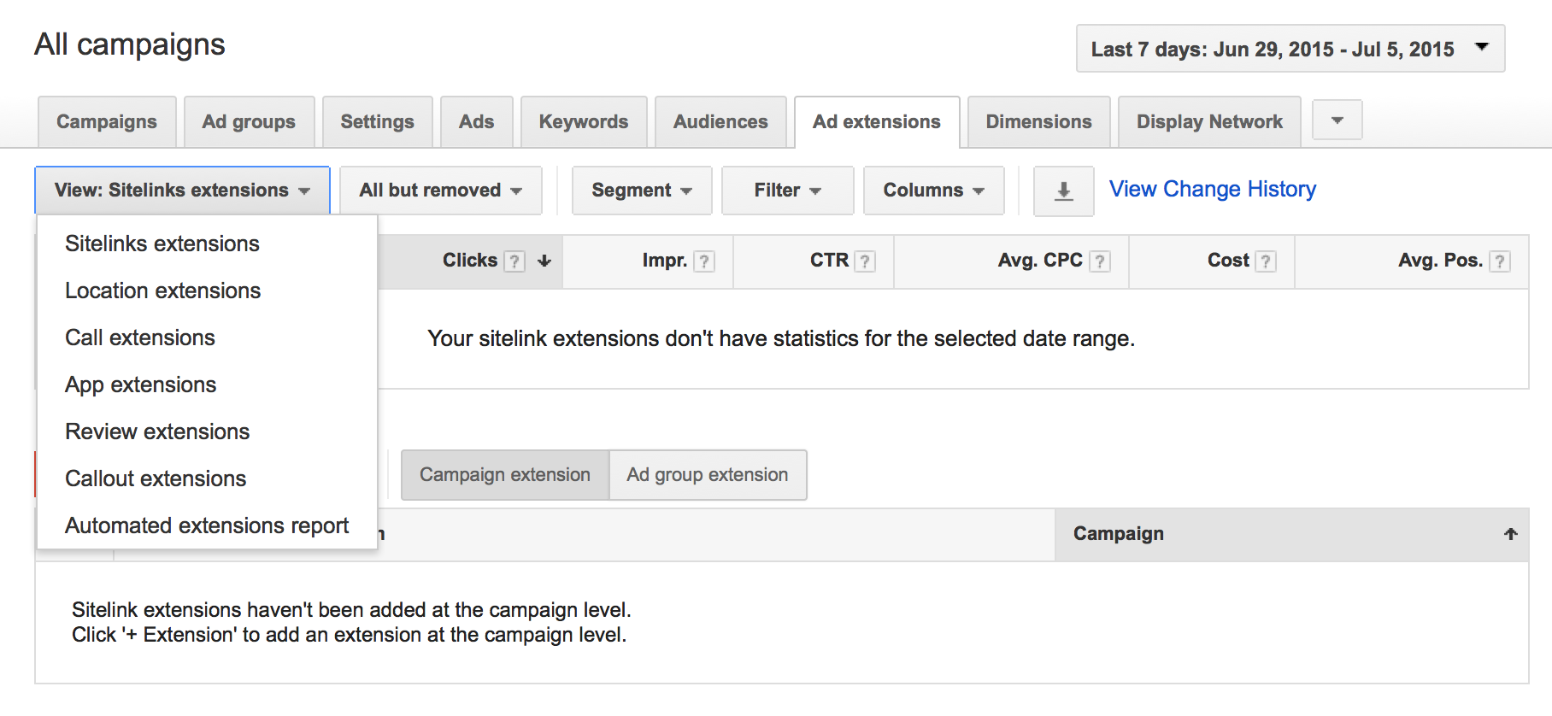
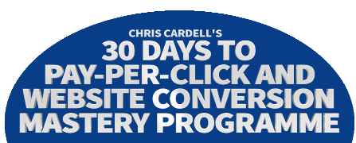
Increase Your CTR: 5. Ad Extensions

Slide 42
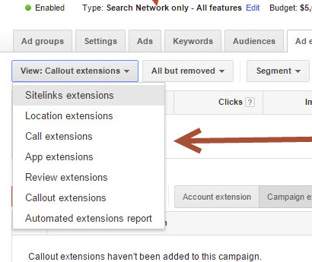
Increase Your CTR: 5. Ad Extensions

Slide 43
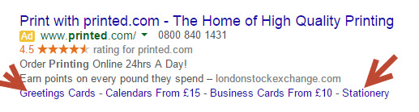
Ad Extensions: SITE Links

Slide 44
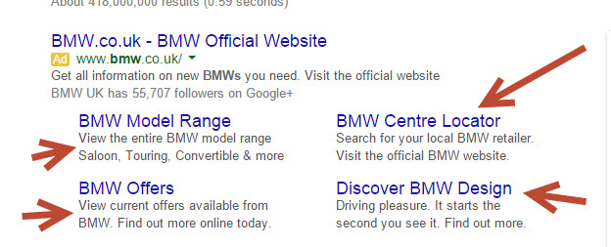
Ad Extensions: SITE Links

Slide 45
Ad Extensions: SITE Links

Slide 46
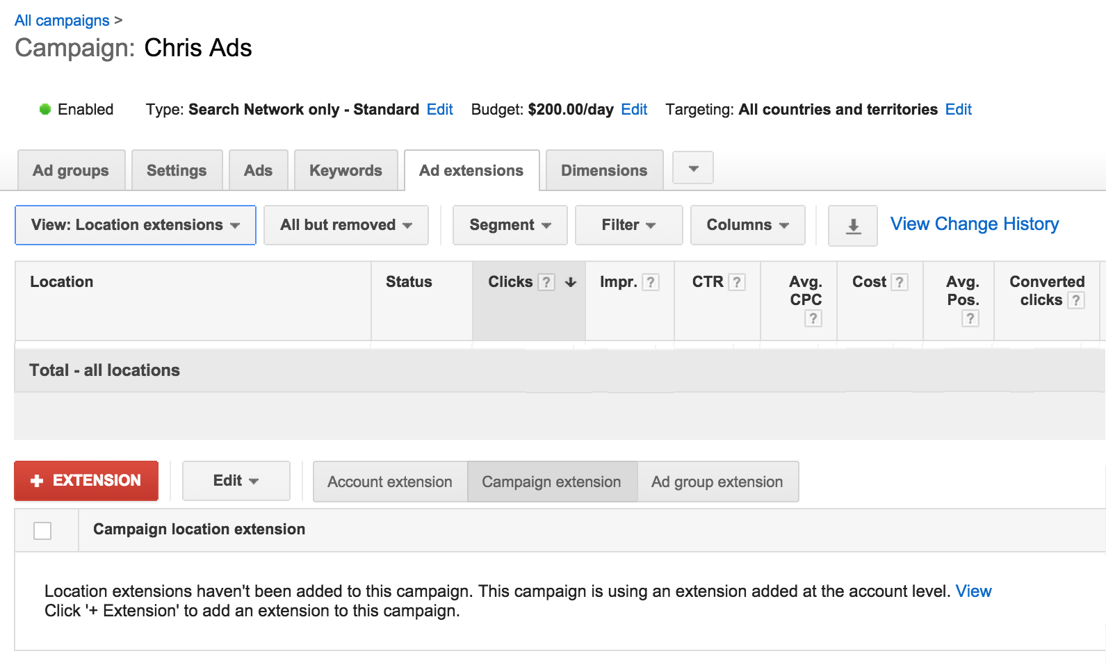
Ad Extensions: SITE Links

Slide 47
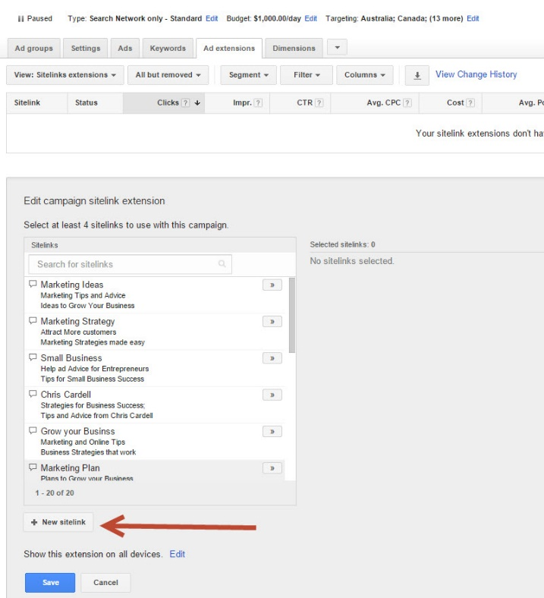
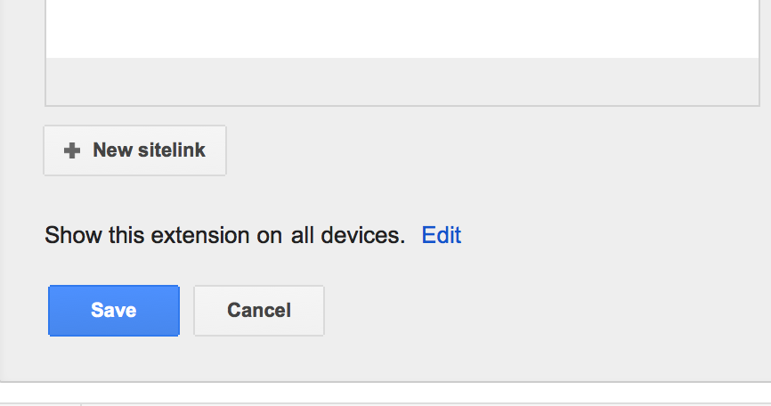
Ad Extensions: SITE Links

Slide 48
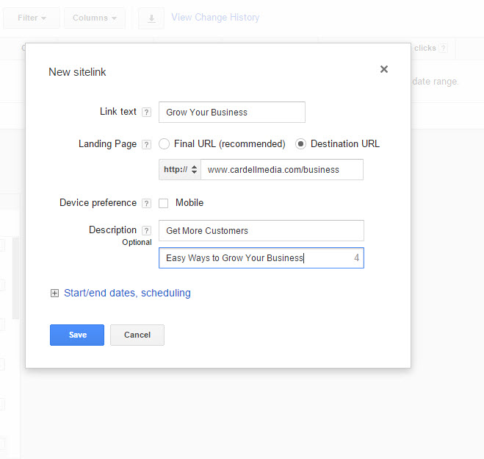
Ad Extensions: SITE Links

Slide 49
Ad Extensions: SITE Links

Slide 50
Ad Extensions: SITE Links

Slide 51
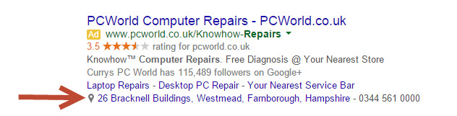
Ad Extensions – LOCATION EXTENSIONS

Slide 52
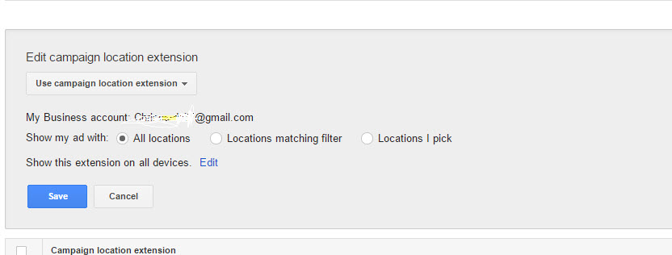
Ad Extensions – LOCATION EXTENSIONS

Slide 53
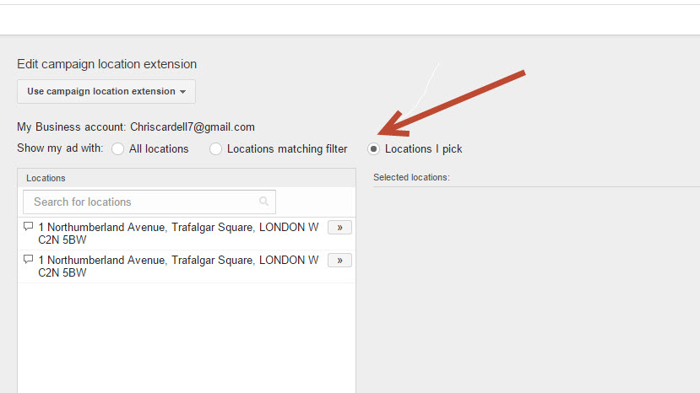
Ad Extensions – LOCATION EXTENSIONS

Slide 54
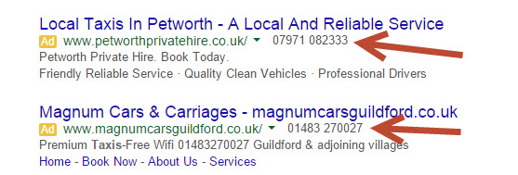
Ad Extensions – CALL EXTENSIONS

Slide 55
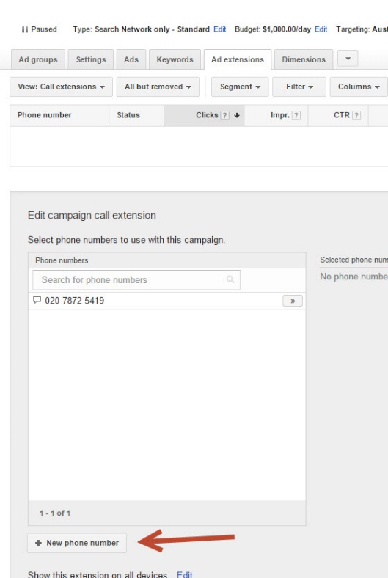
Ad Extensions – CALL EXTENSIONS

Slide 56
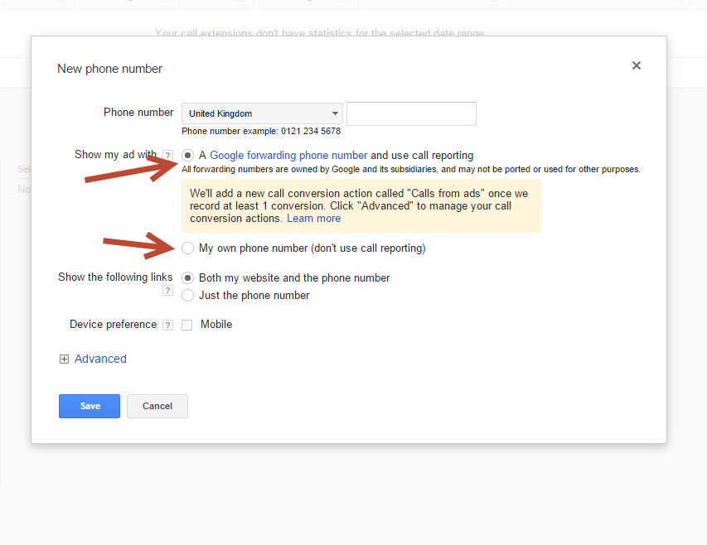
Ad Extensions – CALL EXTENSIONS

Slide 57
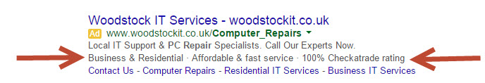
Ad Extensions – CALLouts

Slide 58
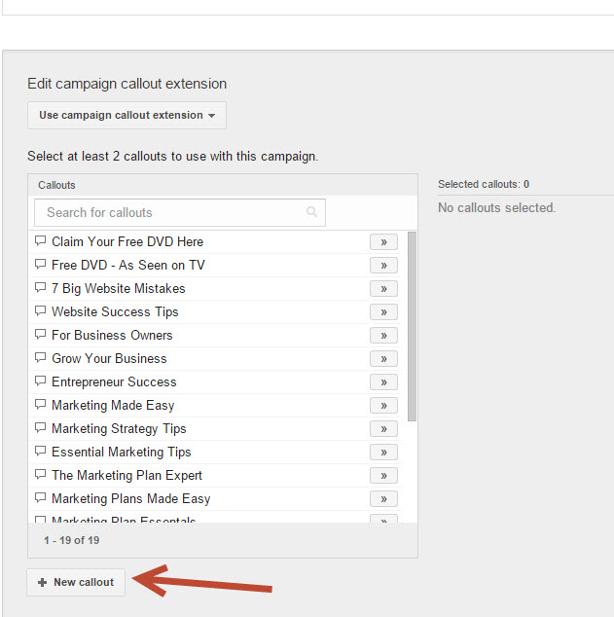
Ad Extensions – CALLouts

Slide 59
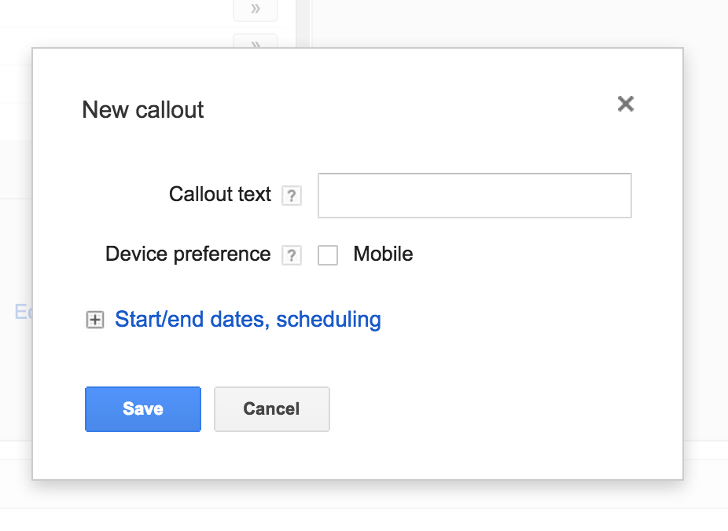
Ad Extensions – CALLouts

Slide 60
Ad Extensions – CALLouts

Slide 61
Increase Your CTR: 6. NEGATIVE KEYWORDS
Example: BMW Dealership
If you only sell brand-new BMWs, you don’t want people who are searching for secondhand BMWs
You would add ‘secondhand’ as a Negative Keyword
The Negative Keyword feature lets you choose Keywords you don’t want your ad to appear for

Slide 62
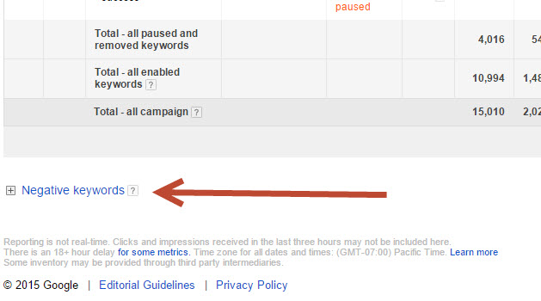
Increase Your CTR: 6. NEGATIVE KEYWORDS

Slide 63
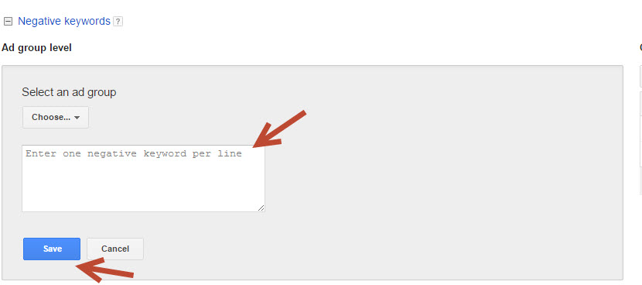
Increase Your CTR: 6. NEGATIVE KEYWORDS

Slide 64
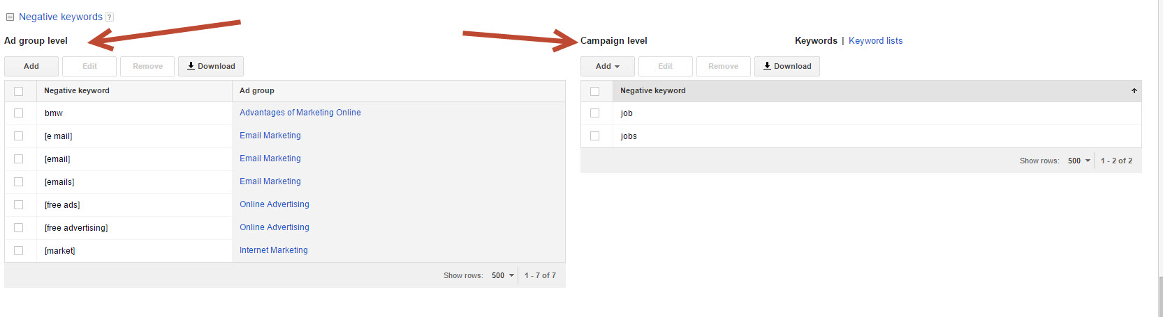
Increase Your CTR: 6. NEGATIVE KEYWORDS

Slide 65
Increase Your CTR: 6. NEGATIVE KEYWORDS
Most AdWords users underestimate the importance
of Negative Keywords
There are two benefits to using Negative Keywords:
It will save you money in wasted clicks
It will improve your CTR

Slide 66
Increase Your CTR: 6. NEGATIVE KEYWORDS
How to find Negative Keywords
Your own knowledge of your business
The “Keyword Details” button in your account

Slide 67
Seminar 2 Checklist
Your driving focus with Adwords should be for your ad to appear on the left-hand side
Get familiar with Quality Score and start monitoring the Quality Score of your Keywords
Obsess about Click-Through Rate!
Split test ads in all of your main ad groups, and keep split testing until you hit a ceiling of CTR

Slide 68
Seminar 2 Checklist
Put good performing Keywords into separate ad groups and write relevant ads for each one
Test your Display URLs
Set up Ad Extensions. Set up Site Extensions immediately!
Research negative Keywords and put them into your account

