Slide 1



Slide 2
SEMINAR THREE:
ESSENTIAL WEBSITE CONVERSION STRATEGIES

Slide 3
The 1% Rule
For the typical website, less than 1% of visitors take any action
This means that you may be losing 99 out of every 100 visitors to your site
This is particularly tragic with PPC traffic because you paid for them
The nature of PPC means they should be highly qualified potential customers

Slide 4
The 8 Second Rule
Research has shown that on average, 50% of visitors to a typical website make a decision about whether to stay on that site within 8 seconds.
For your PPC traffic, this means that even with the most information-packed website, your landing page needs to grab them within a few seconds
or you will lose masses of traffic.

Slide 5
The Landing Page
Your landing page is the page you send visitors to from your PPC ad
Your landing page does not have to be your home page
In many cases, your landing page should NOT be your homepage

Slide 6
The Landing Page
Example: You run a gardening store
Your home page talks about everything you sell
When someone searches for lawn mowers, send them directly to the lawn mower page
Google calculates how relevant your landing page is, and that affects your Quality Score

Slide 7
Your Two Landing Page Options:
Sale or lead generation?
When you engage in Pay-per-Click Advertising (or any other form of Internet Marketing) you want to be clear about the action you want your visitors to take.
Do you want them to buy something from you immediately? Or do you want them to begin a relationship with you?
Good conversion rates for a sales landing page are 1% - 5%. Good conversions for a relationship-building landing page are 15% - 30%.

Slide 8
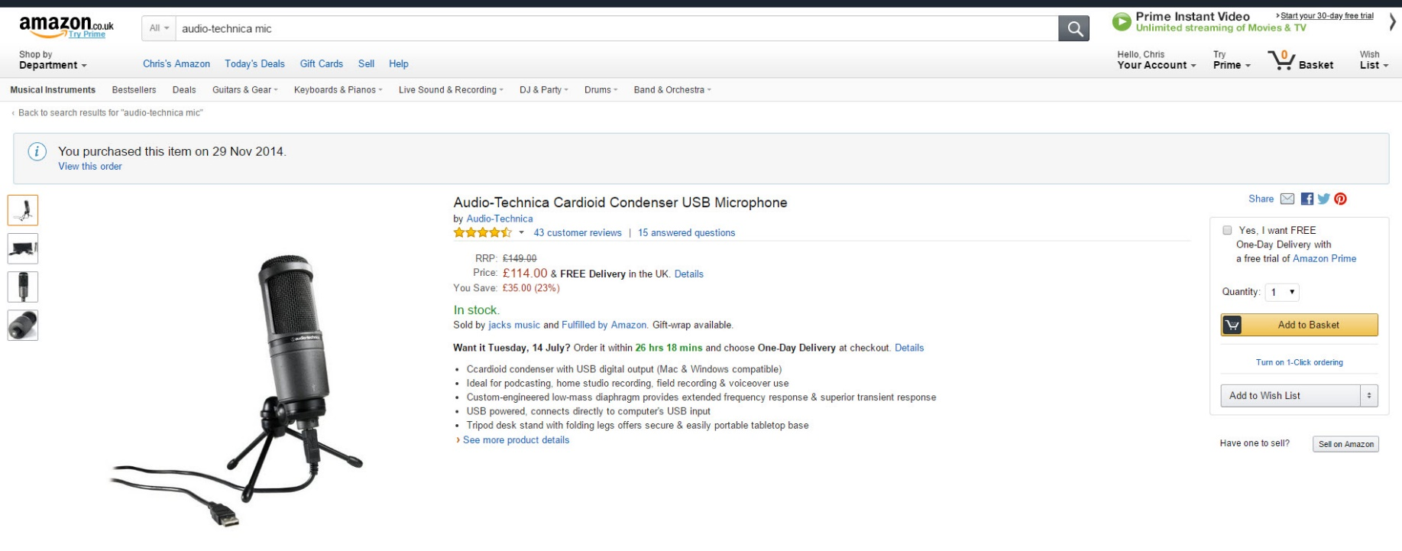
Your Two Landing Page Options:
Sale or lead generation?

Slide 9
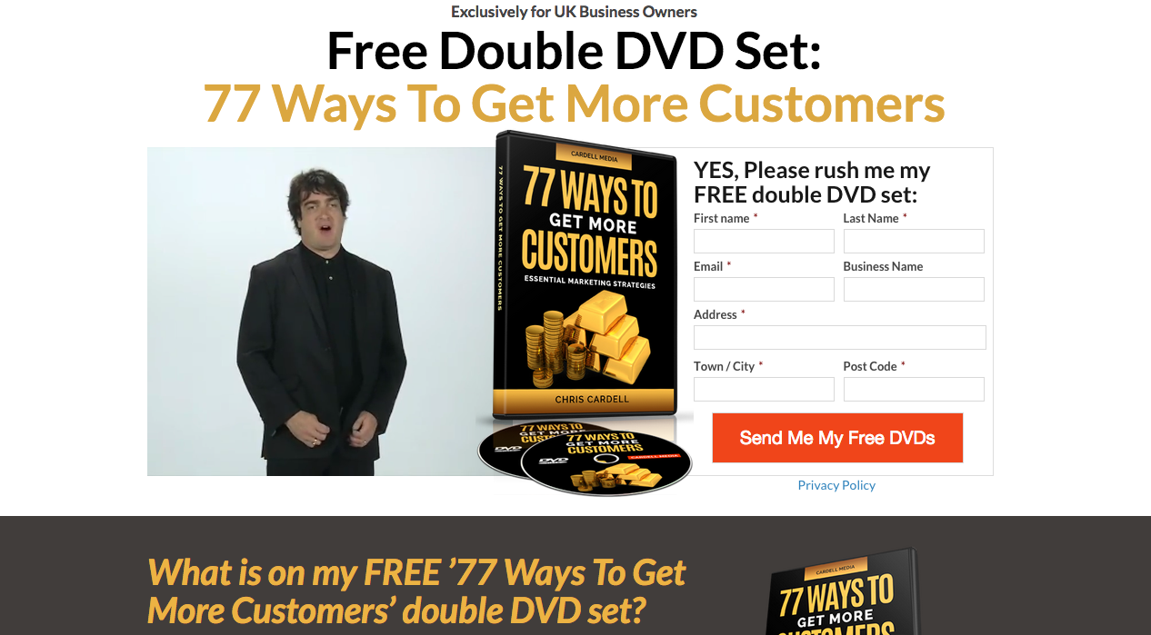
Your Two Landing Page Options:
Sale or lead generation?

Slide 10
Lead generation landing pages
The Headline is the Key
Captivating copy within 8 Seconds
Two columns can work well
Test adding Video
You still need to sell 'What's In It for Them'

Slide 11
Lead generation landing pages
Use Bullet points
Privacy
Ensure that the wording on the sign-up
button is compelling

Slide 12
Lead generation landing pages

Slide 13
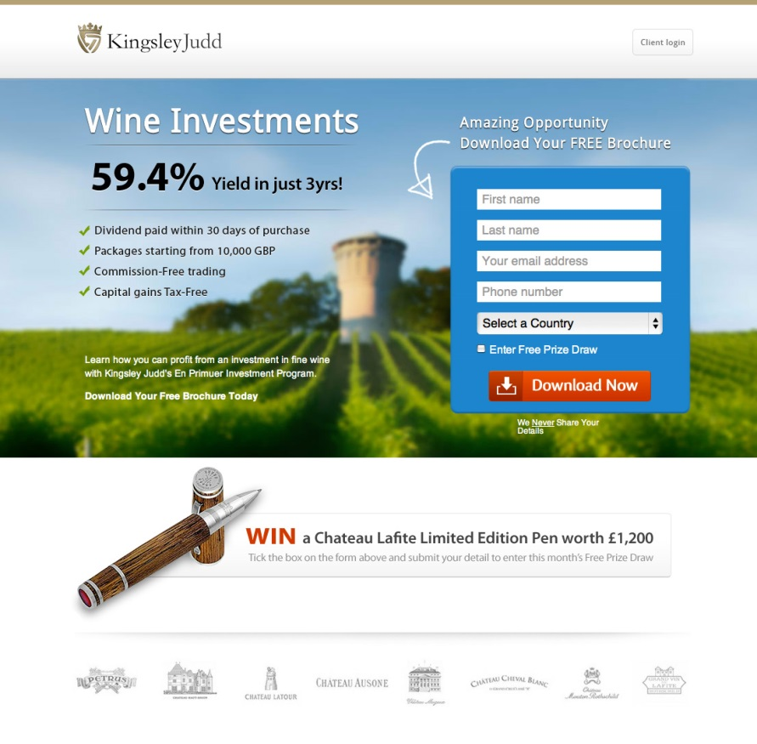
Lead generation landing pages

Slide 14

ABOVE THE FOLD
Notes:
Bad example

Slide 15
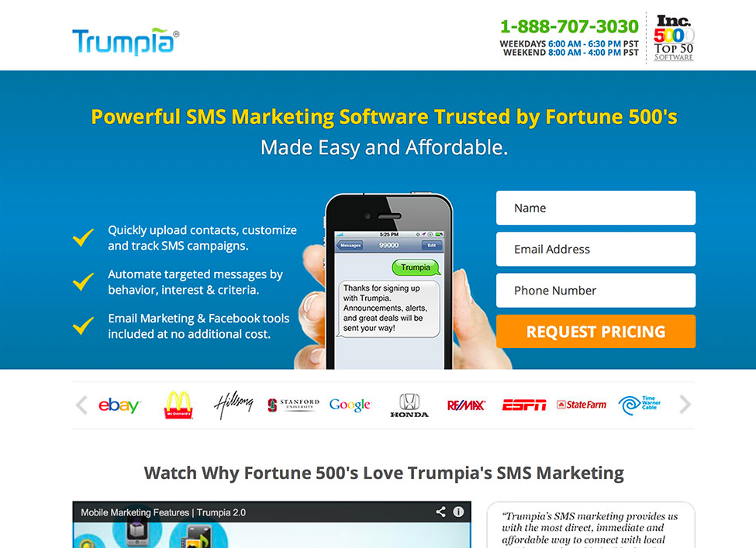
ABOVE THE FOLD
Notes:
Good example

Slide 16
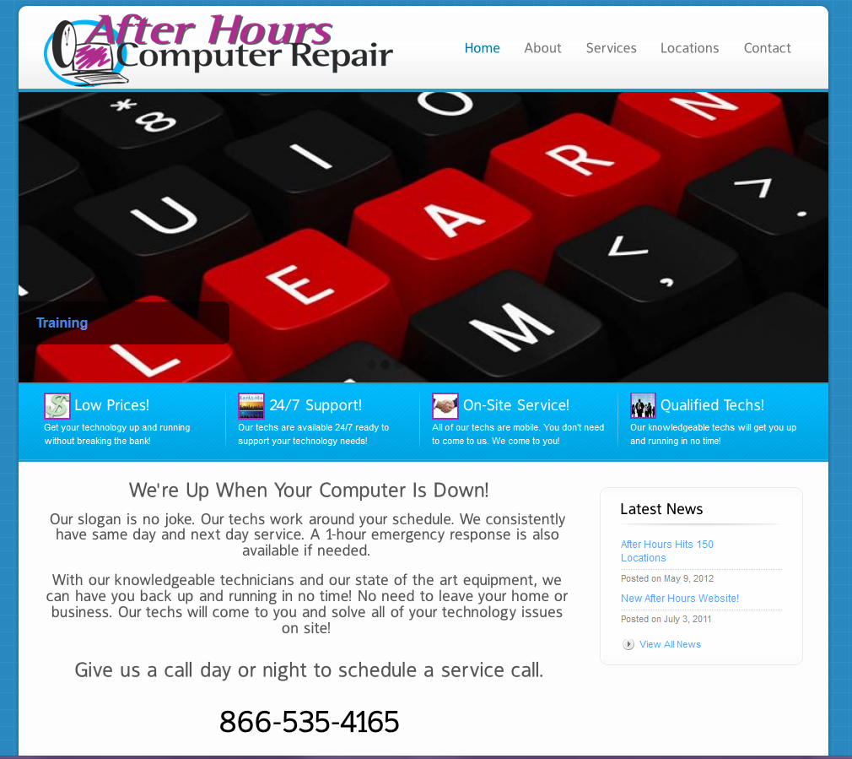
VALUABLE REAL ESTATE
Notes:
Bad example

Slide 17

VALUABLE REAL ESTATE
Notes:
Good example

Slide 18
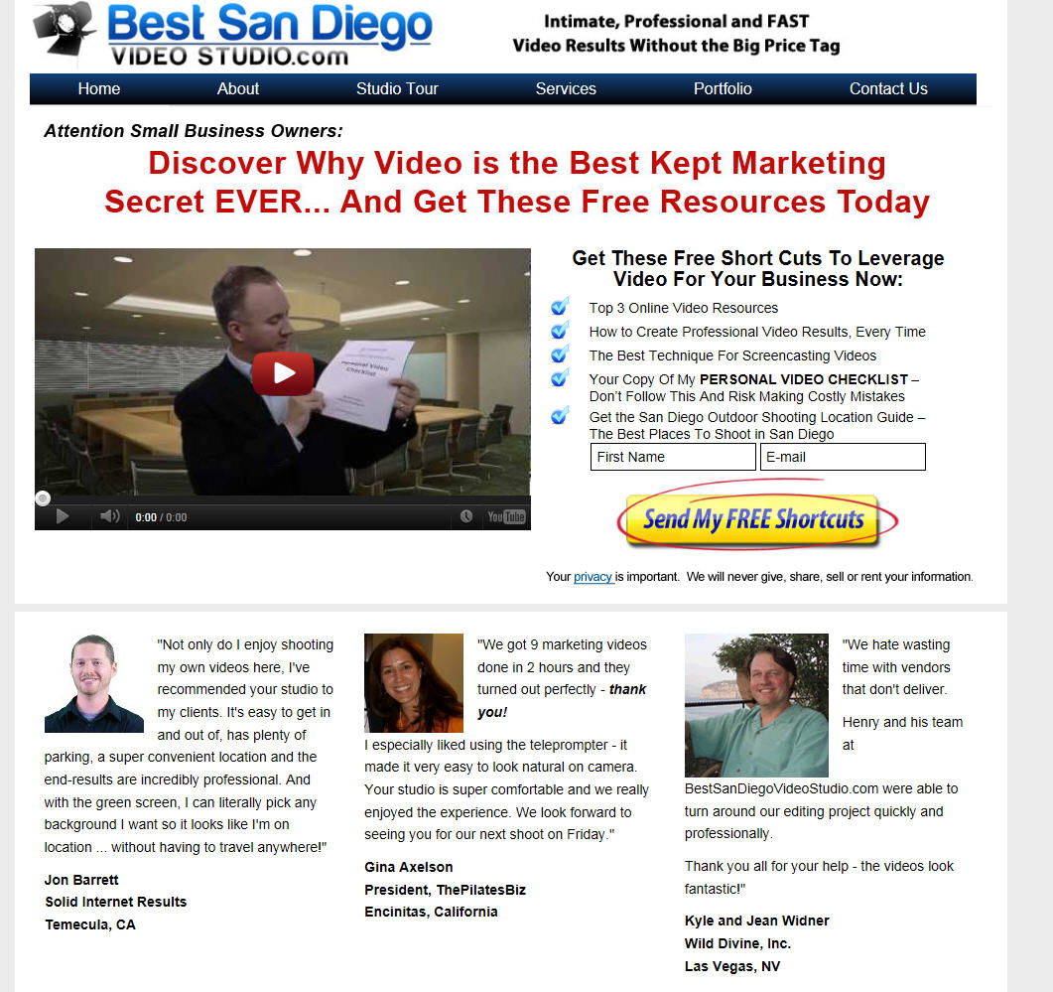

Slide 19
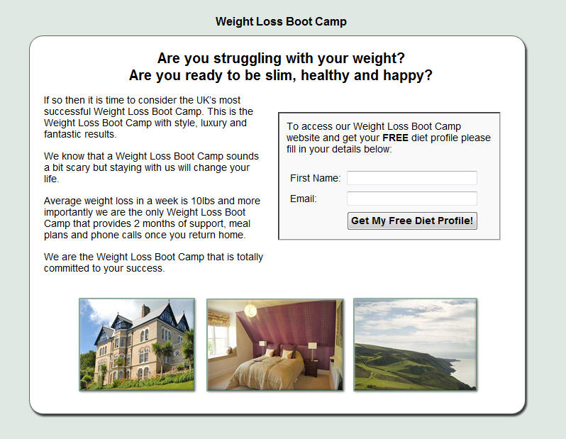

Slide 20
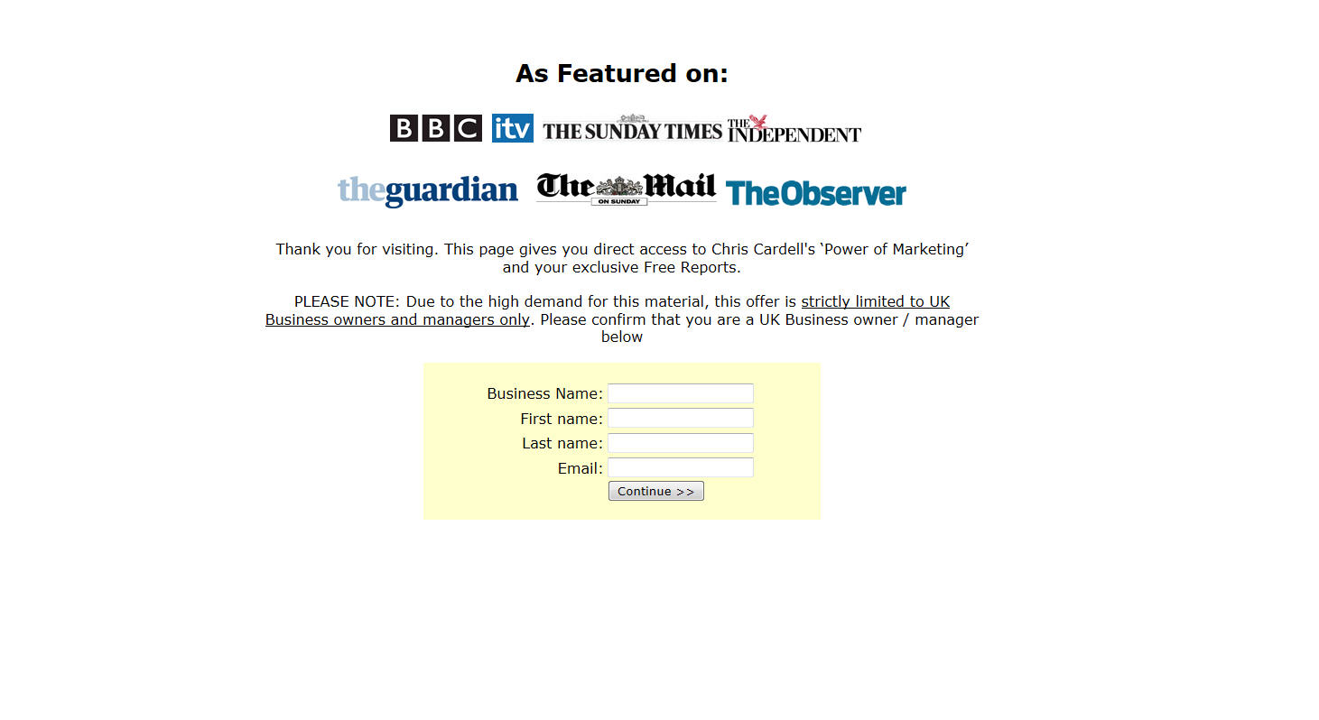

Slide 21
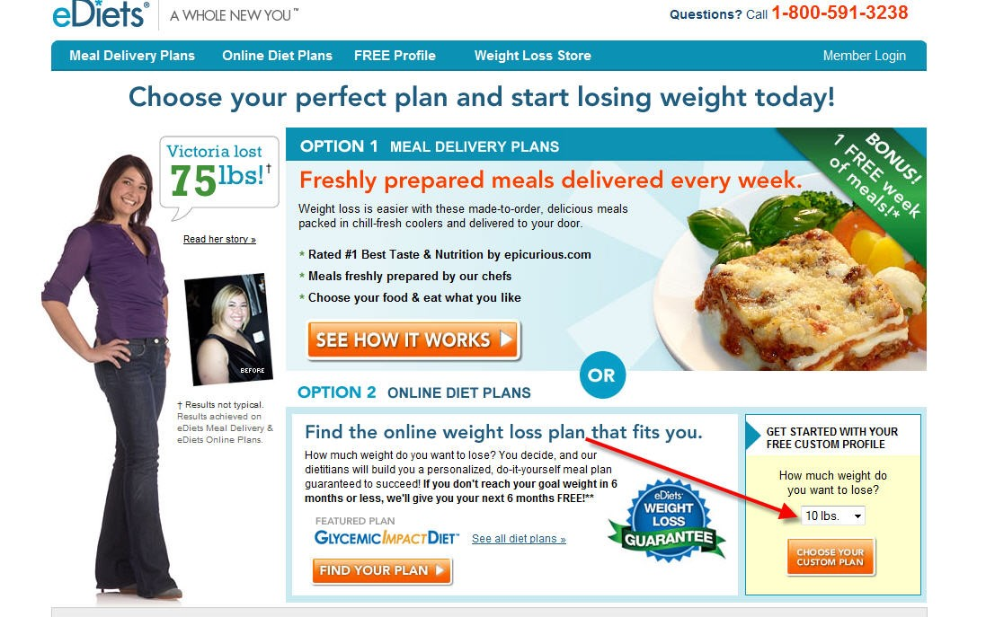

Slide 22


Slide 23
Success strategies for ‘sales only’ pages and websites
Write compelling Headlines
You must convey the benefits
'You, You, You’
Solve problems
Educate
Credibility – Testimonials
Long copy works

Slide 24
Success strategies for ‘sales only’ pages and websites
Avoid clever colour and graphics
Guarantees can increase sales by 100% or more
Answer objections
Telephone Number EVERYWHERE
Make the ordering process easy –
have others test it

Slide 25
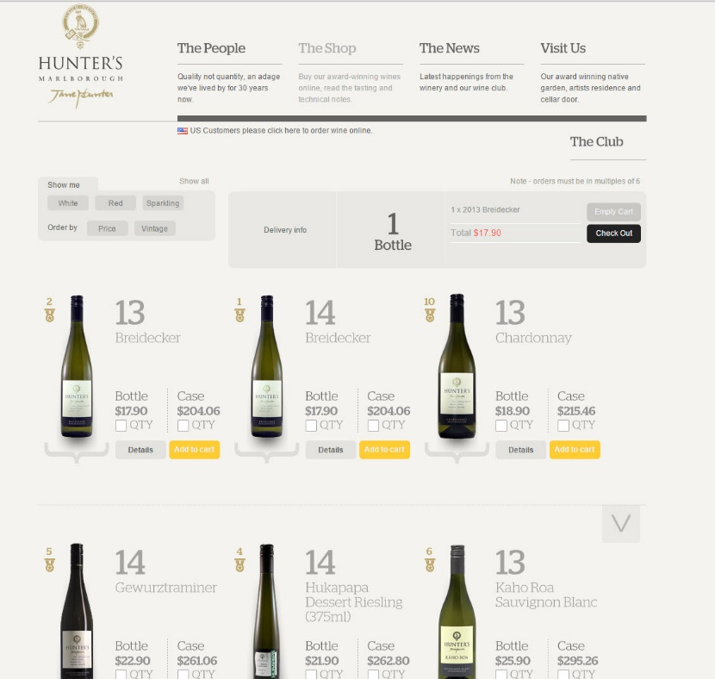

Slide 26
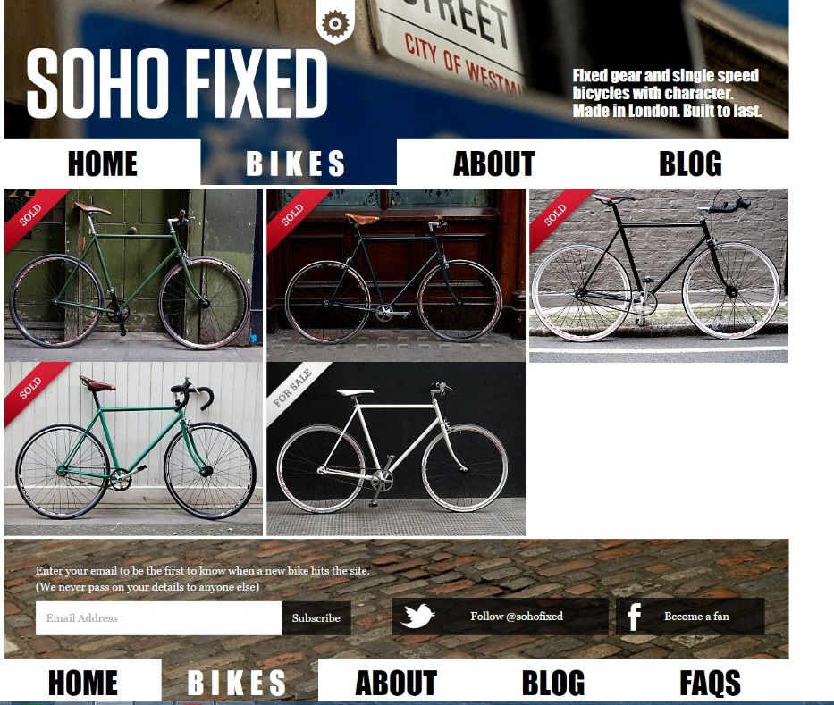

Slide 27
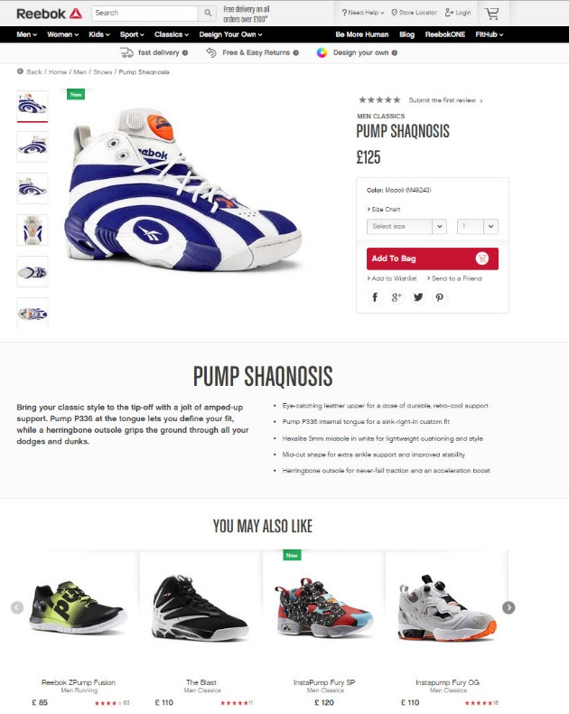

Slide 28
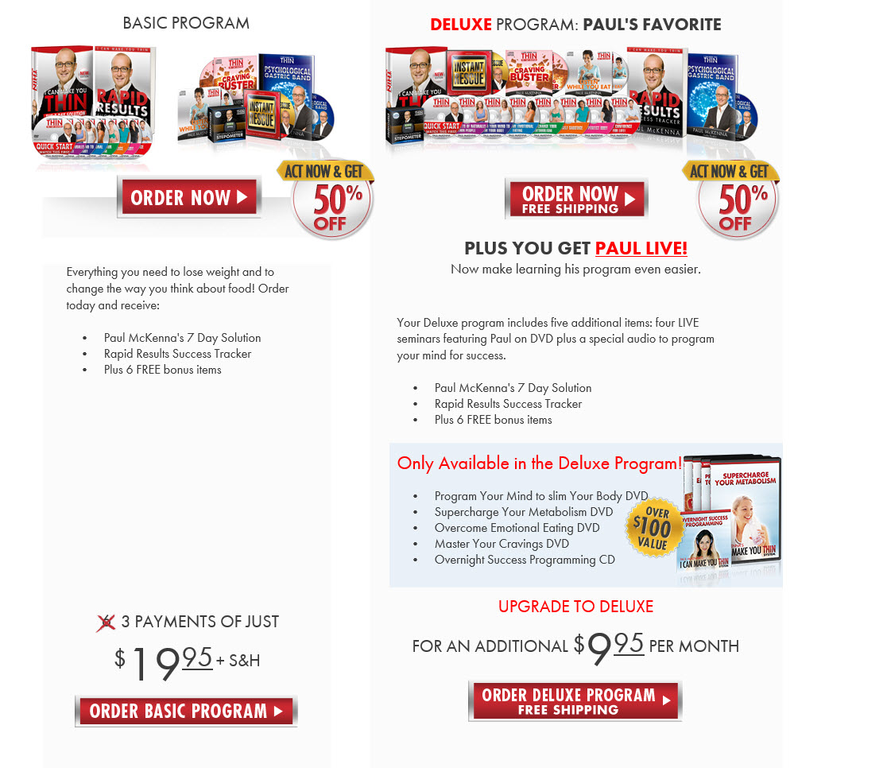

Slide 29
VIDEO
Not an Option – It’s a Must
You need a ‘face’ for your business. Can be you, another staff person, or a paid professional
Personal beats Slick
TEST
On Ecommerce sites, demo videos work well
Consider Celebrity Endorsement

Slide 30
Relevance and landing pages
One of the keys to a successful landing page is RELEVANCE
The more relevant the page is for the visitor, the more likely they are to stay and to take action
So with PPC traffic, you achieve that relevancy by matching the landing page to the keyword
Also, make sure the title of the page is your keyword and caption any images with the keyword too

Slide 31
Design Tips
for Better Conversion

Slide 32
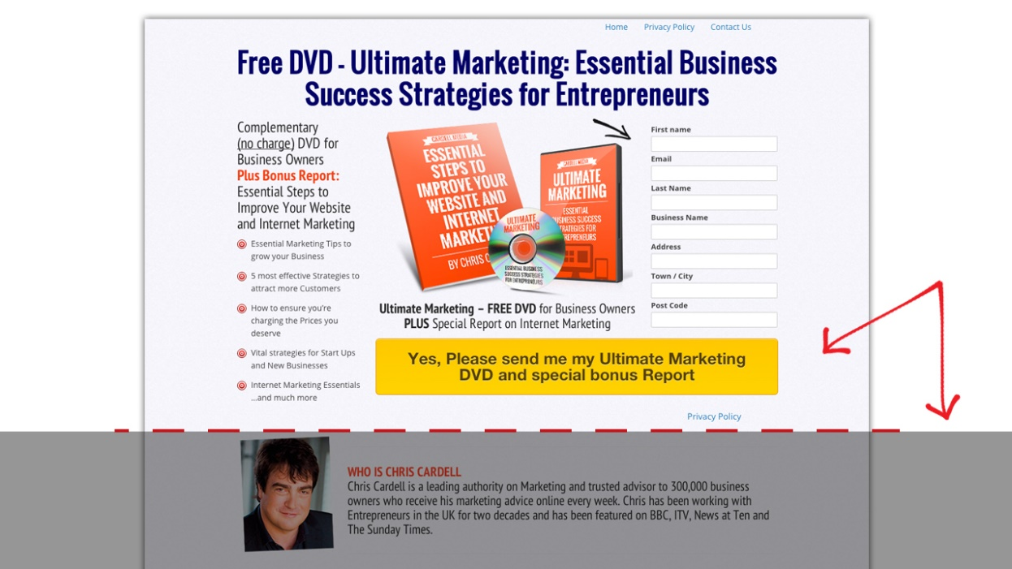
1. Make your call to action big, and position it above the fold.

Slide 33
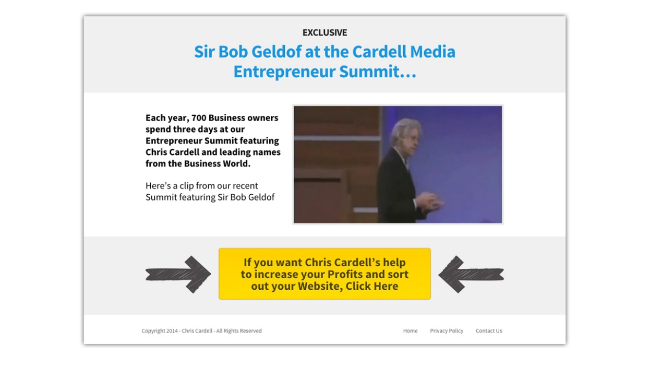
2. Use directional cues to direct attention to your CTA (arrows or photos/videos of people looking or pointing at your button).

Slide 34
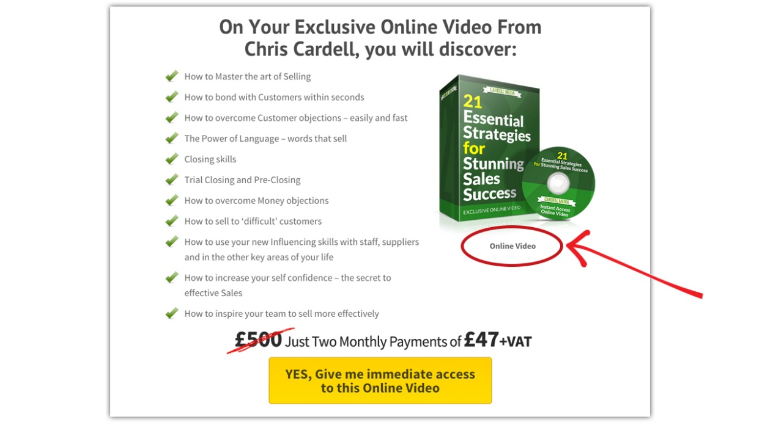
3. Show your report, ebook, free DVD as a physical product, even if it’s only a PDF (use www.fiverr.com).

Slide 35
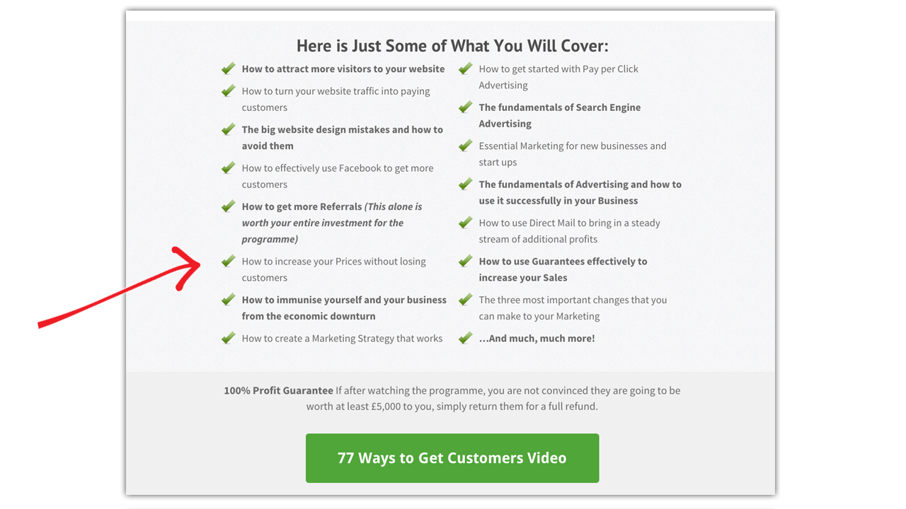
4. Simplify your copy by using bullets.

Slide 36
GOOGLE POLICIES
Google has specific policies about Landing Pages, and your Landing Page contributes to your Quality Score.

Slide 37
GOOGLE POLICIES
You must let users browse your Site
You must include a link to a Privacy Policy if you collect information
Avoid grandiose claims and ‘get rich quick’ copy

Slide 38
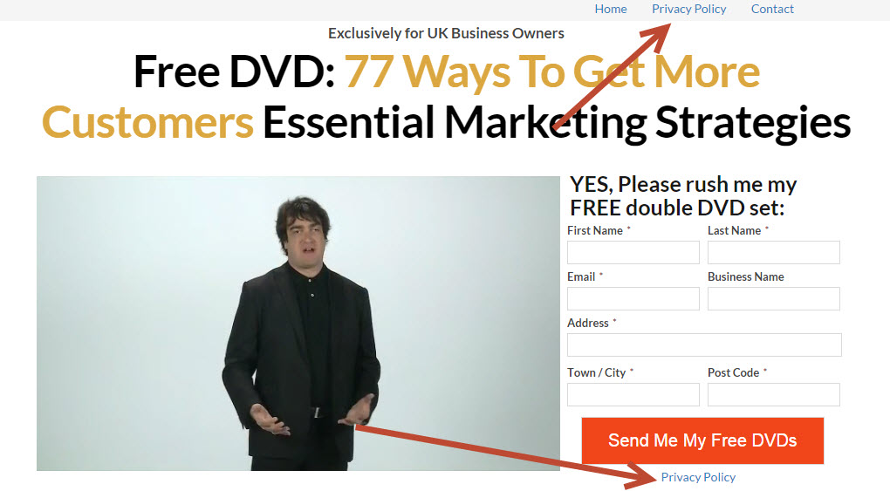

Slide 39
The Fortune that exists in your Shopping Cart / Order Process
‘Shopping Cart Abandonment’ is a huge issue for all of us
This refers to people who begin the order process but bail out before completing
The statistics on this are shocking
It’s not unusual for a normal website to have an abandonment rate of 60% - 70%

Slide 40
The Fortune that exists in your Shopping Cart / Order Process
Here are the steps you need to take to reduce your abandonment rates and significantly increase sales:
Start measuring your abandonment rate so that you
can test and measure the best way to improve it.
This can be done with Google Analytics.
Reduce the number of steps. Multi step order processes guarantee high abandonment. (The exception can be a two step sign up, which
should be tested.)

Slide 41
The Fortune that exists in your Shopping Cart / Order Process
Here are the steps you need to take to reduce your abandonment rates and significantly increase sales:
Test bypassing the shopping cart
Remove unnecessary fields
Repeat the benefits
Repeat Guarantees
Provide help and answer questions

Slide 42
The Fortune that exists in your Shopping Cart / Order Process
Here are the steps you need to take to reduce your abandonment rates and significantly increase sales:
Test Live Chat
Use Security Icons
Include shipping and returns policy
Test different ‘Buy’ buttons. Test colours, size
and wording.
Test the use of Testimonials and Video on
your order page.

Slide 43

The Fortune that exists in your Shopping Cart / Order Process

Slide 44
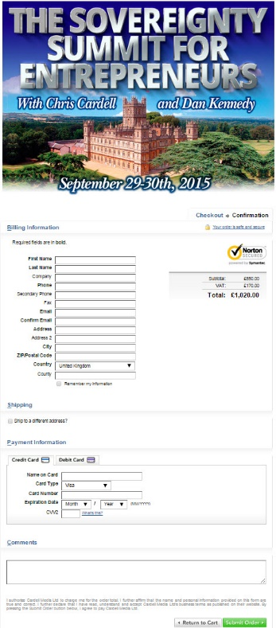
The Fortune that exists in your Shopping Cart / Order Process

Slide 45
Split testing your landing pages
This is one of the KEY Internet Marketing Strategies
The one thing that you can guarantee is that it’s always possible to improve the performance of your landing page
There are numerous choices of elements to test. You can only discover which approach works best by doing accurate split testing.
To split test a landing page, you create two separate pages and serve them up alternately to measure the results

Slide 46
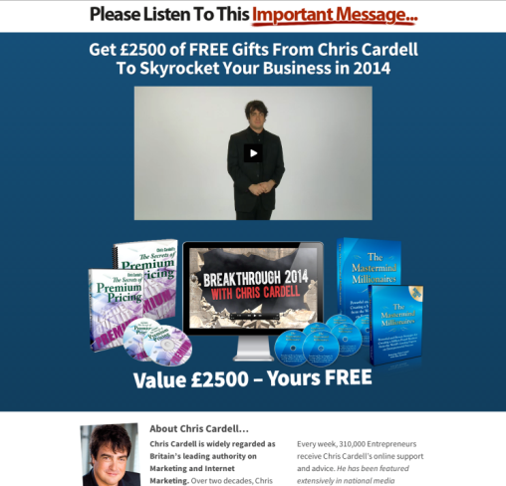
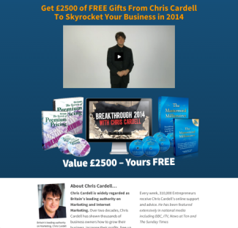
Split testing your landing pages
Performed 45.5% better
Notes:
Click for percentage

Slide 47
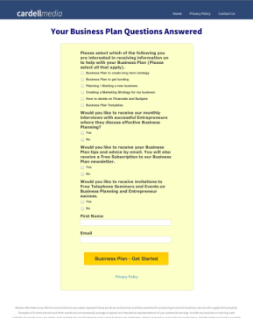
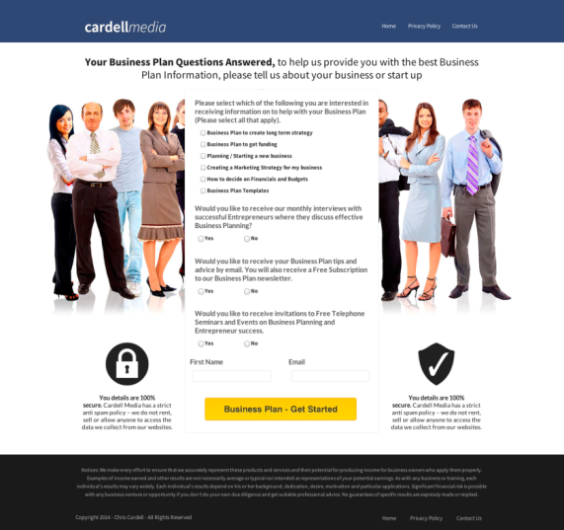
Split testing your landing pages
Performed 82% better
Notes:
Click for percentage

Slide 48
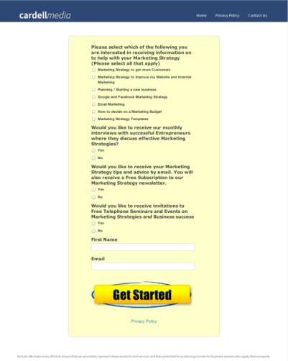
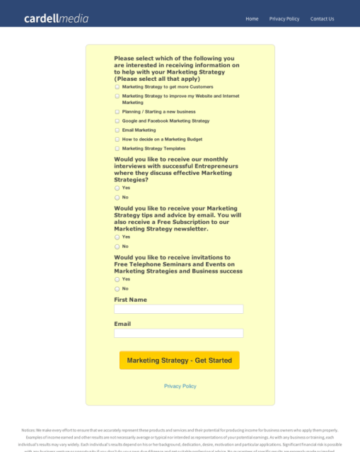
Split testing your landing pages
Performed 48% better
Notes:
Click for percentage

Slide 49
Split testing your landing pages
This is one of the KEY Internet Marketing Strategies
The one thing that you can guarantee is that it’s always possible to improve the performance of your landing page
There are numerous choices of elements to test. You can only discover which approach works best by doing accurate split testing.
To split test a landing page, you create two separate pages and serve them up alternately to measure the results

Slide 50
Split testing your landing pages
Split Testing Tools:
Google Analytics ‘Content Experiments’
Search for ‘Split Testing Tools’
e.g., www.Optimizely.com

Slide 51
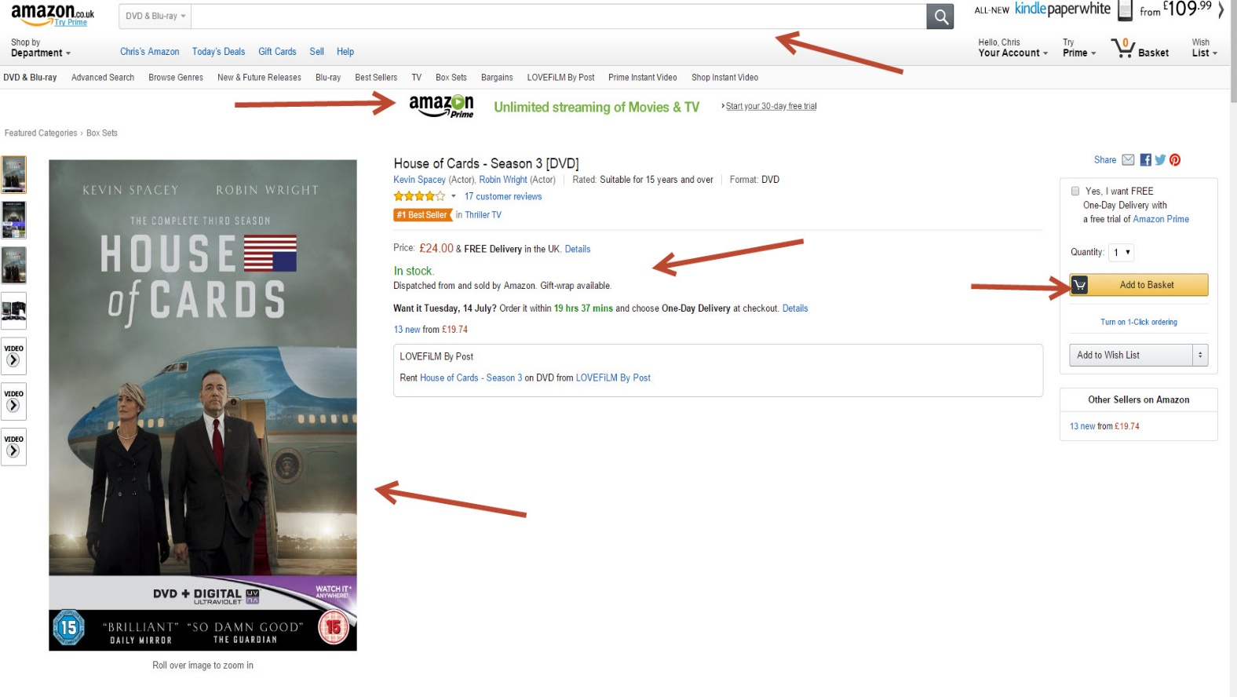

Slide 52
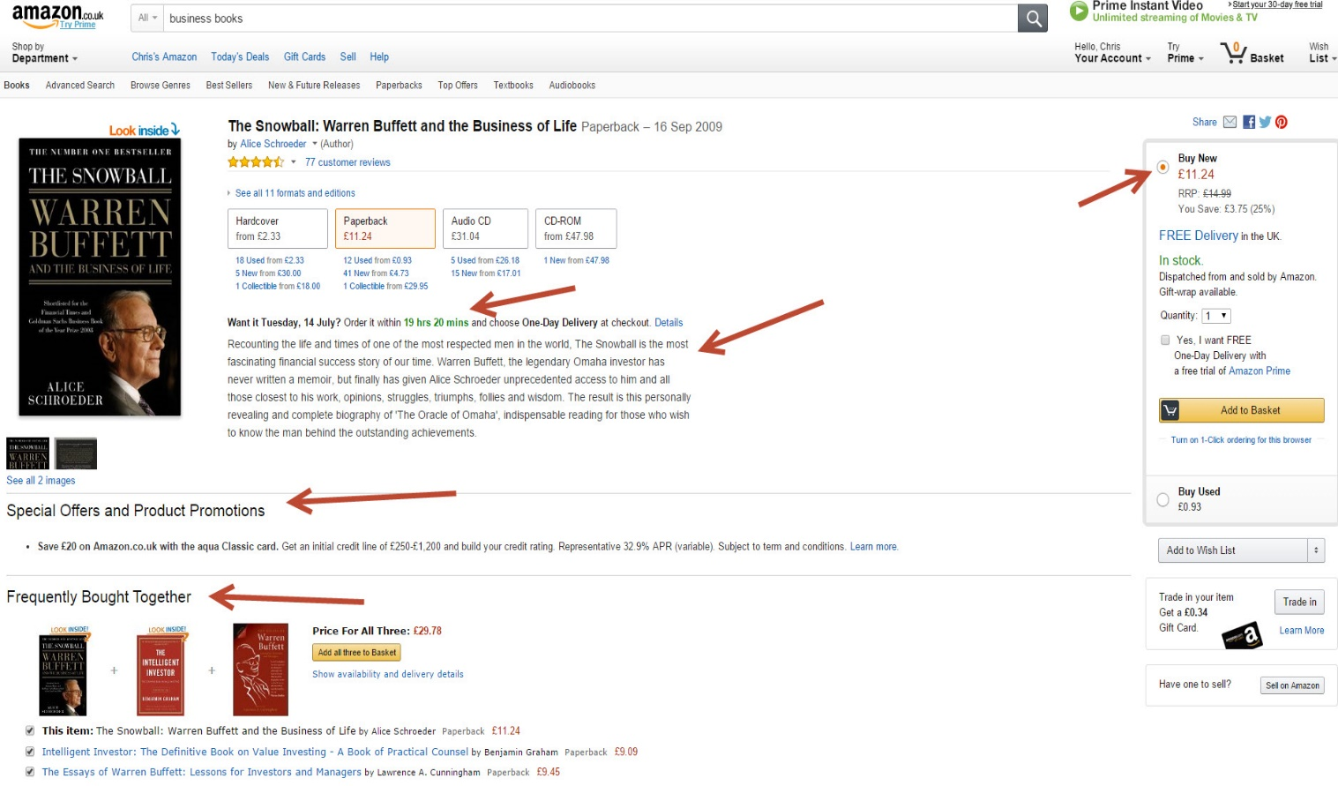

Slide 53
MAIN COURSE PAGE AND MEMBERS’ PRIVATE GROUP
All the course information, slides and
Seminar recordings are here:
http://www.cardell2015.com
The Private Facebook Group for Members is here:
https://www.facebook.com/groups/ppcmastery/

