Slide 1



Slide 2
SEMINAR FOUR:
The Secrets of the PPC
and Internet Marketing Millionaires

Slide 3
Bidding Options
In your Campaign Settings (Campaigns, then
Settings), you have some options that deal
with how your bidding and budget are handled.

Slide 4
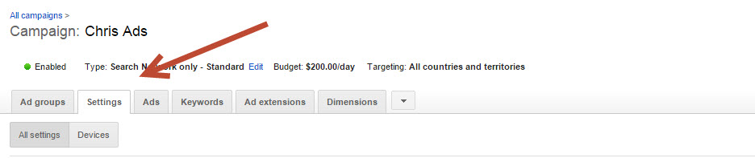
Bidding Options

Slide 5
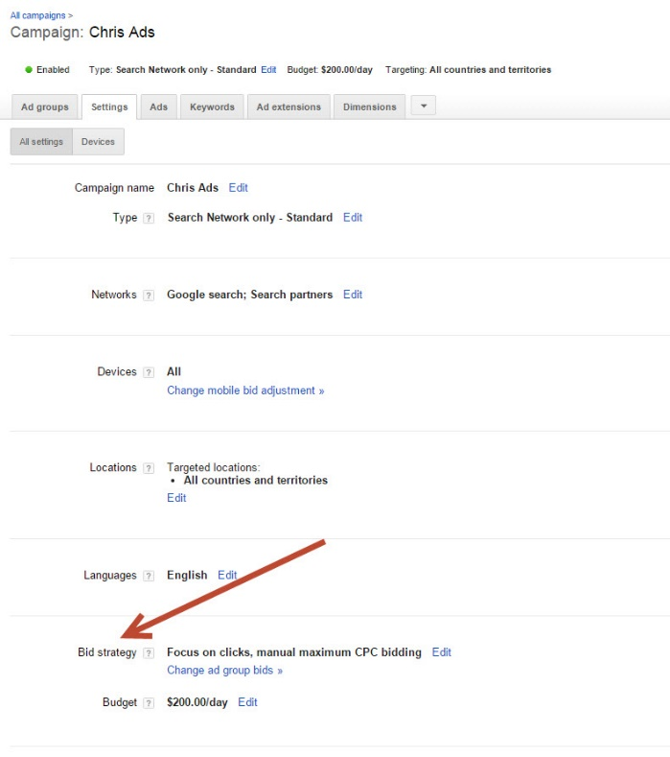
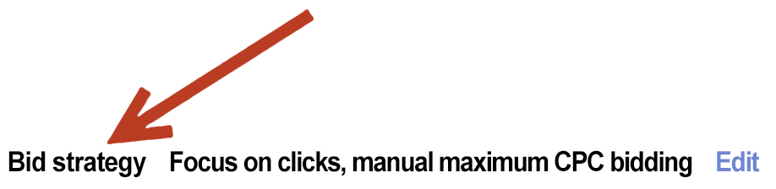
Bidding Options

Slide 6
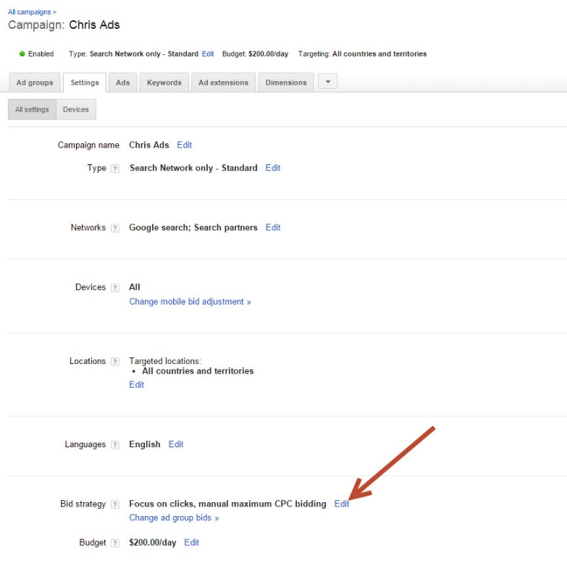
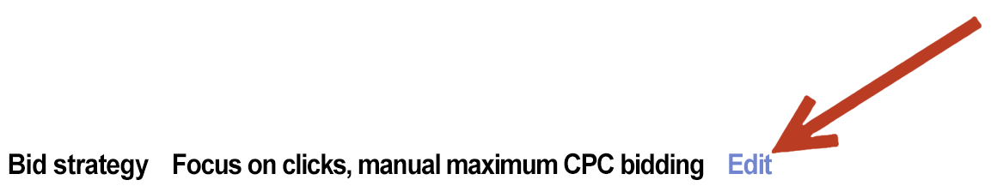
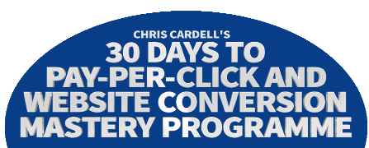
Bidding Options

Slide 7
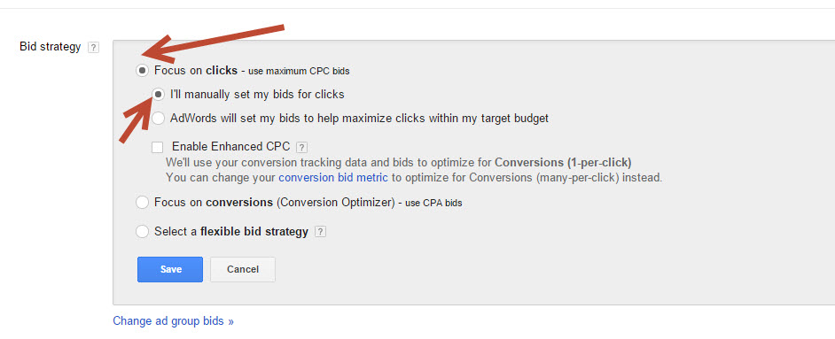
Bidding Options

Slide 8
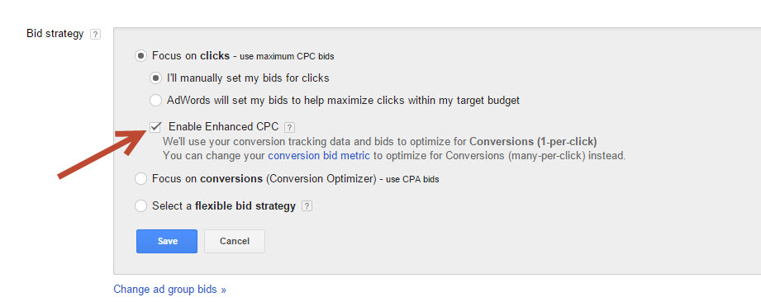
Bidding Options

Slide 9
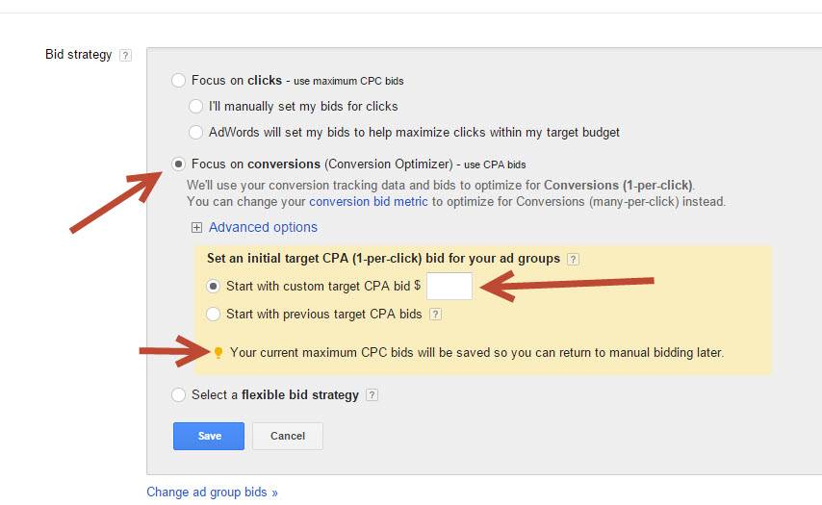
Bidding Options

Slide 10
Time: Ad Schedule
If you advertise on TV and Radio, you will often specify the time of day that you want your ads to appear, because you know that you get a better response on certain days or at certain times.
Google allows you to do the same. Select ‘Campaigns’ and ‘Settings’ and click on the ‘Edit Ad Schedule’ button.

Slide 11
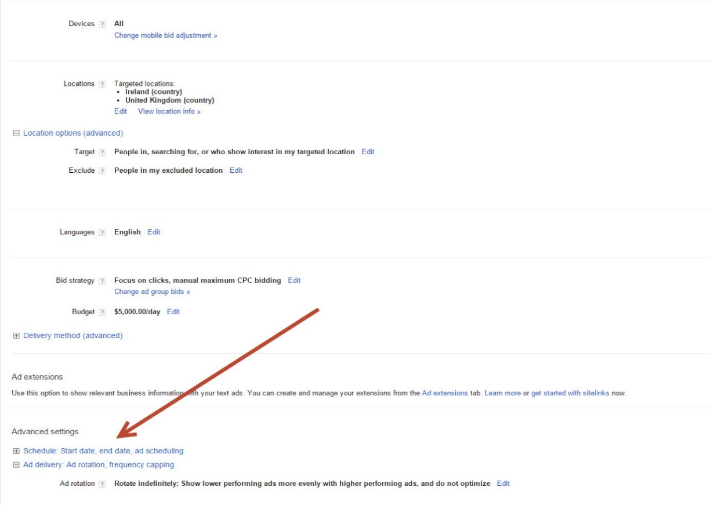
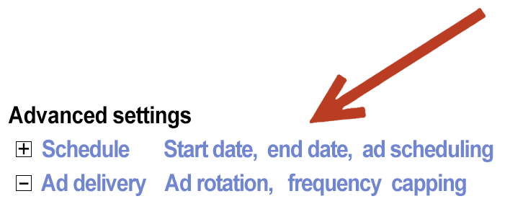
Time: Ad Schedule

Slide 12
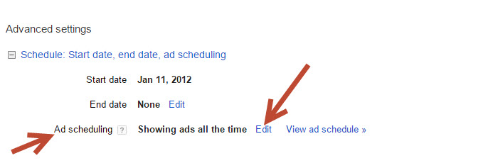
Time: Ad Schedule

Slide 13
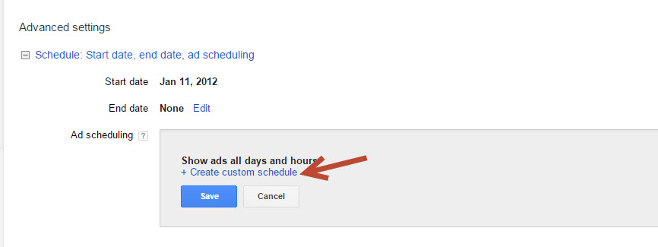
Time: Ad Schedule

Slide 14
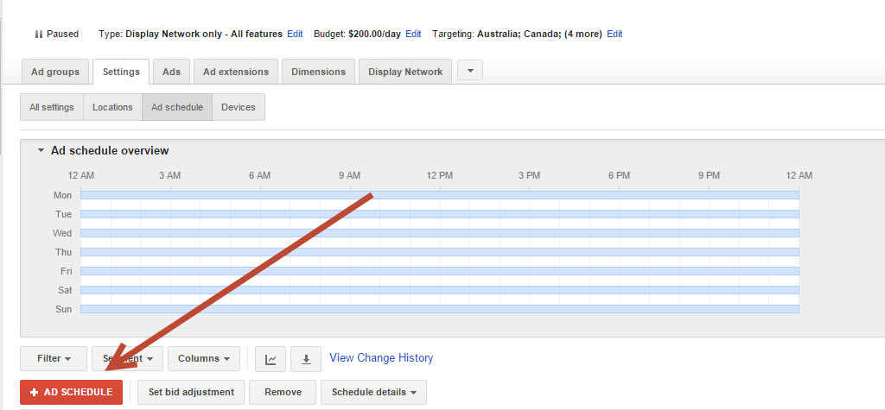
Time: Ad Schedule

Slide 15
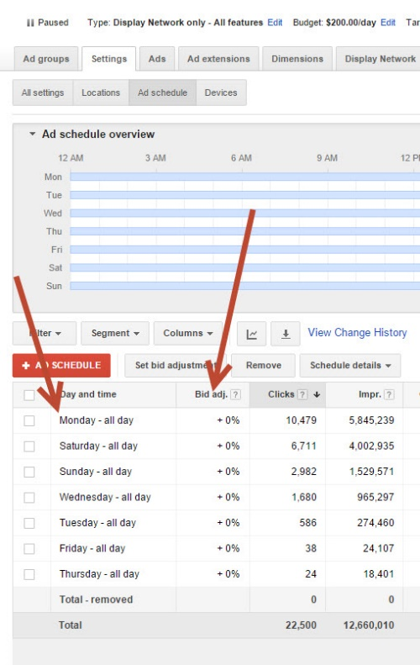
Time: Ad Schedule

Slide 16
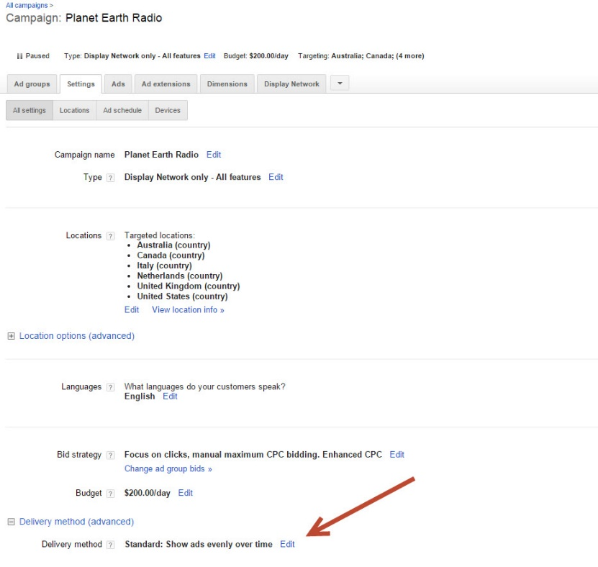
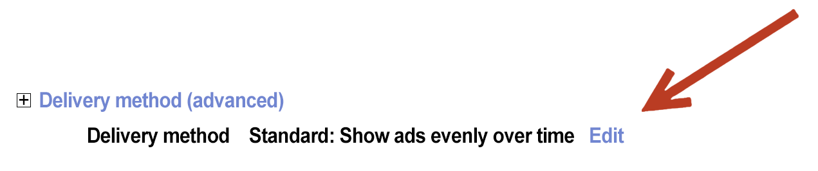
Delivery Method

Slide 17
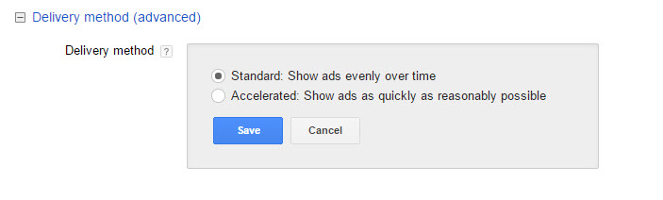
Delivery Method

Slide 18
Delivery Method
If you’re operating on a limited budget, you may want to go into ‘Delivery Method’ and select ‘Standard: Show ads more evenly.’ This will ensure that your ads are spread across the day. If you’ve got a high budget you don’t expect to reach, you don’t want this option.

Slide 19
Delivery Method

Slide 20
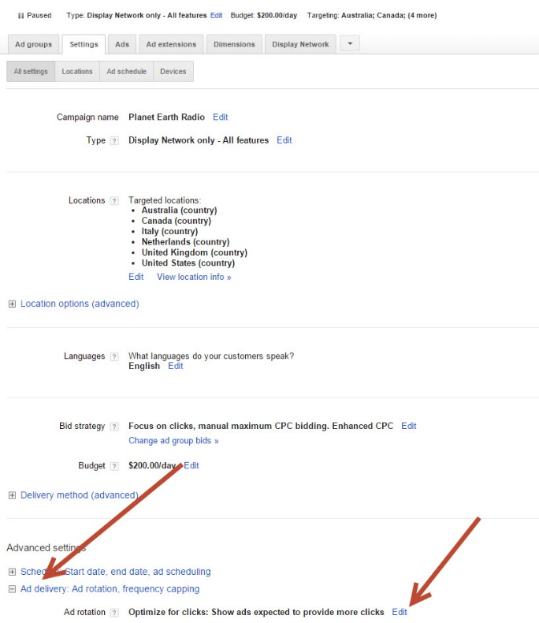
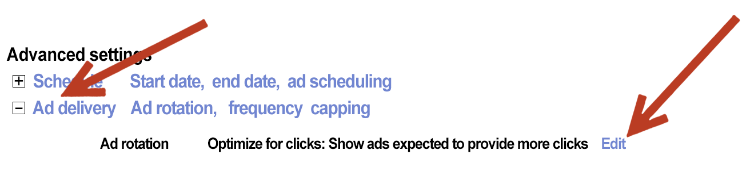
Ad Delivery

Slide 21
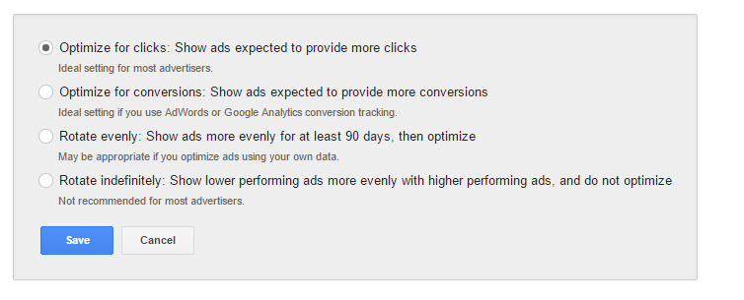
Ad Delivery

Slide 22
Bid Simulator
This is a tool that lets you see how much you’ll need to pay to get more clicks. Click on the bid simulator icon next to your keywords.

Slide 23

Bid Simulator

Slide 24
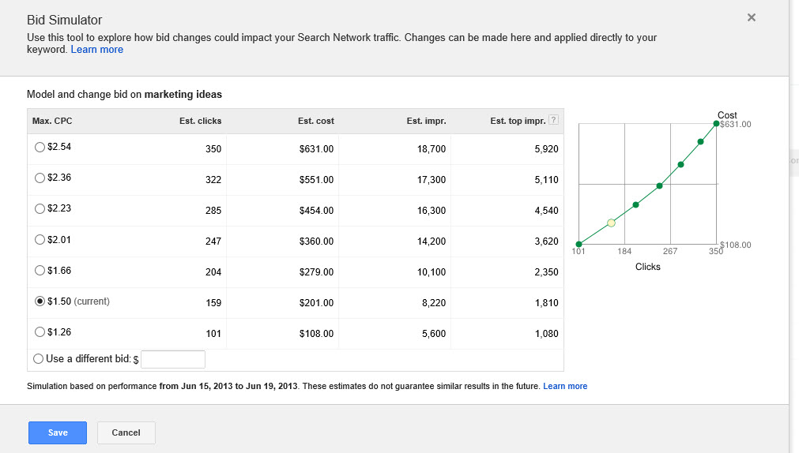
Bid Simulator

Slide 25
Dynamic Keyword Insertion
If you have several keywords in an ad group (this is particularly useful if you have large numbers of keywords in an ad group) you can write your ad so that Google will serve up the keyword in the headline.

Slide 26
Dynamic Keyword Insertion
Suppose you have an ad group where the main keyword is:
IT Jobs
But you also have 20 related keywords such as:
IT Jobs UK
IT Jobs USA
IT Jobs Canada
Dynamic Keyword Insertion will insert whichever keyword is searched for as the headline of your
ad. This will make it more relevant and will
normally increase CTR.

Slide 27
Dynamic Keyword Insertion
In this example, we would set up Dynamic Keyword Insertion by writing the headline in the following way:
{KeyWord:Alt IT Jobs}
If the Keyword is too long for the headline, it will default to whatever you typed in originally (in this case, IT Jobs)

Slide 28

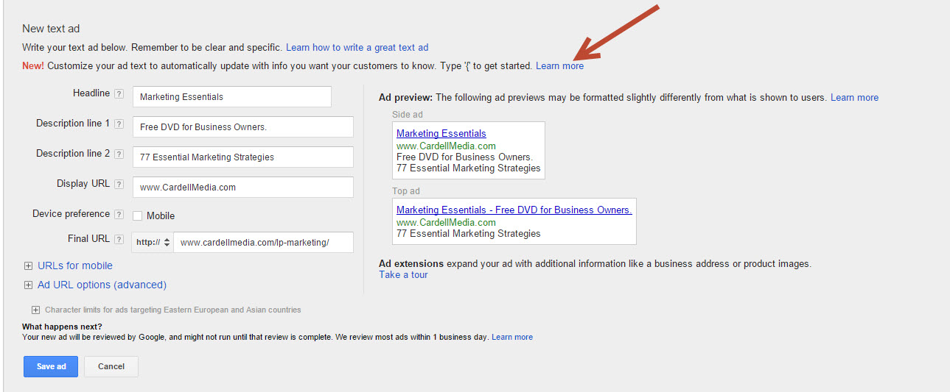
Dynamic Keyword Insertion

Slide 29
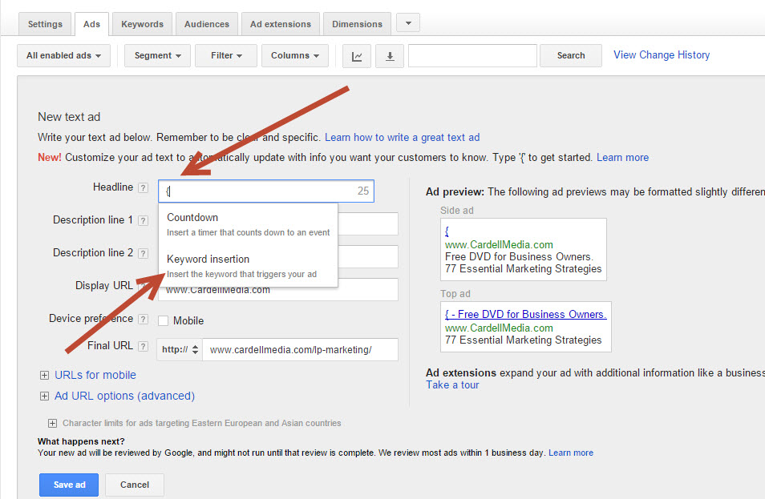
Dynamic Keyword Insertion

Slide 30
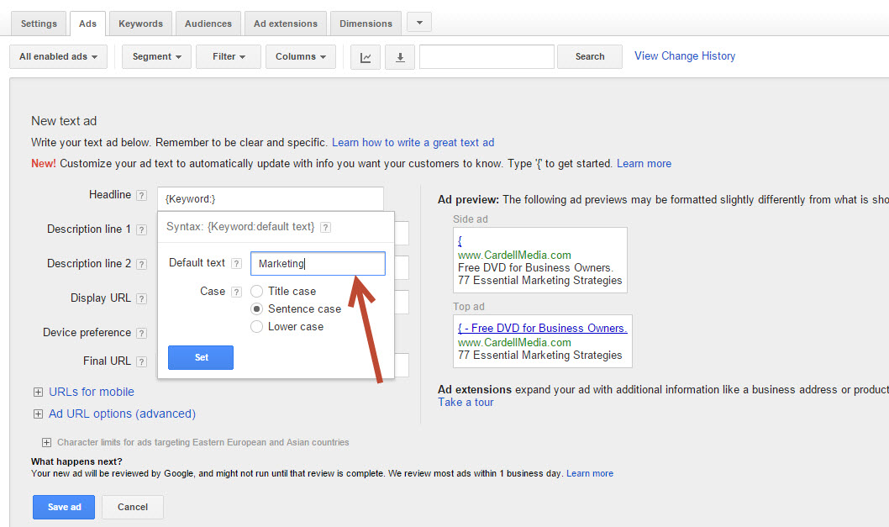
Dynamic Keyword Insertion

Slide 31
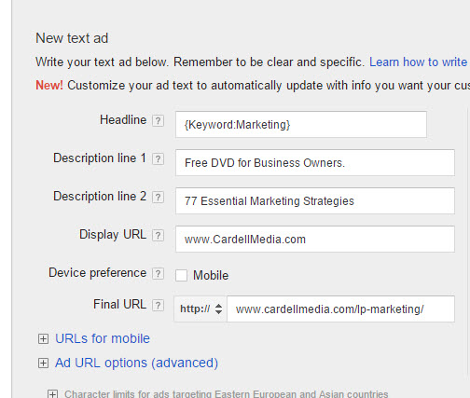
Dynamic Keyword Insertion

Slide 32
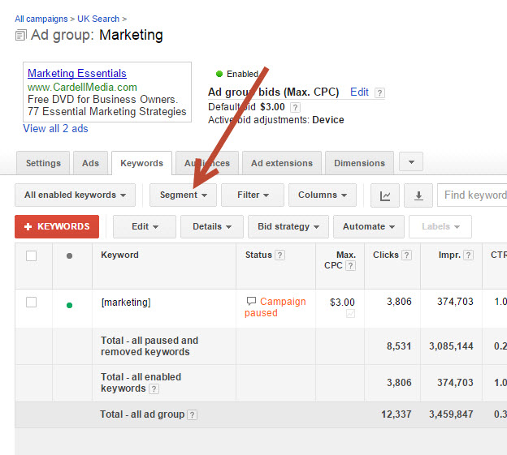
Segment

Slide 33
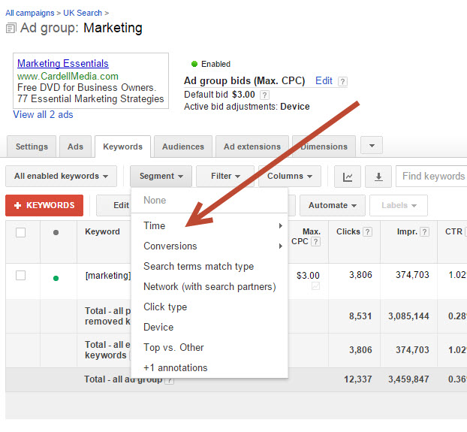
Segment - time

Slide 34
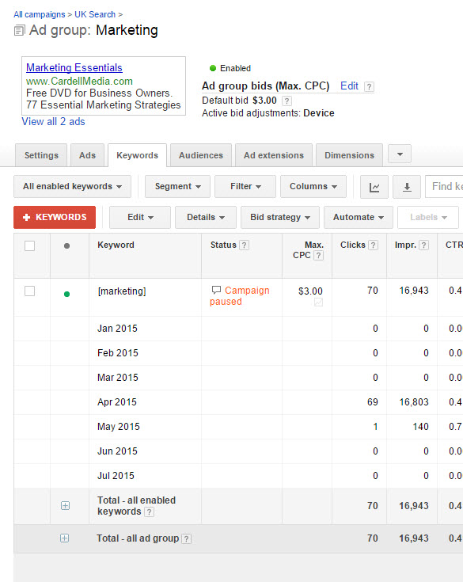
Segment - time

Slide 35
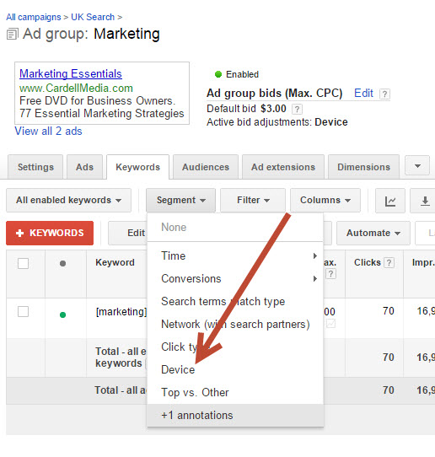
Segment - device

Slide 36
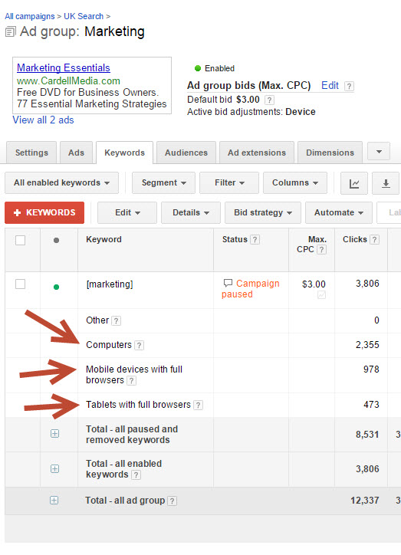
Segment - device

Slide 37
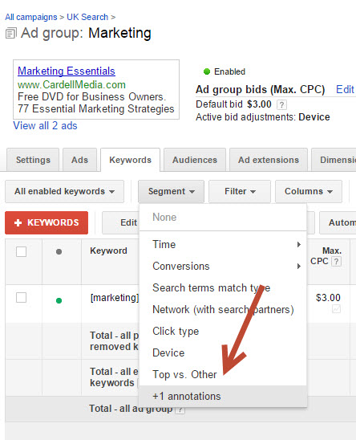
Segment – top vs other

Slide 38
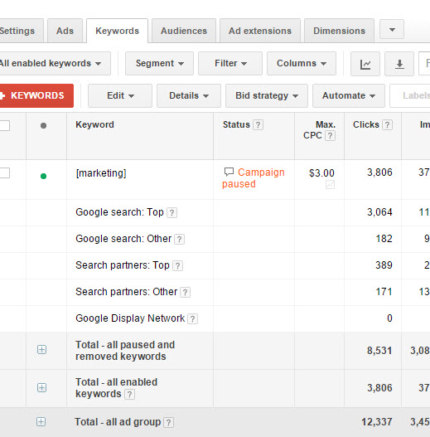
Segment – top vs other

Slide 39
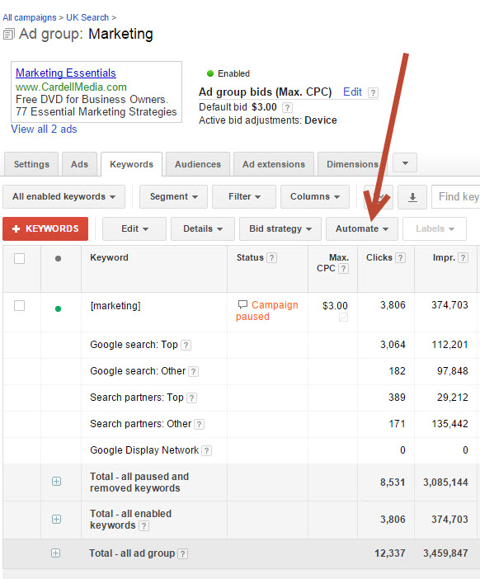
Rules - automate

Slide 40
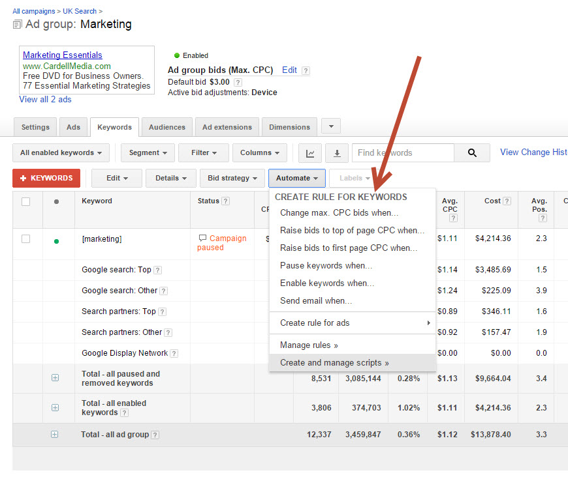
Rules - automate

Slide 41
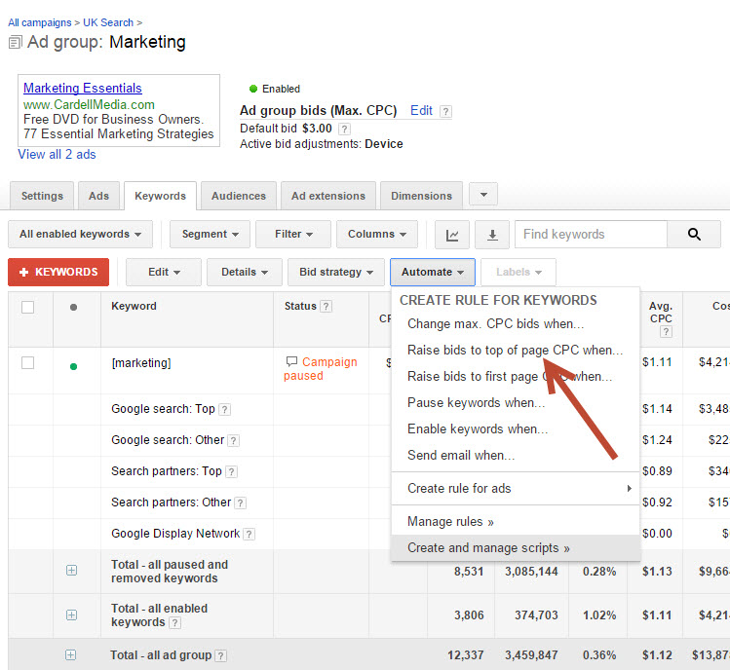
Rules - automate

Slide 42
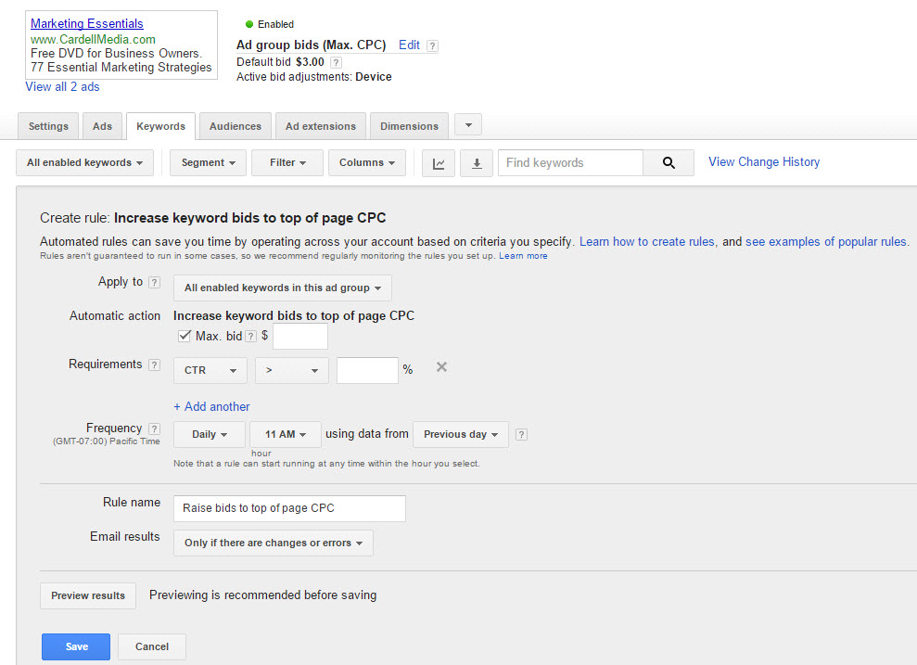
Rules - automate

Slide 43
Product Testing
Smart businesses are stepping outside the box with PPC and being creative in using it for more than just attracting customers.
One of these additional applications is to test new products, services and markets.

Slide 44
Product Testing
Remember, you can deliver a couple of hundred visitors to a landing page, often for a few dollars or pounds. You’re not obliged to have something to sell on the landing page. You could just provide some useful information and do it as a test to see if certain keywords and ads produce visitors.
There’s also nothing to stop you asking people to sign up for information on a certain subject – even though you have not yet created a product or service for that market.

Slide 45
The One Time You Should Pay Too Much for a Keyword
It may seem counter-intuitive to pay too much for a keyword but when you’re starting a new campaign, or when you want to give your campaigns a fast boost, here’s what you can do:
Let’s say we’ve started a campaign with an important new keyword. In the first few days of the campaign, pay whatever it takes to get in a high position.
Why do we want to do this? Because the top positions will give us the highest click-through rate. If you also split test your ads at the same time, you should be able to
quickly increase that high CTR.

Slide 46
The One Time You Should Pay Too Much for a Keyword
Within a few days, you may well end up with a CTR far higher than all the competition.
You then have two choices. Your CTR may be high enough to keep you at the top with a greatly reduced Cost per Click that you’re happy to pay.
Alternatively, you can start reducing your maximum CPC and dropping down the page – but that CTR you’ve achieved should give you a good position for minimum cost.

Slide 47
The One Time You Should Pay Too Much for a Keyword
Of course, all this depends on cash flow. If you’re on a limited budget, the more patient approach may be appropriate for you.
NOTE: In theory, if your ad appears on the left-hand side of the page, Google factors in that this gives you a disproportionately high CTR and adjusts accordingly to stop people getting high up just by throwing money at a campaign. But this strategy is still worth pursuing.

Slide 48
Adwords Editor
www.google.com/intl/en_uk/adwordseditor/
Or search on Google for ‘AdWords Editor’

Slide 49
Pay per Click Advertising with Yahoo and Bing / Microsoft
Once you have a successful campaign on Google, it is normally worth rolling it out on Yahoo / Bing.

Slide 50
Pay per Click Advertising with Yahoo and Bing / Microsoft
Key points on Advertising with Yahoo / Bing:
Advertising on Yahoo and Bing is covered by Bing Ads (run by Microsoft)
In the UK, Bing / Yahoo covers about 10% of the Market
In the US, Yahoo and Bing have a higher share of the Market than the UK
Yahoo and Bing same type of system as Google - You are rewarded for a high click-through rate

Slide 51
Pay per Click Advertising with Yahoo and Bing / Microsoft
Key points on Advertising with Yahoo / Bing:
All of the principles involving the use of keywords applies here, too
They can be slower with updates, and some of it is done by people
It is possible that Yahoo produces a higher quality lead for some markets in some countries

Slide 52
Pay per Click Advertising with Yahoo and Bing / Microsoft
Key points on Advertising with Yahoo / Bing:
Bing / Yahoo tends to be less competitive than Google (it’s smaller ,so less people use it.) So if you have an effective PPC and Website Conversion strategy, you should be able to significantly out perform the competition on Yahoo

