Slide 1

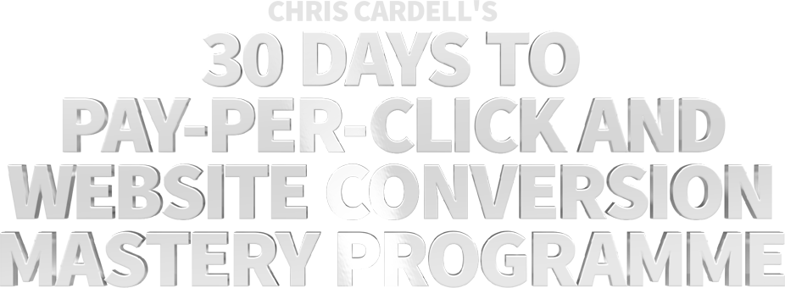

Slide 2
SEMINAR FIVE:
Mobile Advertising
on Google – Plus the
Power of Remarketing

Slide 3
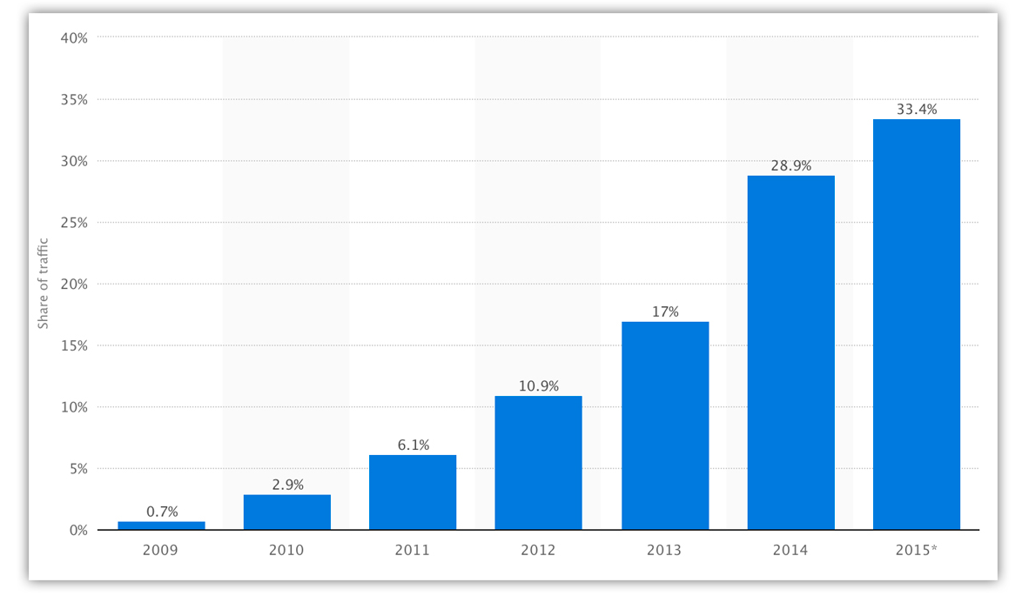
Mobile currently accounts for a third of all global web pages served – up 96% since 2013

Slide 4
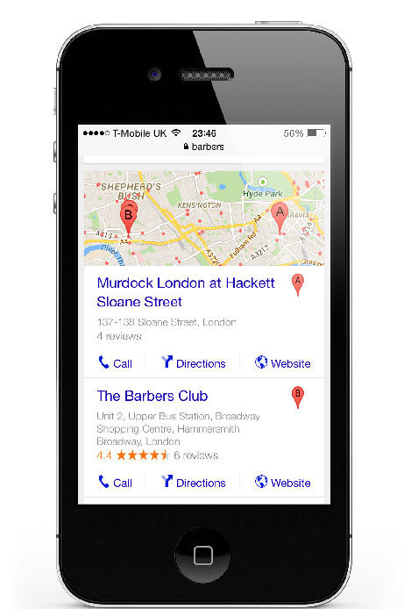
GOOGLE Mobile Facts
50% of searches are on mobile devices
You should make sure your address and directions appear in your ads
Ensure your business is on Google Places www.google.com/business

Slide 5
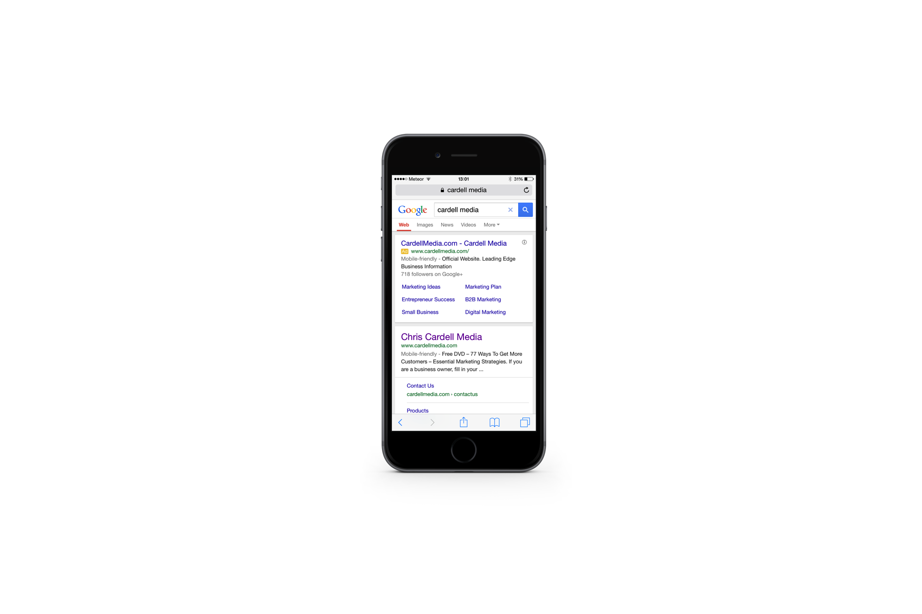
GOOGLE Mobile Facts
Mobile optimised websites with mobile targeted campaigns get 11.5% higher CTR’s on average
Have a ‘Clickable’ phone number on your landing page – make it as easy as possible for people to reach you

Slide 6
GOOGLE ADWORDS
The BIG One:
Separate Campaigns for Desktop and Mobile

Slide 7
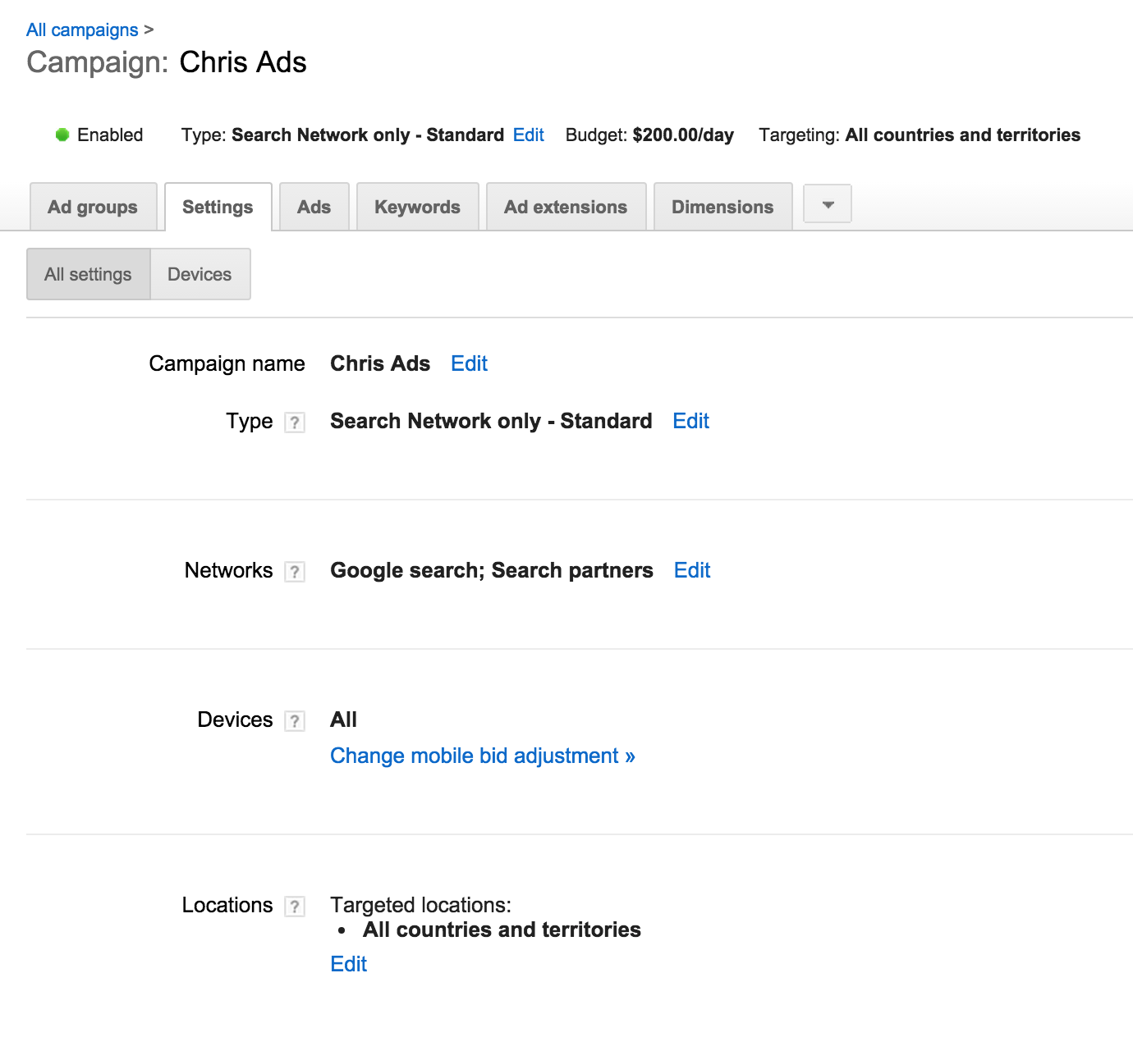
Mobile bid adjustments

Slide 8
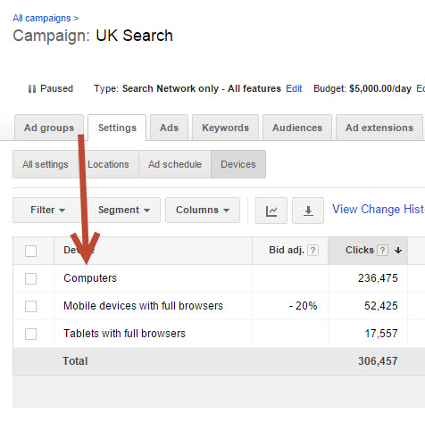
Mobile bid adjustments

Slide 9
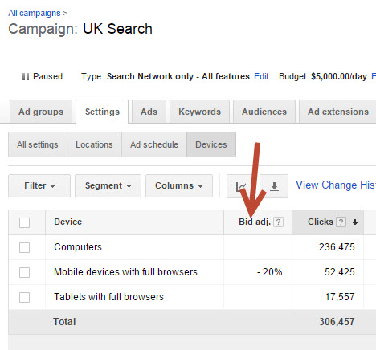
Mobile bid adjustments

Slide 10
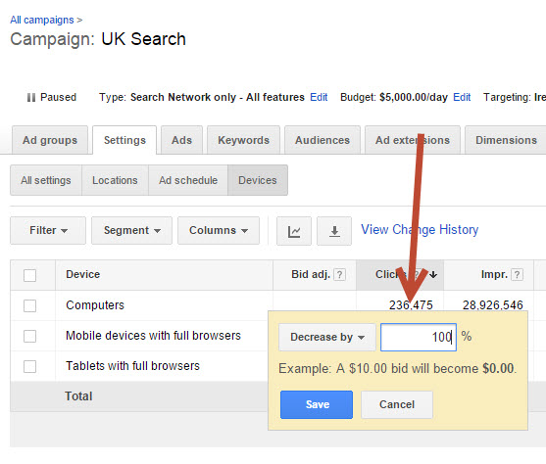
Mobile bid adjustments

Slide 11
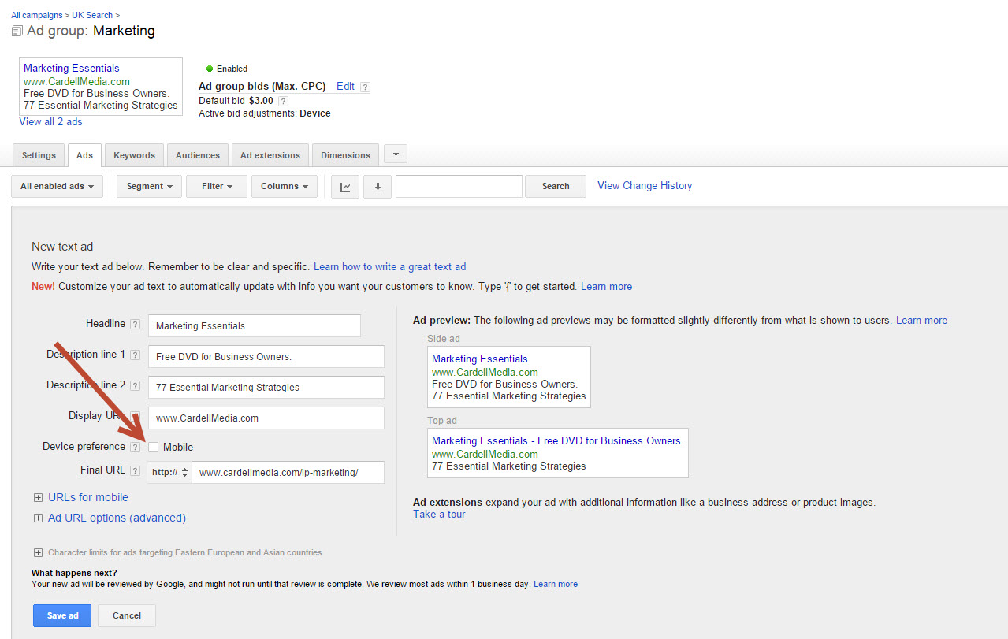
Mobile bid adjustments

Slide 12
GOOGLE’S MOBILEGEDDON
48% of searches are on mobile
Google wants the best experience for its users
April 2015 – Google made sweeping changes
Only Mobile search results impacted

Slide 13
MOBILEGEDDON
‘Mobile-Friendly’ appears next
to search results
Your site can still be updated - unlike previous algorithm updates, websites can upgrade their ‘mobile friendliness’ at any time to appear higher in the search results
To check your site, go to: www.google.com/webmaster/
tools/mobile-friendly

Slide 14
What is ‘mobile friendly’?
Content is optimised to fill the screen – regardless of the screen size (iPhone, Android, etc.)
Buttons and links are easy to ‘tap’
Text/Font size is easy to read
Pages don’t require you to ‘pinch and zoom’ to view each element

Slide 15
What is ‘mobile friendly’?
Site navigation is easy and intuitive
Videos play across all devices
Contact forms are easy to complete

Slide 16
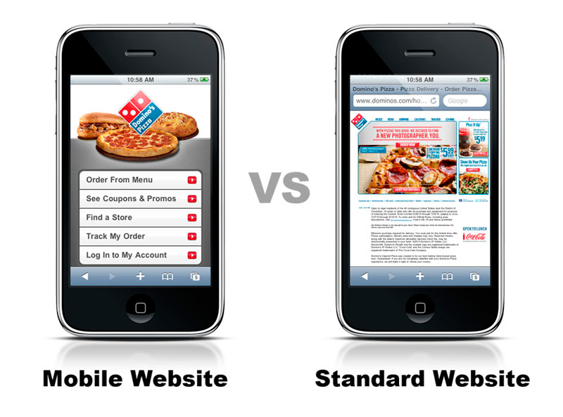
What is ‘mobile friendly’?

Slide 17
How to Make Your Website Mobile Friendly

Slide 18
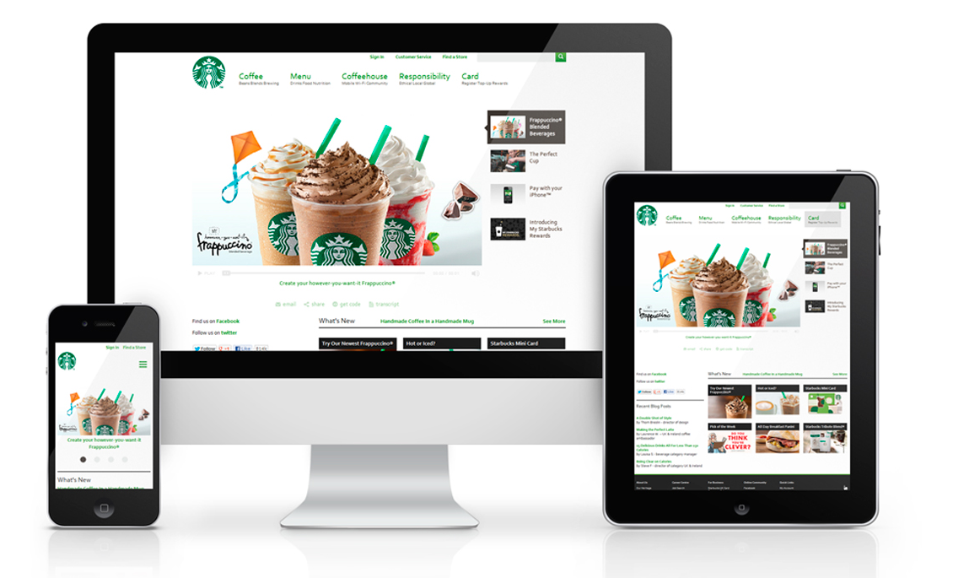
Option one: ‘Responsive websites’
'Responsive Websites' dynamically realign themselves to look good on any device; mobile, tablet or desktop. Headlines, text and pictures automatically scale and move around to fill the screen

Slide 19
Option one: ‘Responsive websites’
Pros of Responsive Web Design
Highly flexible - one website works on all devices, easy to maintain
This is Google's recommended configuration
Future proof - will comply with new browsers

Slide 20
Option one: ‘Responsive websites’
Cons of Responsive Web Design
Expensive upfront cost
Landing pages don't convert as well as
specific mobile optimised pages

Slide 21
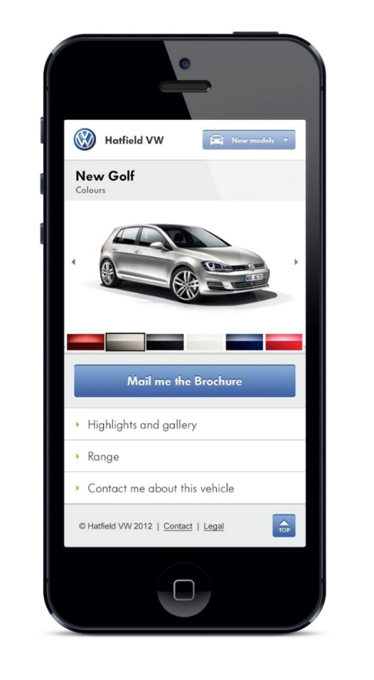
Option two: ‘Mobile websites’
Mobile sites are built specifically for mobile devices. A piece of code on your main website detects mobile visitors and diverts them to your mobile site
Mobile sites can be put on a subdomain of your main site, e.g.,
www.mobile.cardellmedia.com

Slide 22
Option two: ‘Mobile websites’
Pros of Mobile Websites
Can be optimised specifically for mobile users
Is the most mobile-friendly option
Easier and cheaper to design/build

Slide 23
Option two: ‘Mobile websites’
Cons of Mobile Websites
Recurring maintenance
Higher cost for updating content on
multiple pages
May need to updated to work with
future browsers

Slide 24
RESPONSIVE vs. MOBILE:
The Difference
Responsive sites work across any device
Mobile sites only work on mobile devices
Mobile sites look like apps

Slide 25
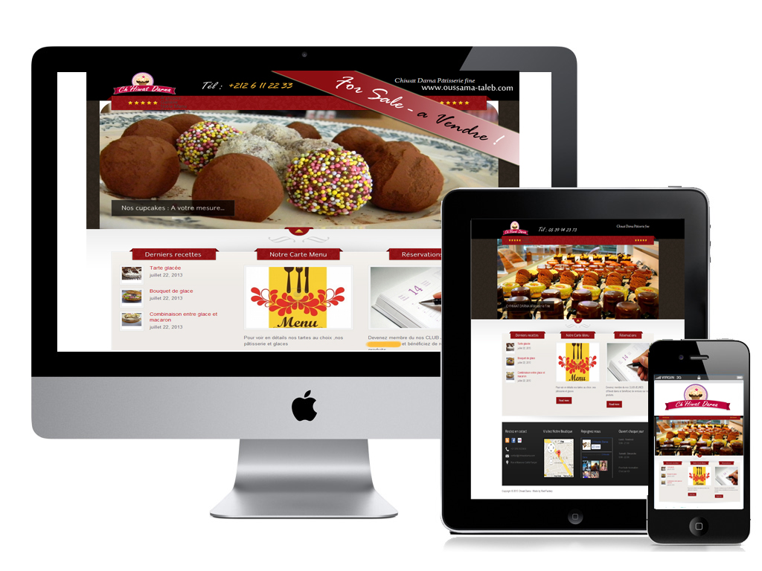
RESPONSIVE vs. MOBILE:
The Difference
Example: A restaurant could have their website turned into a ‘responsive’ site so mobile visitors see the same content as everyone else

Slide 26
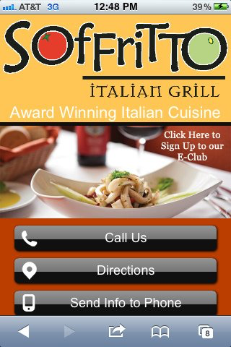
RESPONSIVE vs. MOBILE:
The Difference
Or they could build a mobile-specific site like this:

Slide 27
Landing Pages

Slide 28

Your Landing Pages
Landing Pages must be ‘Responsive’
Drive traffic to mobile and tablet pages designed specifically for each device
Avoid 2-step opt-in overlays or exit
pop-ups, as these behave differently on mobile devices

Slide 29
Remarketing

Slide 30
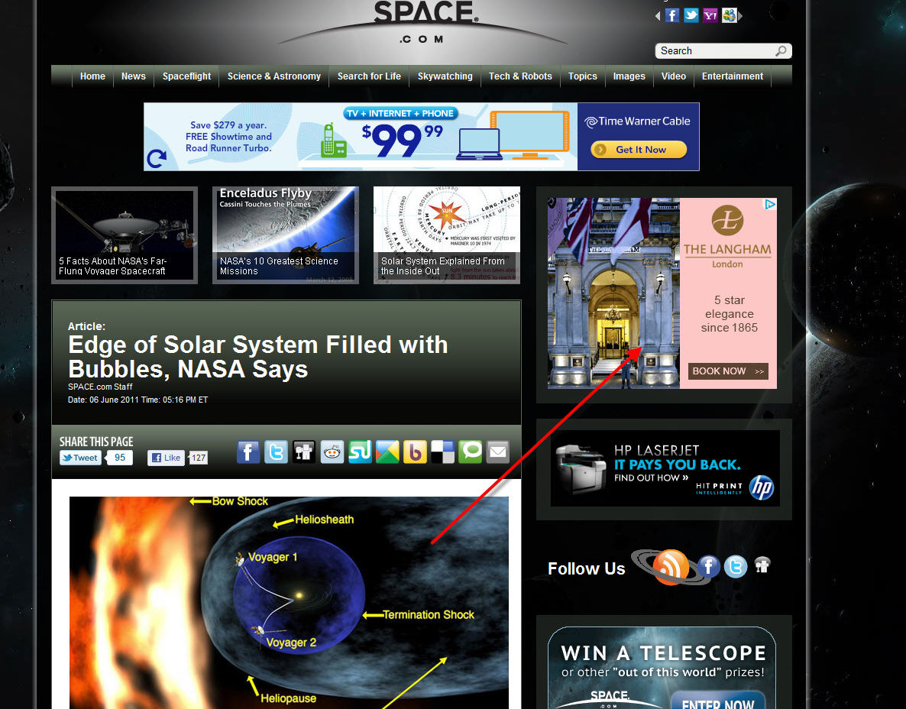

Slide 31
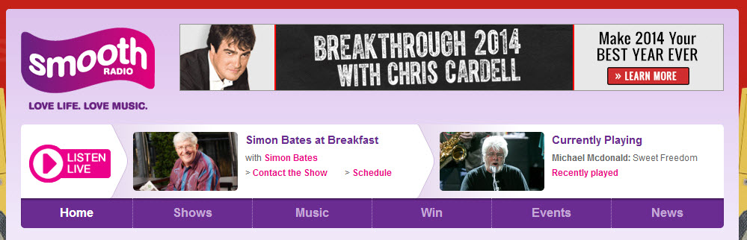

Slide 32
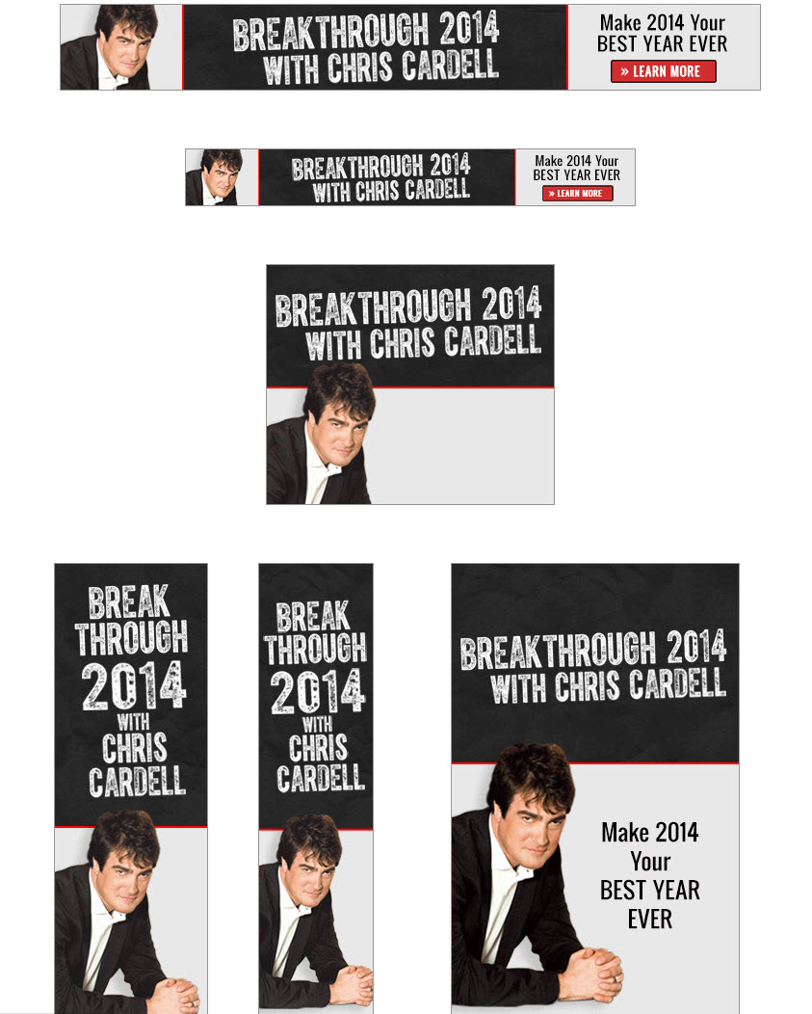

Slide 33
Why Remarketing is a Must

Slide 34
Why Remarketing?
1) Remarketing is the Only Way to Continue Communicating With Non-Customers Who Have Visited Your Website
With Remarketing, you can stay in front of them for up to 18 months

Slide 35
Why Remarketing?
2) Remarketing Gives the Impression That You’re Everywhere
This is particularly powerful for local businesses
When people in your area go to a national website and see your ads, it gives the impression that you’re everywhere

Slide 36
Why Remarketing?
3) Remarketing Tracks Customers Based on Behaviour
You can target people who have been to specific pages on your website
You could have a separate Remarketing list for people who have bought from you

Slide 37
Why Remarketing?
4) Remarketing is Great for Companies with a Long Lead Time
Example: high-end bathroom company
It could be one to six months between someone visiting their website and actually doing business with them
With Remarketing, the company can keep serving them banner ads in the interim

Slide 38
Why Remarketing?
5) Remarketing Bypasses Email
The challenges of Email Marketing:
Delivery
Open Rates
Can be as low as 10% to 25%

Slide 39
Why Remarketing?
There are Three Distinct Groups to Target with Remarketing Campaigns:
Customers
Google AdWords Visitors
Other Non-Customers

Slide 40
BIG REMARKETING TIP FOR
ADWORDS TRAFFIC:
Keyword-Specific Remarketing Ads

Slide 41
How to Set Up Your Remarketing Campaign

Slide 42
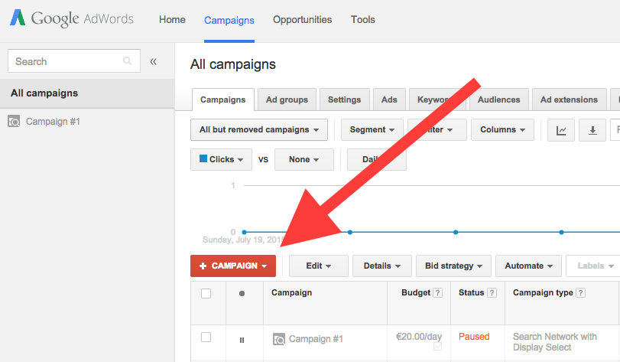
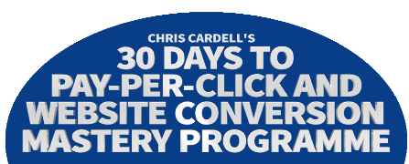
How to Set Up Your Campaign
Click
+ CAMPAIGN

Slide 43
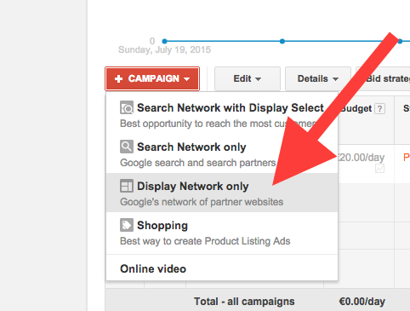
How to Set Up Your Campaign
Select Display Network Only from the dropdown options

Slide 44
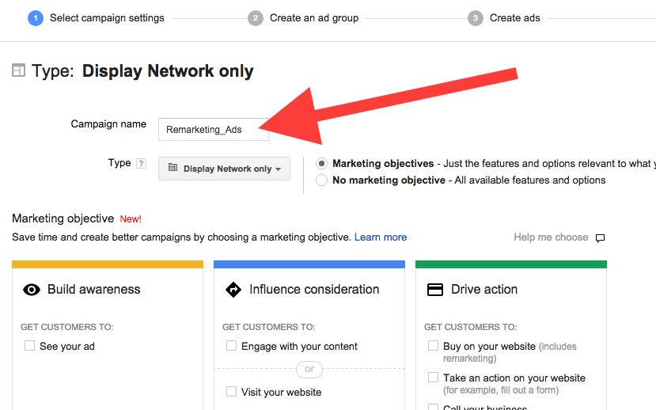
How to Set Up Your Campaign
Name your campaign

Slide 45
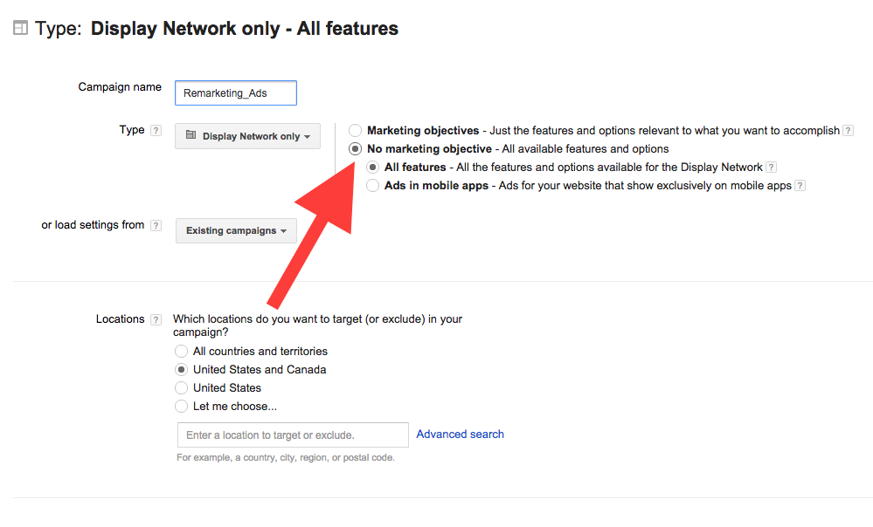
How to Set Up Your Campaign
Google recently launched the new ‘Marketing Objective’ assistant – but for this campaign, select the No marketing objective radio button

Slide 46
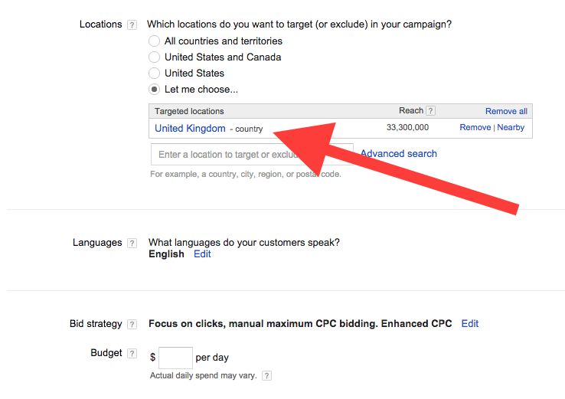
How to Set Up Your Campaign
Set your location targeting

Slide 47
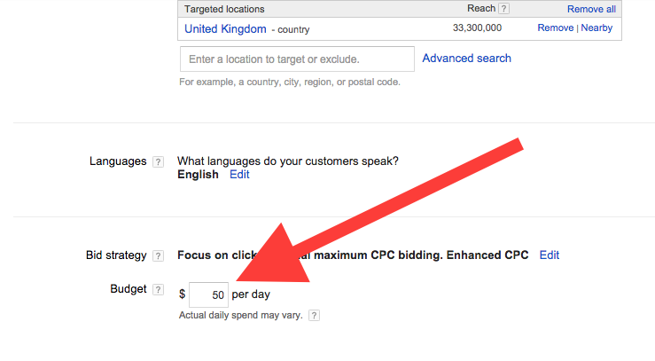
How to Set Up Your Campaign
Set your campaign budget

Slide 48
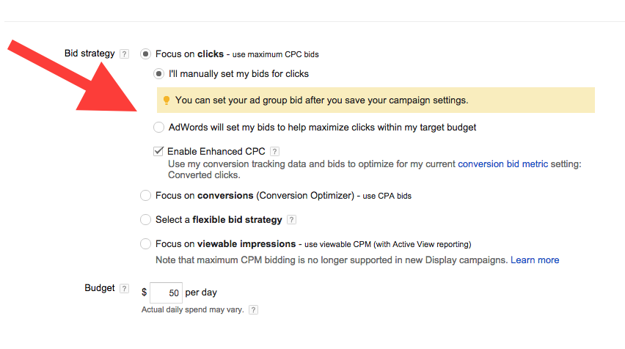
How to Set Up Your Campaign
For more control over your budget, click edit to reveal the extra options

Slide 49
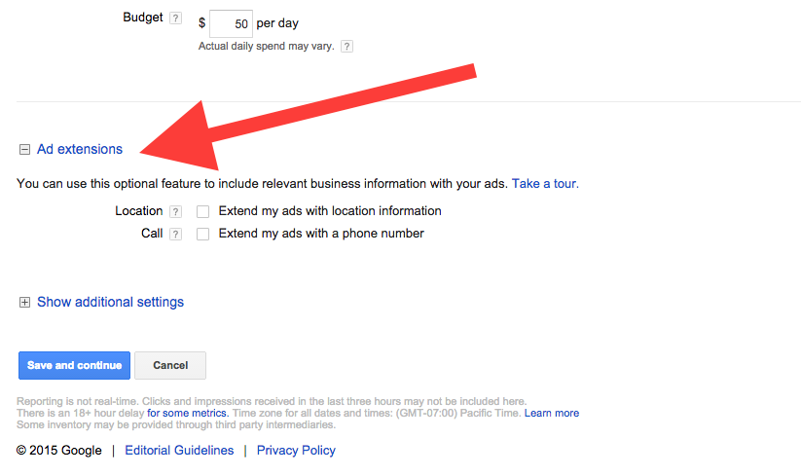
How to Set Up Your Campaign
Toggle Ad extensions to reveal the extension options

Slide 50
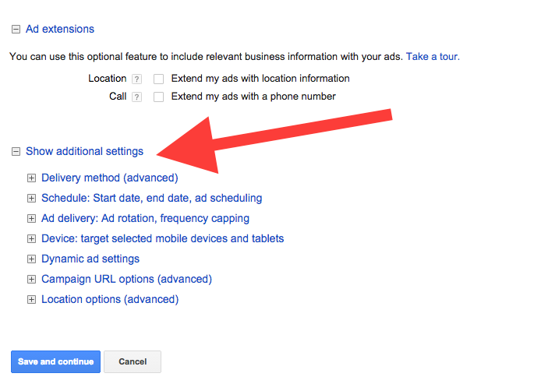
How to Set Up Your Campaign
Toggle Additional Settings to reveal:
Delivery method (advanced)
Schedule: Start date, end date, ad scheduling
Ad delivery: Ad rotation, frequency capping

Slide 51
How to Set Up Your Campaign
Toggle Additional Settings to reveal:
Device: Target selected mobile devices and tablets
Dynamic ad settings
Campaign URL options (advanced)
Location options (advanced)

Slide 52
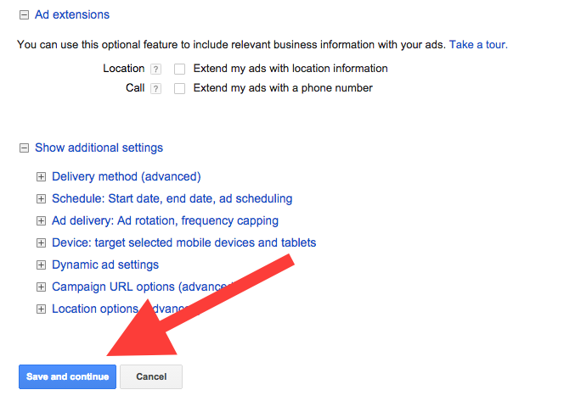
How to Set Up Your Campaign
Click Save and Continue

Slide 53
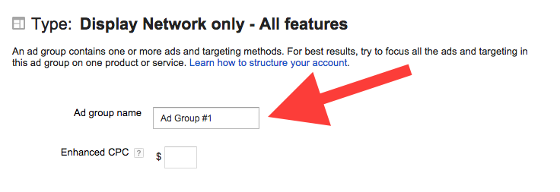
How to Set Up Your Campaign
Name your
Ad Group

Slide 54
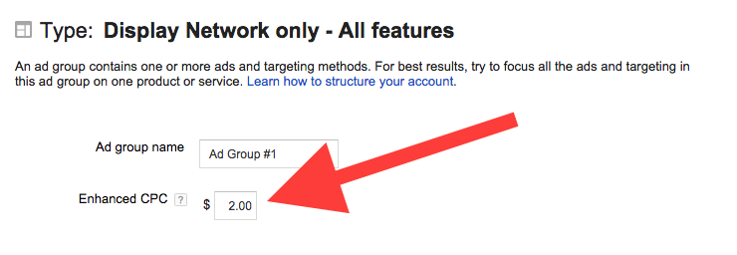
How to Set Up Your Campaign
Set your cost per click

Slide 55
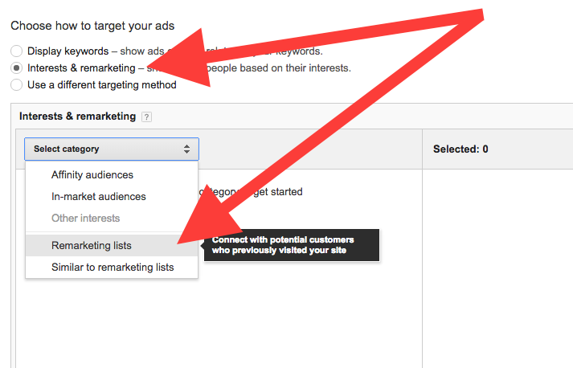
How to Set Up Your Campaign
Select the Interests & remarketing radio button and choose Remarketing lists from the dropdown menu

Slide 56
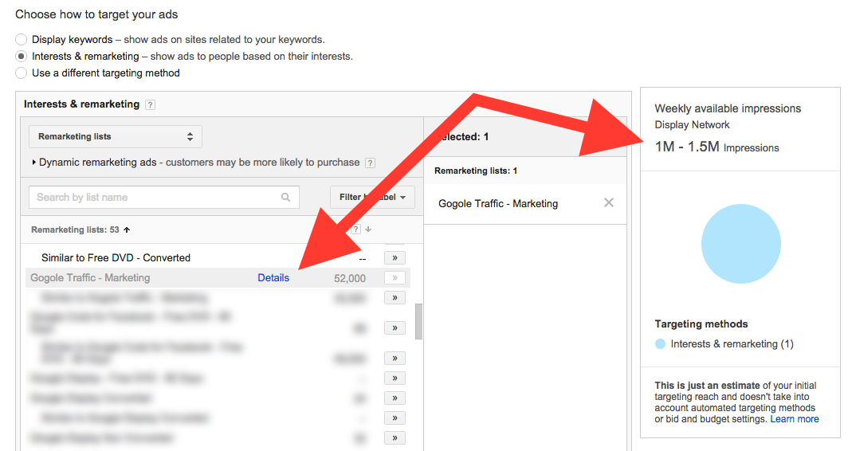
How to Set Up Your Campaign
Select the remarketing lists you want to target. Notice how the table on the right updates to show the estimated number of impressions your campaign will achieve.

Slide 57
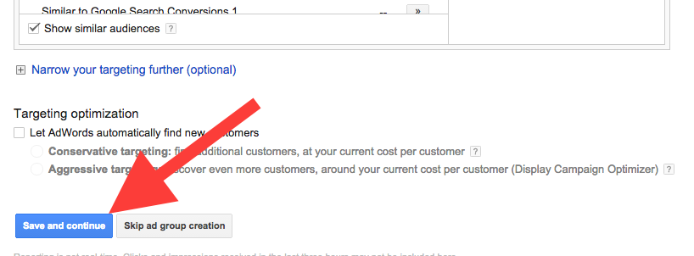
How to Set Up Your Campaign
Click Save and continue

Slide 58
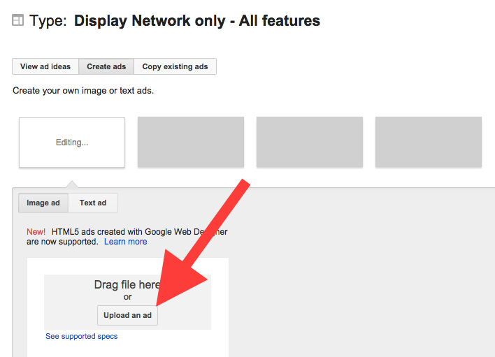
How to Set Up Your Campaign
Upload your first banner ad

Slide 59
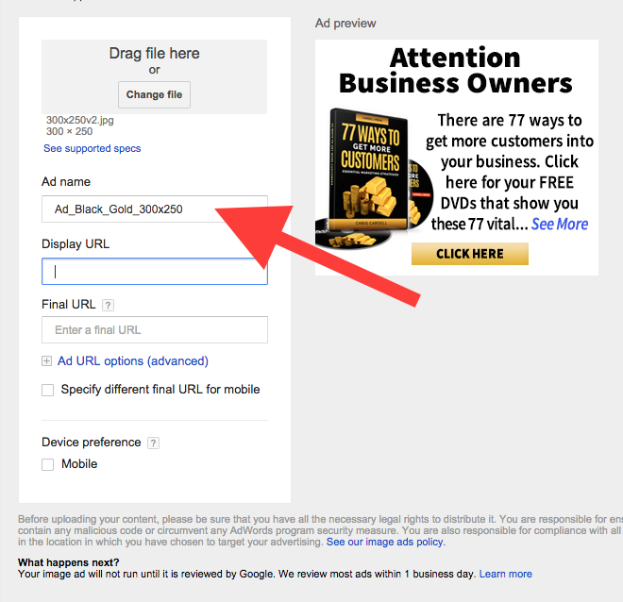
How to Set Up Your Campaign
Enter a name for your ad

Slide 60
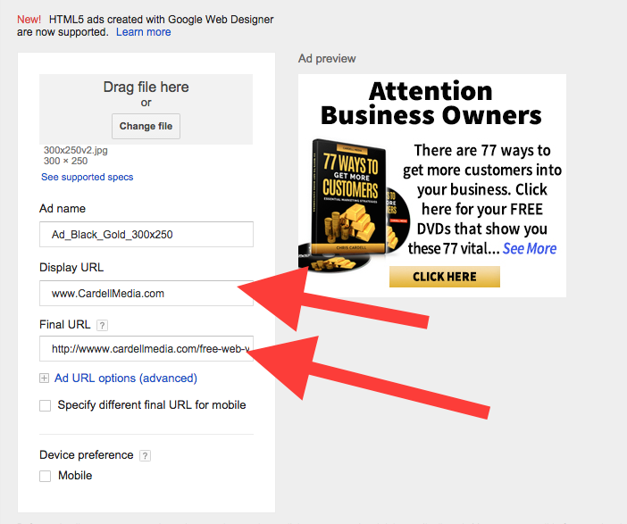
How to Set Up Your Campaign
Enter your display and destination URLs

Slide 61
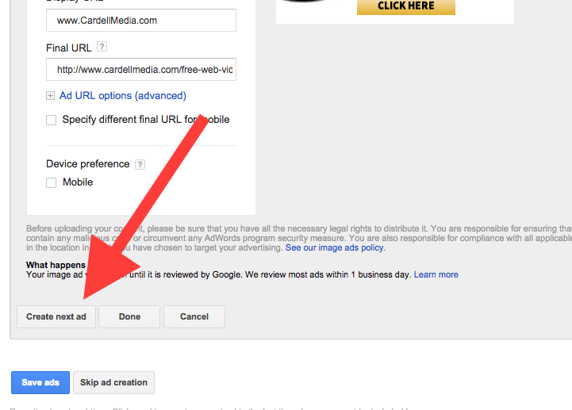
How to Set Up Your Campaign
Click Create next ad to upload more banners and repeat the process

Slide 62

How to Set Up Your Campaign
The common
banner sizes are:
728x90
468x60
300x600
160x600
120x600
300x250

Slide 63
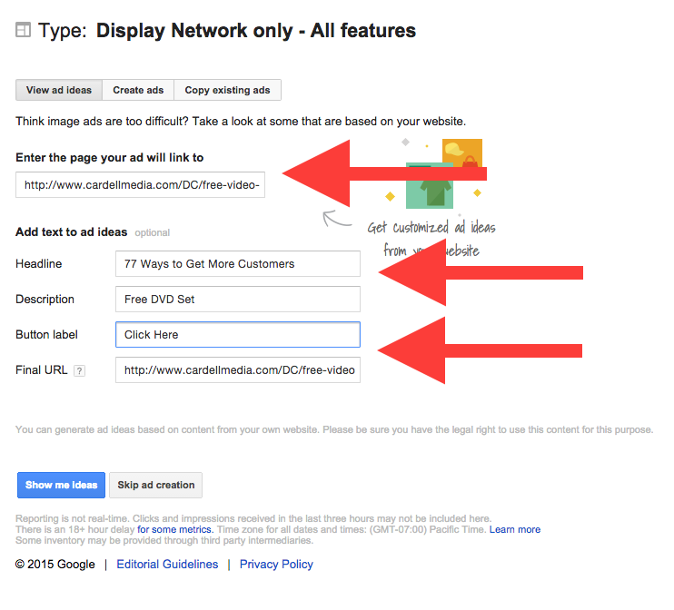
How to Set Up Your Campaign
Alternatively, you can let Google design
your ads for you:
Select the 'View ad ideas' button
Enter your web page URL
Enter your headline (optional)
Add a description (optional)

Slide 64
How to Set Up Your Campaign
Alternatively, you can let Google design
your ads for you:
Enter your button label (optional)
Click 'Show me ideas'

Slide 65
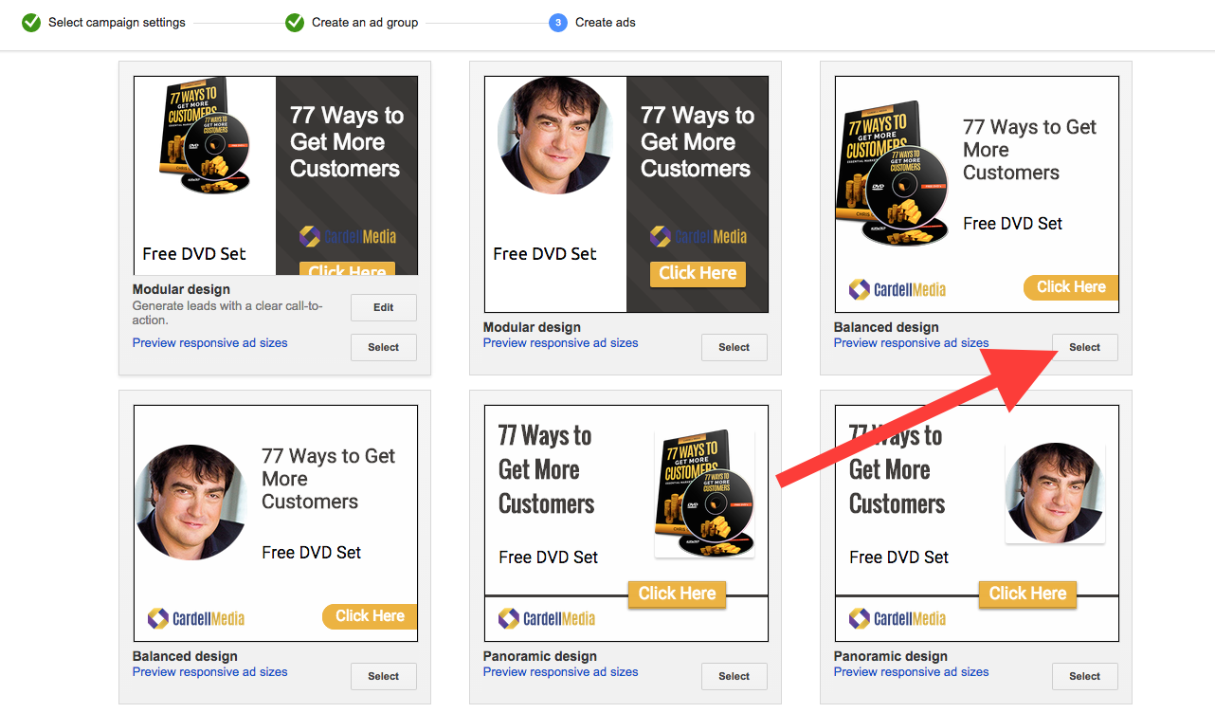
How to Set Up Your Campaign
Google will scan your site and present you with a read-to-use ad. To use, click the Select button

Slide 66
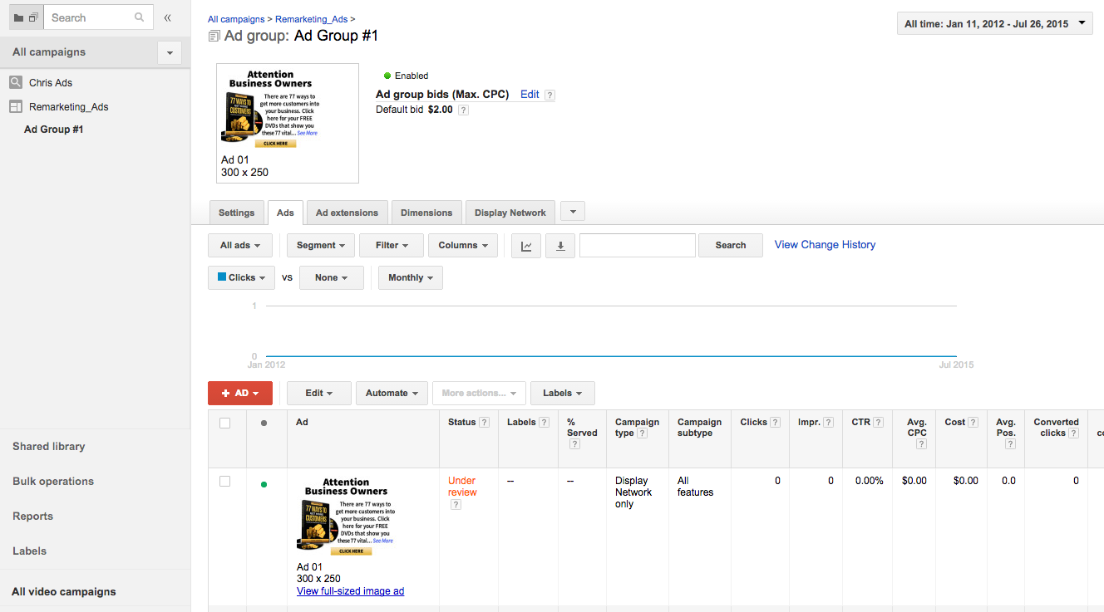
How to Set Up Your Campaign
Your campaign will go live when you click Save

Slide 67
MAIN COURSE PAGE AND MEMBERS’ PRIVATE GROUP
All the course information, slides and
Seminar recordings are here:
http://www.cardell2015.com

Slide 68
Recommended Reading
Definitive Guide to Google AdWords
Perry Marshall
Advanced Google AdWords
Brad Geddes

