Slide 1



Slide 2
BONUS VIDEO
How to Set Up Your
Remarketing Tag and Remarketing Lists in AdWords

Slide 3
ADWORDS REMARKETING
Before you can create a Remarketing list, you need to place the AdWords remarketing tag across your website.

Slide 4
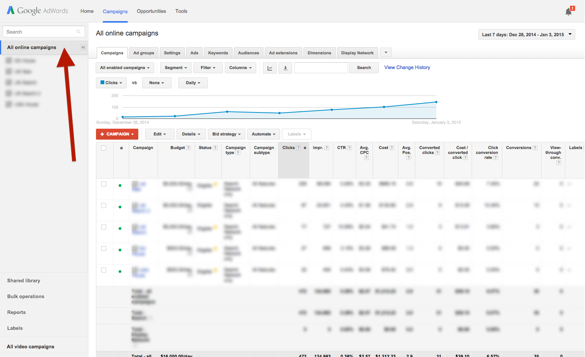
ADWORDS REMARKETING
Log into your AdWords account and click ‘All Campaigns’

Slide 5
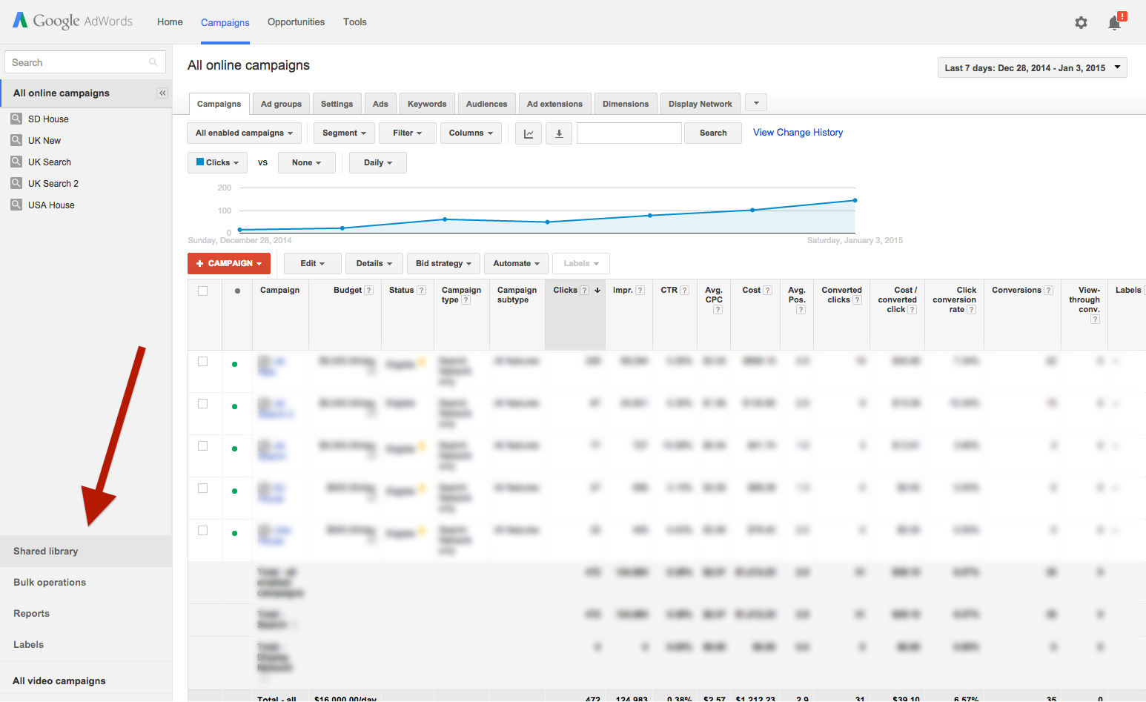
ADWORDS REMARKETING
Click ‘Shared Library’

Slide 6
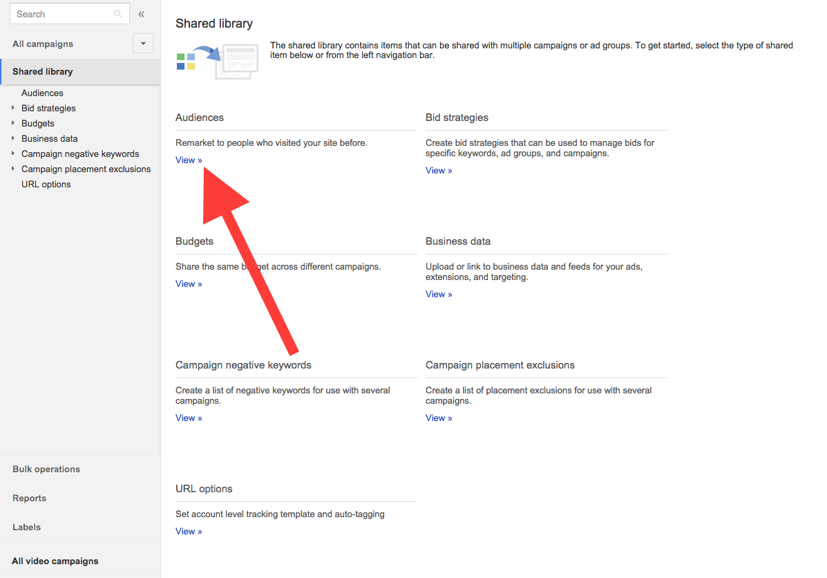
ADWORDS REMARKETING
Select ‘View’
under the Audiences library

Slide 7
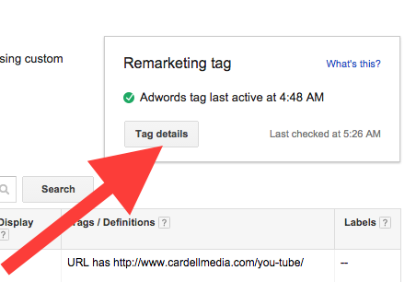
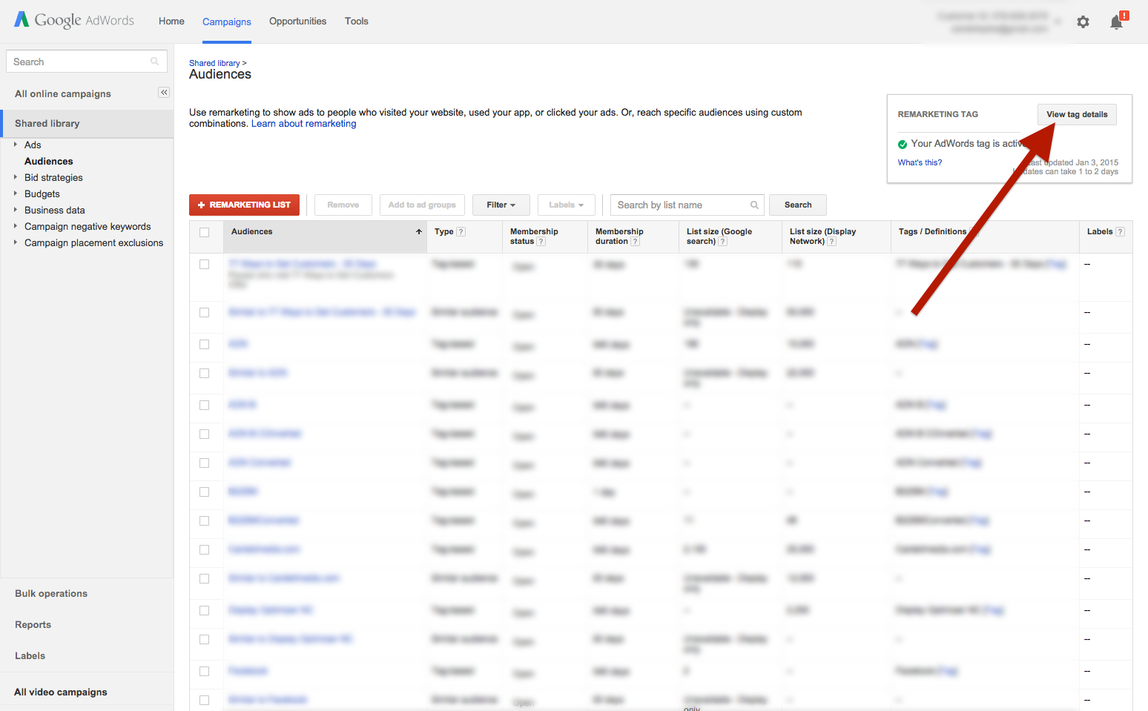
ADWORDS REMARKETING
Click ‘Tag details’

Slide 8
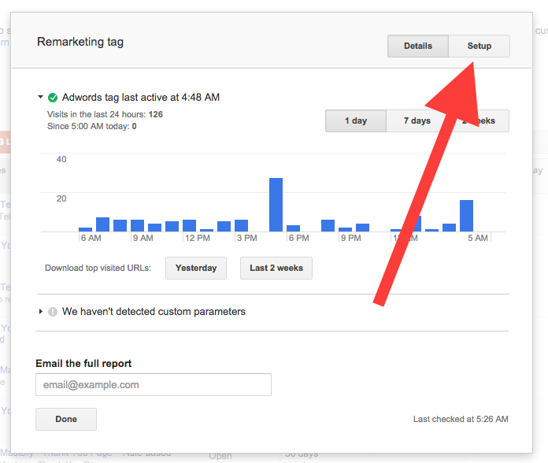
ADWORDS REMARKETING
Click ‘Setup’ in the overlay menu

Slide 9
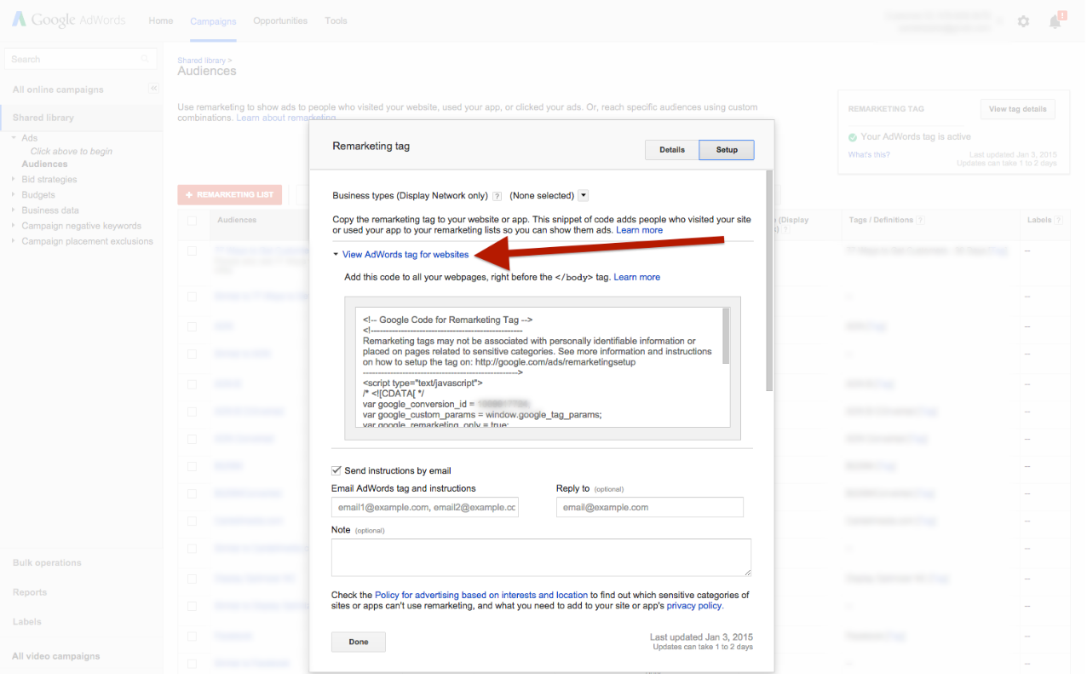
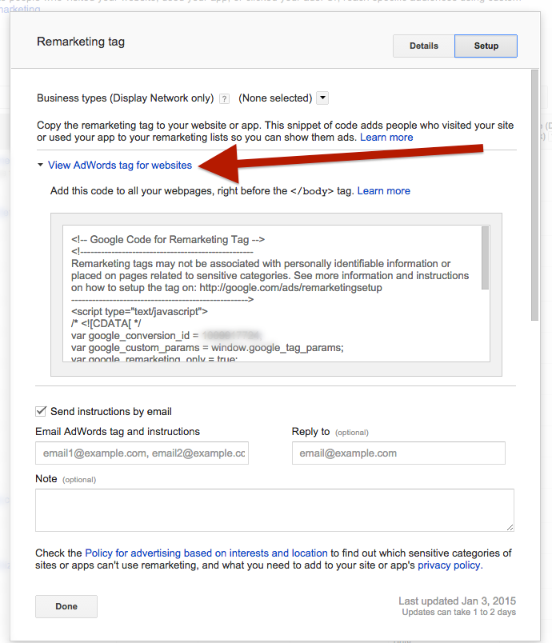
ADWORDS REMARKETING
Toggle the ‘View AdWords tag for websites’ link to reveal your Remarketing tag

Slide 10
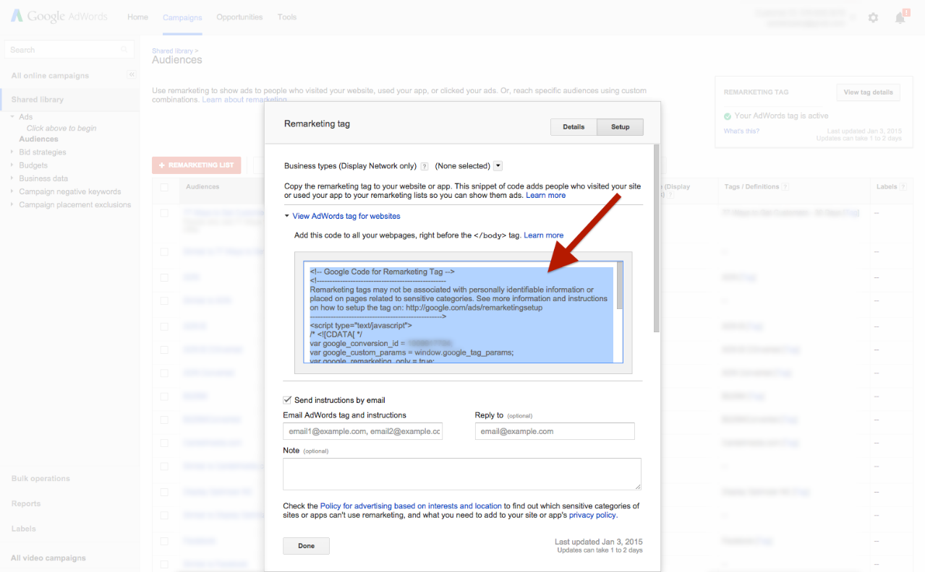
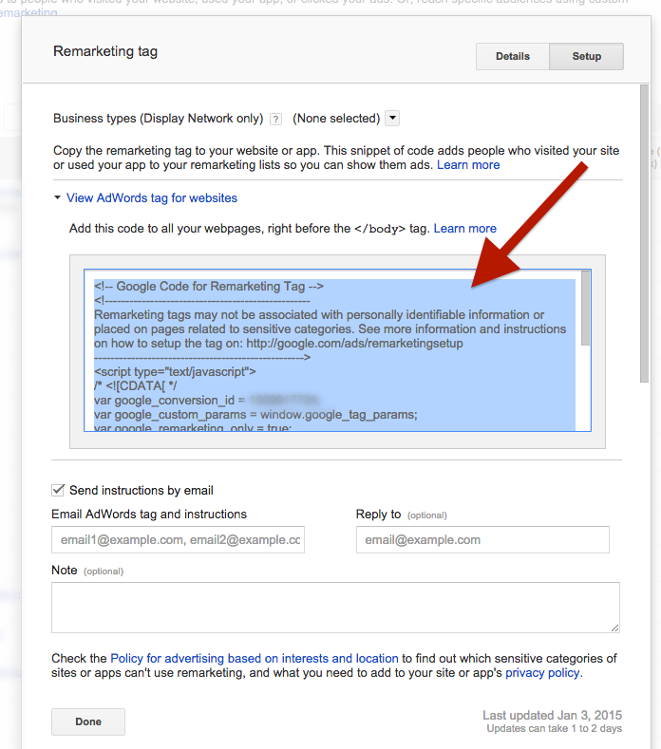
ADWORDS REMARKETING
Copy this code and add it to all your webpages before the </body> tag

Slide 11
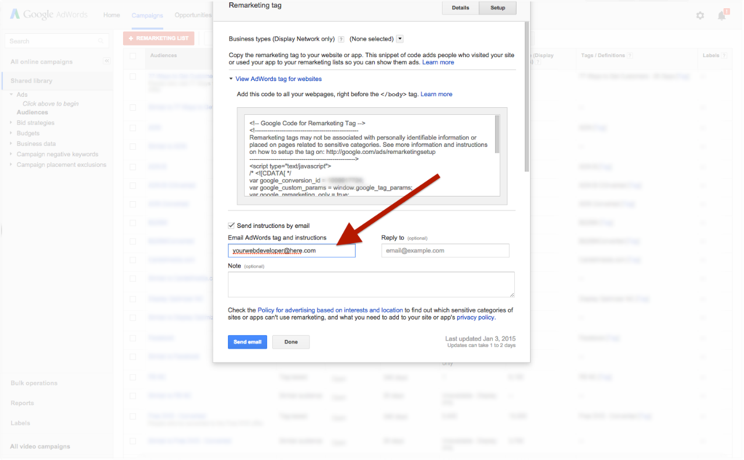
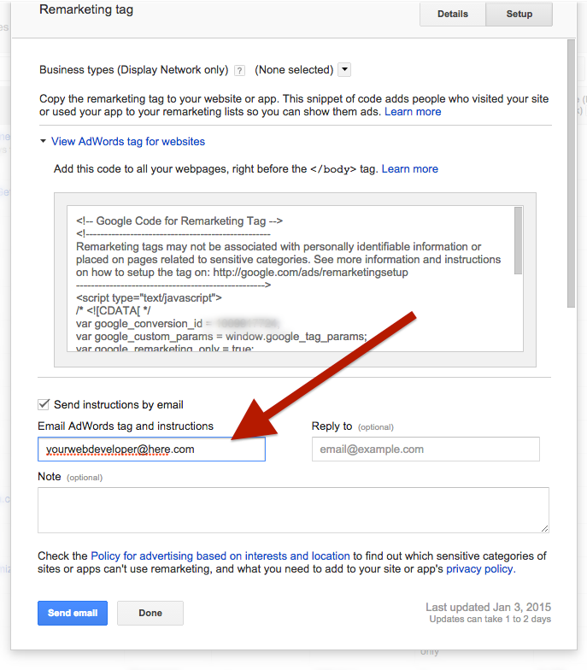
ADWORDS REMARKETING
Alternatively, enter your web developer’s email address to email the code

Slide 12
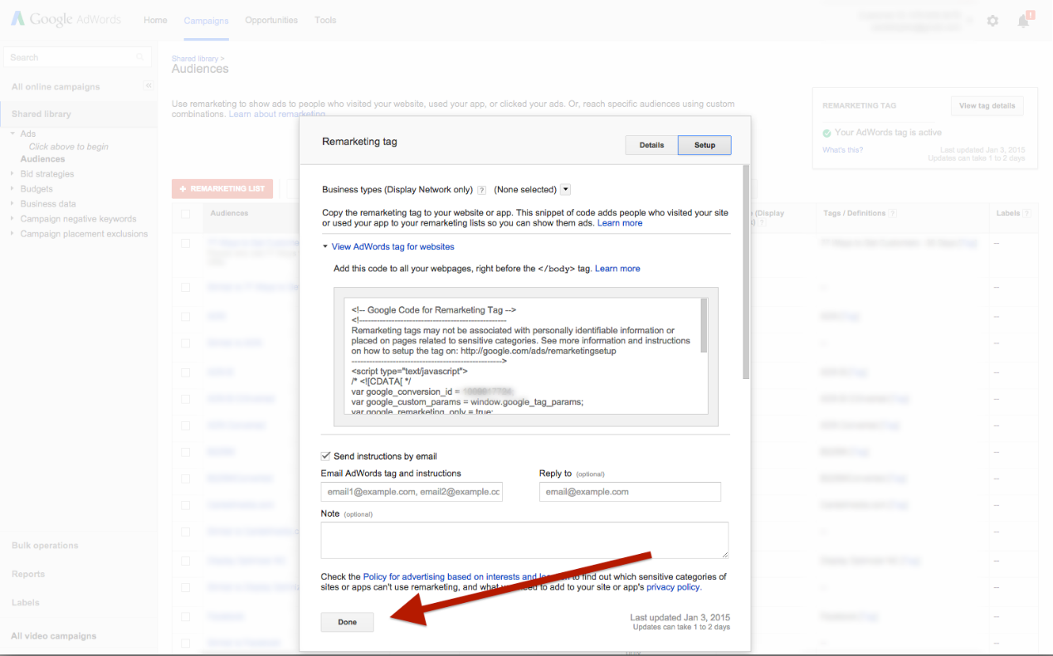
ADWORDS REMARKETING
Click ‘Done’

Slide 13
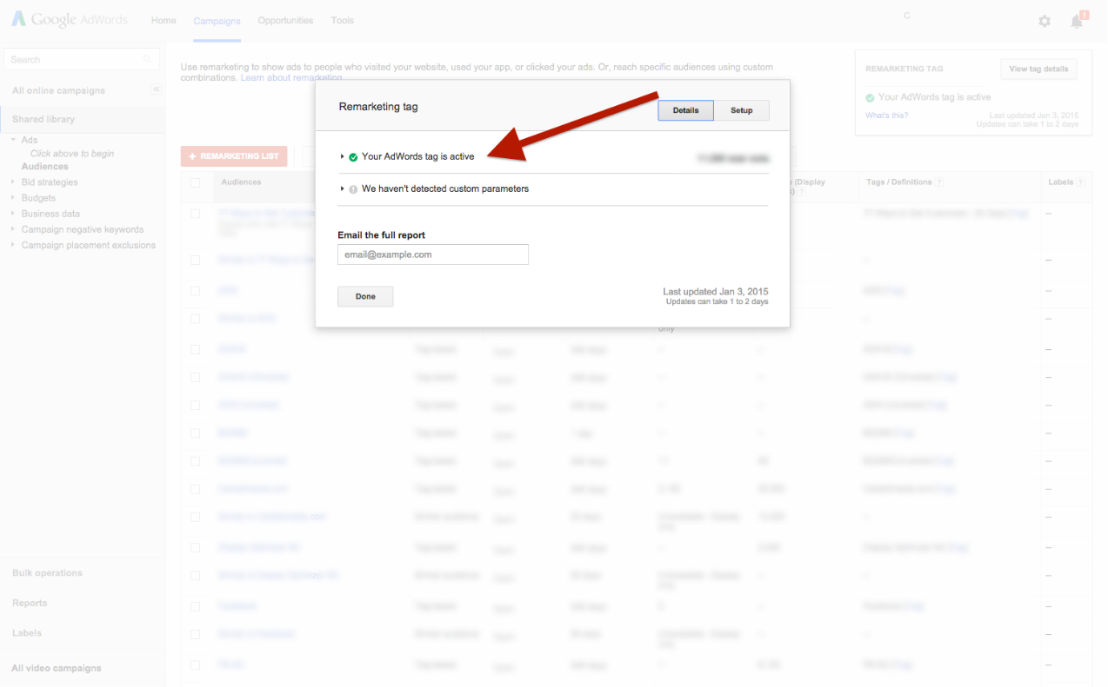
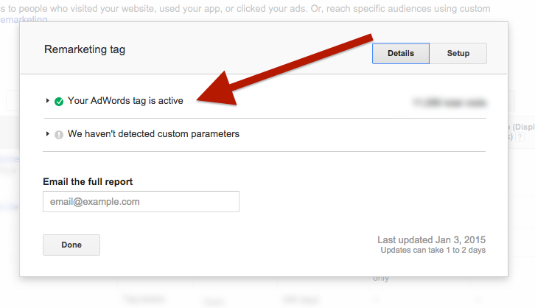
ADWORDS REMARKETING
When installed, you will see a green tick in the menu show it is active

Slide 14
ADWORDS REMARKETING
Now you can create your Remarketing lists…

Slide 15
ADWORDS REMARKETING
Log in to AdWords and click ‘All Campaigns’

Slide 16
ADWORDS REMARKETING
Click ‘Shared Library’

Slide 17
ADWORDS REMARKETING
Select ‘View’ under the Audiences library

Slide 18
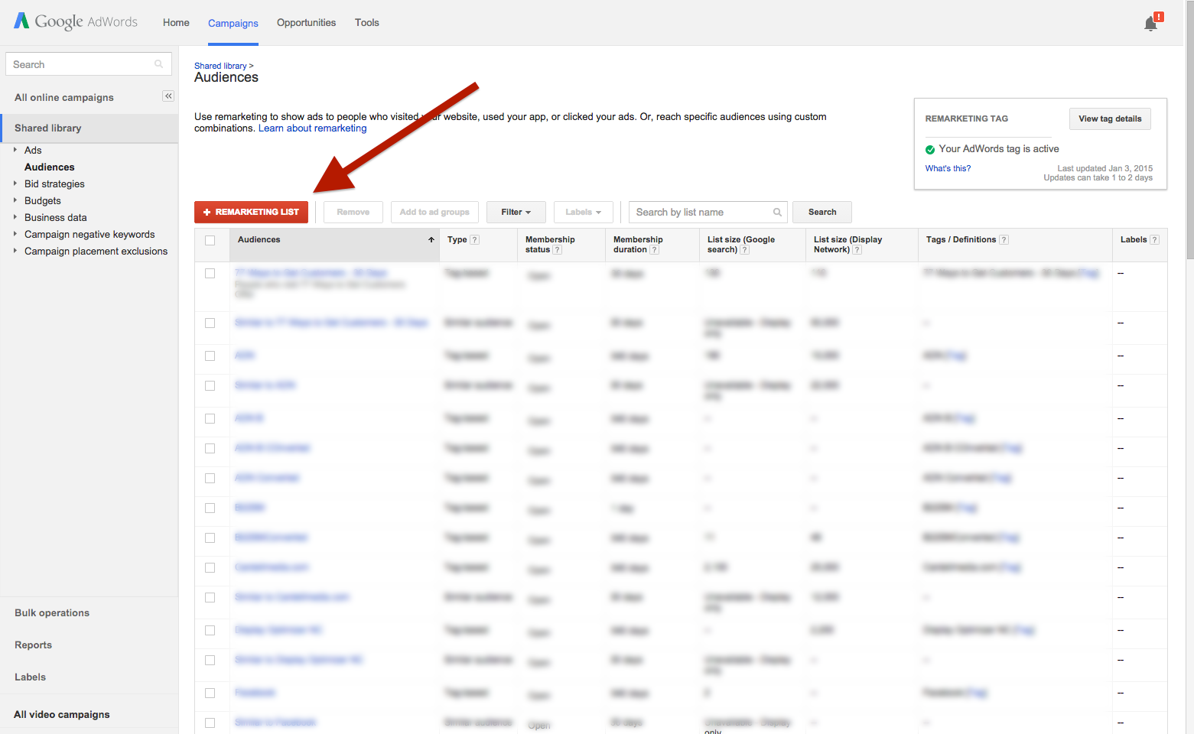
ADWORDS REMARKETING
Click ‘+Remarketing List’ to create a new Remarketing list

Slide 19
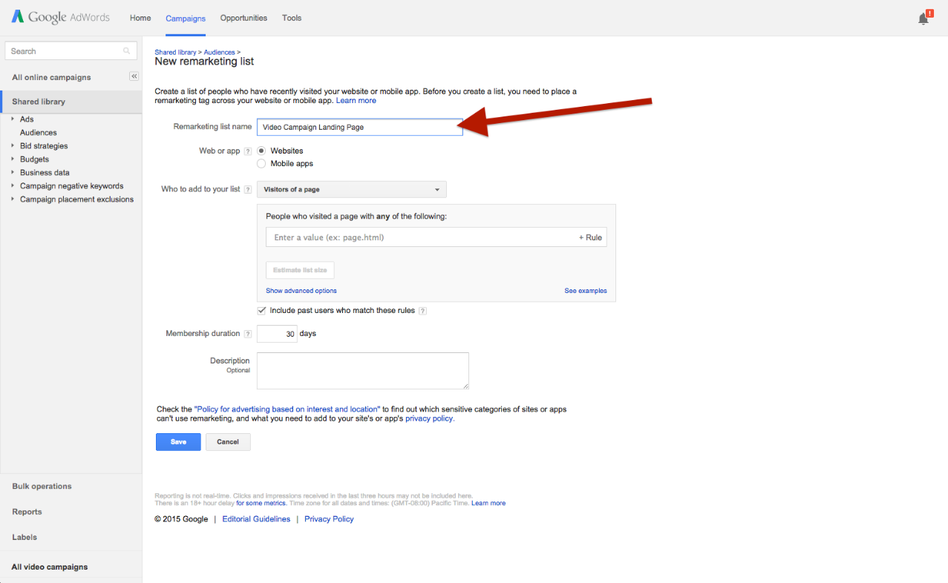
ADWORDS REMARKETING
Give your new list a name

Slide 20
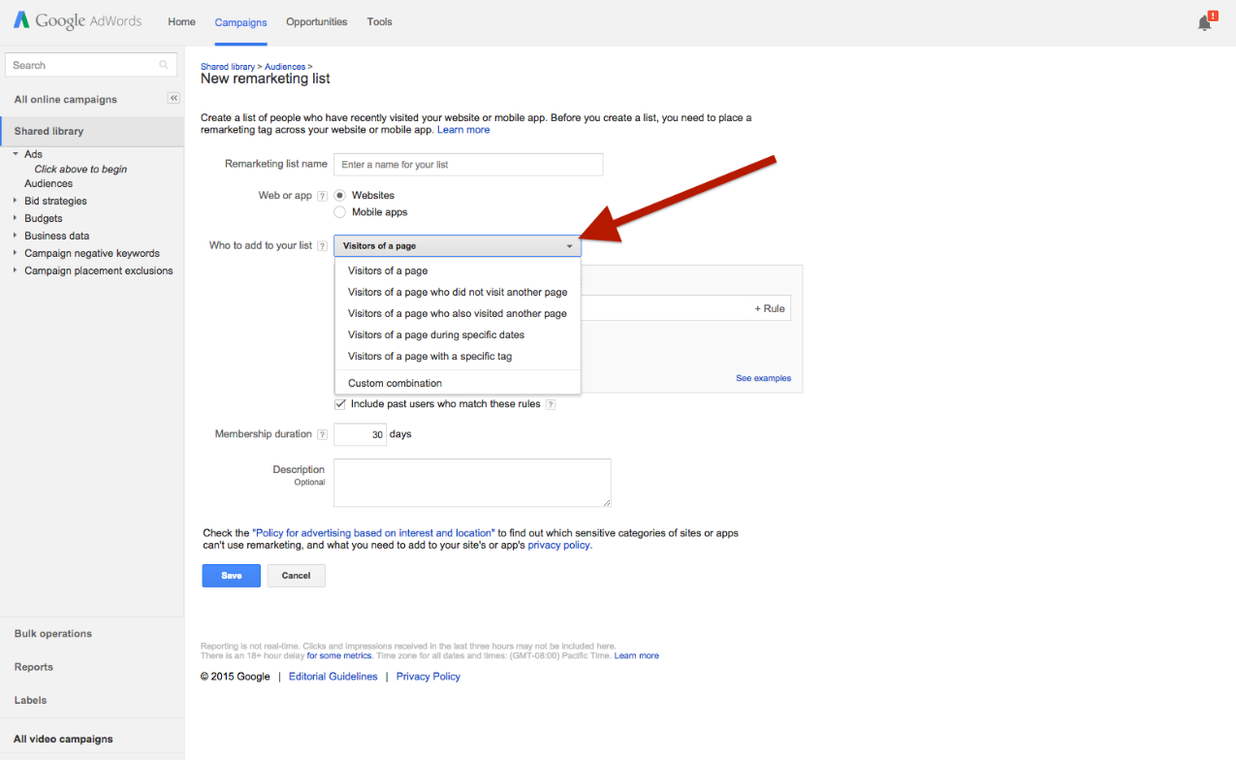
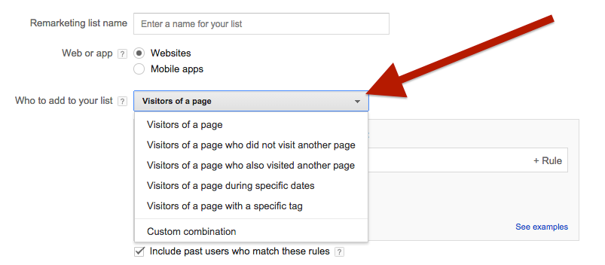
ADWORDS REMARKETING
Choose who to add to your list from the drop-down menu
The options are…

Slide 21
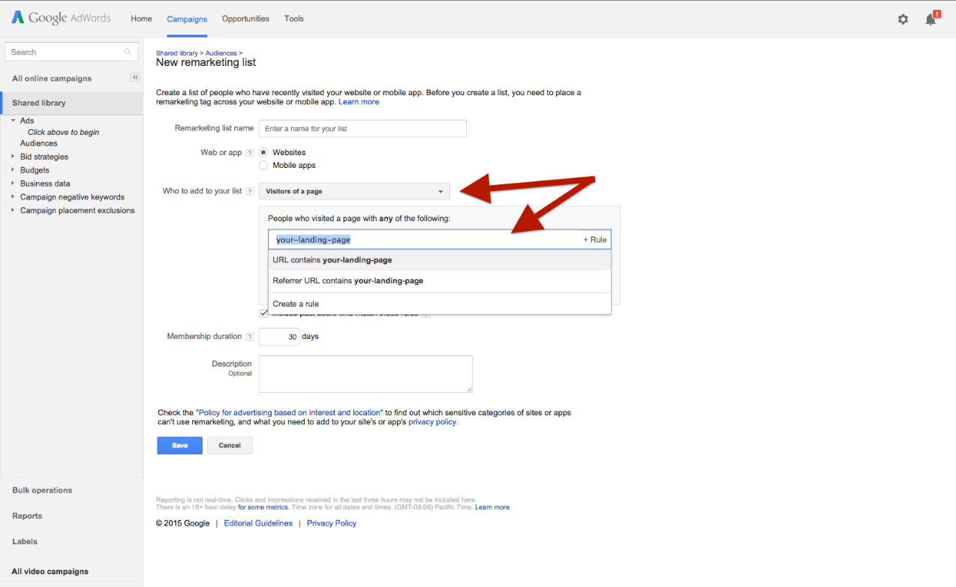
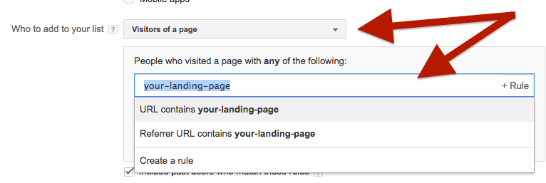
ADWORDS REMARKETING
Visitors of a page: This is the default option. Use it to create a list of people who visit a certain page of your website. Simply enter the /URL of the page you want to retarget.

Slide 22
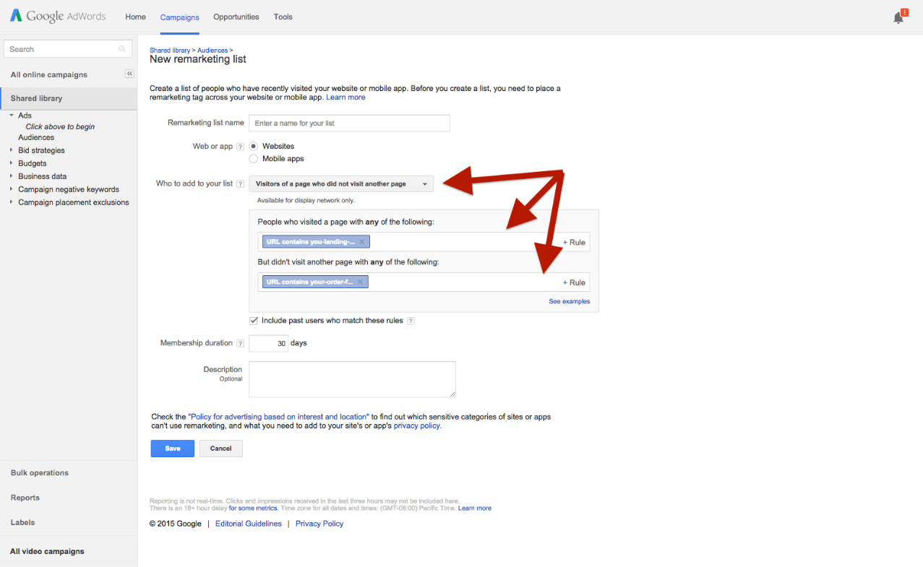
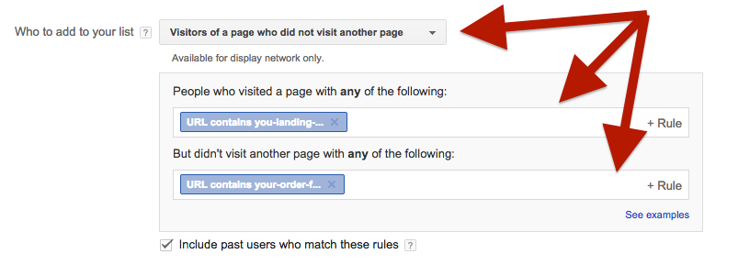
ADWORDS REMARKETING
Visitors of a page who did not visit another page: Use this to reach people who visited a certain page of your website but did not visit another page (such as your thank you page or order confirmation page).

Slide 23
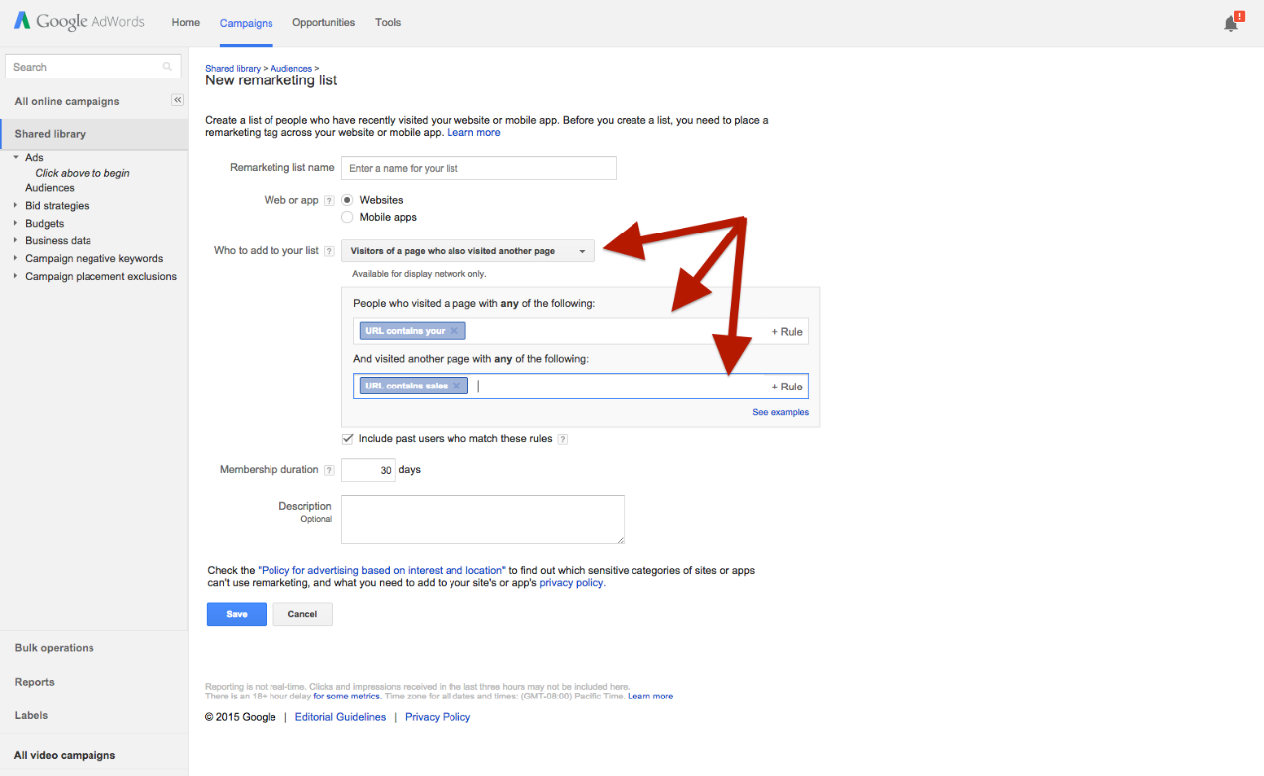
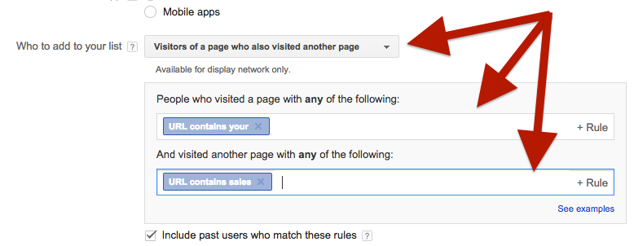
ADWORDS REMARKETING
Visitors of a page who also visited another page: Use this to create a Remarketing list of people who visited two different pages of your site (for example, your opt in page and your sales page)

Slide 24
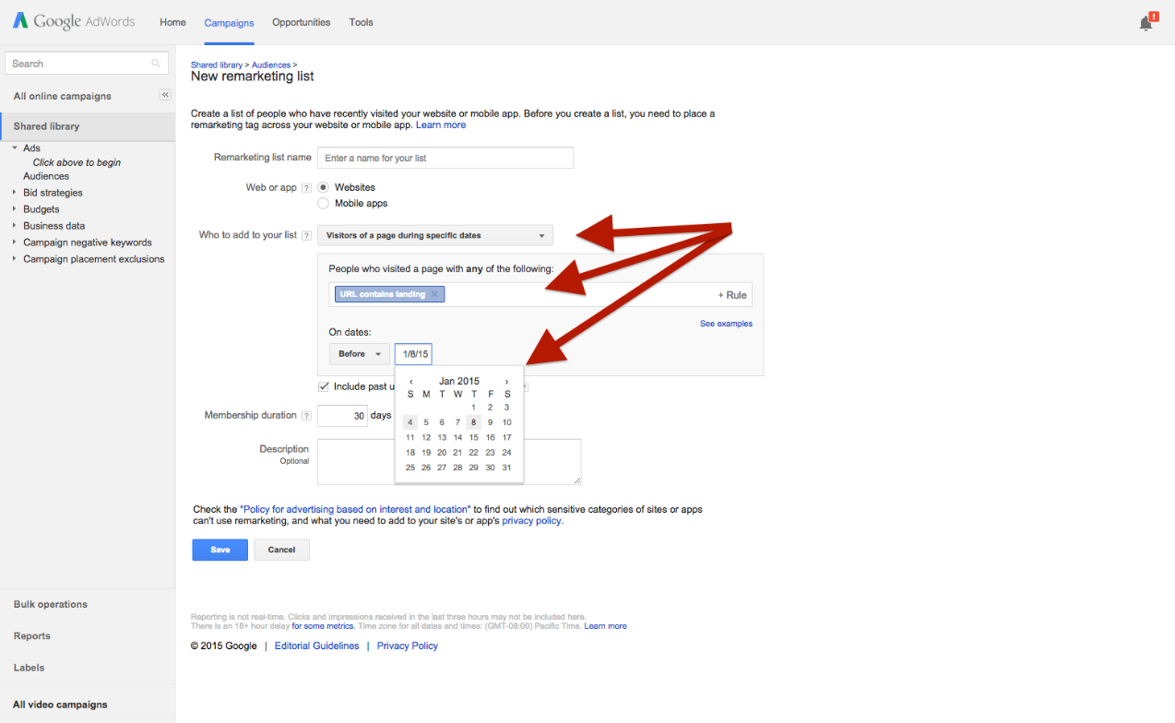
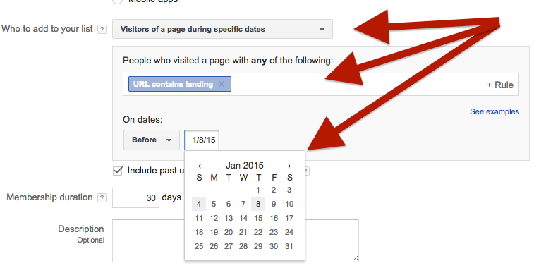
ADWORDS REMARKETING
Visitors of a page during specific dates: Use this to create lists of visitors who came to your website before, after or in-between specific dates

Slide 25
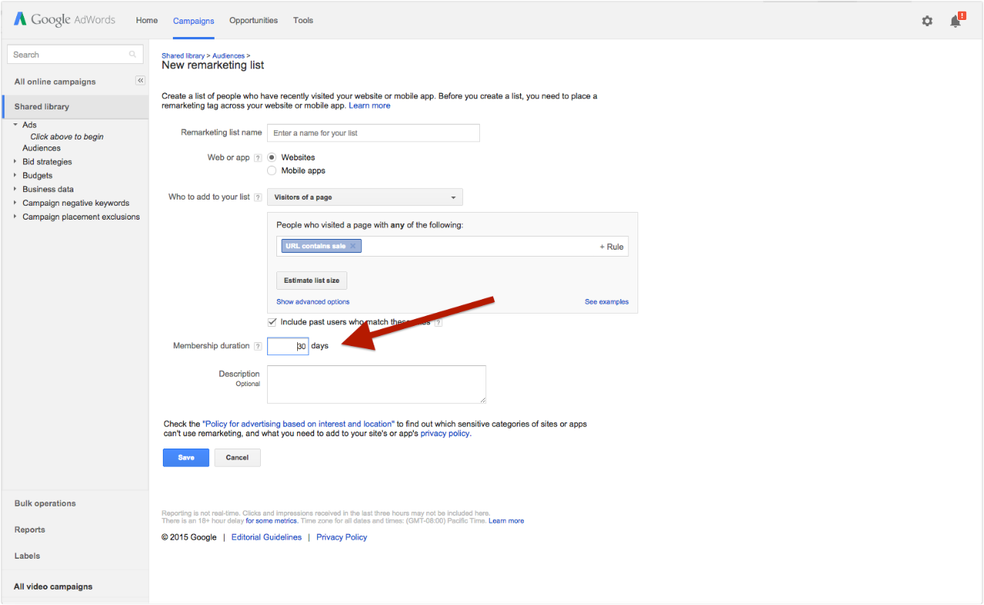
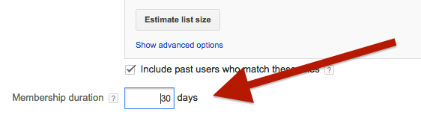
ADWORDS REMARKETING
Next, set your Membership Duration (this is the number of days a user stays on your Remarketing list)

Slide 26
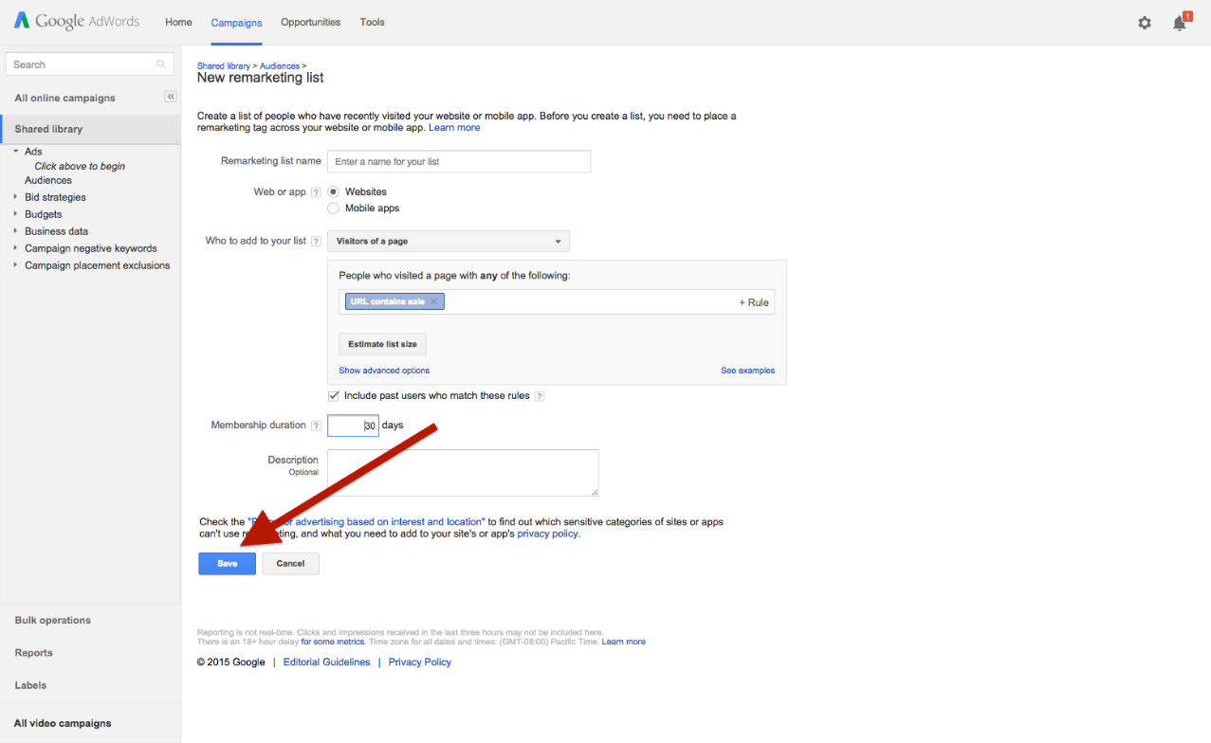
ADWORDS REMARKETING
Click ‘Save’ to activate your new list

Slide 27
ADWORDS REMARKETING
To use your new Remarketing list, you need to select it in the targeting settings of your campaign…

